Slide 1
Machine Learning for Enterprise Security
Pratyusa K. Manadhata
Hewlett Packard Labs
manadhata@hpe.com

Slide 2
Outline
Evolution of enterprise security
Uses of machine learning
Strengths and weaknesses
Trends and research opportunities
Focus on problems, not on ML techniques

Slide 3
Enterprise security
Users
Information
Interactions
Infrastructure

Slide 4

A Security framework
Prevent
Detect
Recover

Slide 5
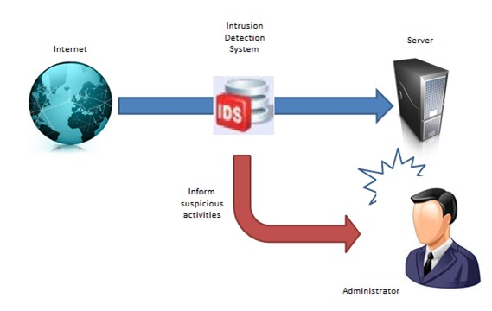

1st Generation: Point products

Slide 6
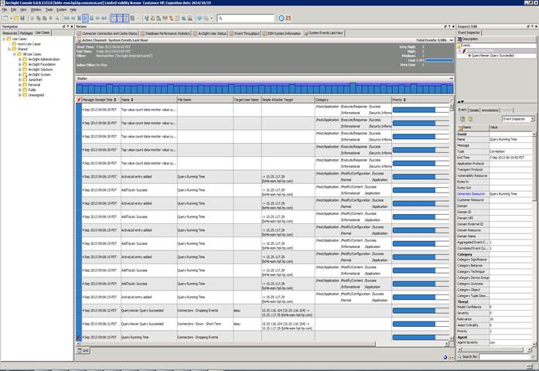
2nd Generation: Security information and event management systems (SIEM)
IDS
AntiVirus
IDS
Unified UI
False positive reduction
Proxy
Firewall

Slide 7
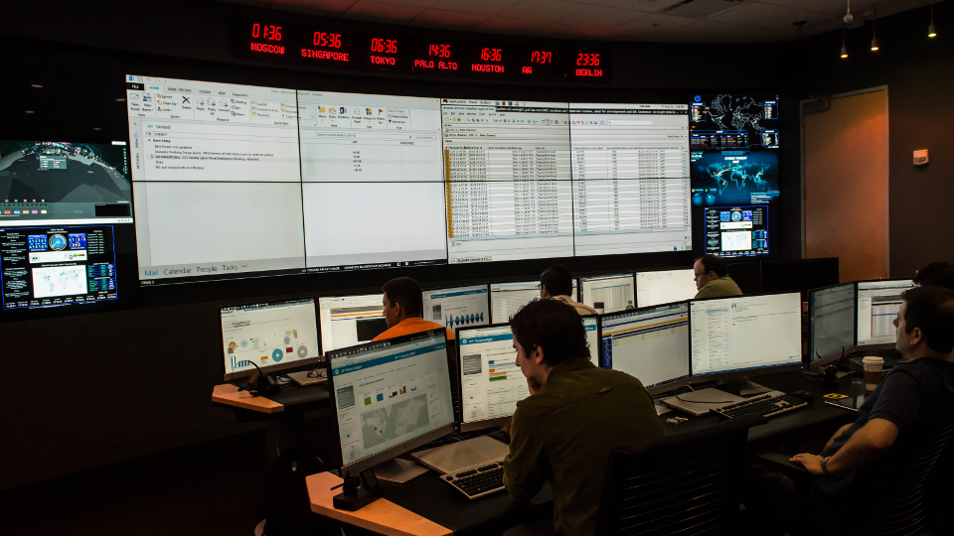
3rd Generation: Security Operations Centers

Slide 8
1st Generation Point Products

Slide 9
Do one thing and do it “well”
Anti-malware products
Data leakage prevention products
Firewalls
Application firewalls
…
Intrusion detection systems (IDS/IPS)
Domain/IP Blacklists
Sandboxes
Web proxies
….
Notes:
Some examples of point products

Slide 10
Product structure
Platform
Intelligence
+
AV
Firewall
IDS
…
AV Signatures
Firewall Rules
IDS Signatures
..

Slide 11
Anti-Malware products
Benign
Samples
Label
Malware
Signature Generation
Signature Matching
Back End
Front End

Slide 12
Sample labelling
Similarity
Machine Learning: Detect similarity at scale

Slide 13
Similarity is key in other detection mechanisms too
No “true” indicators of good/bad exist

Slide 14
Static analysis: looks similarity
Features: PE Headers, instruction sequences,..
Classification/Clustering
False positives
False negatives – easy to evade

Slide 15
Dynamic analysis: behavior similarity
Features: system call sequences, API sequences, ..
Classification/clustering
Computational challenges
Hard to run samples

Slide 16
Reputation analysis: behavior similarity
Program behavior data from end points, no need for samples
Features: popularity, source, destinations,…
Lightweight data collection
Lagging detection

Slide 17
Front end detection: False positive-false negative trade-off
File hash
Strings
Behavior signatures
Almost no machine learning on end devices

Slide 18
Complex and Fragile

Slide 19
Malicious domain detection
Many Methods/Papers
Features
Classification/clustering/regression
Graph analysis
Pattern mining and matching
Statistical analysis
…
Syntactic properties of a domain name string
HTTP/DNS protocol properties
Access patterns
Registration information
Association with malware
…

Slide 20
A command & control domain used in the OPM breach
opmsecurity.org
source: https://www.threatconnect.com/opm-breach-analysis/

Slide 21
Observations and opportunities
ML helps with scalability, but not much with accuracy
Complex and fragile systems
ML on end devices instead of signature matching

Slide 22
2nd Generation Security Information and Event Management

Slide 23

Correlation
IPS
16.119.144.12
Firewall
16.119.144.12
Anti-Malware
16.119.144.12
Reduce alerts by grouping
Reduce false alarms

Slide 24

Security Information and Event Management
firewalls
IDS/IPS
Web servers
Active directory
Anti-virus
VPN
DHCP
Billions of events / day
Filtering & Correlation
A few hundred events / day

Slide 25
How to generate correlation rules?

Slide 26
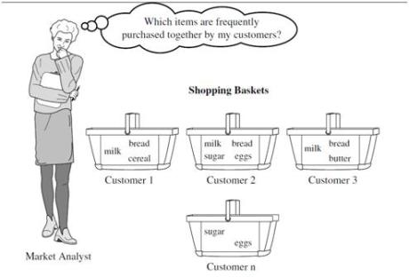
Market-basket Analysis

Slide 27
Observations
Rules are heuristics driven/manually generated
Correlation window order of minutes

Slide 28
3rd Generation Security Operations Centers

Slide 29









A large enterprise network
41K+ servers owned by HP IT
1,500+
2.5B security
events logged per day with
enterprise HPN Routers
11.5M+ Internet mails per day sent/received
HP IT supports 6 NGDC and 86 MCS
450,000 end points protected with anti-virus
Manage 150K+ mobile devices
140+ Windows Domain Controllers
1.2 million connected devices
597 IPS sensors deployed
15K+ HPN switches
2,000+ HP IT managed firewalls
450,000 mailboxes managed
300K+ employees + contractors
39,000,000
IP Addresses including
2 contiguous Class A’s
970K+ scanned devices
for vulnerabilities
440K+ PCs deployed

Slide 30
Reducing false negatives
AV
DNS
LDAP
DLP
Firewall
DHCP
HTTP
IDS

Slide 31

Advanced persistent threat (APT) detection
Remote Control
Discovery
Infiltration
Discovery
Exfiltration

Slide 32
Periodic DNS activity
Bursty DNS activity
Suspicious DNS traffic
Remote Control
Discovery
Infiltration
Internal DNS/LDAP traffic
Discovery
Exfiltration
DNS Exfiltration
HTTP/HTTPS
File formats

Slide 33
The data analysis approach holds promise
Compromised account detection
Lateral movement detection
Anomalous user behavior
Insider threat
Preemptive detection – detecting early stages of an attack

Slide 34
Security Analytics

Slide 35
Magic
Data Lake
DNS
HTTP
IDS
..
..
AV

Slide 36


Scalable, Reliable, and Timely Detection

Slide 37
Challenges
Infer human intent
Adapt
Reduce false alarms
Preserve privacy

Slide 38
4th Generation Remediation & Recovery

Slide 39
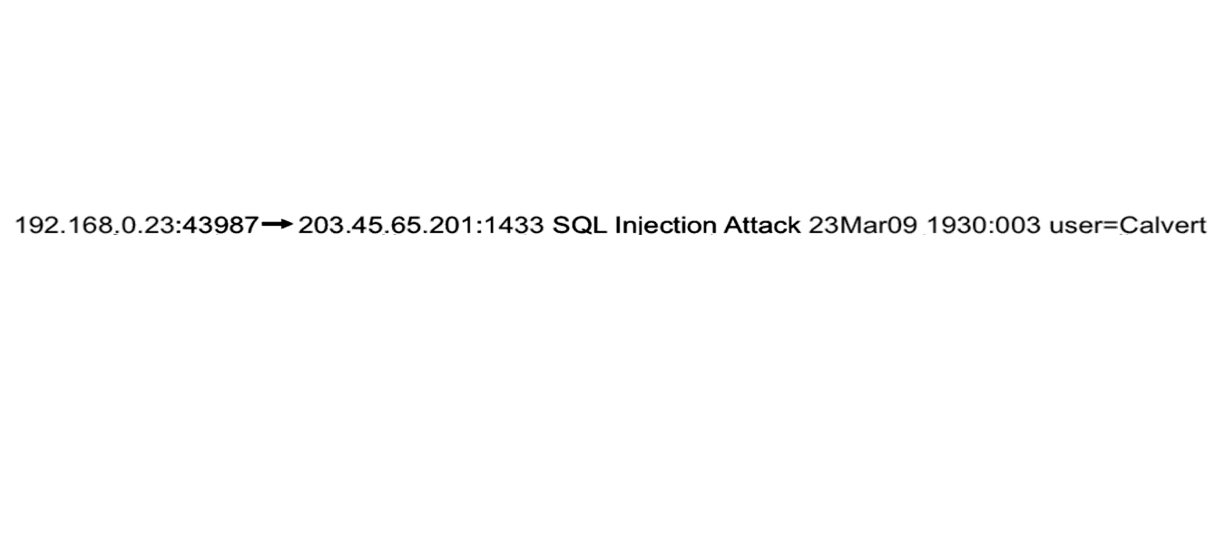
Analyst sees an alert

Slide 40
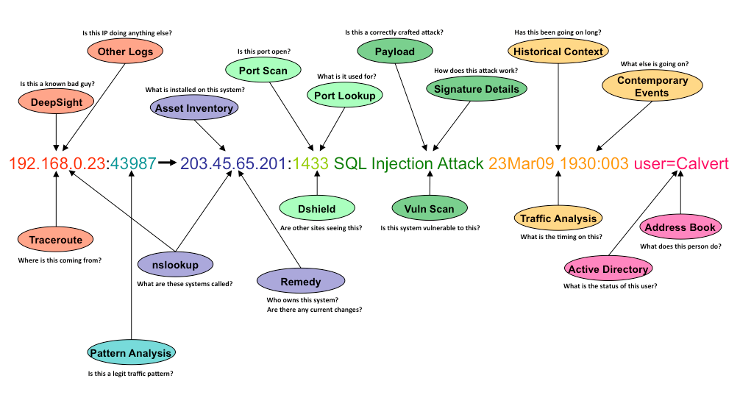
Analyst builds a context

Slide 41
Analyst follows a remediation plan
Quarantine the infected machine
Schedule/ run clean up tools
Schedule/ run reimaging

Slide 42
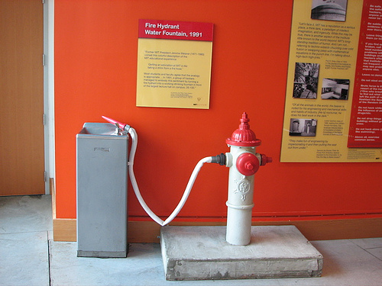
A few minutes per alert

Slide 43
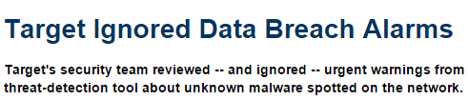
http://www.darkreading.com/attacks-and-breaches/target-ignored-data-breach-alarms/d/d-id/1127712

Slide 44
SOCs don’t scale
Repetitive, Manual, and Error Prone

Slide 45
Machine learning to the rescue???
Notes:
Again, ML could help us in recovery and remediation
We may be able to automate some of the tasks that analysts do
For example, based on alerts, a ML algorithm might be able to build the context and prescribe a remediation plan
This is an area that needs lot of investigation

Slide 46
Context building as a learning problem
Predict the information needed for each alert
alert characteristics
source/destination
protocol
vulnerability
…

Slide 47
Remediation plan as another learning problem
Predict remediation action for each alert
context information
device characteristics
user characteristics
location
connectivity
business needs

Slide 48
Incorporate analyst feedback

Slide 49
Summary

Slide 50
Current state
ML has played a key role since early days of enterprise security
ML helps achieve scale, but FPs/FNs remain
One of the better tools at our disposal for enterprise security

Slide 51
Future: ML targeted toward enterprise security
Detection
Recovery/Remediation
ML/AI/SA
DNS
HTTP
IDS
..
..
AV

Slide 52
Point products: Old problems require new solutions
Targeted new techniques
False positives/False negatives
Resource aware – power
Advances in hardware and systems software

Slide 53
Security analytics and remediation: New problems
Targeted ML techniques for scalable and reliable detection
Holistic approach to detection and remediation
Incorporate user feedback

Slide 54

And finally, be judicious in using ML

Slide 55
Thank You
Pratyusa K. Manadhata
manadhata@hpe.com

