Slide 1
An Attack Surface Metric
Pratyusa K. Manadhata
Carnegie Mellon University

Slide 2
Context: Security Metrics
Software vendors are spending big on security.
How secure is our software?
Are we better-off than before?
Which is more secure: XP or Vista? Ubuntu or Fedora?
Gauging progress is critical for secure software development.
We need measurements and metrics.

Slide 3
We Need Metrics Now!
A long standing research challenge [ACSAC 01, CRA 03, DIMACS 03, CSTB 07]
Toward a Safer and More Secure Cyberspace [CSTB 2007]:
“..though many benefits would flow from the invention of good metrics, the challenge in this cybersecurity research area is particularly great, and some very new ideas will be needed if cybersecurity metricians are to make more progress.”

Slide 4
Our Approach: Attack Surface Measurement (ASM)
How can we quantify a software system’s security?
Measure the system’s attack surface

Slide 5
Motivation: ASM is Useful to both Industry and Consumers
A guide in consumers’ decision making process
A tool in the software development lifecycle to improve security
  design, implementation, testing, deployment, and maintenance

Slide 6
Attack Surface Reduction (ASR) Mitigates Risk
Traditional industry approach: code quality improvement
Software will ship with known and future vulnerabilities
Reduce attack surface to increase the difficulty and decrease the impact of future exploitation

Slide 7
Code Quality and ASR Complement Each Other
Bad
Medium
Security Risk
High
Security Risk
Code
Quality
Low
Security Risk
Medium
Security Risk
Good
Low
High
Attack Surface Measurement

Slide 8
Inspiration: Relative Attack Surface Quotient for 7 Versions of Windows [HPW03]
700
600
500
Windows Server 2003 is “more secure” than previous versions.
400
300
200
100
0
Windows NT 4
Windows 2000
Windows Server 2003
RASQ
RASQ with IIS enabled
RASQ with IIS Lockdown

Slide 9
Linux Attack Surface Measurements
Attack Vector | Debian | RH Default | RH Facilities | RH Used
Open socket | 15 | 12 | 40 | 41
Open RPC endpoint | 3 | 3 | 3 | 3
Services running as root | 21 | 26 | 29 | 30
Services running as nonroot | 3 | 6 | 8 | 8
Setuid root programs | 54 | 54 | 72 | 72
Local user accounts | 21 | 25 | 33 | 34
User id = root accounts | 0 | 4 | 3 | 3
Unpassworded accounts | 0 | 0 | 2 | 2
Nobody account | 1 | 1 | 1 | 1
Weak file permission | 7 | 7 | 21 | 37
Scripts enabled | 1 | 2 | 2 | 2
Confirms perception that Debian is more secure than RedHat

Slide 10
Lessons Learned from Windows and Linux Measurements
Measurement method is ad-hoc
Requires a security expert
Focus is on measuring the attack surfaces of operating systems

Slide 11
Research Goals
Formalize the notion of attack surface
Introduce a systematic attack surface measurement method
  Anyone, anywhere, anything
Validate the method
Demonstrate the uses of the method

Slide 12
Intuition Behind Attack Surfaces
Attacks
system surface
2. Channels
1. Methods
3. Data
Entry/Exit
Points
Hence we define a system’s attack surface in terms of the system’s resources (i.e., methods, channels, and data items).
A system’s attack surface is the ways in which an adversary can enter the system and potentially cause damage.

Slide 13
Model of a System and its Environment
A system, s, and its environment, E_{s}= ⟨U, D, T={t₁, t₂}⟩.
D
U
s
E_{s}
t₁
t₂
Formal model uses I/O automata [LT89] .

Slide 14
Not All Resources Are Part of the Attack Surface
Only those resources that the attacker can use to send data into or receive data from the system are relevant.
We introduce the formal entry point and exit point framework to identify the relevant resources.

Slide 15
Entry Point and Exit Point Framework
U/s’
D/s’
Entry Points/Exit Points
  Direct (input/output action)
  Indirect (internal action)
Channels (e.g., sockets and pipes)
  c є Res(m.pre)
Untrusted Data Items (e.g., files)
  d є Res(m.post), d є Res(m.pre)
m
m
s
D

Slide 16

Attack Surface Definition
Definition
  M: set of entry points and exit points
  C: set of channels
  I: set of untrusted data items.
attack surface = ⟨M, C, I⟩
Theorem: Given an environment, E, if AS(A) ≥ AS(B), then Attacks(A||E) Attacks(B||E).

Slide 17
Not All Resources Contribute Equally to the Attack Surface
Contribution ∝ Damage Potential
Contribution ∝ (Attacker Effort) ⁻¹
Contribution =
Damage Potential
Attacker Effort
Higher Damage Potential ⇒ Stronger m.post
⇒ more methods can follow m
Lower Attacker Effort ⇒ Weaker m.pre
⇒ m can follow more methods

Slide 18

Attack Surface Measurement (ASM)
ASM(A) ≥ ASM(B) if there exists a nonempty set, R, of resources s.t.
  ∀r є R. contribution(r, A) ≥ contribution(r, B).
Theorem: Given an environment, E, if ASM(A) ≥ ASM(B), then Attacks(A||E) Attacks(B||E).

Slide 19
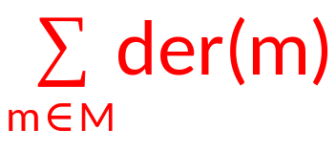
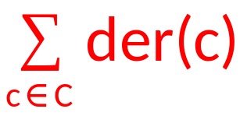
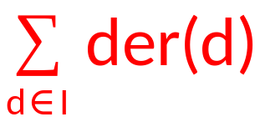
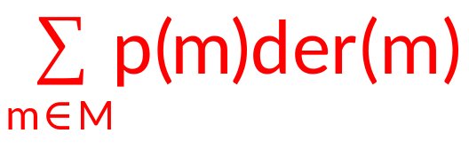
Quantitative Attack Surface Measurement
Assume der: method → Q.
  Similarly, for channel and data.
ASM = ⟨ , , ⟩
Analogous to risk modeling
probability = 1
consequence

Slide 20
Abstract Measurement Method
Identify a set, M, of entry points and exit points, a set, C, of channels, and a set, I, of untrusted data items.
Estimate each relevant resource’s damage potential-effort ratio, der.
Compute Attack Surface Measurement =
⟨ , , ⟩ .

Slide 21
C Measurement Method and Examples
FTP Servers
  ProFTP 1.2.10 , Wu-FTP 2.6.2
IMAP Servers
  Courier 4.0.1, Cyrus 2.2.10

Slide 22
Step 1: Identify Relevant Resources
Entry Points and Exit Points
  Static analysis
  C library methods (e.g., read) for data exchange
  Call graph
Channels and Untrusted Data Items
  Run time monitoring
  Open channels
  Data read and written

Slide 23
Step 2: Damage Potential-Effort Ratio
Resource
Damage Potential
Attacker Effort
Method
Privilege
Access Rights
Channel
Protocol
Access Rights
Data Items
Type
Access Rights
Impose a total ordering among the values of the attributes and assign numeric values accordingly, e.g.,
root = 5 and auth = 3.

Slide 24
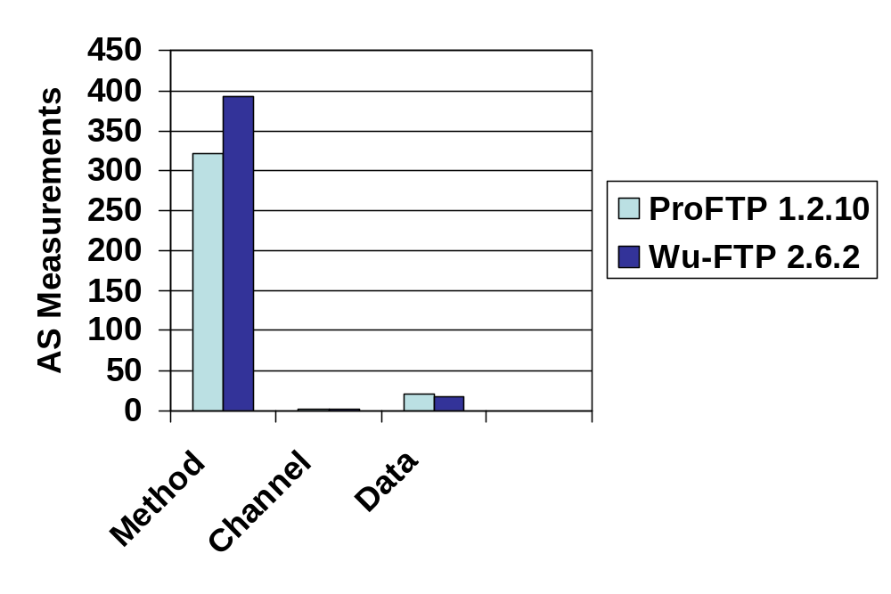
FTP Measurement Results
ProFTP = ⟨312.9, 1.0, 18.9⟩, Wu-FTP = ⟨392.3, 1.0, 17.6⟩
Use domain knowledge to decide which dimension presents more risk and choose accordingly.

Slide 25
Validation
Validating a software measure is hard [KPF97,….]
  security metric is even harder
Software measure | Attack surface | MS Bulletins, Expert Survey
Prediction System | Security Risk | IO Automata Model, Patch Analysis, Anecdotal Evidence
Liu and Traore independently validated our metric [LT07].

Slide 26
Validating the Measurement Method
Key Assumptions
Three dimensions of the attack surface
Damage potential-effort ratio
Six attributes
  method privilege, method access rights, channel protocol, channel access rights, data item type, and data item access rights

Slide 27

Statistical Analysis of Microsoft Security Bulletins (MSB)
An MSB mentions a vulnerability and resources needed for exploitation
Are methods, channels, and data used in the exploitation?
Analyzed MSBs from 2004-2006
Methods
Channels
Data

Slide 28

Results: The Attributes are Indicators of Damage Potential and Effort
Attribute | Significance | Correlation
Privilege
Method Access Rights
Protocol |  | ?
Channel Access Rights
Type |  | ?
Data Access Rights

Slide 29
Expert Linux System Administrator Survey
MSB has no data relevant to a resource’s attackability
  Could not validate damage potential-effort ratio
Surveys are widely used to collect a wide range of data
  Prior work uses surveys to validate measures [K87, ….]
  Feedback from one target user group (Industrial collaboration for other target user group)
  W.r.t. Linux (MSB w.r.t. Windows)

Slide 30

Results: A Majority of the Subjects Agree With Our Measurement Method
Methods
Privilege
Channels
Method Access Rights
Data
Protocol
?
Channel Access Rights
Damage Potential-Effort Ratio
Type
?
Data Access Rights

Slide 31
Validating the Prediction System
Show that if system A is more secure than system B, then ASM(A) < ASM(B)
Assumption: Vulnerability patches improve software security
  ASM(After Patch) < ASM(Before Patch)
Patches reduce attack surface measurement

Slide 32
Results: A Majority of the Patches Reduce ASM
Software | Percentage of Patches that reduce ASM | Significance (p< 0.05)
Firefox 2.0 | 67%
ProFTP (all) | 70%
All NVD Bulletins | 76.9%

Slide 33
Anecdotal Evidence from Industry
Microsoft
  Sasser Worm
  Nachi Worm
  Zotob Worm
Firefox 2.0
  SSL buffer overflow

Slide 34
Collaboration with SAP
SAP is world’s largest provider of enterprise-scale software
  Complex technology platforms and business applications
Demonstrate that the measurement method scales to enterprise-scale software
Receive feedback from software architects and developers

Slide 35
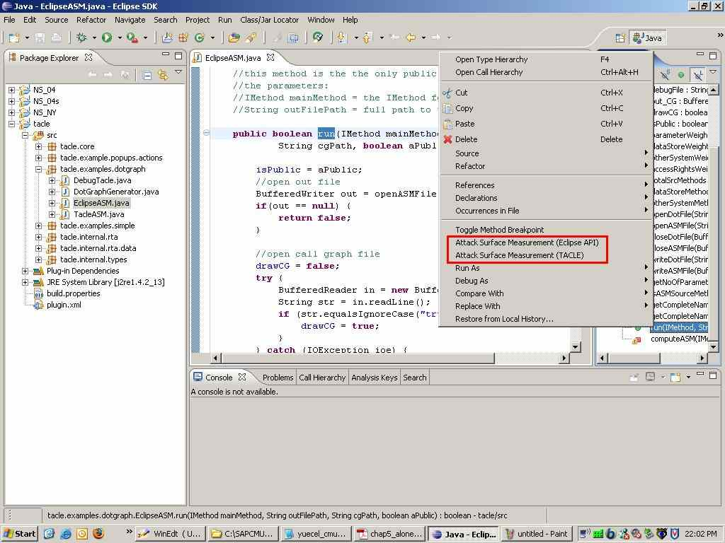
Java Measurement Tool Screenshot

Slide 36
Results
Measured the attack surface of a key component of SAP component
  Measurement results conform to expectation
  Detailed tool output, incremental analysis, and what-if scenarios are useful for attack surface reduction
  Lessons learned

Slide 37
ASM in Software Development LifeCycle
Use ASM to guide testing and code inspection
[MuSecurity, SAP]
Implementation
Testing
Compare and reduce ASM from version to version [Microsoft, Firefox, OpenSSH]
Use ASM to choose a secure configuration [Microsoft, Firefox]
Design
Deployment
Use ASM in patch implementation
Maintenance

Slide 38
Future Work: Software Development
Range analysis
Other uses
  ``Safe’’ software composition
  Testing, deployment, maintenance
Min
Max

Slide 39
Future Work: Software Consumers
Attack surface measurement in the absence of source code
  Components as Entry/Exit points
  Channels and Data as before
Multiple metrics are needed for decision support
How do we combine multiple measures?

Slide 40
Related Work-1
Prior work assumes the knowledge of vulnerabilities [AB95, VGMCM96, ODM99…]
ASM is based on a system’s inherent properties
  Formal framework encompasses past, present, and future vulnerabilities
  Complementary to prior work

Slide 41
Related Work-2
Prior work takes an attacker-centric approach [S99, MBFB05, LB08,..]
ASM takes a system-centric approach
  Depends on a system’s design
  No assumptions about the attacker
  Can be used as a tool in software development

Slide 42
Related Work-3
Prior work is conceptual in nature and haven’t been applied to real systems [AB95, MGVT02, S04,..]
We measured the attack surfaces of real-world software
  FTP servers, IMAP servers
  SAP business applications

Slide 43
Summary
Introduced a pragmatic approach for security measurement
  Software industry found it useful [Microsoft, Firefox, OpenSSH, MuSecurity, SAP, ..]
First step in the grander challenge of security metrics
  Understanding over time will lead to more meaningful metrics
Acknowledgements: Jeannette Wing, Roy Maxion, Virgil Gligor, Mike Reiter, Yuecel Karabulut, Effrat Keren, Dilsun Kaynar, Kymie Tan, Gourav Kataria, Miles McQueen, Mark Flynn, Michael Howard, Paul Hoffman, Mary Shaw, and Survey Participants.

Slide 44
Backups

Slide 45

I/O Automata [LT89]
Action Signature
  Input, Output, Internal actions
  Pre and Post conditions m.pre and m.post
Composition
  E_{s} = (U_{io} || D_{io} || ( ))
  P = s_{io} || E_{s}
m
m
S
E
n
n

Slide 46
Validation of the Attributes
An MSB has a severity rating and mentions the six resources attributes
Impact | Damage Potential
Difficulty | Attacker Effort
Significant Predictor | Two sided Z-test (p < 0.05)
Correlation | Sign of Coefficient in Ordered Logistic Regression

Slide 47
Inspiration: Howard’s Relative Attack Surface Quotient (RASQ)[H03]
Howard’s informal RASQ Measurement Method
  Identify a system’s attack vectors
  Assign weights to the attack vectors to reflect their attackability
  RASQ = sum of the weighted counts of the attack vectors

Slide 48
Direct Entry Points
Methods that directly receive data.
s’
D
s’
U
m
m
m
m
(a)
(b)
(c)
(d)
API Invocation
Data flow
direct entry point: an input action with a matching output action

Slide 49
Indirect Entry Points
Methods that indirectly receive data.
E_{s}
E_{s}
E_{s}
E_{s}
m₁
m₂
m₁
m₂
m
m
m
m
(a)
(b)
(c)
(d)
API Invocation
Data flow
indirect entry point: internal action
(m1.post => m.post) Λ
(d є Res(m1.post) Λ d є Res(m.pre))

Slide 50
Channels and Data
Channels (e.g., sockets and pipes)
  c є Res(m.pre)
Untrusted Data Items (e.g., files)
s
s
D
D
d є Res(m.post) d є Res(m.pre)

Slide 51
Definition of An Attack
Attacks (s_{io}) = Set of executions of (s_{io} || E_{s}) that contain either an input action or output action of s_{io}.

Slide 52
Not All Resources Contribute Equally to the Attack Surface
contribution α damage potential
α 1/attacker effort
r1 ≥ r2 if higher damage potential and/or lower attacker effort
m(MA, CA, DA, MB, CB, DB)
pre: P_{pre} Λ (MA ≥ m.ef) Λ (CA ≥ c.ef) Λ (DA ≥ d.ef)
post: P_{post} Λ (MB ≥ m.dp) Λ (CB ≥ c.dp) Λ (DB ≥ d.dp)

Slide 53
Damage Potential-Effort Ratio
Contribution ∝ Damage Potential
Contribution ∝ (Attacker Effort) ⁻¹
Contribution =
Damage Potential
Attacker Effort
Effort
+
=
Effort
Damage Potential
Damage Potential

Slide 54
C Measurement Method
C Library Methods
Annotation
Annotated
Callgraph Generator
And Analyzer
Sourcecode
Entry/Exit Points
Source
Code
AS
Computation
AS
Measurements
Channels
Compilation
And Execution
Running
Runtime
Monitoring
Process
Data
Items
Numeric
Values

Slide 55
Survey Methodology
Email survey of experienced Linux system administrators
  Diverse background and geographic location
Questions on a five point Likert scale [L32]
  Pretesting and interviewing to avoid bias
  Self-selection bias
Descriptive analysis techniques
  Central tendency bias
  %age of agreement, disagreement, and neither
  t-test (p < 0.05)

Slide 56
Not All Patches Are Relevant
Heuristics: vulnerability type determines patch relevance
  Use National Vulnerability Database (NVD) type information
  Infer type if missing
Not all relevant patches reduce the attack surface
Consider local effect of a patch

Slide 57
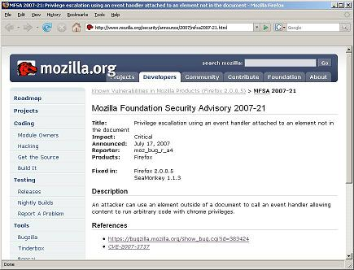
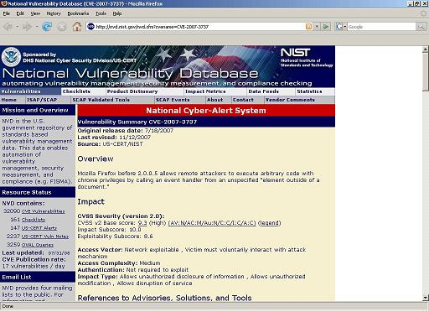
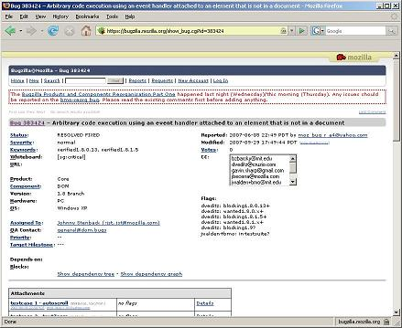
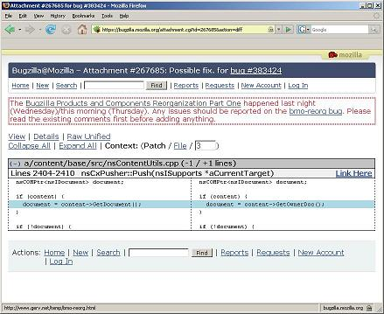
Data Collection for Firefox 2.0
Relevant?
MITRE
Reduces
ASM?

Slide 58
Java Measurement Method
Focus on method dimension
Entry Points and Exit Points
  Call graph
  Interface methods, methods invoking other systems’ interfaces and Java I/O library methods
Damage Potential-Effort Ratio
  Use SAP’s threat modeling process to assign numbers

Slide 59
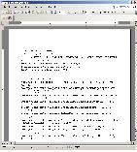
Tool Usage in Software Development
Tool produces detailed output
  Guides attack surface reduction
Incremental analysis
What-If scenarios
  Addition of a new feature
  Removal of a feature

Slide 60
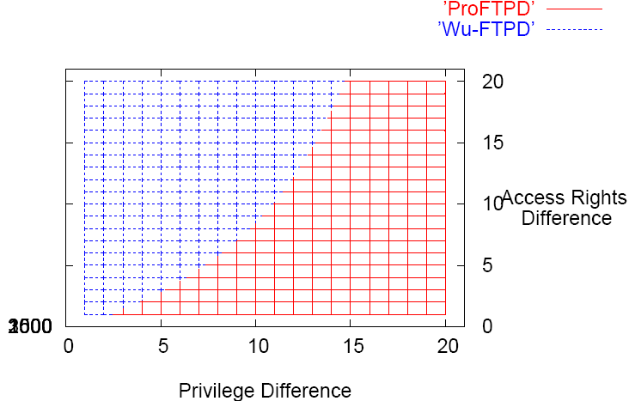
FTP Daemons (method)
Access rights do matter.
ProFTPD has less unauth and more auth access rights.
Access rights don’t matter.
proftpd privilege level contributes more than auth.
Access rights don’t matter.
Total no of entry and exit points matter.

Slide 61
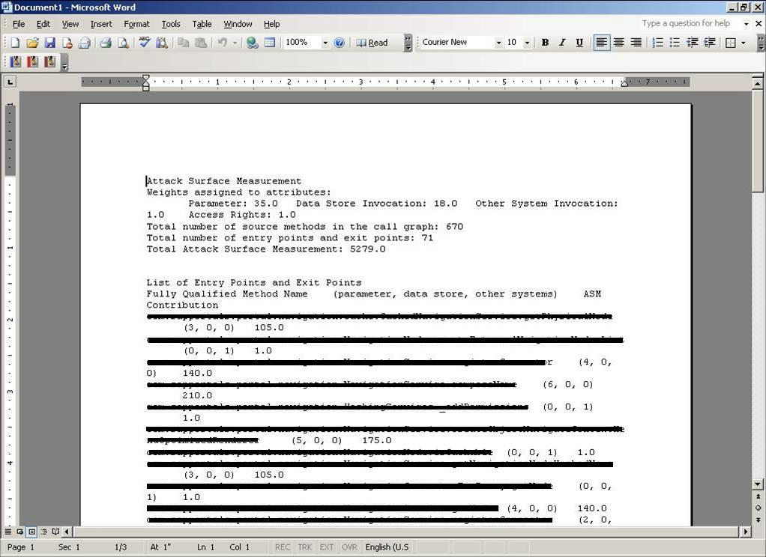
Tool Output
Measurement
Contribution
Entry (Exit) Point
Reason

Slide 62
References- 1
[ACSAC 01] Rayford B. Vaughn, Ronda R. Henning, and Ambareen Siraj. Information assurance measures and metrics - state of practice and proposed taxonomy. In Proc. of Hawaii International Conference on System Sciences, 2003.
[CRA 03] Computing Research Association (CRA). Four grand challenges in trustworthy computing. http://www.cra.org/reports/trustworthy. computing.pdf, November 2003.
[DIMACS 03] Gary McGraw. From the ground up: The DIMACS software security workshop IEEE Security and Privacy, 1(2):59–66, 2003.
[CSTB 07] Seymour E. Goodman and Herbert S. Lin, editors. Toward a Safer and More Secure Cyberspace. The National Academics Press, 2007.
[HPW03] M. Howard, J. Pincus, and J.M. Wing. Measuring relative attack surfaces. In Proc. of Workshop on Advanced Developments in Software and Systems Security, 2003.

Slide 63
References- 2
[LT89] N. Lynch and M. Tuttle. An introduction to input/output automata. CWI-Quarterly, 2(3):219–246, September 1989.
[KPF97] Barbara Kitchenham, Shari Lawrence Pfleeger, and Norman Fenton. Towards a framework for software measurement validation. IEEE Trans. Softw. Eng.,21(12):929–944, 1995
[LT07] M. Y. Liu and I. Traore. Properties for security measures of software products. Applied Mathematics and Information Science (AMIS) Journal, 1(2):129–156, May 2007.
[K87] Chris F Kemerer. An empirical validation of software cost estimation models. Commun.ACM, 30(5):416–429, 1987.
[L32] R. Likert. A technique for the measurement of attitudes. Archives of Psychology, 22(140):5–55, June 1932.

Slide 64
References- 3
[AB95] J. Alves-Foss and S. Barbosa. Assessing computer security vulnerability. ACM SIGOPS Operating Systems Review, 29(3):3–13, 1995.
[VGMCM96] J. Voas, A. Ghosh, G. McGraw, F. Charron, and K. Miller. Defining an adaptive software security metric from a dynamic software failure tolerance measure. In Proc. of Annual Conference on Computer Assurance, 1996.
[ODM99] R. Ortalo, Y. Deswarte, and M. Kaˆaniche. Experimenting with quantitative evaluation tools for monitoring operational security. IEEE Transactions on Software Engineering, 25(5):633–650, 1999.
[S99] Bruce Schneier. Attack trees: Modeling security threats. Dr. Dobb’s Journal, 1999.
[MBFB05] Miles A. McQueen, Wayne F. Boyer, Mark A. Flynn, and George A. Beitel. Timeto-compromise model for cyber risk reduction estimation. In ACM CCS Workshopon Quality of Protection, September 2005.

Slide 65
References- 4
[LB08] David John Leversage and Eric James Byres. Estimating a system’s mean time-tocompromise. IEEE Security and Privacy, 6(1):52–60, 2008.
[MGVT02] Bharat B. Madan, Katerina Goseva-Popstojanova, Kalyanaraman Vaidyanathan, and Kishor S. Trivedi. Modeling and quantification of security attributes of software systems. In DSN, pages 505–514, 2002.
[S04] Stuart Edward Schechter. Computer Security Strength & Risk: A Quantitative Approach. PhD thesis, Harvard University, 2004.

