Slide 1
Enterprise Data Exfiltration Detection and Prevention
Pratyusa K. Manadhata
Hewlett Packard Labs

Slide 2

Unauthorized transfer of sensitive information from a victim enterprise to an attacker
https://www.google.com/imghp

Slide 3
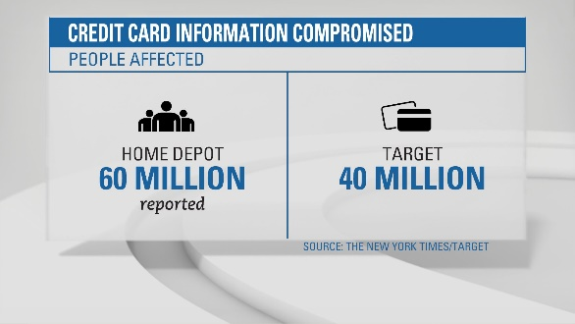

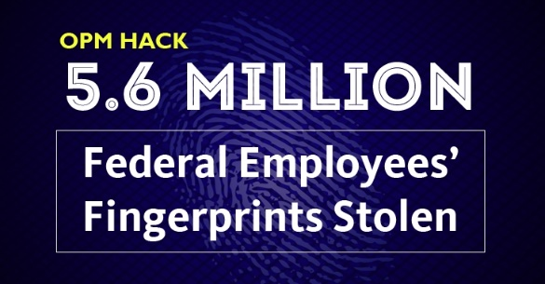






Examples..
http://www.privacyrights.org/data-breach

Slide 4
Cyber Espionage in 2015
548 incidents reported in 2015.
2015 Data Breach Investigations Report, Verizon.

Slide 5
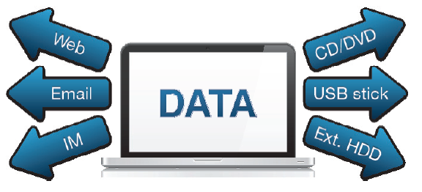
Data Loss Prevention (DLP) Products (2006~)
Image: http://blog.skodaminotti.com/blog/data-loss-prevention-part-2-choosing-a-dlp-solution/

Slide 6
Sensitive data identification
Regular expression
social security numbers, telephone numbers, addresses, and other data that has a significant amount of structure.
Keywords
small number of known keywords can identify private data, e.g., medical or financial records
Fingerprints
Hashes of substrings of unstructured data

Slide 7
Limitations
Good at identifying “universally” confidential data, e.g., credit card number and SSN
Organization specific key word and fingerprint generation was challenging
Prevents accidents and commodity attacks
Easy to circumvent

Slide 8
Can we learn organization specific sensitive data?

Slide 9
Text classification for DLP
Text Classification for Data Loss Prevention, Michael Hart, Pratyusa Manadhata, and Rob Johnson
Privacy Enhancing Technology Symposium (PETS) 2011

Slide 10
Real world is messy
Enterprise Private (EPR), Enterprise Public (EPL), and Non Enterprise (NE)
EPR and EPL likely to be relatively similar
Many NE share almost no features with EPR and EPL
Some NE may be quite similar to EPL
Contradicting goals: catch subtle differences between EPL and EPR,
but not overfit to be able identify NE as non-sensitive

Slide 11
Our approach [PETS 2011]
Supplement training data with NE
Adjust SVM boundary toward EPL
Two-step classifier to reduce FPs
Dataset Baseline FDR Our classifier FDR
DynCorp 4.49% 0.00%
Enron 47.05% 0.92%
Google 8.99% 1.06%
Mormon 0.88% 0.36%
TM 22.06% 0.01%
Table 3. The False Discovery Rate of the baseline approach far exceeds our classifier,
implying that the baseline approach would fare poorly in real world networks whereas ours would not raise much fewer alarms.

Slide 12
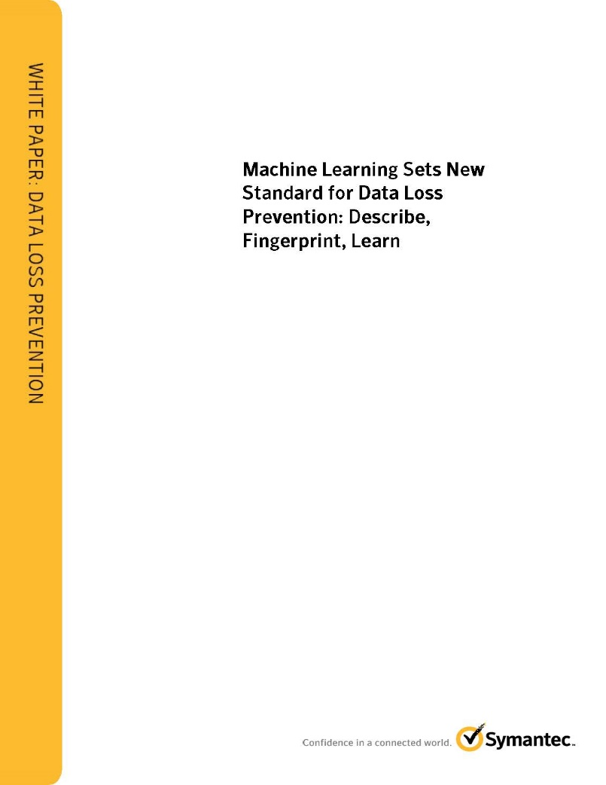
“Vector Machine Learning”
http://eval.symantec.com/mktginfo/enterprise/white_papers/b-dlp_machine_learning.WP_en-us.pdf

Slide 13
The threat landscape has evolved.

Slide 14

Advanced threats: The new landscape
Remote Control
Discovery
Infiltration
Discovery
Exfiltration
DNS HTTP
HTTPS

Slide 15



Example: DNS Exfiltration
msg1.attacker.com?
msg2.attacker.com?
msg3.attacker.com?
msg4.attacker.com?
msg5.attacker.com?
msg1.attacker.com?
msg2.attacker.com?
msg3.attacker.com?
msg4.attacker.com?
msg5.attacker.com?
Malware
DNS server
Authoritative Server for attacker.com

Slide 16
A real world example
Queries
BLGCOFDAGOOOESDULBOOBOOOOOOOOOOOOOOOOOOLDOSESKGKHHF.detacsufbo.ru
EUJSFLDAGOOOESDUDBOOBOOOOOOOOOOOOOOOOOOOSSJHGHFCLFOHCHLGHSAHAHU.CHLAAFHLSGHAFGFUOOEUGDKLCSHEKLJBOCOSECHFFUGBSKGDJGGGHOJHJCGJG.KCDOELDUOEGUCUOUHJUAKEGGGFGEKHLGFDFESJOEL.detacsufbo.ru
SHUDHFDAGOOOESDUGBOOBOOOOOOOOOOOOOOOOOOEDKDFBBHLEGGJLGUFABHCCU.DHDFFCHHKSHGHAOUBGEGEJLGFHUBDFGUGJDFFEAKFSBFFGSDACGHCSKBHLSCGHH.EHSHHJFHUAAOOGKKSDDAHAUBBJDCCKGSHKLGJGAS.detacsufbo.ru
OHDOBHDAGOOESDUGBOOHOOOAOOOOOOOOOOOOOOO.detacsufbo.ru
HBSGGCDAGOOESDUUSOOBOOOOOOOOOOOOOOOOOOO.detacsufbo.ru
Responses (TXT records)
LLCDGHDABOOOSSUHOOOFOOOOOOOOOOOOOOOOOOO
KJGDUDABOOOSBSUHOOOFOOOOOOOOOOOOOOOOOOO
JJDHUDABOOOSBSUHOOOFOOOOOOOOOOOOOOOOOOO
HBEAGDABOOOSBSUHOOOUOOOOOOOOOOOOOOOOOOO
KALFCSDAOOOSBSUHOOOFOOOOOOOOOOOOOOOOOOO

Slide 17
How do we deal with the new threat landscape?

Slide 18
Detection mechanisms ??
Many queries from a client to a domain -> misconfigured devices
Many distinct queries from a client to a domain -> signaling needs few subdomains
Many long queries from a client to a domain -> credit card numbers are not long

Slide 19
Detection mechanism: Information content
Vern Paxson, Mihai Christodorescu, Mobin Javed, Josyula Rao, Reiner Sailer, Douglas Schales, Marc Ph. Stoecklin,
Kurt Thomas, Wietse Venema, and Nicholas Weaver.
Practical comprehensive bounds on surreptitious communication over DNS.
In Proceedings of the 22nd USENIX conference on Security (SEC'13). USENIX Association, Berkeley, CA, USA, 17-32.

Slide 20
Industry heuristics for DNS exfiltration detection
Lengths of DNS queries and responses
Sizes of request and reply packets
Entropy
Total number/volume of DNS queries from a device
Total number/volume of DNS queries to a domain
…

Slide 21
Characteristics of heuristics driven solutions
Complex to build/maintain, but very fragile
False negatives and false positives
Independent of other security products in the network
Need a human being in the loop for response/remediation

Slide 22
Can we build a reliable detector on top of ‘noisy’ detectors?

Slide 23
Problem setting
Defender
observes a stream of noisy alerts (or absence of alerts)
has partial knowledge of the network
Must identify domains involved in exfiltration and decide whether to block traffic (plan of action)
While weighting the cost of
Deploying noisy detectors
Data loss due to false negatives
Disruption due to false positives
Decision making and planning under uncertainty

Slide 24
Virtually Distributed Partially Observable Markov Decision Processes (VD-POMDP) [GameSec 16]
Network of enterprise devices, web domains,
and noisy detector nodes
Original POMDP: Impractical to solve for 3-4 nodes
VD-POMDP:
Abstract action and observation space
Factor the original POMDP into one sub-POMDP per domain, solve them “offline”
Online policy aggregation using MILP to get final joint action
Sara Mc Carthy, Arunesh Sinha, Milind Tambe and Pratyusa K. Manadhata, Data Exfiltration Detection and Prevention: Virtually Distributed POMDPs for Practically Safer Networks, 7th Conference on Decision and Game Theory for Security (GameSec), New York, NY, Nov 2016.

Slide 25
Experimental setting
DETER testbed at USC
Iodine to simulate DNS exfiltration
Normal DNS query behavior simulation via scripts
Paxson et al.’s approach as the noisy detector
Synthetic workload for parameter sensitivity testing

Slide 26
Results
Runtime
POMDP doesn’t scale beyond 3 domains, whereas VD-POMDP scales linearly
For small networks (~1000 nodes), offline phase takes hours and online phase takes seconds
Performance
VD-POMDP’s accuracy and time to detection is similar to POMDP
Robustness
Very high detection rate (>0.95%) even with extremely noise detectors

Slide 27
Summary
Data exfiltration detection and prevention is an ongoing arms race
Existing approaches don’t work in the new threat landscape
Point detection approaches will always be noisy
We need to build robust detectors on top of noisy detectors
POMDP/Game theory may help us build robust detectors

Slide 28
Thank you
Pratyusa K. Manadhata
manadhata@hpe.com

