Slide 1
Data Exfiltration Detection and Prevention: Virtually Distributed POMDPs for Practically Safer Networks
Sara Mc Carthy*, Arunesh Sinha,* Milind Tambe*, Pratyusa Manadhata✹✹
University of Southern California*
Hewlett Packard Labs✹✹

Slide 2


Slide 3
Motivation
advanced persistent threats
Attackers are sophisticated and intelligent, with large set of resources.
Use human ability and creativity, not just bots or worms with continuous monitoring and interaction
Advanced
"Low-and-slow" approach, operates quietly over an extended period of time maintain long-term access to the target,
Persistent
Goal is often Data Exfiltration: obtaining and extracting financial, technological, or other information.
Threat
Notes:
While there are many organizations with a vested interest in solving this problem, a common thread is that they are all working within an extremely limited budged. While there are many different security resources like NGO personnel, local police and volunteers along with equipment like UAV’s and ground vehicles that can be leveraged in order to protect the forest, the limited budget means that choosing among these investments becomes critical as there is an extremely large areas to protect.

Slide 4
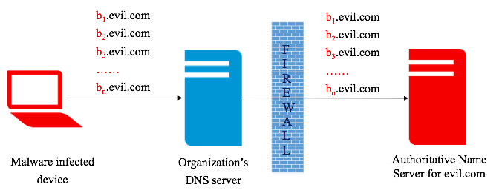
Motivation
DNS Exfiltration

Slide 5
Long Queries
5.1o19sr00ors95qo0p73415p3r8r8q777634r5o86osn295ss2rqoss3r9601ro3.1r1p7r4719o34393648s2345nn60qnqoop45psos37n551s002n80850sr2r8n3.r1105qqq28r7pn82843rp76383qr6344qqpq7rpnrp63o957687r980r.rrqs656p04pn614q6n76o97883op73r0p787rn92.i.02.s.sophosxl.net
g63uar2ejiq5tlrkg3zezf2fksjrxpxyvro4ce5yz65udnjn.dagbuu5pkocwcaxkntmxzwvkbulhg3qlj6ho7jwobeddjqvv.gepxfdwfhu76on6gza2nkringxp35e6g3ftpqlpl5h6uofgo.kukjy4jvybu7jhrlhrgxe7es3lmkxdrpmpb4lg7wmbpygjg7.gef2uoemc6pi88tz.er.spotify.com
Legitimate
Repeated Queries
1751913.86c0ade0d13143ab83d7e4f60cbd204c.00000000.xello.xobni.com
1753942.86c0ade0d13143ab83d7e4f60cbd204c.00000000.xello.xobni.com
1756950.86c0ade0d13143ab83d7e4f60cbd204c.00000000.xello.xobni.com
1758762.86c0ade0d13143ab83d7e4f60cbd204c.00000000.xello.xobni.com
Malicious
p9b-8-na-5w-2z3-djmu-7pk-qy-0-bok-re9-ym-v9h-av-njx-2es.info
Paxson, V., Christodorescu, M., Javed, M., Rao, J., Sailer, R., Schales, D., Stoecklin, M.P., Thomas, K.,
Venema, W., Weaver, N.: Practical comprehensive bounds on surreptitious communication over dns.

Slide 6
Problem : Classical machine learning
Outlier Detection
High Cost of Error
Semantic Gap

Slide 7
Problem : Classical machine learning
Outlier Detection
High Cost of Error
Semantic Gap
ML is good at identifying what is similar rather than discovering meaningful outliers
Lack of labelled attack data leads to too many false positives and alerts
Results in alert fatigue

Slide 8
Problem : Classical machine learning
Outlier Detection
High Cost of Error
Semantic Gap
ML is good at identifying what is similar rather than discovering meaningful outliers
Lack of labelled attack data leads to too many false positives and alerts
Results in alert fatigue
Cost of any misclassification is extremely high compared to many other machine learning applications.
False positive requires spending time examining the reported incident.
False negatives cause serious damage

Slide 9
Problem : Classical machine learning
Outlier Detection
High Cost of Error
Semantic Gap
ML is good at identifying what is similar rather than discovering meaningful outliers
Lack of labelled attack data leads to too many false positives and alerts
Results in alert fatigue
Cost of any misclassification is extremely high compared to many other machine learning applications.
False positive requires spending time examining the reported incident.
False negatives cause serious damage
How to transfer results into actionable reports for the network operator
What remedial steps should be taken?

Slide 10
Problem : Decision Theory
MDP
POMDP
Can reason about uncertainty in environment and provide actions to take
Need Complex Models to Capture real world dynamics
May be infeasible to generate model from domain experts
Can become extremely difficult to solve / not scalable

Slide 11

Given that you’re stuck with dealing with noisy detectors, how then do you reason about your network?
Notes:
Given that you’re stuck with dealing with noisy detectors, how then do you reason about

Slide 12
Contributions
Address the Active Sensing challenge with a scalable, fast decision-theoretic model for reasoning about noisy sensors in a computer network and determine optimal sensing strategies
Provide a novel VD-POMDP solution method for solving this model
Evaluation on a real network testbed

Slide 13


Problem
Data Exfiltration over DNS
Computer Network
Nodes:
Host Computer
Routers, etc.
Edges:
Channels of Communication
Acces Point:
Nodes connected to the outside world (Internet)
Notes:
Formally, we model the data exfiltration problem using a graph of nodes and edges. Nodes in the graph correspond to network entities such as host computers, routers and switches. Edges in the graph correspond to channels of communication between these nodes. Additionally there are special nodes designated as access points where communication with the outside world is allowed

Slide 14
Problem
Data Exfiltration over DNS
DNS Queries originates at Host nodes
Travel through Network
google.com
Leaves through Access Point
evil.com
Notes:
A DNS query made at a host computer travels a path throughout the network and leaves through the access point. We refer to the path that the node travels as a channel.

Slide 15
Problem
Data Exfiltration over DNS
Need to determine which domains are being used as malicious channels for exfiltration
google.com
✓
evil.com
X
Notes:
Our job is to determine which domains correspond to malicious channels being used for exfiltration

Slide 16
Problem
Data Exfiltration over DNS
Cost of Exfiltration:
Value of information located on host computer
google.com
✓
evil.com
X
Notes:
There is an associated cost of exfiltration, which is determined by the value of information located at the source of any channel

Slide 17
Problem
Data Exfiltration over DNS
google.com
Detectors can be deployed at multiple locations
evil.com
Different thresholds can be set for different detectors.
Notes:
in order to determine which channels are malicious we can deploy detectors at multiple locations throughout the network. Different detectors can be set at different thresholds. For a machine learning based detector, this can be thought of as the threshold for classification.

Slide 18
Problem
Data Exfiltration over DNS
Gather Information
Detectors are imperfect:
will often miss attacks
have high false positive rates
Threshold determines miss rate
Need to gather information from many sources
Build up a belief over time about the network state
Notes:
Our goal is to gather information about the network state. The detectors that we deploy are imperfect and will often miss attacks and have high false positive rates. The thresholds we set for the detectors influence what these rates are. In order to maximize the information we gain about the network we need to reason about where to sense, and with how much sensitivity to sense in order to build up a belief over time about the network state

Slide 19
Problem
Data Exfiltration over DNS
Ensure Network Performance
Sensing Impacts Network Performance
Cost of sensing is determined by amount of traffic through a node
Notes:
We also need to reason about the cost of our sensing actions and unsure a certain level of network performance. There is an associated cost of sensing determined by the amount of traffic through each node. Using a basic

Slide 20
VD-POMDP
Virtually distributed POMDP formulation
1
Factoring: Abstract the model to induce sparse interaction
Divide and solve sub-POMDPs Offline
2
Policy Aggregation: resolve interactions online
3
Execute Joint Policy

Slide 21
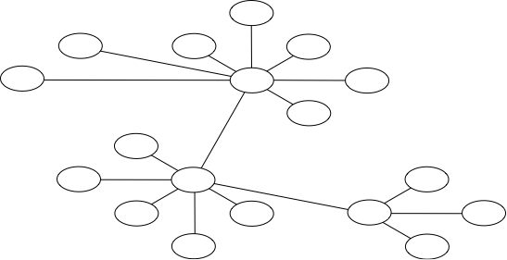
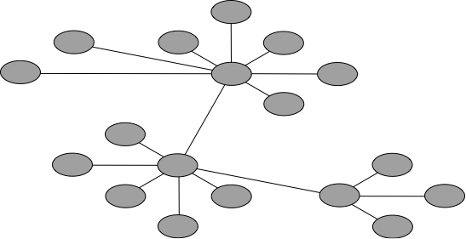
1
Factor
Network representation couples channels & information about each domain
Domain1
Domain 2
Domain 3

Slide 22
1
Factor
Domain1
Domain2
Network representation couples channels & information about each domain
Choice of node gives us information about many domains
Choice of channel gives information about one domain

Slide 23
1
Factor
Domain1
Domain2
Reason about which channels to sense over instead of which nodes to sense on.
Choice of node gives us information about many domains
Choice of channel gives information about one domain

Slide 24
1
Factor
How does this change the cost of actions?
Cost of a node = Traffic through node
Build a lookup table mapping each action on channels to lowest cost action on nodes.
We can efficiently compute this using a linear program
#channel | nodes | cost
Domain1
#channel | nodes | cost
Domain2

Slide 25
2
Online Policy Aggregation & Execution
Sub-Agent maintains belief for every domain
10% Bad
90% bad!
Query Sub-Agent for an action
Set of channels
Set of channels
Policy 1
Policy 2
Notes:
Once we have mapped to actions over channels we can divide the pomdp into many sub pomdp-s one for each domain. we solve each of these sub-pomps offline to get a policy for each domain. At execution time each pomdp then reasons about and maintains a belief over the state of a single domains. We query each of the sub-agents for an action at every time step, which the agent provides, using the generated policy

Slide 26
2
Online Policy Aggregation & Execution
Aggregate actions
Set of channels
MIN ( Cost of nodes)
Set of Nodes
St. cover all required channels
Set of channels
Turn on corresponding detectors
Get observations
Update Belief
Notes:
each individual action from the sub agent will be a set of channels to sense over. Agregating these actions involves converting back into the network representation, and involves solving the same linear program used to initially convert to the channel representation. Once this is done we get a joint action which can be executed, by turning on the corresponding detectors. We then get observations from these detectors and update the beliefs of the subagents correspondingly.

Slide 27
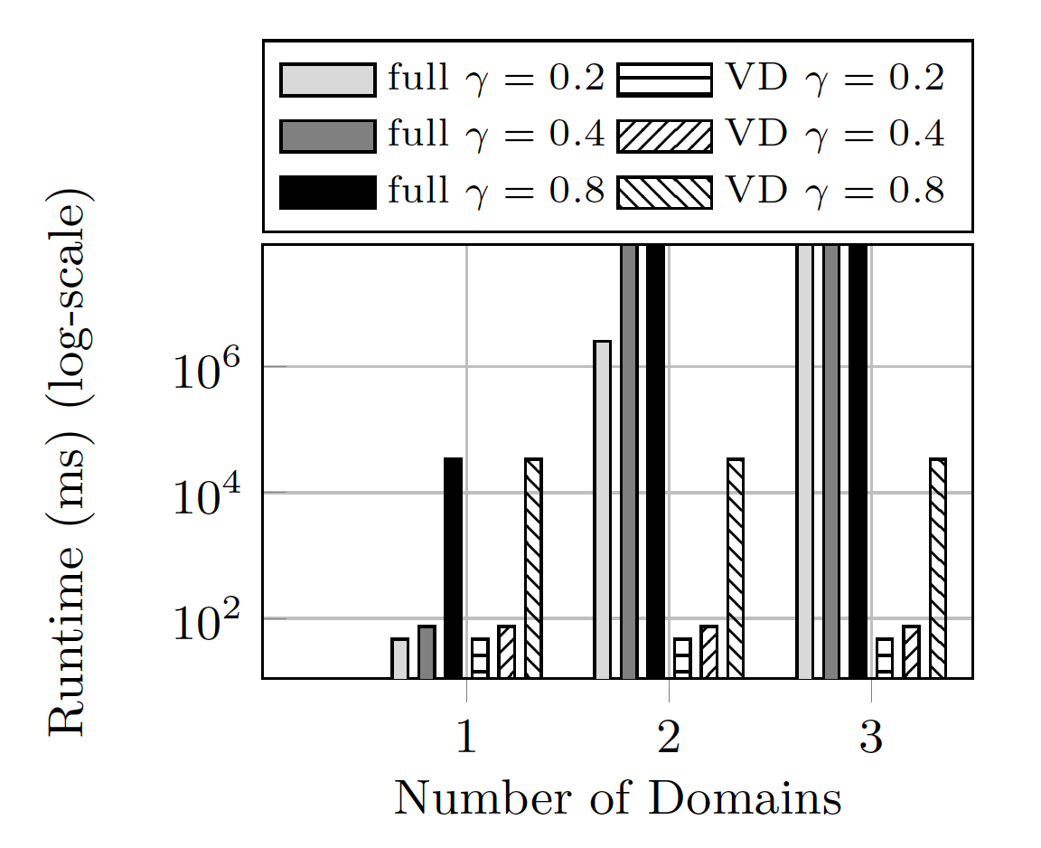
Evaluation
Notes:
in order to evaluate our solution method, we first look at the offline performance of the VD-POMDP when compared to a full pomdp. Here we have solve times of both models for a network of 2 nodes with increasing number of domains. As expected both models are equivalent when there is only a single domain. However, as we move to 2 domains, we are unable to solve the full POMDP for a discount factor of larger than 0.2, while none of the POMDP models terminated for 3 domains. Our VD-POMDP solve time remained constant as expected.

Slide 28
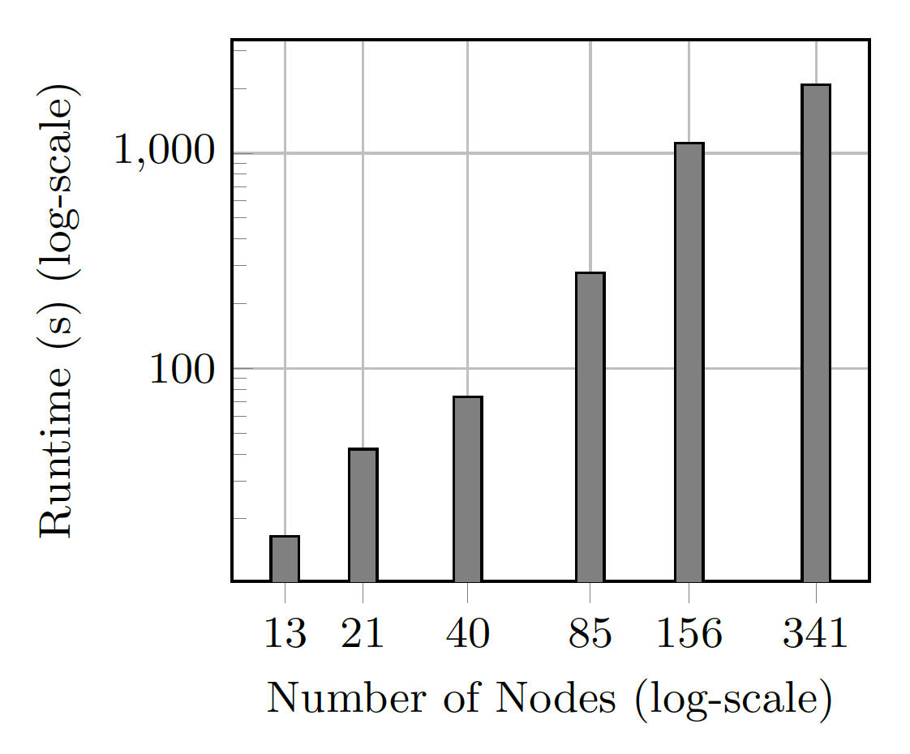
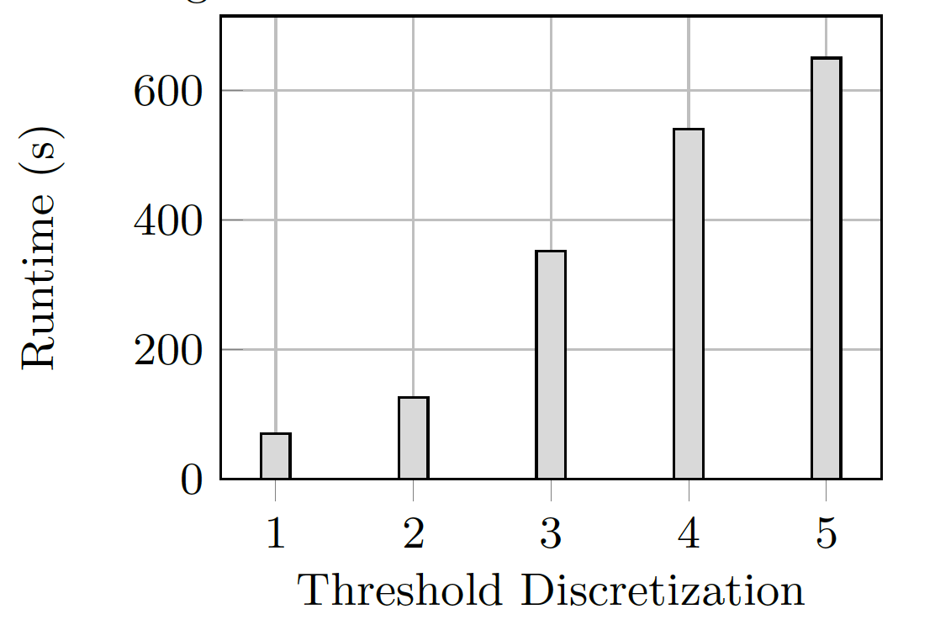
Evaluation
Notes:
Here we show the solvtime of the VDPOMDP with increasing network size. We generated several tree structure network for this experiment and can see that the solve time remains linear with increasing size. We also did the same for the threshold discretization, increasing the number of actions available and see a similar linear increase in solve time.

Slide 29
DETER TESTBED
Entropy Based Detector
Legitimate Domain
Lower Information Content
If Information Content Passes Threshold Value
Generate Alert
Malicious Domain
Higher Information Content
Paxson, V., Christodorescu, M., Javed, M., Rao, J., Sailer, R., Schales, D., Stoecklin, M.P., Thomas, K.,
Venema, W., Weaver, N.: Practical comprehensive bounds on surreptitious communication over dns.
Notes:
In order to evaluate the online performance of our solution method we test two different types of networks. The first were synthetic network, created in simulation where the alerts were drawn from a probability distribution.
The second network we test was using the deter testbed, which allowed us to create an actual network of virtual machines. We implemented an entropy based dns exfiltration detector which looked at the information content of each of the channels and generated an alert if the information passed a certain threshold. We also conducted some basic attacks using the software iodine and attempted to exfiltrate data

Slide 30
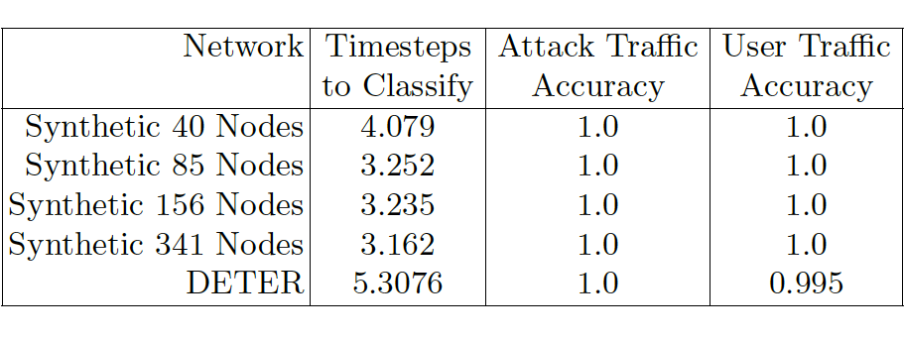
DETER TESTBED
Notes:
We tested synthetic network of up to 341 nodes and looked at the time steps required to classify a domain, as well as the accuracy in classifying legitimate traffic and attack traffic. For the synthetic networks, we were able to correctly classify both kinds of traffic, indicating that this method is extremely efficient when you have a well characterized detected.
For the deter testbed we see similar results, with a slightly lower accuracy on user traffic.

Slide 31
Summary
Decision theoretic model for reasoning about noisy sensors in a computer network and determine optimal sensing strategies
Provide a scalable efficient solution method for solving this model
solving large scale pomds faster
introduces abstraction in planning to induce sparse interaction in factored POMDPs offline
interactions are resolved at execution time
Experimental validation of our model
Notes:
to conclude we provide a scalable efficient solution method for solving POMDP

Slide 32
Thanks!
sara.m.mccarthy@gmail.com

Slide 33
