Slide 1
Operational Security Games
Pratyusa K. Manadhata
manadhata@hpe.com

Slide 2
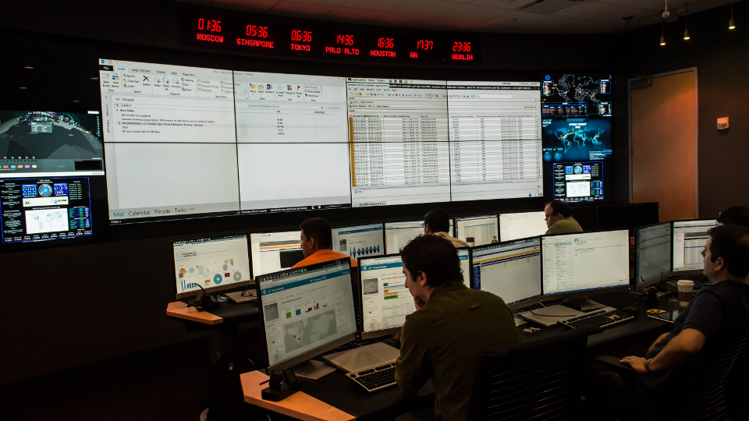

Slide 3
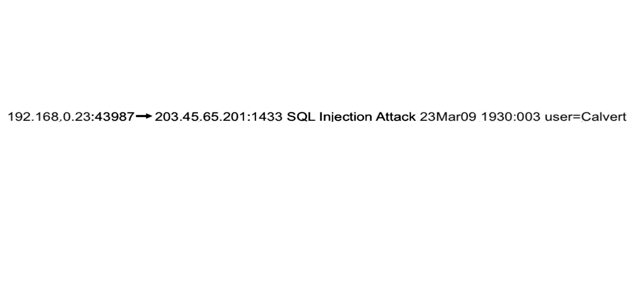
A tier-1 analyst sees an alert

Slide 4
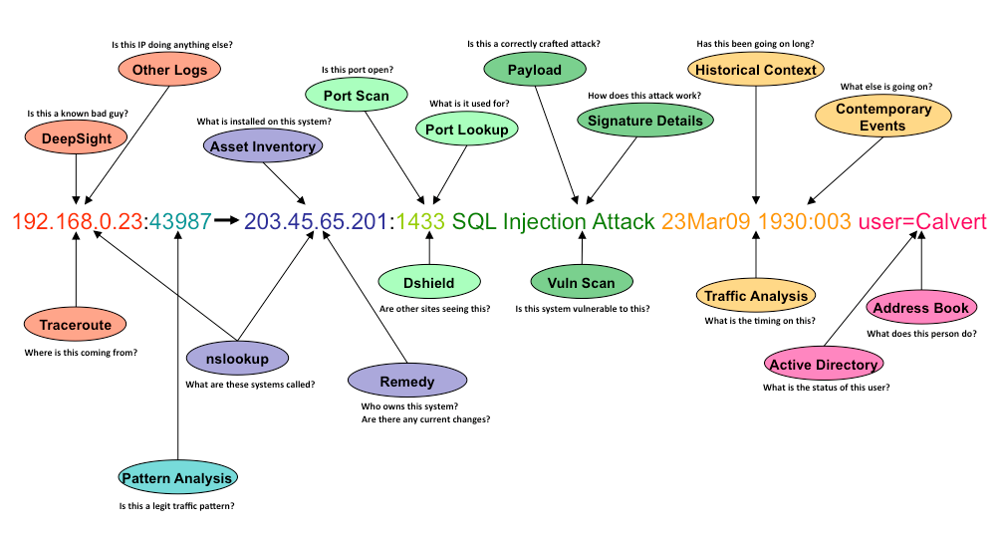
The tier-1 analyst builds a context

Slide 5
A tier-2 analyst takes remediation actions
Quarantine the infected machine
Schedule/ run clean up tools
Schedule/ run reimaging
Notes:
Once the analyst decides to take action, he has to decide on a remediation plan and then execute it

Slide 6
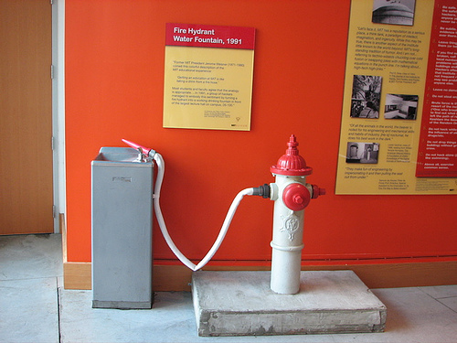
1.5 billion events/day
~200 actionable alerts
~10 minutes/alert for escalation

Slide 7

SOCs: Repetitive, manual, and error prone

Slide 8
Remediation as ‘planning under uncertainty’ or ‘games’
Input: events and alerts from the network
partial view of the network
costs of sensor placement, false positives, and false negatives
adversary’s goals and actions
…
Output: Remediation action plan
Approach: Decision making under uncertainty
Two player games

Slide 9
Challenges
Generating realistic models/inputs
Model updates in response to network changes
Scalable, reliable, and timely
Interpreting results
Incorporating analyst feedback

Slide 10
Thank you
Pratyusa K. Manadhata
manadhata@hpe.com

