Slide 1
Game Theoretic Approaches to Attack Surface Shifting and Reduction
Pratyusa K. Manadhata
HP Labs
manadhata@hp.com

Slide 2
Context: Attack Surface Measurement (ASM)
How can we quantify a software system’s security?
Measure the system’s attack surface [MW10]

Slide 3
Attack Surface Reduction (ASR) Mitigates Risk
Traditional industry approach: code quality improvement
Software will ship with known and future vulnerabilities
Reduce attack surface to increase the difficulty and decrease the impact of future exploitation

Slide 4
Code Quality and ASR Complement Each Other
Bad
Medium
Security Risk
High
Security Risk
Code
Quality
Low
Security Risk
Medium
Security Risk
Good
Low
High
Attack Surface Measurement

Slide 5
ASR in the Industry
Microsoft
SAP
MuSecurity
OpenSSH
Firefox
…

Slide 6
Moving Target Defense [GPS09, JGSWW11]
Shift the attack surface
“Attacks only work once if at all”
X
X
X
system surface

Slide 7
Outline
Introduce the notion of attack surface reduction
Formalize the notion of attack surface shifting
Explore game theoretic approaches to shift and reduce the attack surface

Slide 8
Intuition Behind Attack Surfaces
Attacks
system surface
2. Channels
1. Methods
3. Data
Entry/Exit
Points
Hence we define a system’s attack surface in terms of the system’s resources (i.e., methods, channels, and data items).
A system’s attack surface is the ways in which an adversary can enter the system and potentially cause damage.

Slide 9
Model of a System and its Environment
A system, s, and its environment, E_{s}= ⟨U, D, T={t₁, t₂}⟩.
D
U
s
E_{s}
t₁
t₂

Slide 10
I/O Automata [LT89]
Action Signature
Input, Output, Internal actions
Pre and Post conditions m.pre and m.post
Composition
E_{s} = (U_{io} || D_{io} || ( ))
P = s_{io} || E_{s}
m
m
S
E
n
n

Slide 11
Not All Resources Are Part of the Attack Surface
Only those resources that the attacker can use to send data into or receive data from the system are relevant.
We introduce the formal entry point and exit point framework to identify the relevant resources.

Slide 12
Entry Point and Exit Point Framework
U/s’
D/s’
Entry Points/Exit Points
Direct (input/output action)
Indirect (internal action)
Channels (e.g., sockets and pipes)
c є Res(m.pre)
Untrusted Data Items (e.g., files)
d є Res(m.post), d є Res(m.pre)
m
m
s
D

Slide 13
Attack Surface Definition
Definition
M: set of entry points and exit points
C: set of channels
I: set of untrusted data items.
attack surface = <M, C, I>

Slide 14
Larger Attack Surface Leads to More Attacks
Attacks (s) = The set of executions of (s || E_{s}) that contain either an input action or output action of s.
Theorem: Given an environment, E, if AS(A) ≥ AS(B), then Attacks(A||E) Attacks(B||E).

Slide 15
Not All Resources Contribute Equally to the Attack Surface
Contribution ∝ Damage Potential
Contribution ∝ (Attacker Effort) ⁻¹
Contribution =
Damage Potential
Attacker Effort

Slide 16
Attack Surface Measurement (ASM)
ASM(A) ≥ ASM(B) if there exists a nonempty set, R, of resources s.t.
∀r є R. contribution(r, A) ≥ contribution(r, B).
Theorem: Given an environment, E, if ASM(A) ≥ ASM(B), then Attacks(A||E) Attacks(B||E).

Slide 17
Quantitative Attack Surface Measurement
Assume der: method → Q.
Similarly, for channel and data.
ASM = ⟨ , , ⟩

Slide 18
Numeric Damage Potential-Effort Ratio
Resource
Damage Potential
Attacker Effort
Method
Privilege
Access Rights
Channel
Protocol
Access Rights
Data Items
Type
Access Rights
Impose a total ordering among the values of the attributes and assign numeric values accordingly, e.g.,
root = 5 and auth = 3.

Slide 19
Attack Surface Measurement Method
Identify a set, M, of entry points and exit points, a set, C, of channels, and a set, I, of untrusted data items.
Estimate each relevant resource’s damage potential-effort ratio, der.
Compute Attack Surface Measurement =
⟨ , , ⟩ .

Slide 20
Shifting the Attack Surface
Scenario: A system’s defender is trying to protect the system from an attacker.
Goal: Shift the attack surface such that old attacks don’t work any more
may introduce new attacks

Slide 21
Not All Changes Shift the Attack Surface
Changing the attack surface by changing features
Add/remove resources
Change existing resource’s contribution
Shifting the attack surface
Remove at least one existing resource
Reduce an existing resource’s contribution

Slide 22
Definition of Shifting
R_{o}: old attack surface
R_{n}: new attack surface
r_{o}: a resource, r’s, contribution to R_{o}
r_{n}: r’s contribution to R_{n}
ΔAS = |R_{o}\ R_{n}| + |{r: (r є R_{o} ∩ R_{n}) Λ (r_{o} > r_{n})}|

Slide 23
Shifting Prevents Old Attacks
Given a system, S, an environment, E, and S’s attack surface, R, the set of attacks on S is
Attacks(S_{R}||E).
Theorem: Given an environment, E, an old attack surface, R_{o},
a new attack surface, R_{n},
if ΔAS > 0, then
Attacks(S_{Ro}||E) \ Attacks(S_{Rn}||E) ≠ φ.
Old attacks
New attacks
Notes:
Picture of overlapping circles

Slide 24
Disable Features: AS Shift and ASM Reduction

Slide 25
Enable and Disable Features: AS Shift and ASM Reduction/Addition/Identical

Slide 26
Enable Features: No AS Shift and ASM Addition

Slide 27
Summary of Scenarios
Scenario | Feature | AS Shift | ASM
A | Disabled | Yes | Reduction
B | Enabled and Disabled | Yes | Reduction
C | Enabled and Disabled | Yes | Identical
D | Enabled and Disabled | Yes | Addition
E | Enabled | No | Addition
Notes:
Scenario preferences
So can we always choose the preferred scenario while performing moving target defense?
The answer is not obvious as there is a trade-off involved.

Slide 28
Scenario choice is a Security-Usability Trade-off
While shifting the attack surface, which features to disable and which features to enable?
More features => more usable system
More features => larger attack surface
Notes:
…
How does an optimal trade off be made?
That is where game theory can help

Slide 29
A Game Theoretic Approach to Moving Target Defense
Prior work: static software development process
No assumptions about the attacker
Moving target defense is a dynamic scenario
Interaction between a defender and an attacker is a game
Explicit attacker model

Slide 30
Two-Player Stochastic Game Model [LW02]
Game = <S, A^{d}, Aª, T, Rd, Ra, β>
S: set of states
A*: action sets
T: S x A^{d} x Aª x S → [0,1] : transition function
R*: S x A^{d} X Aª → R : reward functions
β: discount factor

Slide 31

Game Play
R^{d} (s_{t,} a^{d} , aª)
a^{d}
T(s_{t,} a^{d} , aª , s_{t+1})
s_{t}
s_{t+1}
aª
Rª (s_{t,} a^{d} , aª)
Goal: maximize discounted reward.

Slide 32
States, Actions, and Transitions
State: Feature → Configuration
Action: Feature → FeatureAction
Transition: Specific to a system and its environment

Slide 33
Reward Functions
ΔF: change in features
ΔAS: shift in the AS
ΔASM: change in the ASM
R^{d}: B₁^{d} (ΔF) + B₂^{d} (ΔAS) – C^{d} (ΔASM)
Rª: Bª (ΔASM) – Cª (ΔAS)

Slide 34
Optimal Defense Strategies
Model the interaction as an extensive game
Complete and perfect information
General sum game
Solution: Equilibrium

Slide 35
Stationary and Dynamic Strategies
Stationary strategy
Independent of history
Nash equilibrium
Non-linear program for stochastic games [FV96]
Dynamic strategy
Optimal action after every game history
Subgame perfect Nash equilibrium
Dynamic programming approach [MG07]

Slide 36
Future Work: Instantiate the Model
Challenges in applying the model to real-world systems
State space explosion
Focus on an important set of features
Transition probabilities
Reward functions
Cost and Benefit functions

Slide 37
Future Work: Model Efficacy
How much effort is necessary to instantiate the model?
Is the model’s benefit worth the effort?
How does one compare alternative game models?
Alternative approaches to achieve moving target defense?

Slide 38
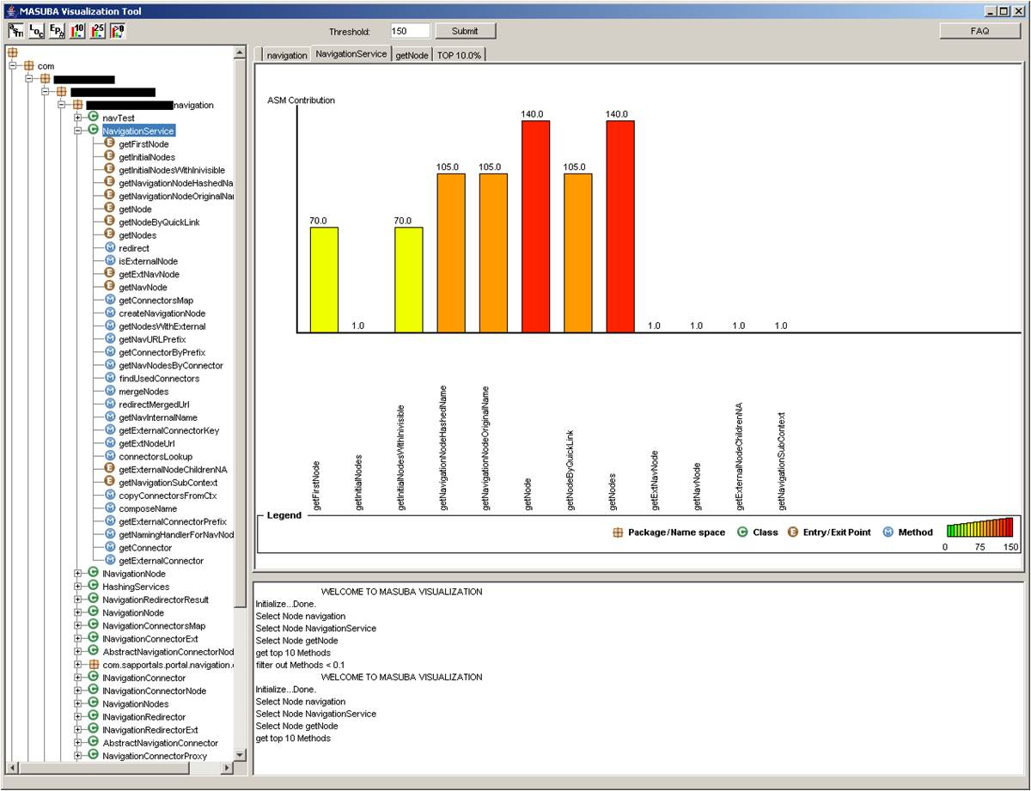
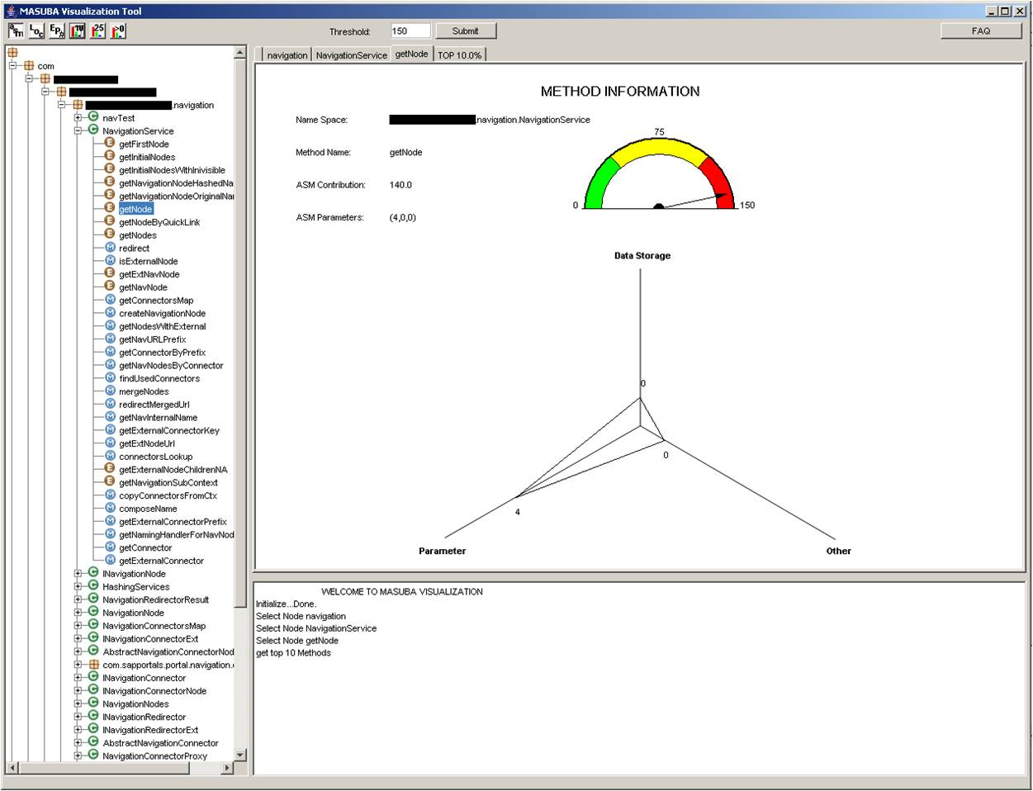
Future Work: Software Development Lifecycle
Which features to add and which to remove?
Prior work: Use the feature’s contribution to ASM

Slide 39
A Game Theoretic Approach
Consider a feature’s “reward” value
B₁^{d} (ΔF) + B₂^{d} (ΔAS) – C^{d} (ΔASM)
Add features in decreasing order of reward
Remove features in increasing order of reward
The simplistic approach ignores feature interaction.

Slide 40
Shapley Value [S53]
Coalitional game (N, v)
N: a set of players
v: 2^{N} → R : characteristic function

Slide 41
Choose Features According to their Shapley Value
Features are players in a coalitional game
Characteristic function: Reward function
Shapley value: A feature’s contribution to security and usability

Slide 42
Related Work
Moving target defense
A. Ghosh et al.: National cyber leap year summit 2009 co-chairs report, 2009.
S. Jajodia et al.: Moving Target Defense: Creating Asymmetric Uncertainty for Cyber Threats, Springer, 2011.
Game theory and security
S. Roy et al.: A survey of game theory as applied to network security, HICSS 2010.
M. Manshaei et al.: Game Theory Meets Network Security and Privacy, ACM Trans. On Computational Logic, 2010.

Slide 43
Summary
Formalized the notion of shifting the attack surface
Introduced game theoretic approaches to shift and reduce the attack surface
A first step in moving target defense
Understanding over time will lead to better approaches

Slide 44
Backup
[MW10], P. K. Manadhata and J. Wing, An Attack Surface Metric, IEEE Trans. on Software Engg., 2010.
[GPS09] A. Ghosh et al.: National cyber leap year summit 2009 co-chairs report, 2009.
[JGSWW11] S. Jajodia, A. Ghosh, V. Swarup, C. Wang, and X.S. Wang, Moving Target Defense: Creating Asymmetric Uncertainty for Cyber Threats, Springer, 2011.
[LT89] N. Lynch and M. Tuttle, An introduction to input/output automata, CWI-Quarterly, 1989.
[LW02] K. Lye and J. Wing, Game strategies in network security, International Journal of Information Security, 2005.
[FV96] J. Filar and K. Vrieze, Competitive Markov decision processes, Springer, 1997.
[MG07] C. Murray and G. Gordon,:Finding correlated equilibria in general sum stochastic games, Tech. Rep. CMU-ML-07-113, Carnegie Mellon University, 2007.
[S53] L. Shapley, A Value for n-person Games, In Contributions to the Theory of Games, volume II, 1953.

