Slide 1
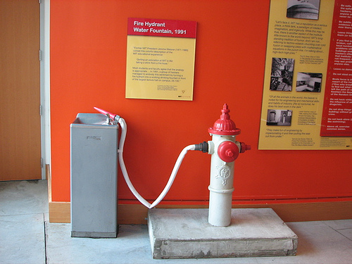
Security Event Management: Challenges and Opportunities
Pratyusa K. Manadhata
HP Labs
manadhata@hp.com

Slide 2
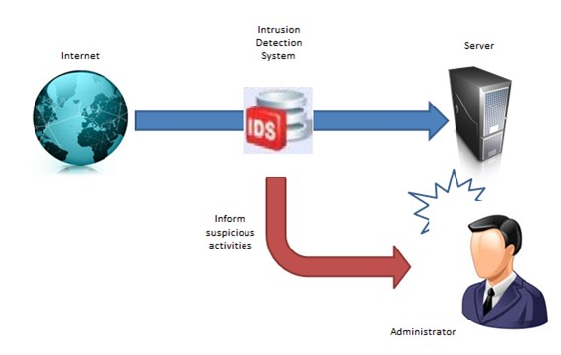
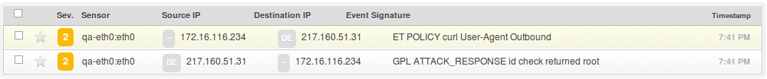
Enterprise Security: Point products

Slide 3
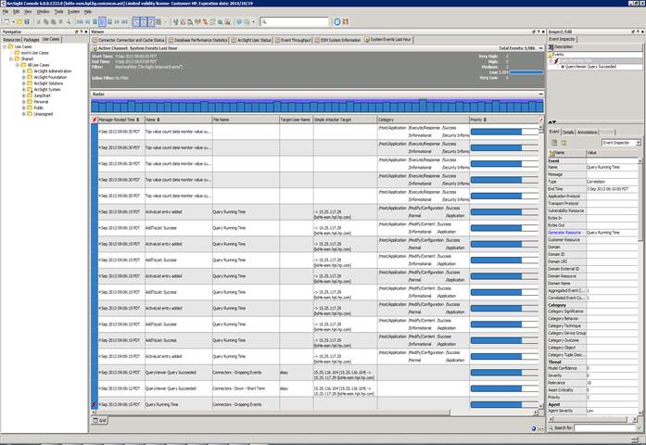
Security information and event management systems (SIEM)
IDS
AntiVirus
IDS
Unified UI
False positive reduction
Proxy
Firewall

Slide 4
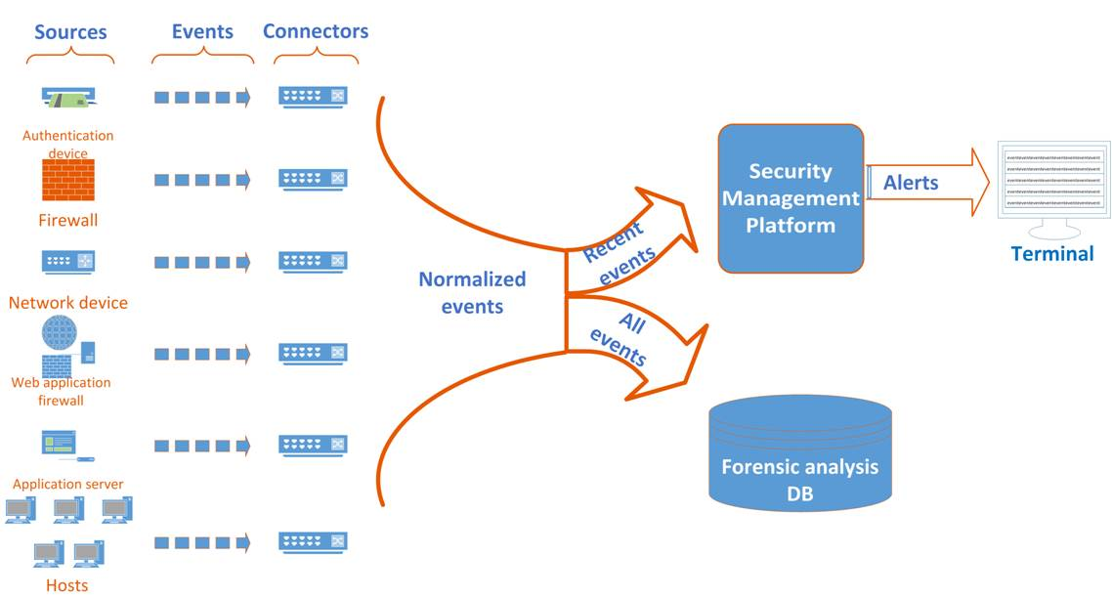
SIEM architecture

Slide 5
Management platform
Rules
Rule Generation
Rule Matching
~10K eps
Alerts
Few hours’ data

Slide 6

Security operations center (SOC)
Targeted attacks
$$$$
Escalation
Severity of Attack
Time and cost
IDS
Tier 3 SA
Firewall
SIEM Alerts
Tier 2 SA
Proxy
Tier 1 SA
Commodity attacks
$

Slide 7

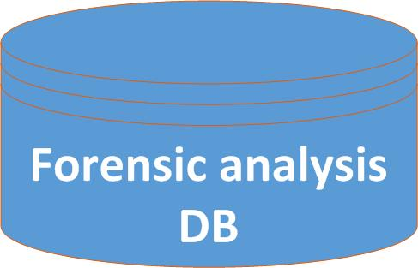

An HP SOC
Hundreds of connector servers
A few hundred forensic DBs
Multiple management platforms

Slide 8
The reality
3 000 000 000 events/day
20 analysts

Slide 9
Operational challenges
Implementing rules – balancing FPs and FNs
Lack of context

Slide 10
Challenge: Drinking from a firehose
Minutes to decide if an alert or event needs
further attention

Slide 11
Challenge: Getting value out of data
AV
AV
DNS
LDAP
DLP
Fire-wall
DLP
Fire-wall
DHCP
HTTP
IDS
IDS

Slide 12



Why enterprises collect security data
Compliance
Cheaper Storage
Forensics
Big Data

Slide 13
Research opportunity
Algorithms and systems to identify actionable security information from event data

Slide 14
Research opportunity
Improve SOC Workflow
Better Security Products
Better Enterprise Security

Slide 15


Data-driven security products
AV/IDS/Firewall/..
Signatures/Rules/..

Slide 16



Anti-malware evolution
Static Analysis
Dynamic Analysis
Reputation Analysis
Data analysis: feature extraction/learning/classification/..

Slide 17
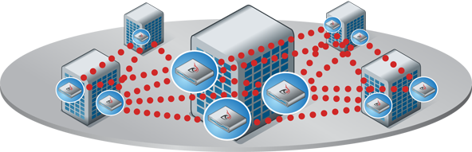
On-Premises analysis
On-site analysis
Fine-grained behavior data
Hardware and virtualization
progress enable scaling
Notes:
Picture?

Slide 18
Research opportunity
What can we infer from event logs?
How do they compare to on-premises analysis?
Notes:
Can this be better?

Slide 19



Data collection and storage
Legal, Privacy, Logistics
Input Validation
Storage Cost vs. Data Requirements

Slide 20
Scalable analysis
Work with human analysts, not replace them
Things that we took for granted are not true any more

Slide 21
Infer human intent from machine logs
No definition of bad exists – rely on heuristics
Automation is hard
History is not a good indicator of future

Slide 22
Algorithms must learn and evolve
Adversaries adapt
Networks and systems change and fail
People behave unpredictably

Slide 23

Beware of false positives
Benign events outnumber malicious events
Scalability
Accuracy

Slide 24
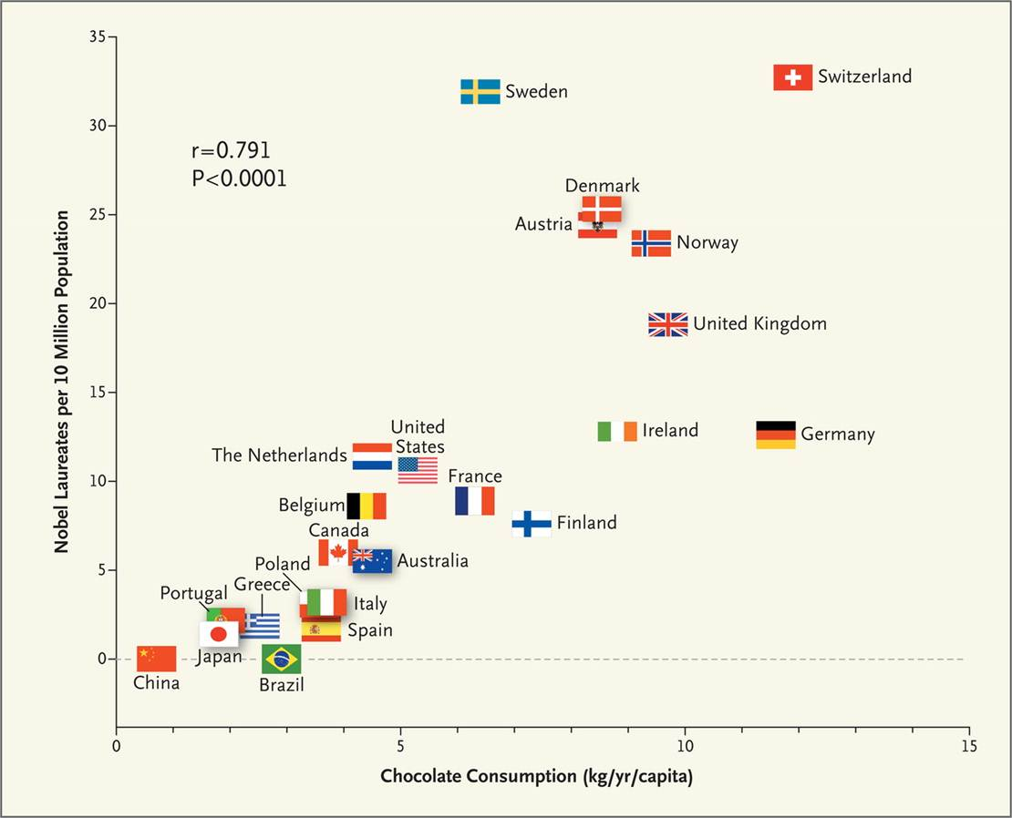
More data = More spurious correlations
Chocolate Consumption, Cognitive Function, and Nobel Laureates, Franz H. Messerli, New England Journal of Medicine, Oct 2012

Slide 25
Privacy
Data minimization vs Serendipity
Privacy-utility trade off

Slide 26





Malicious domain detection
Domains
Hosts
httpz.ru
unknown.net
16.199.144.23
nytimes.com

Slide 27
Estimating marginal probability of being malicious
Domains
??
Hosts
0.99
??
0.01
??

Slide 28
Belief propagation algorithm [P82, YFW01]
Marginal probability estimation in graphs
NP-complete
Belief propagation is fast and approximate
Iterative message passing

Slide 29
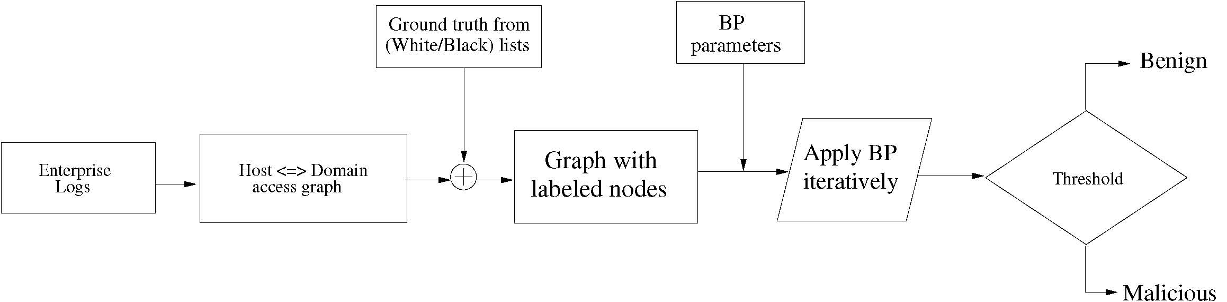
Our approach

Slide 30
Message passing
Message(i → j) ∝ (prior, edge potential, incoming messages)
Prior
Edge potential
Incoming messages

Slide 31
Belief computation
Belief(i) ∝ (prior, incoming messages)
Normalization constant
Prior
Incoming messages

Slide 32
HTTP Proxy logs
Logs from a large enterprise
98 HTTP proxy servers, 7 months of data
1 day’s logs : 1.29 billion events
2.80M nodes and 27.8M edges
Priors from ground truth (1.45% nodes) Edge potential
21.6K known bad domains: 0.99
19.7K known good domains: 0.01
Unknown hosts and domains: 0.5
 | Benign | Malicious
Benign | 0.51 | 0.49
Malicious | 0.49 | 0.51

Slide 33
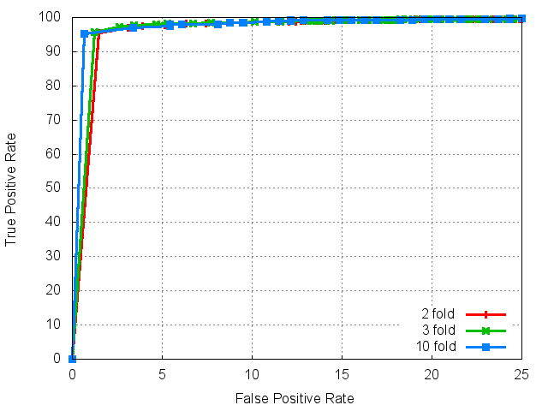
Domain detection ROC plot

Slide 34
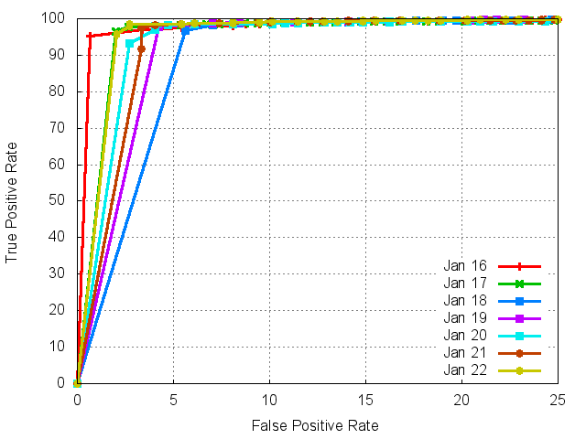
ROC plots for seven days’ data

Slide 35

Beehive [Yen et al., ACSAC13]
Prioritized Alerts
Clustering
Feature extraction
Destination-based
Host- based
Policy- based
Traffic-based
Normalization
Device Timezone Config.
IP-Host Mapping
Host-User Mapping
SIEM

Slide 36
Parting thoughts
A significant Industry problem
Could benefit from academia
Engineering and algorithmic challenges

Slide 37
Thank you
Acknowledgements: Jorge Alzati, Sandeep Bhatt, Stuart Haber, William Horne,
Doron Keller, Prasad Rao, and Loai Zomlot
manadhata@hp.com

