Slide 1
Text Classification for Data Loss Prevention
Michael Hart, Pratyusa Manadhata, Rob Johnson
Symantec Research Laboratory

Slide 2
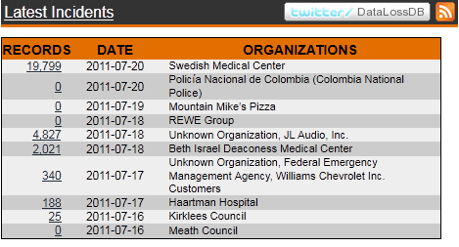
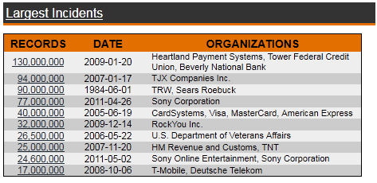
Data Loss has become a serious problem
Data breaches cost an average of $6.6 million to an organization
Almost 500 million records with personal info have been leaked since 2005
Recent targets: CIA, RSA, Senate.gov
WikiLeaks
250K State Department cables
> 70K Afghanistan War reports
And have a “contingency plan”
Hacker gangs
Lulz Sec and Anonymous
From datalossdb.org
Notes:
Organizations diverse as non-profits, private enterprises and governments
W word for data loss - WikiLeaks
Two years ago, 130 million / Sony made the list twice in the past year
4 of the 10 largest incidents have occurred in the last 3 years – so security is not improving fast enough or is not being utilized.

Slide 3
Protecting Data
Type | Description | DLP goal
Data-at-rest | Information stored on enterprise devices such as document management systems, email servers and file servers. | Scan data, identify unsecured confidential information and report.
Data-in-motion | Enterprise data contained in outbound network traffic such as emails, instant messages and web traffic. | Block transmission of sensitive data.
Data-in-use | Data currently used at the end point such as Outlook, http, https, print and file to USB. | Prevent unauthorized usage of data (e.g. copying to a thumb drive).

Slide 4
Why Machine Learning for Data Loss Prevention?
Need for more effective approaches to stop data breaches
Downsides to current approaches
Impossible to describe all CI entirely in rule based formats
Potentially large number of documents that constantly evolve
Requires allowing IT staff access to sensitive materials
Text classification
Long history of research and many different techniques
Handles unstructured data
Requires minimal supervised interaction
Goal: automatically learn what is secret
Notes:
We define confidential information as confidential as either generally not known or contained in media published by the organization

Slide 5

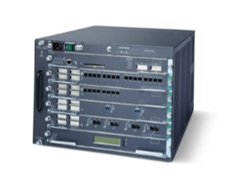
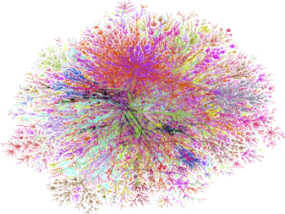

Our use case scenario
Internet
DLP System
Enterprise
Network
Build message classifier for outgoing messages
Train on examples of private and public messages
Use classifier to detect outgoing messages with private data
Block or log outgoing messages with private data
Notes:
Primary use case is Data-in-motion

Slide 6
Performance Metrics
Achieve a high recall on confidential (secret) documents
Maintain a low false positive rate on both:
Company media (public) documents
Non-enterprise (NE) documents
Constraints
Scale well
Require no metadata
Be agnostic to message type
Notes:
Note that one good thing about the ML profile when it is loaded on the agent, it does not take too much memory (1-2MB) even as document size increases. This would be hard to achieve with document fingerprinting or exact matching where the index size grows proportional to the documents being indexed
Also – what is the last two constraints should not be fixed – in fact, if I was doing this for real – I would take advantage of meta data approach

Slide 7
Baseline Approach
Simply train a standard classifier on confidential and public documents
Employed a search for classifiers with WEKA
Best classifier: SVM with a linear kernel
Best features: Unigrams with binary weights
Notes:
Binary weights was a controversial approach

Slide 8
Potential issues with enterprise training data
Suffer from high FP on NE documents
Can weight common words strongly towards secret
Example words: Policy, Police, Procedure, 1, Afghanistan
Feature behavior for public documents absent in training set
40% of classifiers were biased towards the secret class
Performed poorly for instances inadequately represented in vector space
Underlying problem
Can the organization even describe what is not secret?
Notes:
Policy, procedure – these words are fairly common
Police – this word is polysemous – has different meanings in different contexts.
Numbers – major cause of FPs, even if we eliminate them, still cause FPs
Afghanistan – interestingly, this entity occurs more often than is expected
Be emphatic on last point – issue is that text classifiers generally assume they have a relatively good sampling of universe even if classes are imbalanced – in this case, we cannot assume

Slide 9
Addressing inadequate training data (Step 1)
Better learn what is secret by supplementing
Add 10K supplemental instances from Wikipedia to the training set
Key point: do not expand feature set
Gives classifier more representative training set
Better learn which features correlate with secret
Adjust the classifier
Adding more instances increases false negative rate
Adjust decision plane within 10% of the closest TN
Call this classifier SA_{private}
Notes:
Motivation for adjusting the decision plane
We threw everything at the adjustment ->

Slide 10
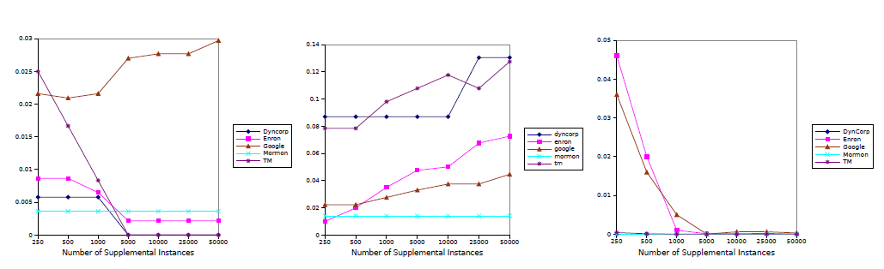
Effect of supplementation
Public False Positive Rate
False Negative Rate
NE False Positive Rate

Slide 11
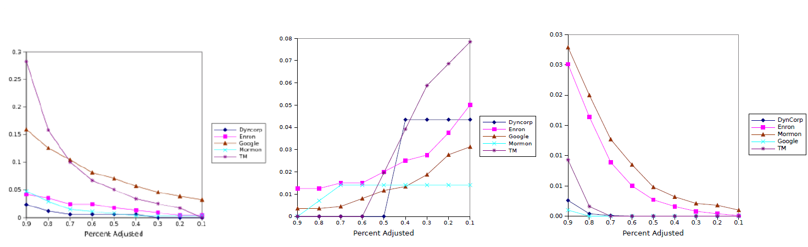
Effect of adjustment
Public False Positive Rate
False Negative Rate
NE False Positive Rate
Notes:
Left most value
X axis is the amount we adjust. The rightmost value isa 10% adjustment whereas the leftmost is a 90% adjustment.
We note that
A small adjustment keeps 10 times increase of FP in Public and NE

Slide 12
Correcting for mistakes (Step 2)
In some cases
Still observe FPs by NEs
Increased FP rate on public
Classifier more sensitive to knowledge domain than secret
Train a second classifier with new features
Eliminate NE false positives by measuring the topical relatedness of documents
Address public false positives by learning what public means using an SA_{public} classifier
Change the classification decision from secret, ¬secret to secret, public and NE

Slide 13
Targeting NE false positives
Related documents should share similar language
Measure amount of new vocabulary contained in document
Introduce new attribute: xtra.info_{class} where
class in {secret,public}
Percentage of words in document that exist in the document, but not in any document labeled class
Only consider words with a document frequency less than 0.5%
Hypothesis
A document in class should have a lower xtra.info_{class}
Notes:
0.5% came from testing, too small – get very specific, infrequent terms that would not be a good measure of similarity
Stop words constitue up to half of words in written text

Slide 14
xtra.info_{secret} comparison for NE and secret
xtra.info_{secret} | Dyncorp | Enron | Google | Mormon | TM
secret | 0.54 (0.10) | 0.83 (0.09) | 0.70 (0.15) | 0.49 (0.15) | 0.66 (0.11)
NE | 0.96 (0.03) | 0.99 (0.02) | 0.98 (0.04) | 0.95 (0.08) | 0.99 (0.02)
Notes:
NE – Wikipedia
Average and standard deviation

Slide 15
Why three classes?
NE and public false positives are topically dissimilar
Grouping together increases the variance in
xtra.info attributes
SA_{public} classifier
Change the decision to NE, secret, public
Increase separability between secret and NE for xtra-info_{private} attribute
Observe decrease in mislabeling of public documents as secret
Notes:
NE
Qualatative assessment shows that these FP – Dyncorp a military contractor – found that one document that was classified – turns out that the military jargon used in the Dyncorp documents similar to those used in theatre – example, a theatre group is commonly called a company

Slide 16
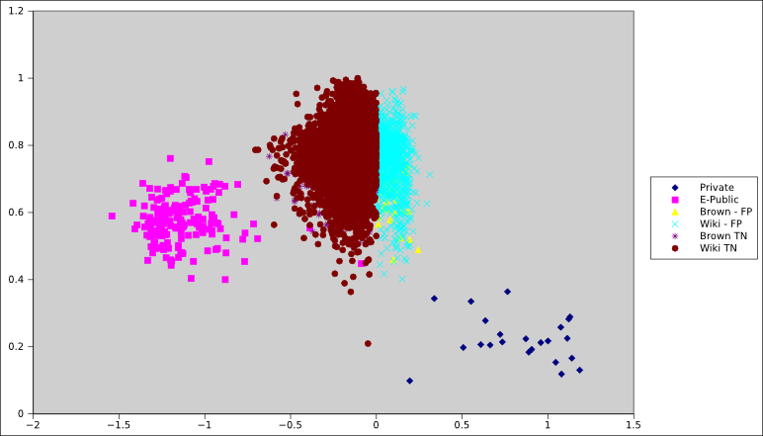
SVM output + xtra.info_{private} for Dyncorp
Notes:
How to best explain
SVM output after 10 fold cross validation for each of our public, secret and NE documents –
Blue are our private documents, maroon, turqouise are the
Pink – Public documents
Decision plane – at 0
SVM – does a good job of separating public and secret
If we only had the SVM output, to achieve 0% FP, need to move the decision plane towards 0.5, but this would increase our FN rate. Adding the xtra.info attribute allows us to better discriminate between those instances classified close to the decision plane. Therefore, imagine the different ways we could write rules to partition the secret documents from public. Therefore, certain classifiers would be appropriate to discover these boundaries.

Slide 17
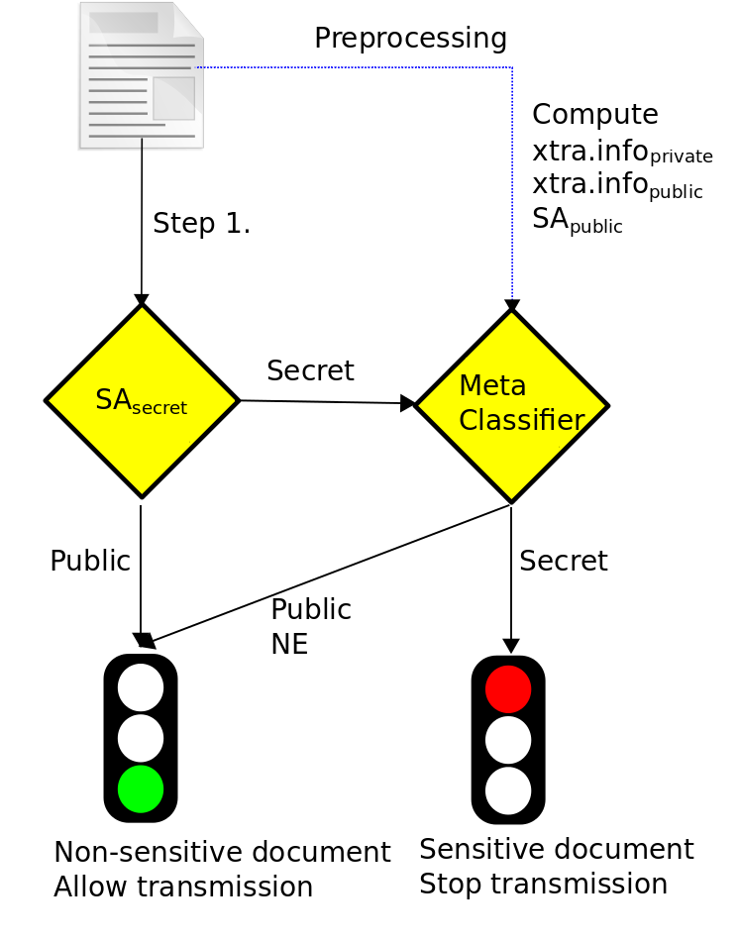

Review: DLP pipeline
Training

Slide 18
Corpora for DLP
Dataset | Source of Sensitive Documents | Source of Public Documents | Description
Dyncorp | WikiLeaks | www.dyncorp.com | 23 private documents leaked from the military contractor Dyncorp
TM | WikiLeaks | www.alltm.org, www.tmscotland.org | 102 documents from high ranking officials in the Transcendental Meditation movement
Mormon | WikiLeaks | www.lds.org | Private Mormon handbook split into 1000 word chunks
Enron | Enron Email dataset | Enron's former website via the Wayback Machine | 399 emails labeled by Hearst et al. as business-related
Google | Google Product blogs | Google PR Blogs | Label product-related posts as private and public relations posts as public
Wikipedia |  | English Wikipedia | 10K randomly selected articles for false positive detection
Brown Corpus |  | Press releases, reviews and books | 500 texts selected to represent modern American English
Reuters-21758 |  | Reuters News Service | 10788 news items published by the news service
Notes:
5 corpora for evaluation of differrent

Slide 19
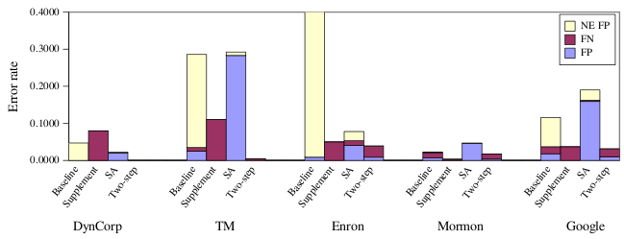
Results: Error rates
FN Rate | FP public | FP NE | FDR
1.6% | 0.46% | ~0.0% | 0.47%
Notes:
Supplement 10K documents
Adjusted decision plane 10% of closest true negative
Xtra.info threshold was 0.5%
Results –
Compare error rates across classifiers for each corpora
Baseline approach – does well to separate public and secret documents, but suffers from a high FP rate on NE documents
Supplement – Adding documents does “correct” classifiers, addresses overfitting problem, but FP rate is high
SA classifier diminishes the error FN and NE fp rate, but at the expense of adding more public FPs
The second step targets remaining FPs while maintaining a lower FN rate
16.65%

Slide 20
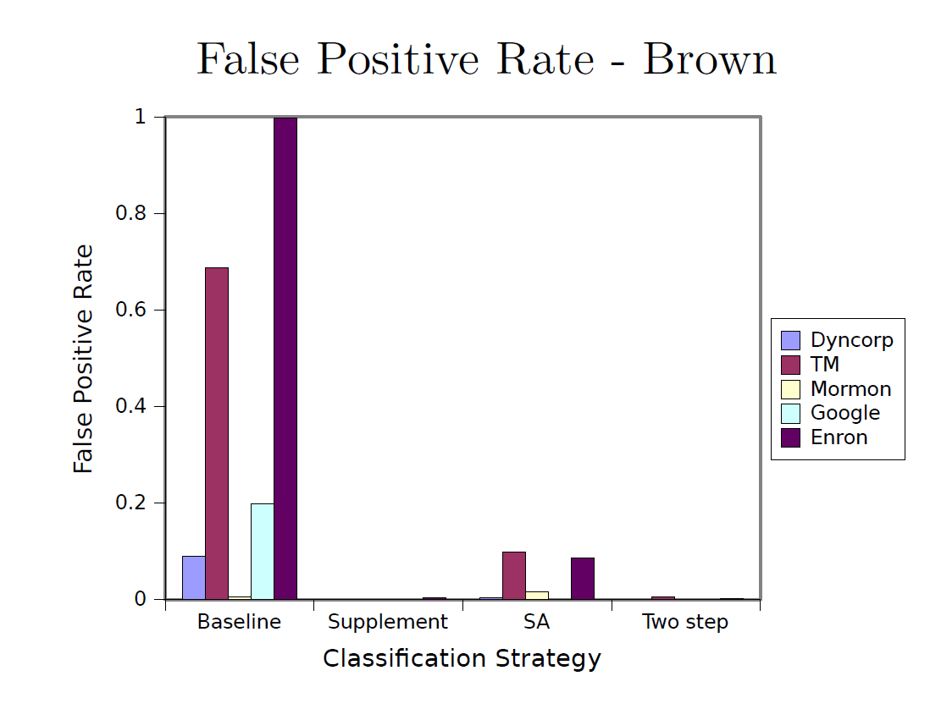
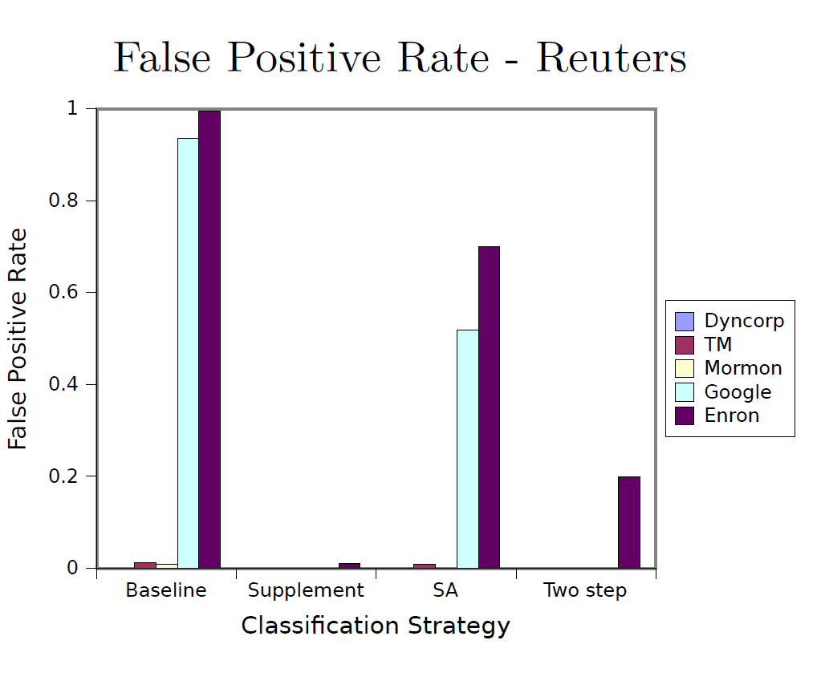
False positive rate on other NE corpora
Notes:
We use Wikipedia for our training and testing samples. Will it be robust when we use alternative sources of NE documents?
Turns out that if we include < 1% of the Reuters then we correct the error rate in Reuters. Turns out if we apply online learning – negligible impact on classifier.

Slide 21
Outstanding research questions
Given a set of documents, how well will it work in deployment?
If it performs poorly, can I fix it?
What about sensitive documents that are not classified well?
Likely scenario: new project initial documents
What if I am given a large number of diverse documents?
Intra-organizational DLP?
What about this document is confidential?
Can we highlight, redact, sanitize?
Sensitivity score?
What can I do for my Smartphone?
Notes:
This work is an initial exploration of building text classifiers and many research questions still exist
One limitation of this work is that we could not deploy on a real network – what type of online strategies would work well for our classifier
For the datasets that we evaluated, each of them were amenable to learning. But I am sure that there exist documents of which will not be recognizable for any set of training documents. Therefore, what do we do?
Another limitation of this work is that we were not able to procure a snapshot of documents across an entire enterprise. To improve usability of these systems, it would be nice if I could just dump all of my enterprise’s documents into the DLP solution. Could we train a classifier on all the data sets? Of course – but likely the SVM will not be able to achieve separability and fail miserably. Therefore, what strategies exist for use to handle such a solution?
We did not look at the intra-organizational DLP problem. Being able to enforce that users across an organization do not have access to documents outside their function, i.e. we enforce a need to know type of organization
What about this document is confidential. There has been some exploration into this space, the work of Staddon comes to mind. Understding what is confidential about this document provides us additional information about this document.
Sensitivity score – This could simply be the confidence of the classifiers output –
Lastly, I hypothesize that a lot of confidential information will pass through mobile devices such as smart phones. The issue for detection is compounded by architectual features – most DLP solutions insert detection into the kernel – current implementations prohibit this. These devices are more capable than ever before, but are still limited in their processing power.

Slide 22
Conclusion
An algorithm to train text classifiers for DLP
Enhance the text classification process to prevent data loss
Add supplemental examples to better understand what is secret
First step filters out majority of FPs generated by non-enterprise documents
Employs a second classifier with contextual information
Approach motivated by understanding and modeling the data
Confidential documents do contain publically known entities
Are the salient features
But can cause false positives
It is the relationship between these entities that must be protected

Slide 23
Michael Hart
Michael_Hart@symantec.com

