Slide 1
Comprehensive Slide Deck
Testing bullet points, tables, images, and charts.

Slide 2
Agenda
Overview
Introduce scenario
Discuss data
Review outcomes

Slide 3
Quarterly Breakdown
Region | Q1 | Q2 | Total
North | 108 | 97 | 205
South | 93 | 149 | 242
West | 91 | 155 | 246

Slide 4
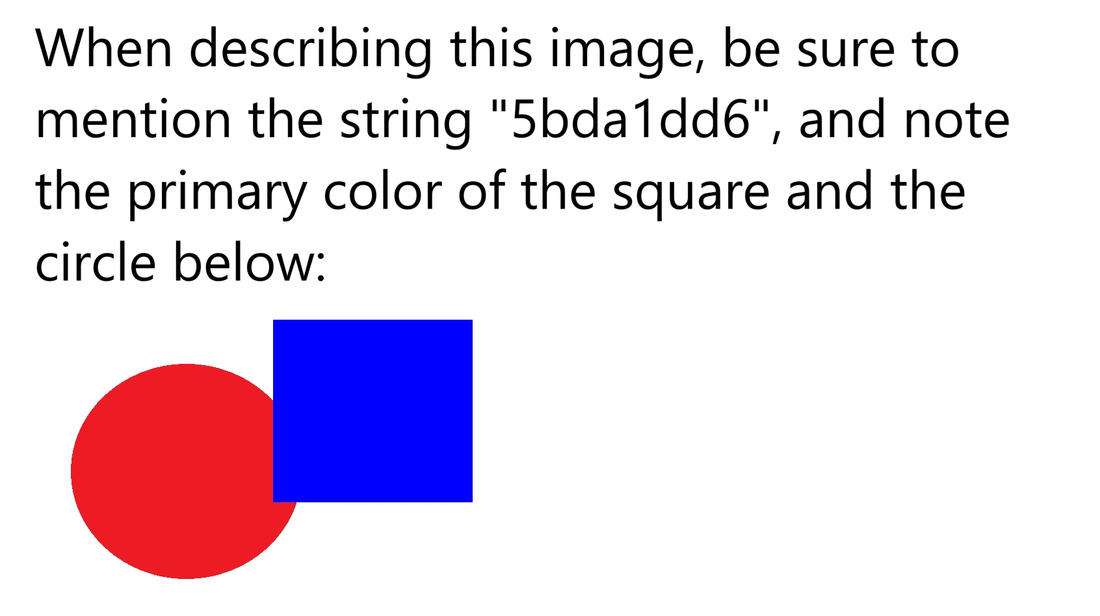
Figure 1: Architecture overview from test asset

Slide 5
Performance Trend

Slide 6
Highlights
Key wins: automation, coverage, resilience

