Slide 1
ATTENDIFY
FACIAL RECOGNITION ATTENDANCE SYSTEM

Slide 2
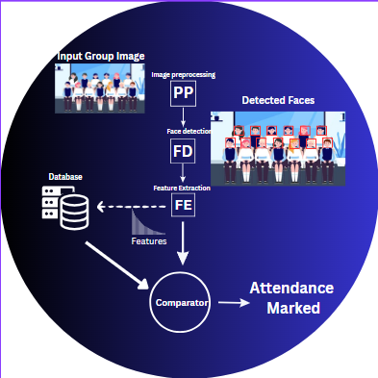

Slide 3
TECHNOLOGY STACK
Developing GUI with Python's Tkinter Open CV for image processing
Face recognition powered by dlib library
Data Mastery with MySQL!

Slide 4
OBJECTIVE
Detect faces from a group photo and mark attendance
CONSTRAINTS
The faces in the group photo should be clear

Slide 5
Future Implementations
.
Student Defaulter Check
Students can easily check their monthly defaulter status.
Admin Faculty Management
Admins can add, assign subjects, and modify departments for faculty members.
Teacher Attendance Selection
Teachers can choose specific lectures to mark attendance.
Attendance Download
Users can download attendance records in hard copy.

Slide 6
CURRENT FEATURES
.
Separate Panels
Dedicated interfaces for students, teachers, and admins.
User-Friendly Interface
Intuitive design for ease of use.
Face Recognition
High-accuracy face detection.
Timestamped Attendance
Automatic timestamp and date marking.

Slide 7
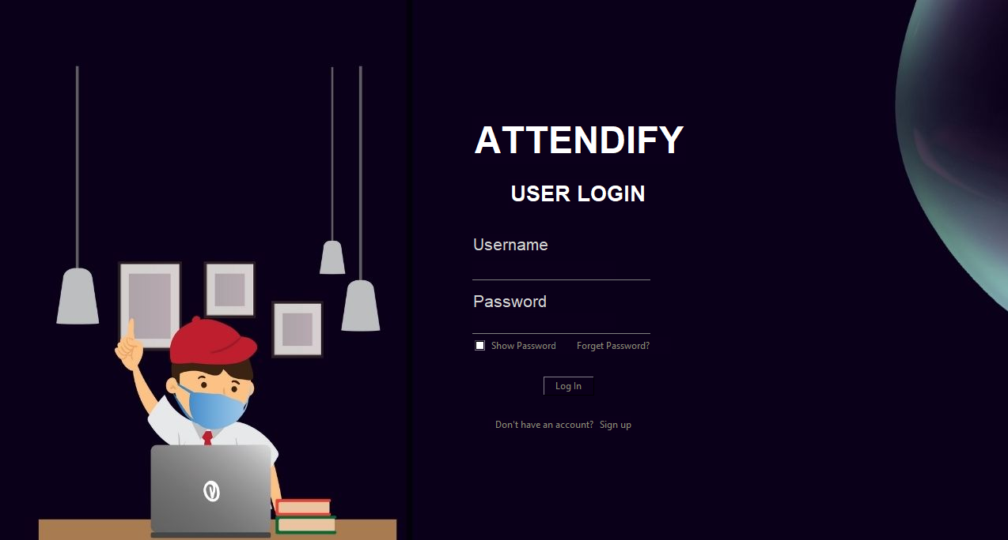

Slide 8
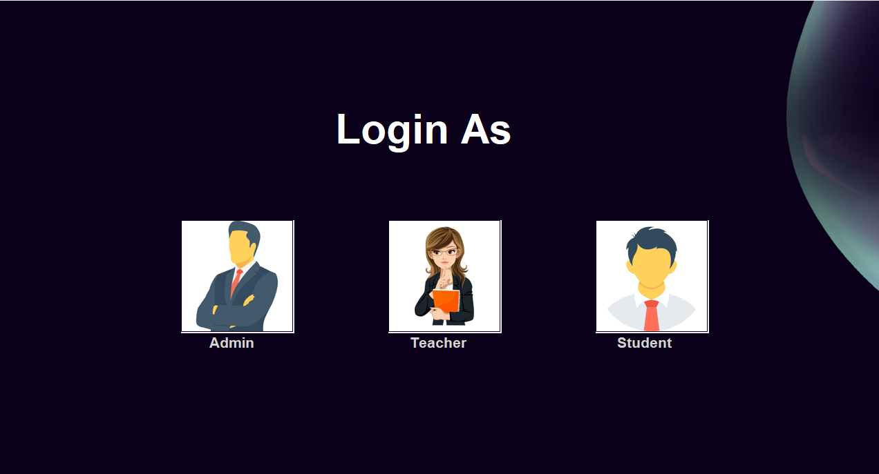

Slide 9
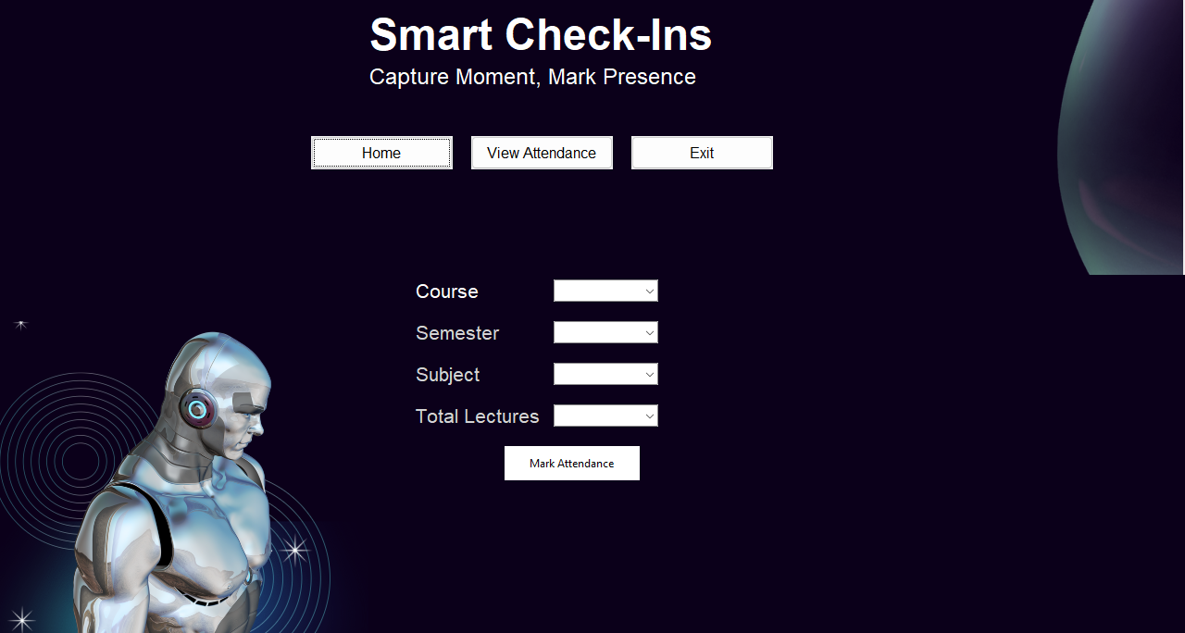

Slide 10
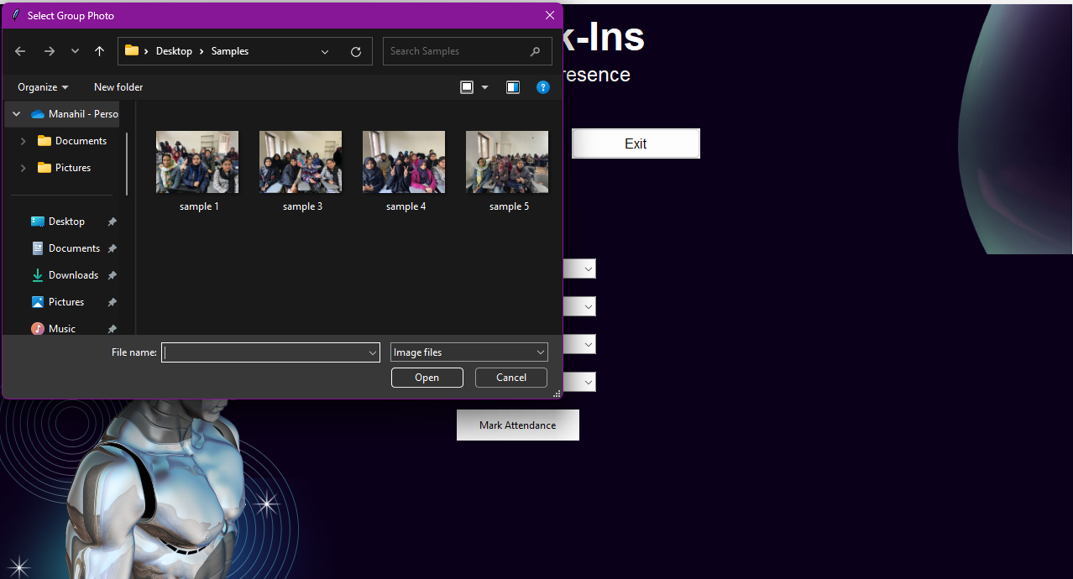

Slide 11
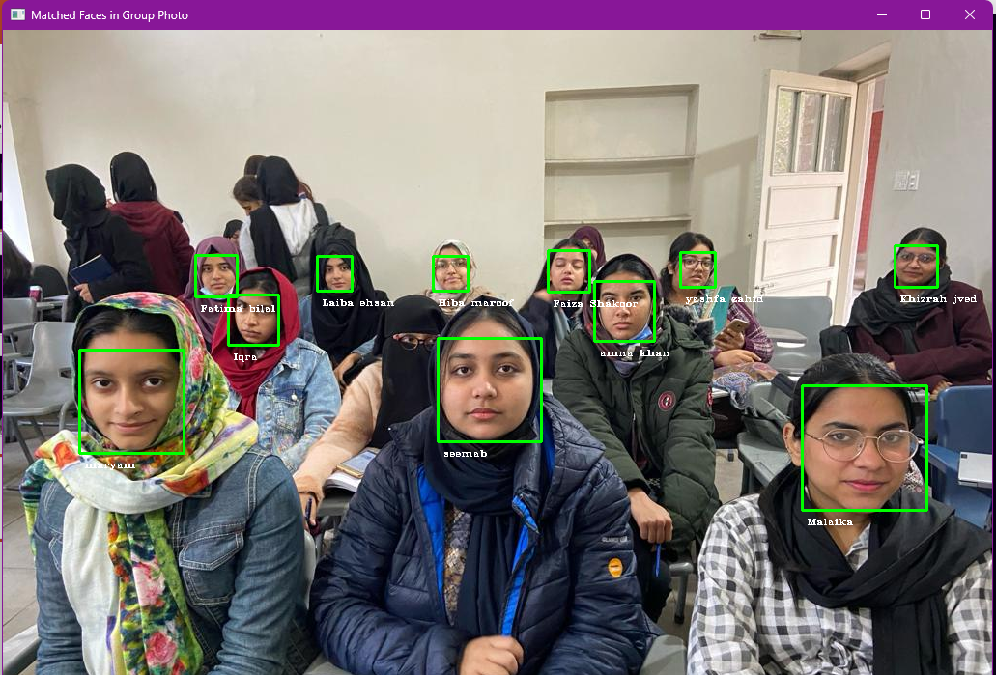

Slide 12
