Slide 1
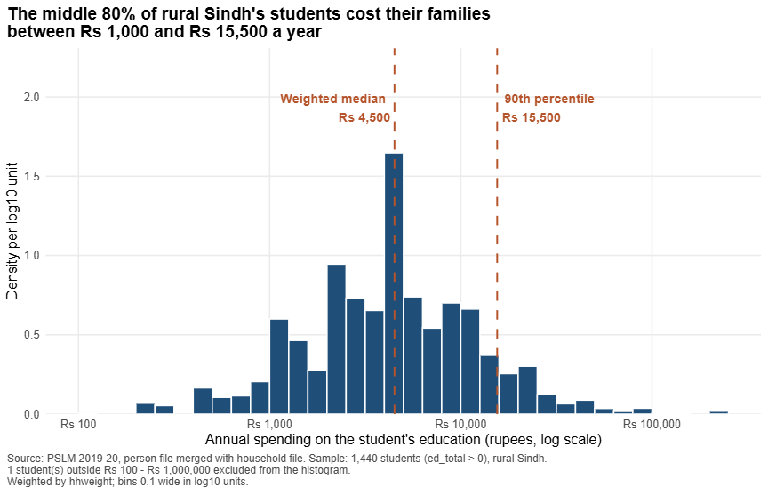
QUESTION 2 | THE DISTRIBUTION
1 / 4
Variant 2 (Sindh rural): spending per student is concentrated in the low thousands of rupees
FA24-BEDS-042 | Section B
42 = 5 × 8 + 2, so variant 2: prov_code 3, urban_rural 1. PSLM 2019-20, weighted by hhweight.
Students | 1,440
Weighted median | Rs 4,500
Unweighted median | Rs 4,295
Weighted 10th percentile | Rs 1,000
Weighted 90th percentile | Rs 15,500
90th / 10th ratio | 15.50
Excluded from histogram | 1
Middle 80% of students spend Rs 1,000 to Rs 15,500 (15.5-fold spread). The weighted median is about 5% above the unweighted: heavily sampled households carry small weights and spend a little less. Weighting corrects this; the gap is small.
Notes:
Q2: 1,440 students; weighted median Rs 4,500, unweighted Rs 4,295; weighted P10 Rs 1,000, P90 Rs 15,500, ratio 15.50; 1 student excluded outside Rs 100 to Rs 1,000,000. Sample: rural Sindh persons with ed_total above zero.

Slide 2
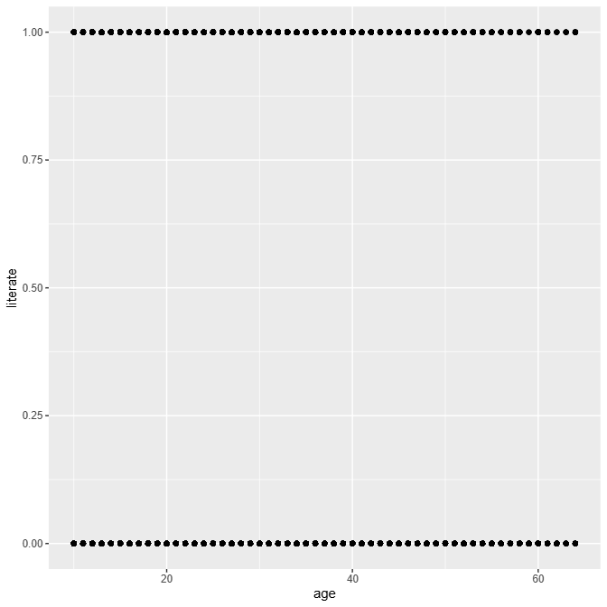
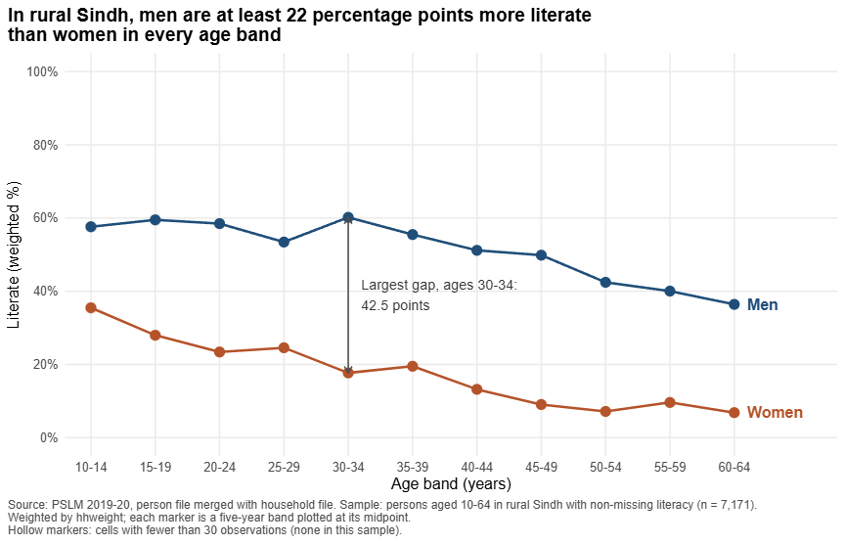
QUESTIONS 3 AND 4 | THE MAKEOVER
2 / 4
From 7,171 overlapping dots to weighted conditional means
DEFAULT: geom_point() only
REDESIGN (Question 3)
Hidden by the redesign
Individual observations and the spread inside each band.
1 Conditional means: weighted E[literate | age] replaces overplotted binary points (overplotting; Cleveland-McGill).
2 Direct labels, no legend (proximity, data-ink).
3 hhweight, hollow thin cells, finding as title (whose distribution).
Notes:
Q4: three changes tied to Chapters 1-4: conditional means and overplotting, Cleveland-McGill, direct labels and data-ink, weights. Default shows individual observations and within-band spread; redesign hides them.

Slide 3
QUESTION 3 | THE FINDING
3 / 4
The gender gap in literacy has barely narrowed: about 30 points among the young and the old
Aged 15-19
Aged 55-59
28.0%
59.5%
9.6%
40.0%
women literate
men literate
women literate
men literate
Gap: 31.5 percentage points
Gap: 30.4 percentage points
Largest gap: ages 30-34, where men lead women by 42.5 points.
One cross-section: older bands are older cohorts, so age and generation are mixed.
Cannot tell us why: school supply and household demand look the same.
Source: PSLM 2019-20, rural Sindh, aged 10-64 (n = 7,171), weighted by hhweight. Band table in README.
Notes:
Women 15-19: 28.0%, men 59.5%, gap 31.5. Women 55-59: 9.6%, men 40.0%, gap 30.4. Largest gap 42.5 at 30-34.

Slide 4
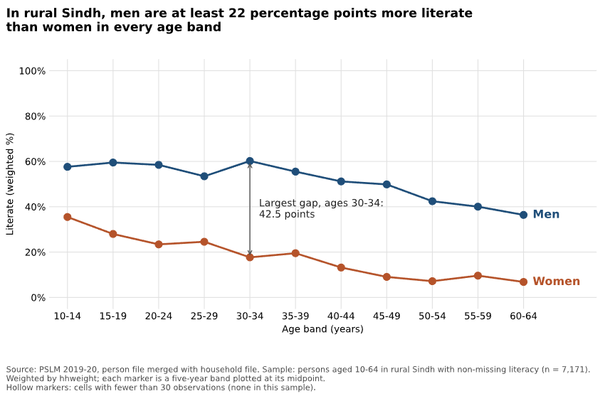
QUESTION 5 | A SECOND LANGUAGE
4 / 4
Python reproduces the R result
28.0%
28.0%
R
Python
Women aged 15-19. The two band tables agree to one decimal place.
A default that differed
ggplot2 pads axis limits by 5%; matplotlib does not. I set ylim(-5, 105) and xlim(10, 70), and built bands with floor(age/5)*5, not cut().
Notes:
Script: scripts/04_second_language.py. It recomputes the band table and compares it with the R table.

