Slide 1
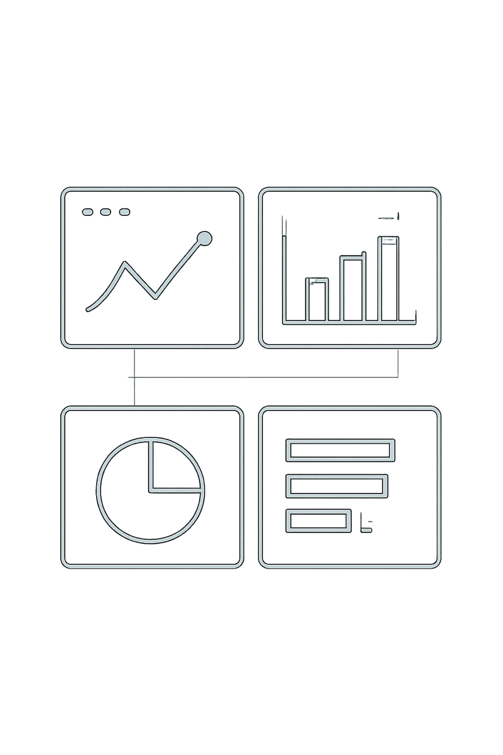
BizSight
Turning Data into Decisions
The Problem: Small businesses, e-commerce sellers, and online stores generate valuable data — but it usually sits in raw Excel or CSV files. Turning that data into meaningful business insights requires technical and analytical skills most business owners don't have.

Slide 2
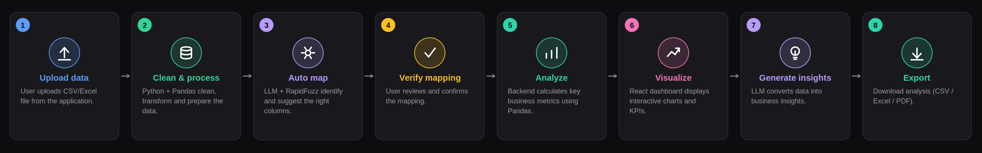
Complete Flow

Slide 3
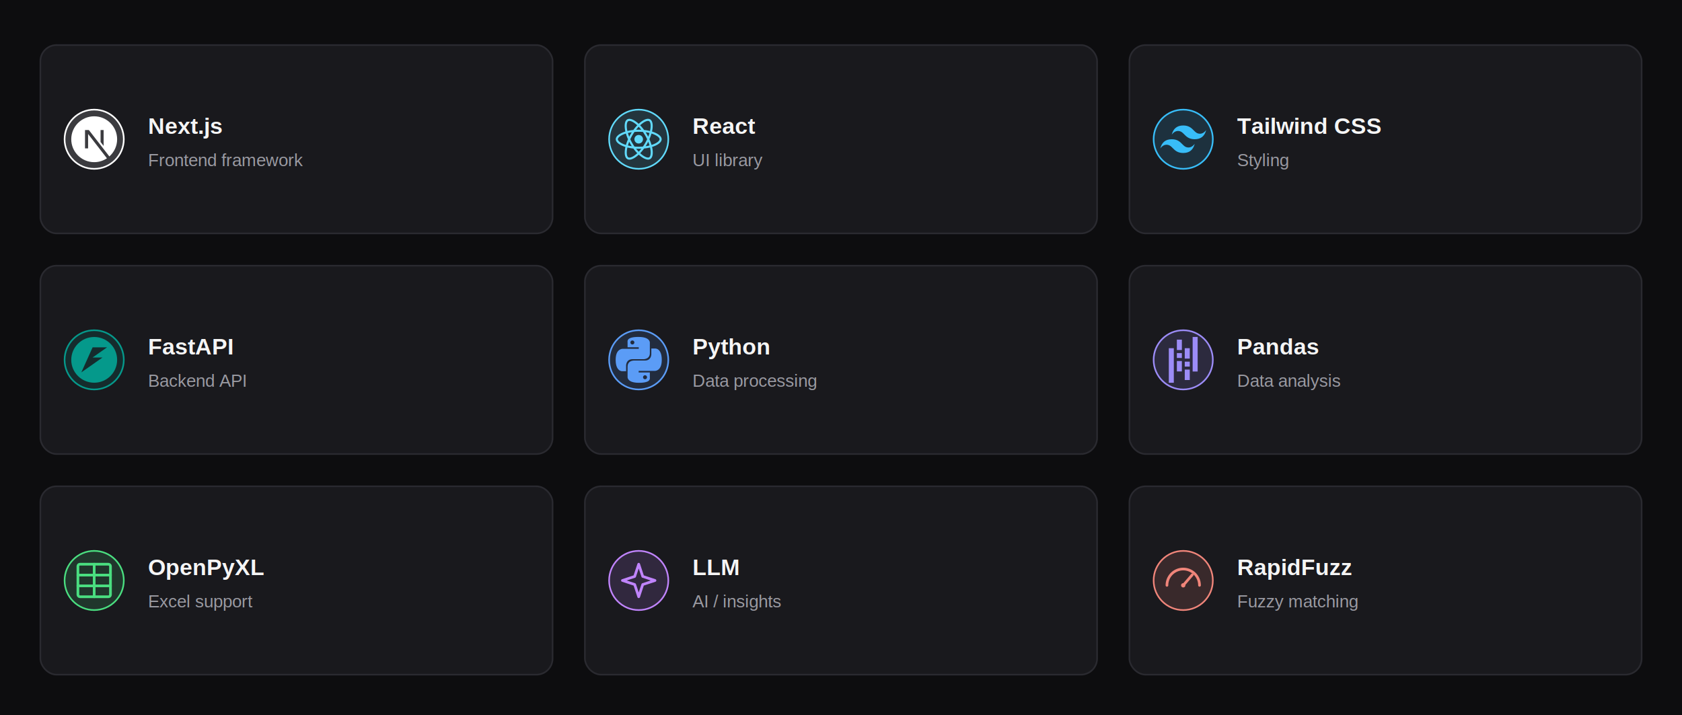
Tech Stack

Slide 4
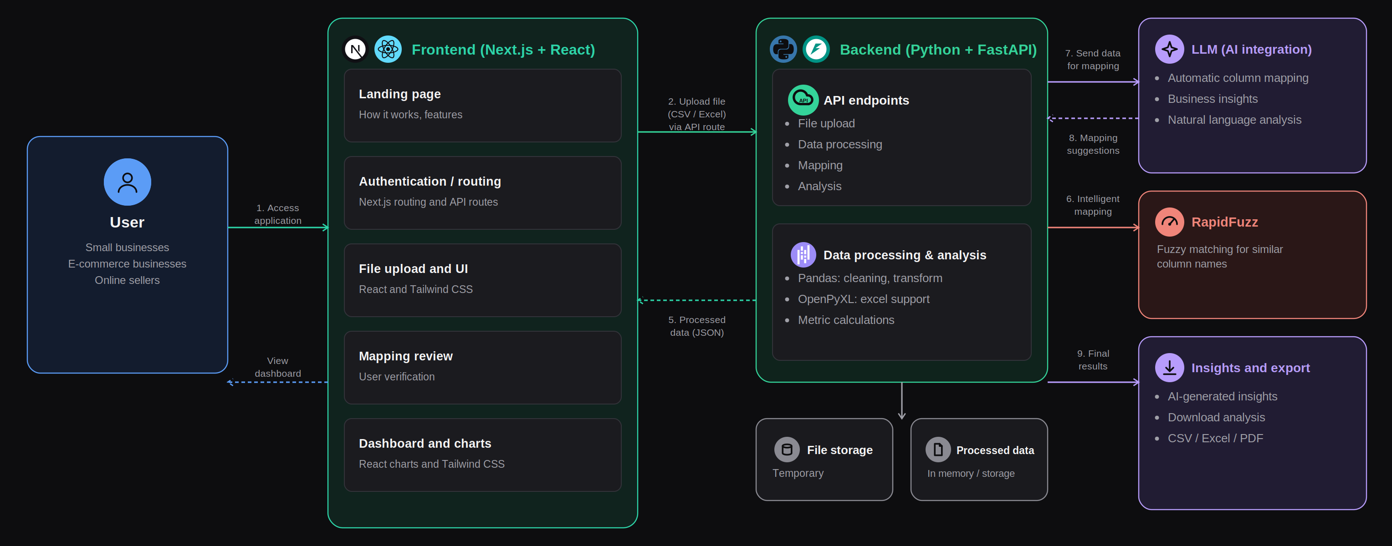
System Architecture

Slide 5

Live Demo
bizzsight.vercel.app

Slide 6
Meet the Team
TEAM MEMBER
ROLE & CONTRIBUTION
MA
Manahil Asif
Team Lead
Prepared the presentation slides and visualizations, and coordinated the project.
Email: manahilasif.017@gmail.com
LinkedIn: linkedin.com/in/manahil-asif-27a906410
WhatsApp: 0337-3192636
AM
Abdul Muqeet
Lead Developer
Built and deployed the complete application — frontend, backend, data processing, and analytics and video presentation..
Email: amuqeet6041@gmail.com
LinkedIn: linkedin.com/in/abdul-muqeet-20250a30b
WhatsApp: 0319-0600415
AT
Areeba Tahir
Live Demo & QA
Tested the application functionalities and flow.
Email: areebatahir696@gmail.com
LinkedIn: linkedin.com/in/areeba-tahir-698658408
WhatsApp: 0301-0062998
FB
Faiza Batool
Research & Documentation
Came up with the original idea and supported content documentation.
Email: fa24-bed-086@cuilahore.edu.pk
LinkedIn: linkedin.com/in/faiza-batool-305754417
WhatsApp: 0311-4641348

