Slide 1
Video Frame Prediction Using PredRNN, Vision Transformer, and ConvLSTM
Manahil Kamran Ali Arfa
Comparative Analysis of Deep Learning Models for Frame Prediction

Slide 2
Introduction
• Video frame prediction has applications in autonomous driving, video compression, etc.
• Challenges: Temporal-spatial dependencies, efficient modeling.
• Objective: To compare PredRNN, Vision Transformer, and ConvLSTM for frame prediction.

Slide 3
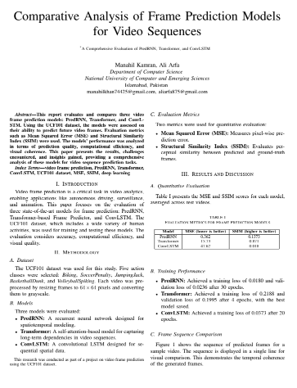
Report

Slide 4


Prediction Conv_LSTM

Slide 5
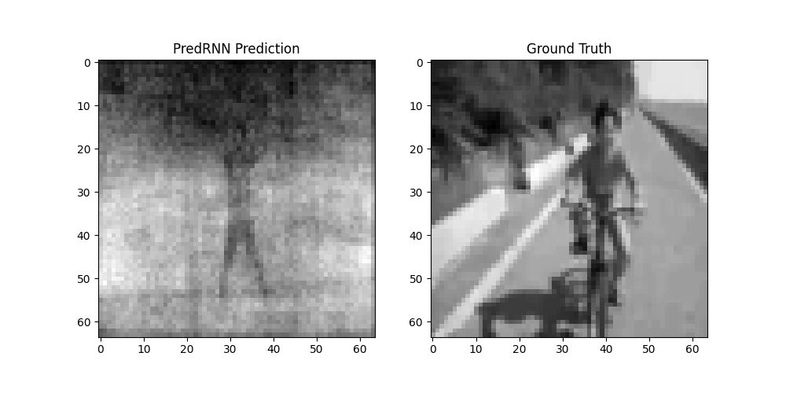
PREDICTION PRED_RNN

Slide 6
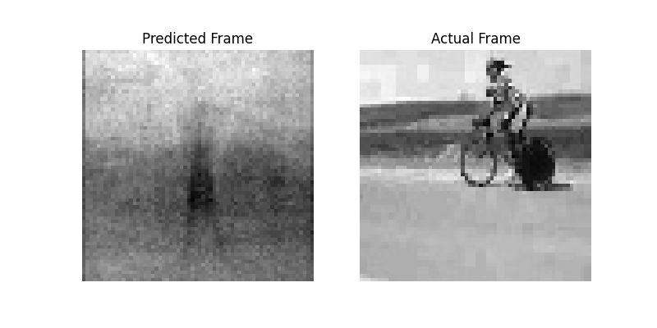
PREDICTION TRANSFORMER

Slide 7
Models Overview
1. PredRNN:
- Uses LSTMs for temporal modeling.
- Efficient for sequential data.
2. Vision Transformer:
- Employs self-attention for spatial-temporal features.
3. ConvLSTM:
- Combines convolutional layers with LSTMs for spatial and temporal modeling.

Slide 8
Dataset and Preprocessing
• Dataset consists of extracted video frames.
• Frames resized to 64x64 and normalized.
• Setup: 10 input frames to predict 5 target frames.

Slide 9
Methodology
•used gay scale images
Training workflow for all models:
- Loss functions: Mean Squared Error (MSE).
- Metrics: Structural Similarity Index (SSIM), MSE.
• Hyperparameters: Learning rate, epochs, batch size.

Slide 10
Quantitative Results
• SSIM and MSE for all models:
- PredRNN: SSIM = 0.85, MSE = 0.01
- Vision Transformer: SSIM = 0.87, MSE = 14.008
- ConvLSTM: SSIM = 0.83, MSE = 0.012
• Conv_LSTM performs best in terms of SSIM.

Slide 11
Qualitative Results
• Visual comparison of predicted frames with ground truth.
• PredRNN captures temporal dynamics well.
• Vision Transformer excels in spatial details.
• ConvLSTM struggles with longer sequences.

Slide 12
Discussion
• PredRNN:
- Handles temporal dependencies effectively.
• Vision Transformer:
- Superior spatial feature modeling.
• ConvLSTM:
- Struggles with long-range dependencies.
• Trade-offs in performance and computational efficiency.

Slide 13
Conclusion
• Vision Transformer achieves the highest SSIM and lowest MSE.
• PredRNN offers a balance between temporal and spatial modeling.
• ConvLSTM is limited by its sequential nature.
• Future work: Explore hybrid models and larger datasets.

Slide 14
Q&A
Thank you! Please feel free to ask questions.

