Slide 1

Data Science Bootcamp
Day 1: Python Fundamentals
Presented by Manahil Mirza
Google Developers Group CUI Wah Campus
Notes:
1

Slide 2
Agenda
What is Data Science?
Data Science Pipeline
Python Basics
Variables & Data Types
Control Flow (Loops & Conditionals)
Functions
Data Structures
Notes:
2

Slide 3
What is Data Science?
Data science is an interdisciplinary field that extracts actionable insights, patterns, and knowledge from structured and unstructured data to inform decision-making.
Goal:
To answer questions about:
what happened
why it happened
what will happen
how to optimize results.
Interdisciplinary field as it combines techniques:
Computer Science
Maths and Statistics
Domain Knowledge
Notes:
3

Slide 4
Data Science Pipeline
Data
Collection
Data
Cleaning
EDA
Modeling
& Evaluation
Deployment
Data Science Roadmap
YouTube
YouTube
Notes:
4

Slide 5
Why Python for Data Science?
Easy to Learn
Rich Ecosystem
Simple, readable syntax perfect for beginners
NumPy, Pandas, Matplotlib, Scikit-learn, TensorFlow
Community Support
Versatile
Large community, extensive documentation
Web dev, automation, AI/ML, data analysis
Notes:
5

Slide 6
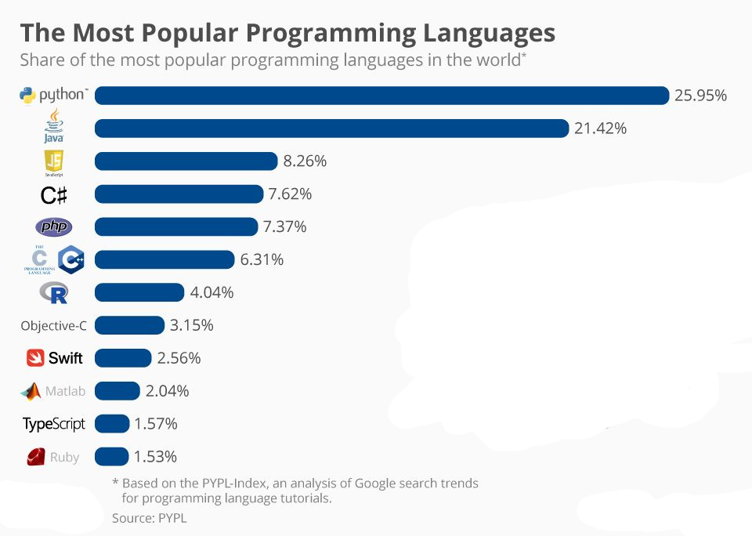

Slide 7
Python Basics - Getting Started
Key Points:
# Your first Python program
print("Hello, World!")
# Python is case-sensitive
name = "Alice"
print
(f"Hello, {name}!")
Python uses indentation for code blocks
No semicolons needed at line ends
Use # for comments
print() function displays output
f-string:
Without f-string: print("Hello, " + name + "! You're " + str(age) + " years old.")
With f-string: print(f"Hello, {name}! You're {age} years old.")
Notes:
6

Slide 8




Rules For Naming Variable
✔ ✔ ✔ ✔
A variable name must start with a letter or the underscore character _ There must be no white space in a variable name A variable name cannot start with a number A variable name can only contain characters (A-Z, a-z, 0-9, and _ ). No special
characters are allowed i.e. @icode , Python$ are the invalid variables.
Variable names are case-sensitive (age, Age and AGE are three different variables)
Keywords cannot be used as variable names.
✔
✔

Slide 9
Variables & Data Types
Integer
Float
age = 25
price = 19.99
String
Boolean
name = "Alice"
is_student = True
Notes:
7

Slide 10
Python Operators
Arithmetic
Comparison
Logical
+ (add)
- (subtract)
* (multiply)
/ (divide)
// (floor divide)
** (power)
== (equal)
!= (not equal)
> (greater)
< (less)
>= (greater/equal)
<= (less/equal)
and
or
not
x = 5
x > 0 and x < 10
Notes:
8

Slide 11
Quick Test
Q: What will be the output?
accuracy = 0.876
print(f"Accuracy: {accuracy:.2%}")
A) Accuracy: 0.88
B) Accuracy: 87.60%
C) Accuracy: 87%
D) Accuracy: 0.876%

Slide 12
Quick Test
Q: What will be the output?
accuracy = 0.876
print(f"Accuracy: {accuracy:.2%}")
A) Accuracy: 0.88
B) Accuracy: 87.60%
C) Accuracy: 87%
D) Accuracy: 0.876%

Slide 13
Quick Test
Q: Which data type would you use to store whether a student passed or failed?
A) int
B) str
C) bool
D) float

Slide 14
Quick Test
Q: Which data type would you use to store whether a student passed or failed?
A) int
B) str
C) bool
D) float

Slide 15
Quick Test
Q:What will this print?
x = "5"
y = 2
print(x * y)
A) 10
B) 7
C) 55
D) Error

Slide 16
Quick Test
Q:What will this print?
x = "5"
y = 2
print(x * y)
A) 10
B) 7
C) 55
D) Error

Slide 17
Conditional Statements
age = 18
if age >= 18:
print("You can vote!")
elif age >= 16:
print("You can drive!")
else:
print("Too young!")
Structure:
if: Checks first condition
elif: Additional conditions
else: Default case
Note: Indentation matters!
Notes:
9

Slide 18
Conditional Statements
age = 18
if age >= 18:
print("You can vote!")
elif age >= 16:
print("You can drive!")
else:
print("Too young!")
If-Statements take a condition and only runs a block of code if the condition evaluates to True.
Elif-Statements take a condition and only tests it if the prior
If-Statement (and all prior Elif-Statements) evaluate to False.
Else-Statements take no condition and runs a block of code if the prior If-Statement (and Elif-Statements, if there are any) evaluate to False.
Notes:
9

Slide 19
Loops - For Loop
# Iterate over a range
for i in range(5):
print(i)
# Iterate over a list
fruits = ["apple", "banana"]
for fruit in fruits:
print(fruit)
Use For Loops When:
You know the number of iterations
Iterating over sequences (lists, strings, ranges)
Processing each item in a collection
Notes:
10

Slide 20
Quick Test
Q: How many times does this loop run?
for i in range(2, 8, 2):
print(i)
A) 6 times
B) 4 times
C) 3 times
D) 2 times

Slide 21
Quick Test
Q: How many times does this loop run?
for i in range(2, 8, 2):
print(i)
A) 6 times
B) 4 times
C) 3 times
D) 2 times

Slide 22
Loops - While Loop
# Count down from 5
count = 5
while count > 0:
print(count)
count -= 1
print("Blast off!")
Use While Loops When:
Number of iterations is unknown
Loop depends on a condition
Need to repeat until condition is met
Caution: Avoid infinite loops!
Notes:
11

Slide 23
Quick Test
Q: What will this print?
count = 1
while count <= 4:
print(count)
count += 1
A) 1 2 3 4 5
B) 1 2 3 4
C) 0 1 2 3 4
D) Infinite loop

Slide 24
Quick Test
Q: What will this print?
count = 1
while count <= 4:
print(count)
count += 1
A) 1 2 3 4 5
B) 1 2 3 4
C) 0 1 2 3 4
D) Infinite loop

Slide 25
Functions
# Define a function
def greet(name):
return f"Hello, {name}!"
# Call the function
message = greet("Alice")
print(message)
Why Use Functions?
Reusable code blocks
Better organization
Easier to debug and test
Make code more readable
Notes:
12

Slide 26
Quick Test
Q — What will be output?
def greet(name):
print(f"Hello {name}!")
result = greet("Ali")
print(result)
A) Hello Ali!
B) Hello Ali! then None
C) None
D) Error

Slide 27
Quick Test
Q — What will be output?
def greet(name):
print(f"Hello {name}!")
result = greet("Ali")
print(result)
A) Hello Ali!
B) Hello Ali! then None
C) None
D) Error

Slide 28
Quick Test
Q2 — What will be the output?
def double(n):
return n * 2
print(double(double(3)))
A) 6
B) 9
C) 12
D) Error

Slide 29
Quick Test
Q2 — What will be the output?
def double(n):
return n * 2
print(double(double(3)))
A) 6
B) 9
C) 12
D) Error

Slide 30

Data Structures: Lists
List
[]
List (Mutable)
Ordered, Changeable, Allows Duplicates
It is used to store multiple Items in a single variable
# Create a list
fruits = ["apple", "banana"]
fruits.append("orange")
print(fruits[0])
Notes:
13

Slide 31
Quick Test
Q3: What is the output?
data = [10, 20, 30, 40, 50]
print(data[1:4])
A) [10, 20, 30]
B) [20, 30, 40]
C) [20, 30, 40, 50]
D) [10, 20, 30, 40]

Slide 32
Quick Test
Q3: What is the output?
data = [10, 20, 30, 40, 50]
print(data[1:4])
A) [10, 20, 30]
B) [20, 30, 40]
C) [20, 30, 40, 50]
D) [10, 20, 30, 40]

Slide 33
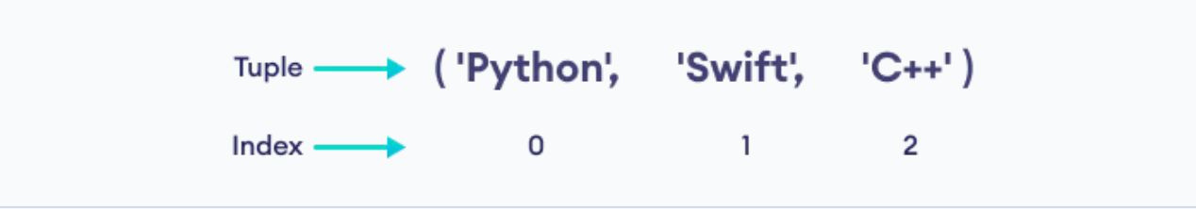
Data Structures: Tuples
Tuple ( )
Tuple (Immutable)
Ordered, UNCHANGEABLE, Allows Duplicates
A tuple is a collection similar to List. The primary difference is that we cannot modify a tuple once it is created.
# Create a tuple
point = (10, 20)
x, y = point
# Cannot modify:
# point[0] = 15 # Error!
Notes:
13

Slide 34
Quick Test
Q: What will this print?
student = ("Ali", 21, "CS",3.7)
print(student[1])
student[1] = 22
A) 21
B) 22
C) 21 then Error
D) Error

Slide 35
Quick Test
Q: What will this print?
student = ("Ali", 21, "CS",3.7)
print(student[1])
student[1] = 22
A) 21
B) 22
C) 21 then Error
D) Error

Slide 36
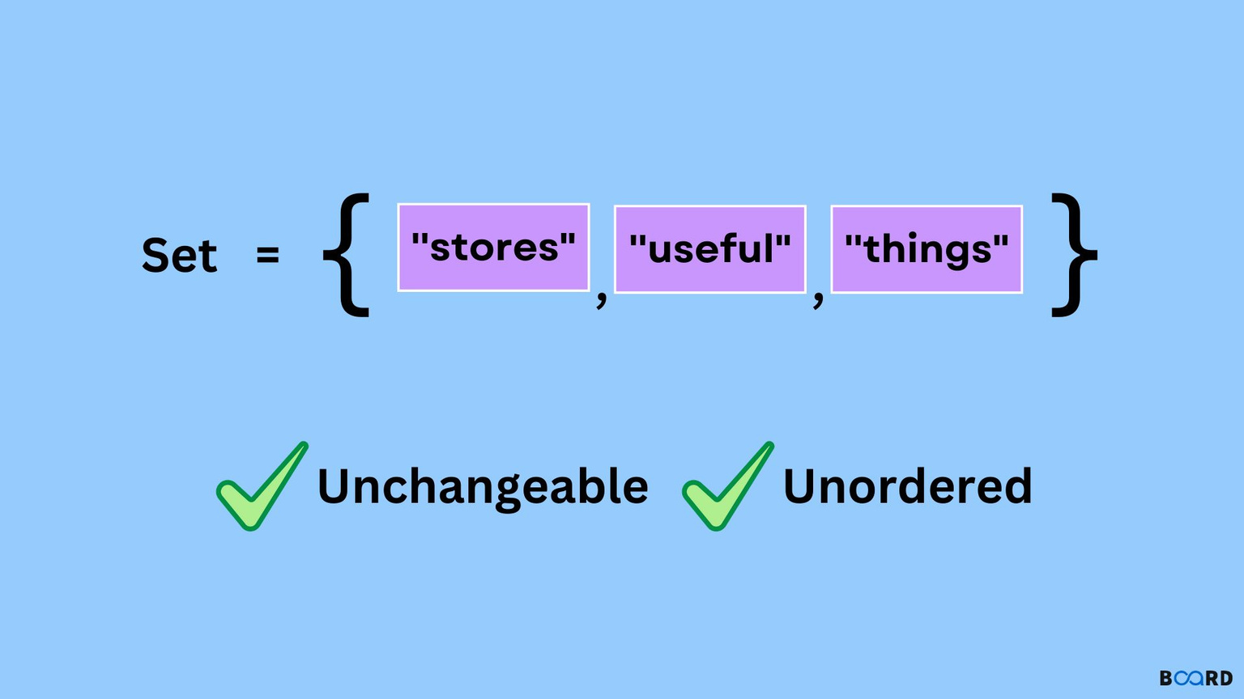
Data Structures: Sets
Sets (Unique Values)
Sets (Unique Values)
Unordered, NO DUPLICATES
A set is a collection of unique data, meaning that elements within a set cannot be duplicated. Cannot Use Indexes to fetch items.
# Create a set
numbers = {1, 2, 3, 2}
print(numbers) # {1, 2, 3}
numbers.add(4)
Notes:
14

Slide 37
Quick Test
Q: You have a column of 500 city names with lots of repetition. Which data structure gives you only unique cities instantly?
A) List
B) Tuple
C) Set
D) Dictionary

Slide 38
Quick Test
Q: You have a column of 500 city names with lots of repetition. Which data structure gives you only unique cities instantly?
A) List
B) Tuple
C) Set
D) Dictionary

Slide 39
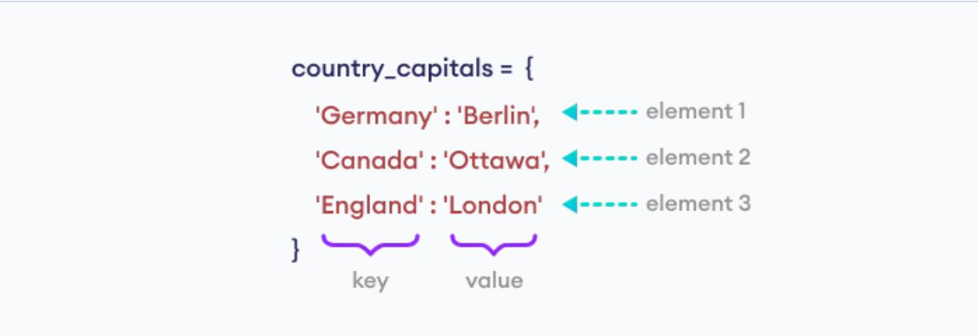
Data Structures: Dictionaries
Dictionaries (Key-Value)
Dictionaries (Key-Value)
Key-Value Pairs, Like a Labelled Dataset
A Dictionary is a key-value pair (consisting of a key and a value)
Keys are always unique.
student = {
"name": "Alice",
"age": 20
}
print(student["name"])
Notes:
14

Slide 40
Quick Test
Q: What will this print?
student = { "name": "Sara",
"age": 20,
"age": 21}
print(student["age"])
A) 20
B) 21
C) [20, 21]
D) Error

Slide 41
Quick Test
Q: What will this print?
student = { "name": "Sara",
"age": 20,
"age": 21}
print(student["age"])
A) 20
B) 21
C) [20, 21]
D) Error

