Slide 1

Data Science Bootcamp
Day 4: Feature Engineering
Presented By Manahil Mirza
Google Developers Group CUI Wah
Notes:
1

Slide 2
Agenda
What is Feature Engineering?
Encoding Categorical Features
What is Feature Scaling?
What is Feature Extraction?
Handling Imbalanced Data
Train/Test Split
Sklearn Pipeline
Notes:
2

Slide 3
What Is Need Of Feature Engineering?
Data Scientist A
Data Scientist B
Uses advanced models:
Random Forest
XGBoost
Deep Neural Network
But uses raw data without feature engineering.
Uses simple model
Linear Regression
but performs:
Encoding
Scaling
Feature extraction
Who’s gonna get better accuracy?
Notes:
3

Slide 4
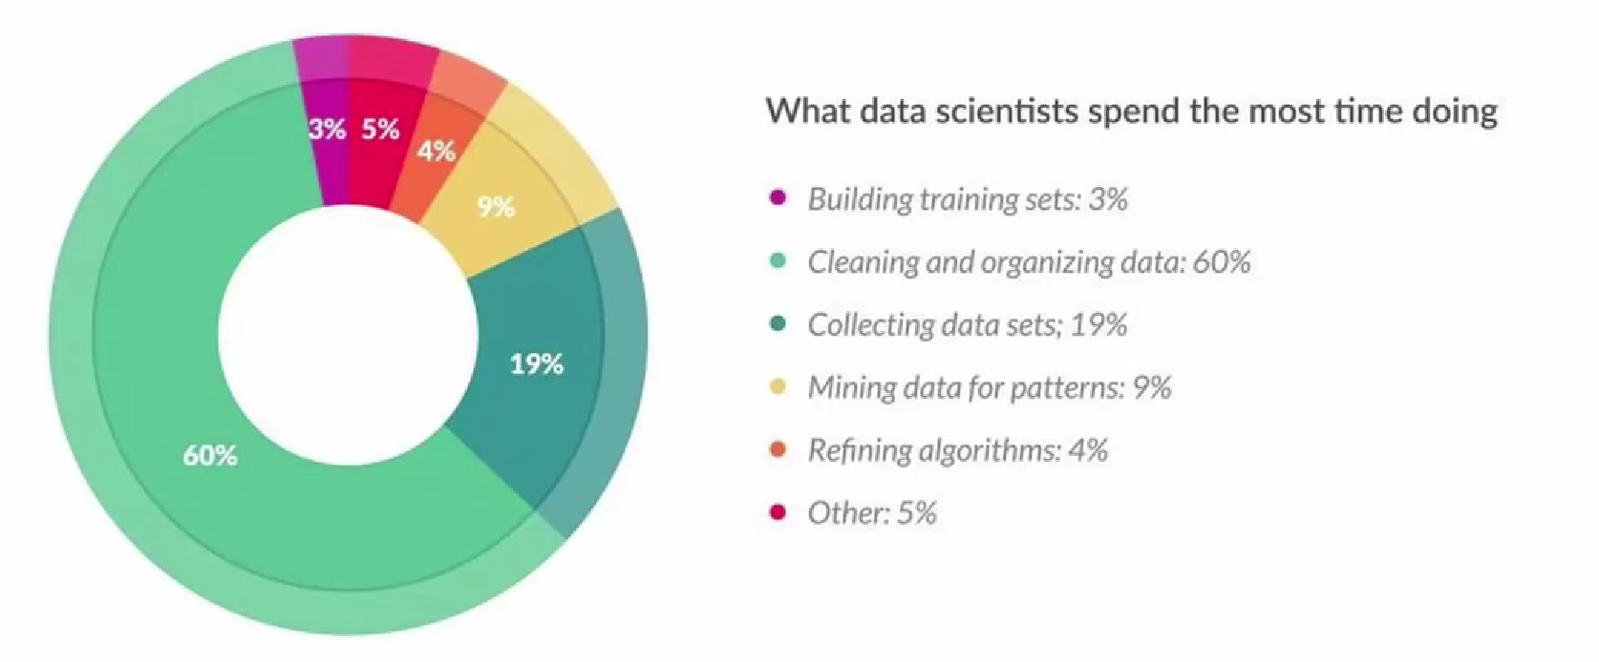

Slide 5
What is Feature Engineering?
Feature engineering is the process of using domain knowledge to select, transform, and create new variables (features) from raw data to enhance the performance, accuracy, and interpretability of machine learning models.
Raw data:
Date: 2026-03-14
Engineered features:
Day = Saturday
Month = March
Weekend = True
Quarter = Q1
Notes:
3

Slide 6
What is Feature Engineering?
What is Feature?
a measurable, individual property or characteristic of the data used as input for a model to make predictions. , typically represented as a column in a dataset
Education Level Ordinal
City Nominal
Salary Continous
IsStudent Boolean
JoinDate Date
Types of Features in Data
Numerical
Continous
Discrete
Categorical
Nominal
Ordinal
Notes:
3

Slide 7
What is Missing Value?
absence of data for a specific variable in an observation, caused by human error, sensor failures, or skipped surveys
Types Of Missing Values
Handle Missing Values
Drop Rows
Drop Columns
Mean Imputation
Median Imputation
Mode Imputation
Forward Fill
ML-Based Imputation
MCAR
MAR
MNAR
Notes:
3

Slide 8
Encoding Categorical Features
Encoding in Machine Learning converts categorical, textual, or non-numerical data into numerical formats (vectors/integers) that algorithms can process
Key Encoding Techniques
Label Encoding
One-Hot Encoding
Ordinal Encoding
Notes:
3

Slide 9
Key Encoding Techniques
Label Encoding
Label Encoding replaces each unique category with a whole number.
Label Encoding assigns a number to each category alphabetically.
from sklearn.preprocessing
import LabelEncoder
le = LabelEncoder()
df['Education_Encoded'] =
le.fit_transform
(df['Education'])
print(df)
Notes:
3

Slide 10
Key Encoding Techniques
Ordinal Encoding
Ordinal Encoding is similar to Label Encoding but specifically designed for ordered categories.
Ordinal Encoding let us decide the order.
from sklearn.preprocessing import OrdinalEncoder
encoder = OrdinalEncoder(categories=[['Matric', 'Bachelors', 'Masters', 'PhD']])
df['Education_Encoded'] = encoder.fit_transform(df[['Education']])
print(df)
Notes:
3

Slide 11
Key Encoding Techniques
One Hot Encoding
Creates binary columns for each category; ideal when no ordering exists among categories (nominal data)
One column per category
it can create many columns, leading to high dimensionality
Always use drop_first=True
df_encoded = pd.get_dummies(df, columns=['City', 'Gender'], drop_first=True)
print("\nAfter One-Hot Encoding:")
print(df_encoded)
Notes:
3

Slide 12
What is Feature Scaling?
is a crucial data preprocessing technique in machine learning that transforms numerical features to a common, standard range
Why it is needed
Machine learning algorithms like KNN, SVM, and Neural Networks calculate distances between data points or use gradient descent. If one feature ranges from 0–1 and another from 0–1,000,000, the model will disproportionately weigh the latter, leading to biased results
.
Notes:
3

Slide 13
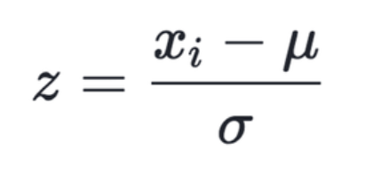
Types of Feature Scaling
Standardization (Z-Score Scaling)
Standardization transforms data so that:
Mean = 0
Standard Deviation = 1
Formula:
Where:
x = original value
μ = mean
σ = standard deviation
fromsklearn.preprocessing import StandardScaler
scaler = StandardScaler()
df[['Age', 'Salary']] = scaler.fit_transform(
df[['Age', 'Salary']]
)
print(df[['Age', 'Salary']].round(2))
Notes:
3

Slide 14

Types of Feature Scaling
MinMax Scaling
MinMaxScaler squeezes all values between 0 and 1. The minimum value becomes 0, the maximum becomes 1, everything else falls proportionally in between.
Formula:
fromsklearn.preprocessing import MinMaxScaler
mm_scaler = MinMaxScaler()
df[['Age', 'Salary']] = mm_scaler.fit_transform(
df[['Age', 'Salary']]
)
print(df[['Age', 'Salary']].round(2))
Notes:
3

Slide 15
What is Feature Extraction?
is a machine learning preprocessing technique that transforms raw, high-dimensional data (like images, audio, or text) into a smaller, more informative set of numerical features
Three main ways
Type 1 — Extract from Dates
Type 2 — Create categories from numbers
Type 3 — Combine columns
Notes:
3

Slide 16
Types of Feature Extraction
Type 1: Extracting from dates
import datetime
df['DOB'] = pd.to_datetime(df['DOB'])
current_year = datetime.datetime.now().year
df['Age'] = current_year - df['DOB'].dt.year
print(df[['Name', 'Age']])
Notes:
3

Slide 17
Types of Feature Extraction
Type 2 : Create categories from numbers
df['Age_Group'] = pd.cut(
df['Age'],
bins=[0, 25, 40, 60],
labels=['Young', 'Mid-Career', 'Senior']
)
print(df[['Name', 'Age', 'Age_Group']])
Notes:
3

Slide 18
Types of Feature Extraction
Type 3 : Combine columns
df['Total_Spend'] = df['Price'] * df['Quantity']
print(df[['Name', 'Price', 'Quantity', 'Total_Spend']])
Notes:
3

Slide 19
Handling Imbalanced Data
Balanced Dataset Imbalanced Dataset
────────────────── ──────────────────
Class 0 → 500 rows Class 0 → 950 rows
Class 1 → 500 rows Class 1 → 50 rows
50% vs 50% 95% vs 5%
Model predicts Class 0 for everything
Accuracy = 950/1000 = 95%
Looks great — but completely useless
Notes:
3

Slide 20
Train–Test Split
Train–Test Split is a technique used in Machine Learning to divide the dataset into two parts:
Training Set → Used to train the model
Testing Set → Used to evaluate the model performance on unseen data
The goal is to check how well the model generalizes to new data.
Example:
Dataset size = 1000 samples
Training data = 800 samples (80%)
Testing data = 200 samples (20%)
Notes:
3

Slide 21
Scikit Learn
sklearn.preprocessingr
sklearn.model_selection
StandardScaler, OrdinalEncoder, OneHotEncode, SimpleImputer
train_test_split, cross_val_score ,GridSearchCV, RandomizedSearchCV
sklearn.linear_model
sklearn.metrics
LogisticRegression, LinearRegression
accuracy_score, precision, recall, mean_squared_error, and r2_score
Notes:
5

Slide 22
Scikit Learn Pipeline
Features & Target
x = df[['Age', 'Salary', 'Education', 'City']]
y = df['Purchased']
print("Features (X):")
print(x.to_string())
print("\nTarget (y):")
print(y.to_string())
Notes:
3

Slide 23
Scikit Learn Pipeline
Train Test Split
x_train, x_test, y_train, y_test = train_test_split(
x, y,
test_size=0.2,
random_state=42
)
print(f"Training rows : {len(x_train)}")
print(f"Testing rows : {len(x_test)}")
print(len(x_train))
print(len(x_test))
Notes:
3

Slide 24
Scikit Learn Pipeline
Columns Group
numerical_cols = ['Age', 'Salary']
ordinal_cols = ['Education']
nominal_cols = ['City']
Notes:
3

Slide 25
Scikit Learn Pipeline
Build the ColumnTransformer
preprocessor = ColumnTransformer(transformers=[
('scale', StandardScaler(), numerical_cols),
('ordinal', OrdinalEncoder(categories=[
['Matric', 'Bachelors', 'Masters', 'PhD'] ]),
ordinal_cols),
('onehot',
OneHotEncoder(drop='first'),
nominal_cols)
])
Notes:
3

Slide 26
Scikit Learn Pipeline
Build the Pipeline
pipeline = Pipeline(steps=[
('preprocessor', preprocessor),
])
print("Pipeline created successfully!")
print(pipeline)
Notes:
3

Slide 27
Scikit Learn Pipeline
Fit & Transformer
x_train_transformed = pipeline.fit_transform(x_train)
x_test_transformed = pipeline.transform(x_test)
print("X_train after Pipeline:")
print(x_train_transformed.round(2))
print()
print(f"Shape before: {x_train.shape}")
print(f"Shape after : {x_train_transformed.shape}")
Notes:
3

