Slide 1

Data Science Bootcamp
Day 5: Model Building & Evaluation
Presented by Manahil Mirza
Google Developers Group CUI Wah
Notes:
1

Slide 2
Agenda
What is Machine Learning?
Supervised vs Unsupervised vs RL
Linear Regression
Evaluation Metrics
Overfitting/Underfitting + Bias-Variance
Notes:
2

Slide 3
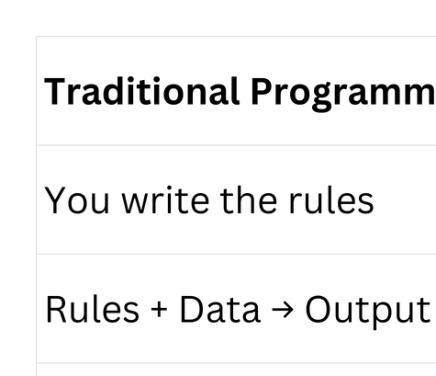
Traditional Programming VS Machine Learning
Notes:
3

Slide 4
What is Machine Learning?
a subset of artificial intelligence (AI) that enables computer systems to learn patterns from data and improve their performance over time without being explicitly programmed for every specific task
Keywords:
Examples — your dataset
Patterns — what the model learns
Predictions — what it does on new data
Notes:
3

Slide 5
Types of Machine Learning
Supervised Learning
Labelled data
Correct answers given during training
Machine learns input → output relationship
Example: Predicting house prices
Types:
Classification:Predicts a CATEGORY
Regression:Predicts a NUMBER
Notes:
3

Slide 6
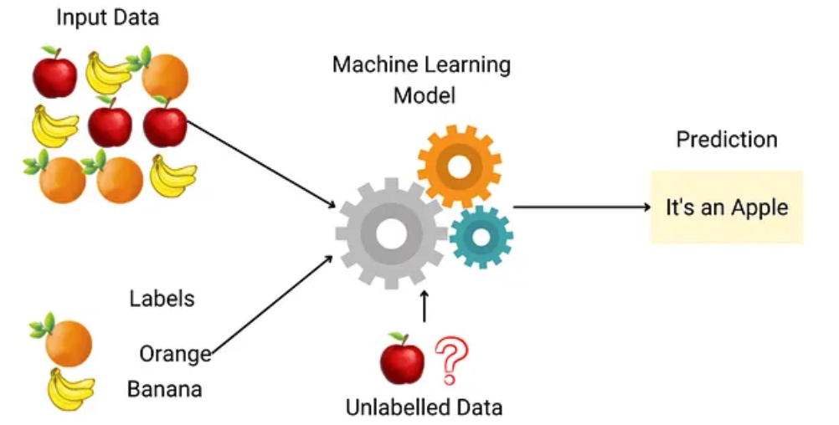
Notes:
3

Slide 7
Types of Machine Learning
UnSupervised Learning
No labels, no correct answers
Machine finds hidden patterns alone
Machine groups similar things together Called Clustering
Example: Grouping customers by behavior
Notes:
3

Slide 8
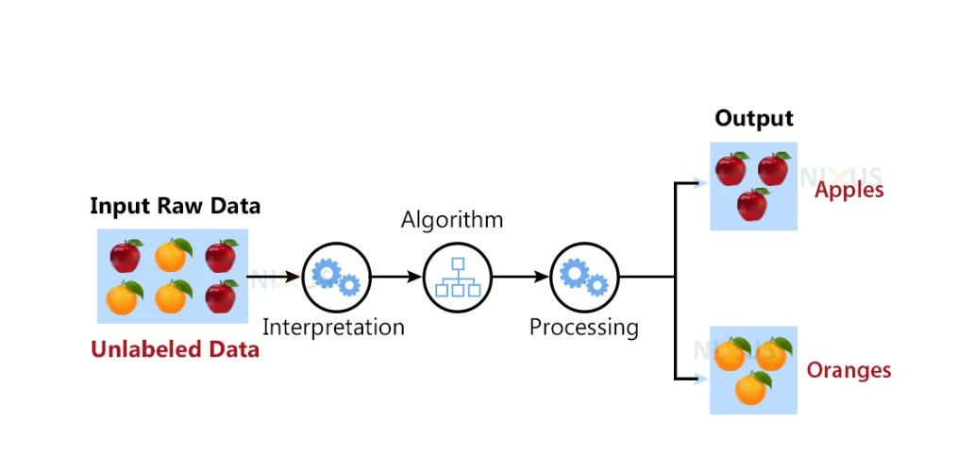
Notes:
3

Slide 9
Types of Machine Learning
Reinforcement Learning
No dataset at all
Learns by trial, error, reward & punishment
Example: Self-driving cars, Chess AI
Agent → takes Action → Environment → gives Reward/Penalty → Agent improves
Notes:
3

Slide 10
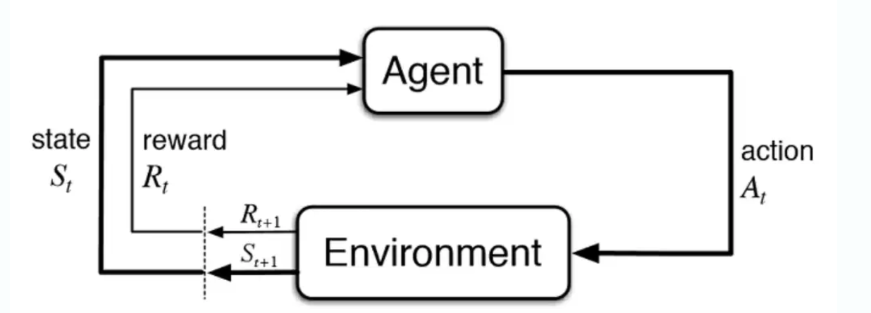

Slide 11
Quick Test
Q: You want to predict whether a student will pass or fail based on attendance and assignment scores. Which type of ML is this?
A) Supervised — Regression
B) Supervised — Classification
C) Unsupervised
D) Reinforcement Learning

Slide 12
Quick Test
Q: You want to predict whether a student will pass or fail based on attendance and assignment scores. Which type of ML is this?
A) Supervised — Regression
B) Supervised — Classification
C) Unsupervised
D) Reinforcement Learning

Slide 13
Quick Test
Q: You have a dataset of house features — size, location, rooms. Every house has a price. You want to predict price of a new house. Which type?
A) Supervised — Classification
B) Unsupervised
C) Supervised — Regression
D) Reinforcement Learning

Slide 14
Quick Test
Q: You have a dataset of house features — size, location, rooms. Every house has a price. You want to predict price of a new house. Which type?
A) Supervised — Classification
B) Unsupervised
C) Supervised — Regression
D) Reinforcement Learning

Slide 15
Quick Test
Q: You have customer transaction data with no labels. You want to find natural groups of similar customers. Which type?
A) Supervised — Regression
B) Supervised — Classification
C) Unsupervised
D) Reinforcement Learning

Slide 16
Quick Test
Q: You have customer transaction data with no labels. You want to find natural groups of similar customers. Which type?
A) Supervised — Regression
B) Supervised — Classification
C) Unsupervised
D) Reinforcement Learning

Slide 17
Linear Regression
The word Linear means a straight line.
The word Regression means predicting a number
.
So Linear Regression = finding the best straight line through data points that can predict new values.
Hours Worked Salary Earned
10 15000
20 25000
30 35000
40 45000
50 55000
Notes:
3

Slide 18
What Is Linear Regression?
Linear regression is a foundational supervised machine learning algorithm and statistical technique used to model the relationship between a continuous dependent variable (target) and one or more independent variables (predictors) by fitting a straight line, known as the line of best fit, through the data points
Hours Worked Salary Earned
10 15000
20 25000
30 35000
40 45000
50 55000
Notes:
3

Slide 19
Evaluation Matrics
MAE — Mean Absolute Error
Average of all prediction errors ignoring positive and negative signs. Tells you — on average how far off are your predictions. Lower is better.
RMSE — Root Mean Squared Error
Same as MAE but squares every error before averaging — making large errors much more impactful. Tells you — how far off are predictions with big mistakes penalized more. Lower is better.
R² — R Squared
Measures what percentage of the pattern in data your model understood. Score between 0 and 1. Higher is better. R²=0.97 means model understood 97% of the pattern.
Notes:
3

Slide 20
OverFitting
Model memorized training data instead of learning the pattern. Performs perfectly on training data but fails on new data.
UnderFitting
Model is too simple to learn the pattern. Performs badly on both training data and new data.
Notes:
3

Slide 21
Bias
Error from wrong assumptions. Model consistently misses in the same direction.
High Bias = Underfitting.
The gap between a model's predictions and the true values
Variance
How much model changes when trained on different data.
High Variance = model too sensitive = Overfitting.
how much a model’s prediction target function changes if trained on different datA
Notes:
3

Slide 22
Bias & Variance TradeOff
Making model simpler increases Bias but decreases Variance.
Making model complex decreases Bias but increases Variance.
They always pull in opposite directions.
Goal is to find the sweet spot — Low Bias + Low Variance
Notes:
3

