Slide 1
DG Interns Hub
Week 1 Report
Lab Setup, Linux and Networking Foundations
Manahil Shahzadi

Slide 2
Lab Setup
VM | Hypervisor | Network | IP | Gateway
Parrot Security 7.2 | VMware Workstation | NAT | 192.168.32.128 | 192.168.32.2
Ubuntu | VirtualBox | NAT | 10.0.2.15 | 10.0.2.2
A clean snapshot named "Clean" was taken for each VM
Parrot was used in place of Kali (approved by instructor)
Each VM reaches the internet through its own NAT

Slide 3
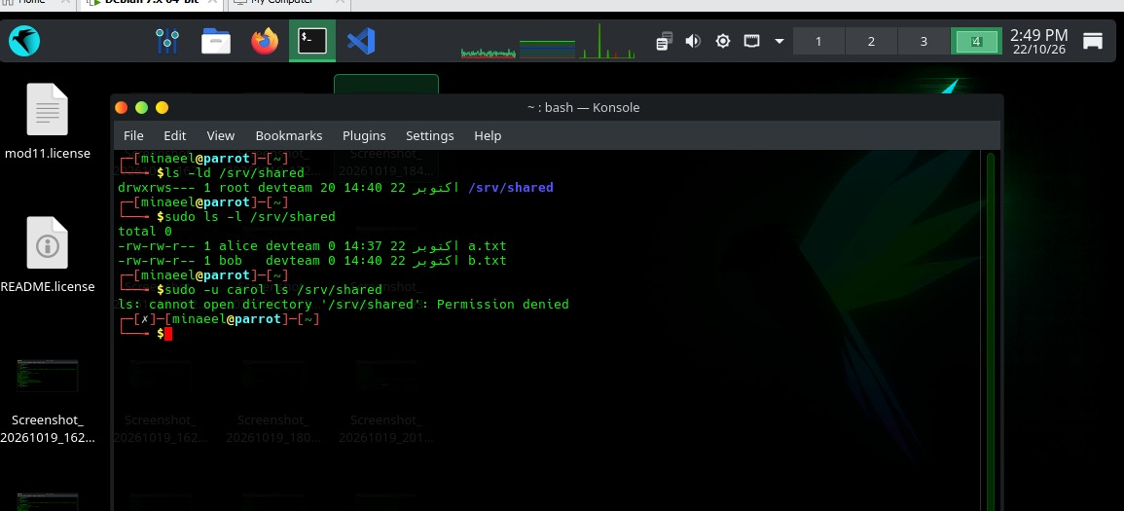
Linux Practice
3 users: alice, bob, carol
2 groups: devteam (alice, bob) and analysts (carol)
Shared folder /srv/shared: root:devteam, mode 2770
carol is denied access, alice and bob can write
find, grep, ps and ss -tulpn used
Cron job writes the date to /tmp/cron.log every minute
Shared folder permissions

Slide 4
Network Map
VM | IP | Gateway | DNS
Parrot (VMware) | 192.168.32.128 | 192.168.32.2 | see screenshots
Ubuntu (VirtualBox) | 10.0.2.15 | 10.0.2.2 | 192.168.100.1
Tools: ip a, ip route, resolv.conf, ping, traceroute, nslookup / dig
Diagram drawn in draw.io (PNG and .drawio in the Network Map folder)

Slide 5
Notes and Cheat Sheet
8 theory notes, one file per question
CIA triad, SOC vs VAPT vs IR, OSI vs TCP/IP
IP, MAC, DNS, DHCP and 12 common ports
Linux file system, chmod, chown, SUID
Threat vs vulnerability vs risk vs exploit
VM networking modes, legal and ethical basics
Cheat sheet with 42 Linux commands

Slide 6
TryHackMe Rooms
Search Skills
Learning Cyber Security
Linux Fundamentals Part 1
What is Networking?
Introductory Networking
Networking Concepts
Pyramid of Pain
Intro to LAN
Defensive Security Intro (bonus)
All rooms completed (100%)

Slide 7
Key Learnings
Building a small lab with two VMs
Users, groups and permissions in Linux (setgid on shared folders)
How IP, gateway and DNS work together
OSI and TCP/IP models, TCP vs UDP
How defenders think: Pyramid of Pain and SOC work

