Slide 1

Haryana Real Estate Regulatory Authority
(HRERA)

Slide 2
INTRODUCTION
Haryana RERA ( is a state-level law that regulates the real estate sector in Haryana, India. It was implemented in 2017, following the enactment of the National RERA Act in 2016. The Haryana RERA aims to provide a framework for the regulation and development of the real estate sector in the state while ensuring the protection of the interests of homebuyers. The act mandates the registration of real estate projects and agents, establishes the Cas a regulatory body, and sets up a dispute resolution mechanism. The act also outlines the obligations of developers, including the timely completion of projects, and imposes penalties for non-compliance. The Haryana RERA Act covers residential and commercial real estate projects and applies to all ongoing Projects, under construction or completed.
The act has had a significant impact on the real estate and development of the real estate sector in the state while ensuring the protection of the interests of homebuyers.

Slide 3
The act mandates the registration of real estate projects and agents, establishes the Haryana Real Estate Regulatory Authority (HRERA) as a regulatory body, and sets up a dispute resolution mechanism. The act also outlines the obligations of developers, including the timely completion of projects, and imposes penalties for non-compliance. The Haryana RERA Act covers residential and commercial real estate projects and applies to all ongoing Projects, under construction or completed. The act has had a significant impact on the real estate sector in Haryana, enhancing transparency and accountability and improving consumer confidence. However, it also faces challenges in its implementation, which need to be addressed to ensure its long-term success.
What is RERA Haryana?
RERA Haryana is the regulatory body that promotes and oversees the real estate sector. RERA in Haryana was set up on 29 July 2017 and the RERA Act Haryana is implemented via two branches: HRERA Gurugram and HRERA Panchkula.
According to a statement issued by the Chief Minister, Sh. Manohar Lal, RERA in Haryana was established with an aim to facilitate 'organic an systematic growth of real estate'. Additionally, h stated that its goal was to create a transparent relationship between real estate developers and buyers. In order to achieve this, the government introduced transparency in transactions, as well as fair and quick resolution of disputes between buyers and builders.

Slide 4
RERA Haryana: Rules and Regulations
Before you register a complaint, learn RERA Haryana's rules. You can access these rules and regulations online, at the HRERA portal.
The RERA Haryana rules detailed online contain important information such as the following.
• In order to make a complaint with the adjudicating officer for interest and compensation you must submit form CAO in triplicate with the appropriate fee
• In case you are given a flat with a reduced carpet area than what was promised, your developer must refund the money to you along with the interest earned at the
prescribed interest rate within 90 days
Once you are conversant with RERA rules that pertain to you, register a complaint online.

Slide 5
Powers and Role of Haryana RERA
The powers and role of Haryana RERA (HRERA) are given below.
To ask any allottee, promoter, or estate agent for data
To look over the promoter's or agent's financial records, books of business, and accounts. to be endowed with all the institutions and authority of a civil court as defined by the Code of Civil Procedure, 1908;
To appoint temporary orders prohibiting Promoters, Allottees, and Agents from taking part in any unlawful activity;
To impose a fine on any Builder or Agent who disobeys the rules of the Act;
To make a note of a circumstance or issue to the Indian Competition Commission. The tenure issue is related to a specific monopoly situation that has affected the interests of allottees.
If an error appears on the promoting record, amend or correct any order within two years; • To collect fees, interest, and damages from agents, allottees, and promoters.

Slide 6
Key Provisions of RERA
Establishment of Real Estate Regulatory Authority
Mandatory Registration of Projects
Disclosure of Project Details
Deposit of 70% of Funds in Escrow Account
Developers are liable for any structural
Structural Defect Liability
Establishment of Appellate Tribunal
Impact of RERA on the Real Estate Industry
Since its implementation, RERA has brought about significant positive changes in the Indian real estate industry:
Increased Transparency
Boost to Consumer Confidence
Reduction in Project Delays
Decline in Fraudulent Practices
Resolving Disputes Swiftly

Slide 7
Why RERA?
The home buyers have grumbled for so long that real estate transactions were skewed and laboriously in the esteem of the developers. RERA and the government's model code, focus to design a more rightful and fair transaction between the seller and the buyer of properties, substantially in the primary market. RERA will make real estate purchase effortless, by bringing in superior accountability and translucency, provided that states do not weaken the provisions and the soul of the central act.

Slide 8


Slide 9
Impact of RERA on the buyer
RERA has been introduced to protect the rights and interests of property buyers. To increase translucency in project completion status, the developers must disclose the construction status on the official website of the Authority. This has to be done every quarter i.e. in every 3 months after getting the registration number from the authority. In case of any malefaction by the promoter/ builders, the buyer/allottee can file a complaint to the Authority online. Builders/promoters cannot change anything in the structure of the building without prior assent from all the buyers. All these measures, in addition to those mentioned in the sections of the Real Estate (Regulation and Development) Act 2016, is expected to boost the confidence of the investors.

Slide 10


Slide 11
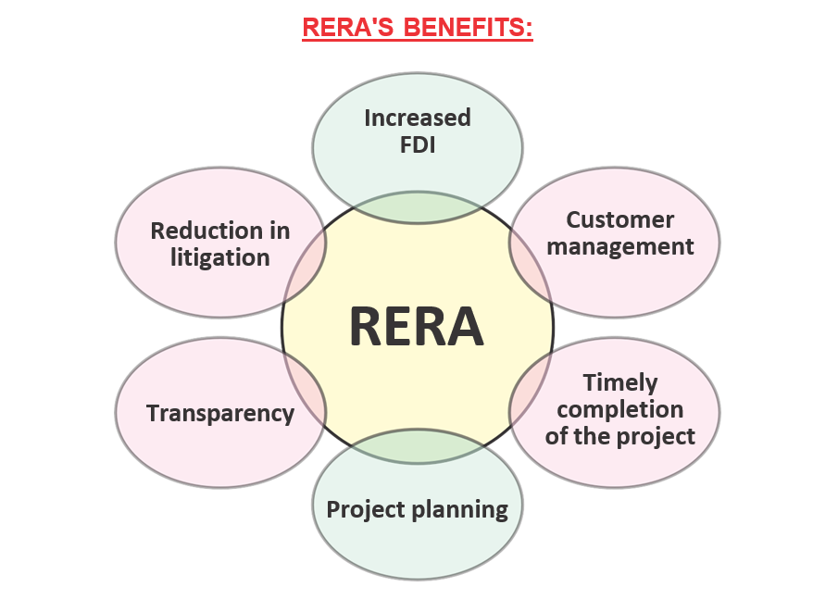

Slide 12
Impact of RERA on promoter/ builders
Under RERA the builders must register critical statistics regarding the project.
This includes :
Layout,
Details of the promoter,
Status of the land a title should be undisputed,
Status of statutory approval from the concerning authorities,
Agreements followed by all the schedules mentioned in the RERA act,
Details of the brokers,
Architects and contractors,
Certificates from Engineer and C.A.
In case of failure to register this information, it will lead the promoter/ builders to heavy penalties. The builders are bound by a five- year agreement with the buyer for quality affirmation of the building and these 5 years are calculated from the date of possession.

Slide 13


Slide 14
Haryana Rera (Rera Haryana) Fees
Here are some of the key fees charged by the HRERA in Haryana:
Project registration fee:
The registration fee for a real estate project in Haryana is based on the project size. For projects up to 1,000 square meters, the fee is Rs. 10,000. For projects larger than 1,000 square meters, the fee is Rs. 20,000 plus Rs. 5 per square meter of the project area.
Agent registration fee: Real estate agents in Haryana must register with the HRERA by paying a fee of Rs. 10,000.
Complaint filing fee: Homebuyers and other stakeholders can file complaints with the HRERA against developers and agents. The fee for filing a complaint is Rs. 1,000.
Renewal fee: The registration of a real estate project or agent is valid for a period of 5 years. After that, it can be renewed by paying a fee of Rs. 5,000 for a project and Rs. 2,500 for an agent.

Slide 15
How to File a Complaint
Here are the steps to follow while filing a complaint are:
1. Find a RERA lawyer and file a complaint under the appropriate jurisdiction.
2. Fill the complaint as per the rules prescribed by the concerned state in which the project is situated. Include the following details:
a. Details of the applicant and the respondent.
b. Address and registration number of the project.
c. A brief statement of the facts as well as the grounds of the claim.
d. If any relief is sought, then details of the relief and interim reliefs (if any).
4. Pay the fee. Keep in mind that this amount differs from state to state. For example, the fee in Maharashtra is Rs.5,000, while it is Rs.1,000 in Karnataka.
5. Alternatively, you can file a complaint complaint online by visiting your state's RERA website.
6. If you aren't satisfied with the decision made by RERA, you can file a complaint with the RERA Appellate Tribunal within 60 days.
7. You can also approach the High Court within 60 days if you aren't satisfied with the Appellate Tribunal's decision.

Slide 16
RERA has a number of benefits for the buyer, the promoter, and the real estate agent. These include:
Standardisation of carpet area
Reduced risk of insolvency of the builder
Advance payment
Rights to the buyer in case of any defects
Interest to be paid in case of default
Buyer's rights in case of false promises
If defect in title
Right to information

Slide 17
Primary Goals Of Haryana RERA
To set rules for the real estate market so that it can grow and develop in a healthy way.
To make sure that the real estate projects are finished in the time allotted.
To ensure deals between developers of real estate projects and people who want to buy homes are transparent.
Compliance of the law and orders of the authority.
To quickly settle disagreements about the projects.

Slide 18
RERA Haryana: Latest news
February 23, 2024
The Haryana RERA Gurugram, has levied a penalty of Rs 25 lakh on Yashvi Homes for publishing a misleading advertisement in a mainstream daily. The developer has published an advertisement that is being developed under government scheme Deen Dayal Jan Awas Yojana (DDJAY) 2016as being developed under DDJAY 2024, which is misleading.

Slide 19
RERA Haryana For Home Buyers (Latest Updates)
For home buyers, the establishment of RERA Haryana signifies a significant shift towards consumer empowerment. It provides protection to home buyers while holding the builders accountable at the same time. One of the primary benefits of HRERA for home buyers is the assurance that developers will deliver projects on time. Under HRERA, developers must deposit seventy percent of the funds collected from buyers in a separate bank account for construction purposes.
The completion of the project in time is ensured and the usage of funds is monitored to prevent any misuse. HRERA makes it compulsory for developers to disclose project details such as layout plans, timeline, cost, and the sale agreement that buyers will have to sign. This makes the process transparent, helping buyers make informed decisions.

Slide 20
The Gurugram bench of the Haryana real estate regulatory authority (HRERA) has imposed penalties of Rs 25 lakh each on five builders after they failed to deliver their housing units to buyers on time. The regulator, however, allowed the realtors’
RERA registration certificates to remain in force with new timelines for completion of their projects.
As per the official statement, Identity Buildtech Private Limited has been fined for not completing its project Ansal Highland Park at Sector 103 within the declared timeline of June 2022. In this case, the authority has allowed the RERA registration to be in force till May 2024.
Similarly, a penalty of Rs 25 lakh has been imposed on BPTP Limited for not completing its project Park Terra at Sector 37-D, Gurugram. The deadline for this project, which was April 2022 earlier, has been extended till April 24.
Another developer Advance India Projects Limited has been penalised for its failure to complete the construction of Zen Residences -1 group housing project at Sector 70-A, Gurugram, the statement said.
Also, a penalty of Rs 25 lakh has been imposed on KLJ Realtech Private Limited for not completing the construction of its commercial project KLJ Square at Sector 83, Gurugram within the declared timeline of June 2021.
While allowing the RERA registration to remain in force for Spaze Towers Private Limited for its project Ishan Singh Commercial at Sector 78, Gurugraam, till December 2025, the authority has imposed a penalty of Rs 25 lakh on the realtor. The project was to be completed by 2020-end, it added.

Slide 21
The Gurugram bench or the Haryana real Estate Regulatory Authority (HRERA) has asked the promoter of ILD Grand project at Sector 37 C in Gurugram to refund Rs 72 lakh to one of its buyers. The applicant had approached the authority in February 2019 after the builder failed to deliver the housing unit as per the deadline of August 2017.
The promoter of ILD Grand at Sector 37C will have to refund the full amount to its allottee, the RERA court said while passing an order on January 6 this year.
"Arguments heard, refund is allowed and complaint now stands disposed off," the court said.
"The authority directs the promoter to return the amount received by him Rs 72,09,911 with interest at the rate prescribed under the Rule 15 of the Haryana real estate (regulation and development) Rules 2017 from the date of each payment till the actual date of refund of amount within the timelines provided in the rule 16 of the Haryana Rules 2017," said the order.
Haryana RERA advices buyer to not invest in projects without RERA registration. The Gurgaon bench of Haryana Real Estate Regulatory Authority (HARERA), has advised the real estate buyers to not book properties in projects that are not registered with RERA.

Slide 22
Section 3 of the Real Estate (Regulation and Development) Act, 2016 says advertisement of unregistered real estate projects in any capacity lays down stringent punishment for such advertisements..
Similarly, Section 9 of the RERA Act, says a person has to register with the RERA before facilitating sale purchase into registered projects.
The authority has noted many unregistered agents are using social media as a tool to advertise unregistered real estate projects in violation of the RERA Act 2016, which is a punishable offence.
"People should not invest in any unregistered real estate project as they may be cheated through false promises .The real estate promoters and agents should work, act, and offer sale purchases in accordance with the RERA Act only," said Arun Kumar, Chairman RERA Gurugram.

Slide 23
Conclusion
In conclusion, the Haryana Real Estate (Regulation and Development) Act, 2017 has brought about positive changes in the real estate sector in the state. It has increased transparency and accountability, reduced project delays, boosted consumer confidence, and attracted more investment. However, some challenges need to be addressed, such as effective enforcement, awareness, and capacity building. The HRERA can potentially transform the real estate sector in Haryana, and the government needs to continue its efforts to strengthen the regulatory framework and improve its implementation. Despite the challenges, the Haryana RERA (Rera Haryana) has set a positive example for other states in India to follow in promoting a transparent and regulated real estate sector.

