Slide 1
WORKSHOP
Build Your First
AI Chatbot
From zero to a working chatbot using Python & OpenAI
⏱ 3–4 hours | 🐍 Python Basics Required | OpenAI API

Slide 2
What We'll Build Today
01
02
How LLMs Work
Setup & API Keys
Intuition behind the magic — no math, just concepts
Python environment, OpenAI library, your first API call
03
04
Build the Chatbot
Mini Project
System prompts, conversation history, personality
Build your own: study assistant, FAQ bot, or recipe helper

Slide 3
What is a Large Language Model?
An AI program that learned the patterns of human language by reading massive amounts of text — and can now generate new text that sounds human.
💡 Key insight
Applications
It doesn't think. It doesn't know facts.
It predicts the next most likely word, over and over.
Everything else is a side effect of doing that extremely well.
It is not magic — it's math, very impressive math.
These models are the brains behind a lot of the cool AI stuff happening right now, like chatbots that can hold surprisingly human-like conversations, tools that can write articles…

Slide 4
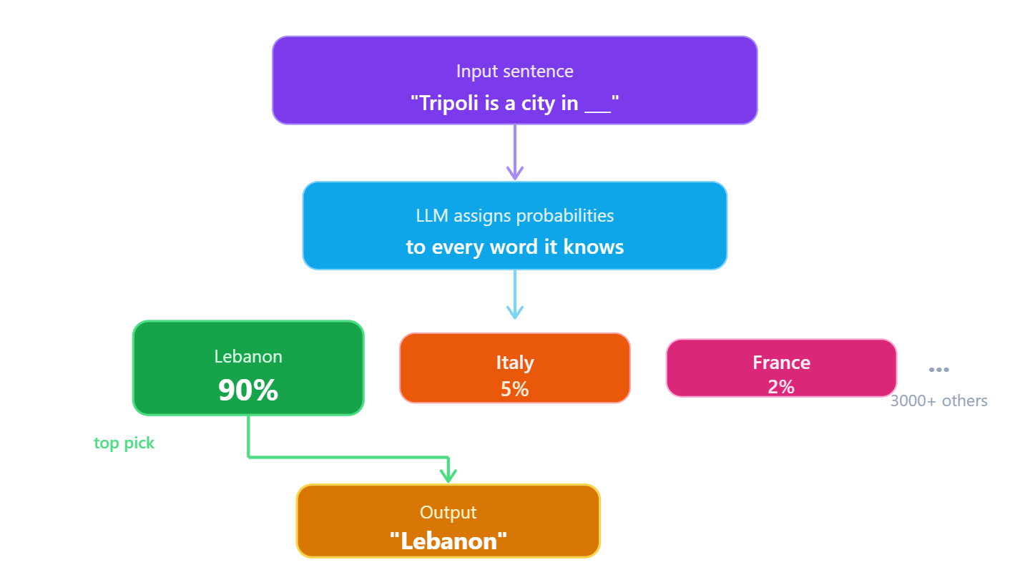
How Does an LLM Predict?
LLMs predict the next most likely word, over and over.

Slide 5
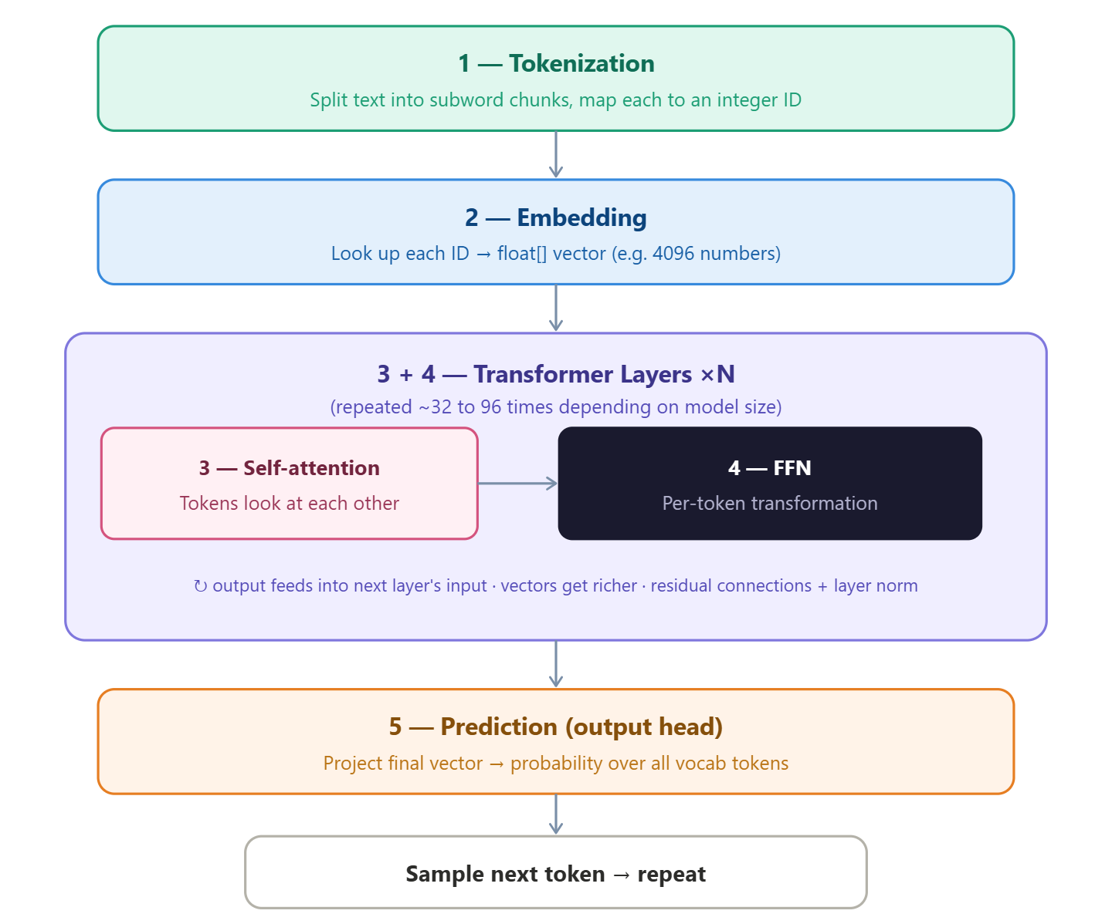
How an LLM Works & Processes Your Text?
Every prompt you send goes through these 5 steps

Slide 6
STAGE 1
Tokenization
Text → Numbers. Computers only understand numbers — tokens are the bridge.
Input:
"THE KING ATE THE APPLE"
↓ Split into tokens
THE
KING
ATE
THE
APPLE
ID: 1996
ID: 3573
ID: 8388
ID: 1996
ID: 6015
💡 Key Insight
The model NEVER sees letters — only token IDs (numbers)
Tokens are sub-word chunks, not always full words (e.g. "unhappiness" → ["un", "happi", "ness"])
This is why LLMs struggle to count letters or spell backwards!

Slide 7
STAGE 2
Embedding
Each token ID gets a rich meaning — a list of hundreds of numbers called a vector.
THE
→
[0.12, -0.30, 0.05, ...]
Meaning in space
KING and QUEEN end up with very similar vectors — the model groups them together
KING
→
[0.82, 0.71, -0.40, ...]
ATE
→
[-0.20, 0.44, 0.61, ...]
Context matters
"bank" near "river" → different vector than "bank" near "money"
THE
→
[0.12, -0.30, 0.05, ...]
Same THE, same vector
APPLE
→
[0.55, -0.60, 0.33, ...]
Both "THE" tokens get identical vectors — context changes later in Attention

Slide 8
STAGE 3
Attention Mechanism
Every token shines a spotlight on all other tokens to understand context.
Our sentence:
THE
KING
ATE
THE
APPLE
When looking at ATE — attention asks:
Who is doing the eating?
→ looks at KING (high attention score)
What is being eaten?
→ looks at APPLE (high attention score)
What are the THEs doing?
→ looks at both THE tokens (low score)
⚡ Every token attends to every other token — this is why longer prompts cost more (quadratic growth)!

Slide 9
STAGE 4
Feed-Forward Network (FFN)
Each token alone thinks: "What do I already know about myself?"
🧠 The Analogy
What KING knows after FFN:
Imagine you say the word "KING" to a professor.
KING
enters as just a vector of numbers
They don't look anything up.
They just think for a second — and everything they know about KING activates in their mind.
↓ FFN processes it
👑 royalty
♂ male
That's the FFN.
The "encyclopedia" is not a book —
it's the professor's trained brain.
⚡ powerful
🏰 has a kingdom
🗡 medieval era
💡 QUEEN goes through the same FFN and gets a very similar result — that's how the model knows they're related.
exits as a richer, knowledge-packed vector

Slide 10
STAGE 5
Prediction
After Attention + FFN, the model scores every possible next token and picks the most likely one.
Input so far:
"THE KING ATE THE ___"
Probability for next token:
APPLE
72%
Why Hallucinations Happen
The model always picks a plausible next token —
not necessarily a true one.
CAKE
12%
It has no built-in fact-checker. It's pattern matching, not reasoning.
FOOD
8%
Temperature controls this:
🔥 High = creative (flatter distribution)
Low = focused (sharper distribution)
PIE
5%
other
3%

Slide 11
The Full Pipeline — From Your Text to My Response
"THE KING ATE THE APPLE" — what actually happens
1
Tokenizer
"THE KING ATE THE APPLE"
→ [1996, 3573, 8388, 1996, 6015]
Why LLMs can't count letters
2
Embedding
[1996, 3573, ...]
→ Each ID becomes 768 numbers capturing meaning
Why context changes meaning
3
Attention
768-number vectors
→ ATE looks at KING (who?) and APPLE (what?)
Why longer prompts cost more
4
FFN
Context-enriched vectors
→ KING gains: royalty, power, male... from training
Why LLMs know facts
5
Prediction
Final vector
→ Scores all tokens → picks "APPLE" (72%)
Why LLMs hallucinate
🔁 This entire pipeline runs once for EVERY token generated in my response — that's why longer answers take longer!

Slide 12
ChatGPT — and How Developers Use It
WHAT IS CHATGPT
Developed by OpenAI
THE KEY INSIGHT FOR DEVELOPERS
You don't have to use ChatGPT's website. OpenAI gives developers direct access to the same model through something called an API.
Released November 2022
100 million users in its first 2 months
SAME MODEL, TWO WAYS TO ACCESS IT
Fastest growing app in internet history
Regular user
→
chat.openai.com
→
GPT model
Developer
→
API + Python
→
chat.openai.com is just one interface to the model
ChatGPT is a chatbot powered by a Large Language Model (GPT-4)

Slide 13
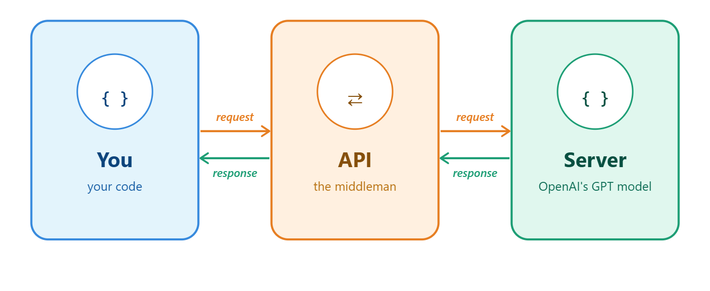
What is an API?
Application Programming Interface
Think of it like a restaurant: You = customer API = waiter Server = kitchen
An API is how we talk to the model directly from our own code — without the website.

Slide 14
Local LLM vs Cloud LLM
Two ways to use an LLM — what's the difference, and which should you use?
🏠 Local LLM
☁ Cloud LLM
Runs entirely on YOUR computer
Runs on a remote server — you call it via API
✅ No API key — ever
✅ Very fast — big server GPUs
✅ No internet required
✅ No installation needed
✅ Completely free
vs
✅ Access the biggest models (GPT-4, Claude)
✅ Your data never leaves your PC
⚠ Needs an API key
Speed depends on your GPU
⚠ Costs money (pay per use)
📥 Get it free:
🔗 Try it free:
ollama.com (easiest) • lmstudio.ai (no terminal)
groq.com (fast, free tier) • openrouter.ai (many models)

Slide 15
How to Run Your First LLM
Step-by-step for both paths — pick the one that suits you
🏠 Local LLM (Recommended)
☁ Cloud LLM (Needs API Key)
No account · No credit card · No API key
For teams & bigger models
1
Go to ollama.com
Download & install Ollama (free)
1
Pick a provider
Groq (free) · OpenAI · HuggingFace
2
Open terminal / PowerShell
Win + R → type 'powershell'
2
Create an account
Sign up & set up access
3
Type: ollama run llama3.2
Downloads & runs a small model
3
Get your API key
A secret code like: gsk_abc123...
4
Start chatting!
Works 100% offline
4
Connect via code
Use the key to call the model
💡 Best beginner models: llama3.2 • phi4 • mistral
🔑 What is an API key?
A secret password your code uses to access the model.
Like a hotel key card — without it, no entry.

Slide 16
Setup in 3 Steps
Install the library
1
pip install openai
Get your API key
2
platform.openai.com → API Keys → Create
Set environment variable
3
export OPENAI_API_KEY="sk-..."
Never share your API key publicly or push it to GitHub!

Slide 17
Your First API Call
chatbot.py
Import the library
from openai import OpenAI
client
= OpenAI()
response
= client.chat.completions.create( model="gpt-4o-mini",
messages
=[ { "role": "user", "content": "Hello! Who are you?" } ] ) print(response.choices[0].message.content)
Create a client instance
Choose your model
Send a message
Print the response

Slide 18
Give Your Bot a Personality
Using System Prompts
system_prompt_example.py
system
The hidden instruction that shapes the bot's behavior, tone, and knowledge
messages = [ { "role": "system",
"content": ( "You are a helpful study assistant for CS students. Explain things simply using analogies." ) }, { "role": "user", "content": "What is recursion?" }
]
user
What the human says in the conversation
assistant
What the chatbot replies — also used to inject fake history

Slide 19
Making It Remember
LLMs have no memory — you have to send the full conversation every time
Hi! What's a for loop?
A for loop repeats code for each item in a list. Think of it like reading a checklist!
Can you show me an example?
Sure!
for item in ["a","b","c"]:
print(item)
⚡ Your code sends ALL messages above each time — that's how the bot 'remembers' the conversation

Slide 20
Build YOUR Chatbot
60 minutes — pick one idea (or invent your own!)
📚 Study Assistant
🍕 Recipe Bot
❓ University FAQ Bot
Helps students understand any CS concept with simple explanations and examples
Suggests meals based on ingredients the user has at home, with step-by-step instructions
Answers questions about your university's courses, deadlines, or registration process
Beginner
Beginner
Intermediate
💼 Interview Prep Coach
🌍 Language Tutor
🎮 Text Adventure Game
Asks technical interview questions, evaluates answers, and gives feedback
Chats in another language, corrects mistakes, and teaches vocabulary in context
Generates a dynamic story where user choices shape what happens next
Intermediate
Advanced
Advanced

Slide 21
🎉
What You Built Today
Keep Going 🚀
✅ Called a real AI API from Python
→ Add a Gradio UI (pip install gradio)
✅ Used system prompts to control behavior
→ Try GPT-4o for harder tasks
✅ Built a multi-turn chatbot with memory
→ Explore function calling & tools
✅ Shipped a working mini project
→ Learn RAG — give your bot documents
→ Deploy it on Hugging Face Spaces
📎 Resources: platform.openai.com/docs | colab.research.google.com | Share your project!

