Slide 1
USC Viterbi Graduate Hackathon
Team 1

Slide 2
Problem
Given a data-set of connections established by devices on a network, the goal is to identify devices on the network as specifically as possible, and generate a policy to block communications that are dangerous.

Slide 3
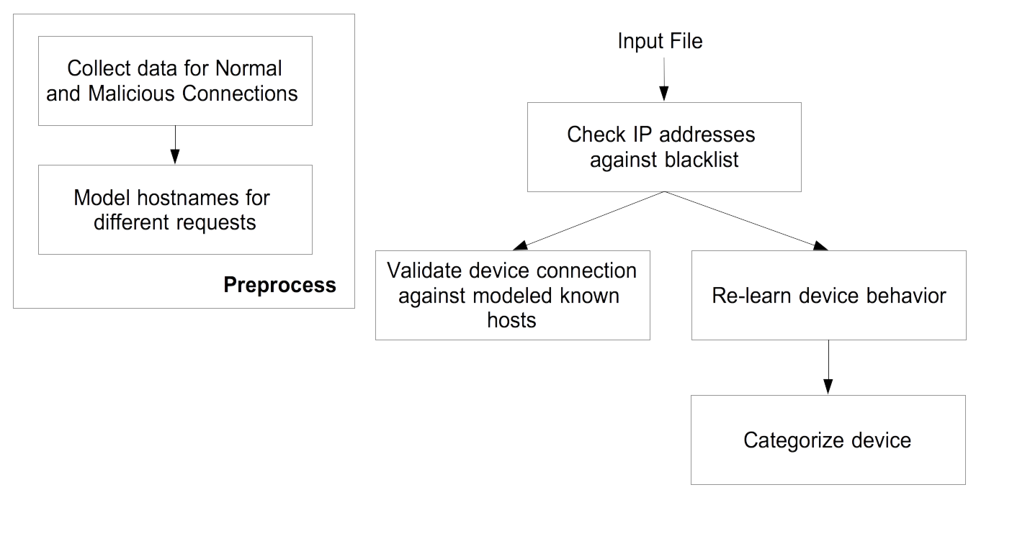
Approach

Slide 4
Approach
Policies
Block connections when source or destination IP address is blacklisted
Allow connections between known devices and known hosts for that device
Note: Unseen devices are identified as a device category and the device is considered as a known device after understanding its behavior

Slide 5
Dataset
Model hostname, collate device information and research policies using the following datasets
Malware and Normal captures from the Stratosphere IPS Project
IOT Device captures, Aalto University
Packet captures on ”vinnovation*” network

Slide 6
Why is our solution effective?
Learns device behavior on-the-fly
Hand curated policies based on network flow
Policies make use of hostname instead of IP address
Validates IP address against DNS-based blacklists and IP reputation services

Slide 7
Results on Test Data
Detected three out of the four malicious packets
Blocked 235 packets out of 673k packets
Categorized test packets at ~1,200 packets per second

Slide 8
Future Work
Validate connections based on certificates in place of mac addresses
Analyse payload data to prevent attacks from malware hosted on cloud providers like AWS, GCP etc.
Use DHCP fingerprint or SSH fingerprint to identify and categorize devices

