Slide 1
USC Viterbi Graduate Hackathon
Internet of Things
-Team 1

Slide 2
Problem
Given a data-set of connections established by devices on a network, the goal is to identify devices on the network as specifically as possible, and generate a policy to block communications that are dangerous.

Slide 3
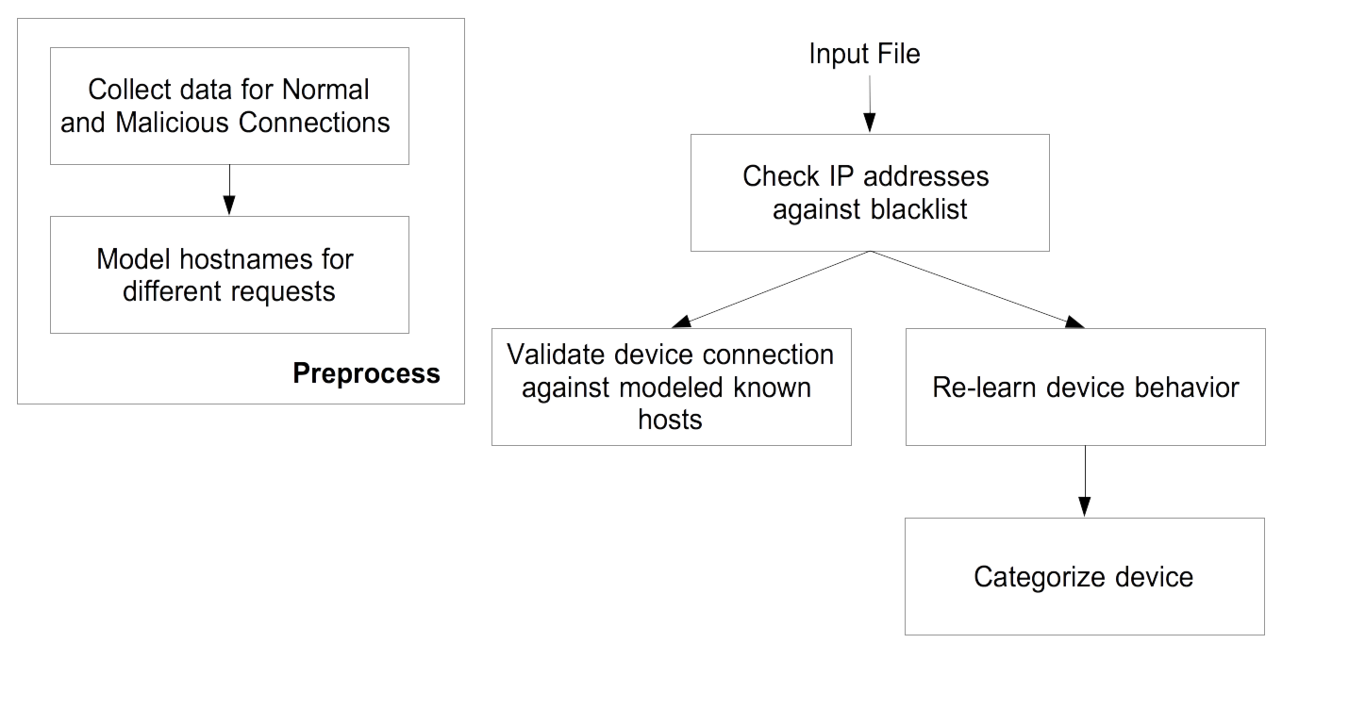
Approach

Slide 4
Dataset
Model hostname, collate device information and research policies using the following datasets
Malware and Normal captures from the Stratosphere IPS Project
IOT Device captures, Aalto University
Packet captures on ”vinnovation” network

Slide 5
Why is our solution effective?
Learns device behavior on-the-fly
Hand curated policies based on network flow
Makes use of hostname instead of IP address
Validates IP address against DNS-based blacklists and IP reputation services

Slide 6
Future Work
Validate connections based on certificates in place of mac addresses
Analyse payload data to prevent attacks from known hosts like malware hosted on cloud providers like AWS, GCP etc.
Additionally use DHCP fingerprint or SSH fingerprint to identify and categorize them.

