Slide 1
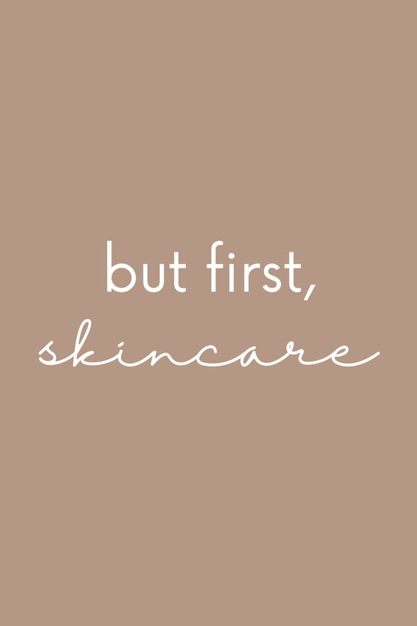
Skincare Sifarish
Skincare products recommendation engine

Slide 2
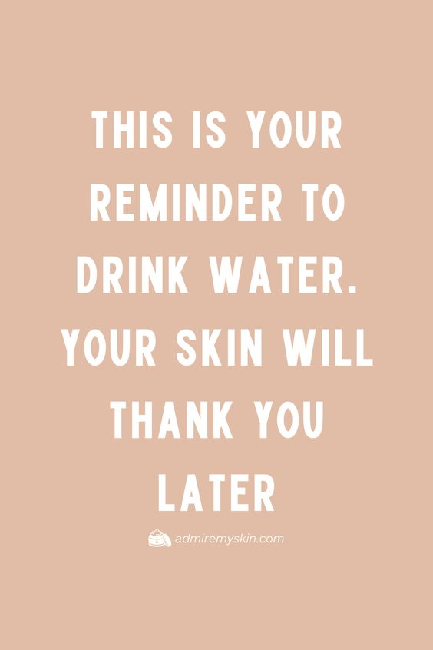
Content
Introduction
Problem Statement
Data Preparation
Dimensionality Reduction Techniques
Visualization
Conclusions

Slide 3

Introduction
In the world of skincare, finding the perfect product can be overwhelming. Traditional approaches often fall short, leaving you with uncertainty in your skincare routine.
But fear not, as we usher in a new era—an era where data meets beauty, and where the science of skincare empowers you to make well-informed choices.
Welcome to the future of skincare recommendation—a data-driven approach that unveils the secrets to your healthiest, most radiant skin
Every day, countless skincare products flood the market, each claiming to be the holy grail for flawless skin. While branding and marketing can be persuasive, we firmly believe that the key to effective skincare lies in one thing: ingredients.
As skincare enthusiasts, we know the frustration of scrutinizing ingredient lists, googling unfamiliar components, and trying to match products with our skin type. It's a time-consuming and often confusing process.
That's why we decided to harness the power of data science. Our mission is to create a recommendation system that focuses solely on what matters most—skincare product ingredients.

Slide 4
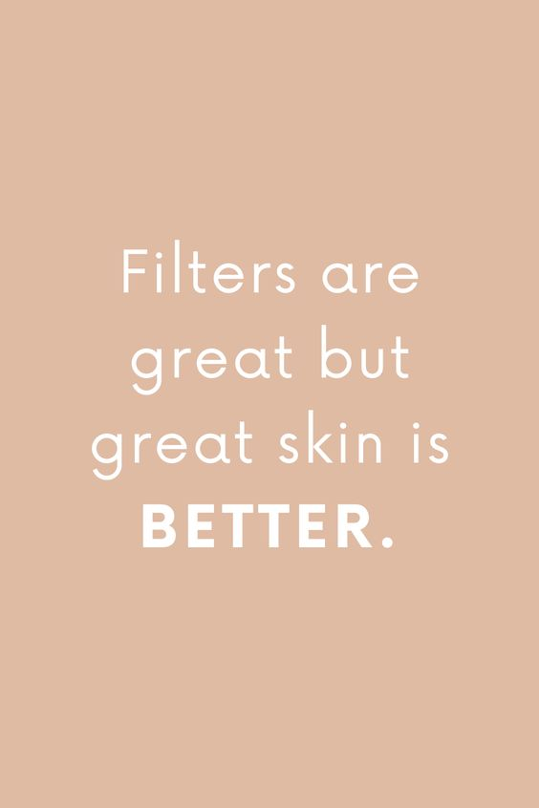
Problem Statement
Countless skincare products on the market can be overwhelming.
Many products promise great results, but how do you choose the right one?
Deciphering product ingredient lists can be challenging for non-experts.
Data science offers a solution to this problem.
The skincare industry's abundance of products makes it tough for consumers to find the right fit for their unique needs. Some may be swayed by fancy branding, but the real question remains: which products are genuinely compatible with their skin?
The crux of the problem is the complexity of ingredient lists. For most of us, it's like deciphering a secret code, especially if chemistry isn't our strong suit.
To simplify this, we set out to develop a recommendation system for skincare products based on their ingredients. We've created a content-based system that treats ingredients as the stars of the show.
Our goal is to recommend similar skincare products by analyzing their ingredient lists? We've delved into natural language processing, dimensionality reduction techniques, and the world of skincare ingredients to give you a straightforward tool for making informed skincare choices.

Slide 5
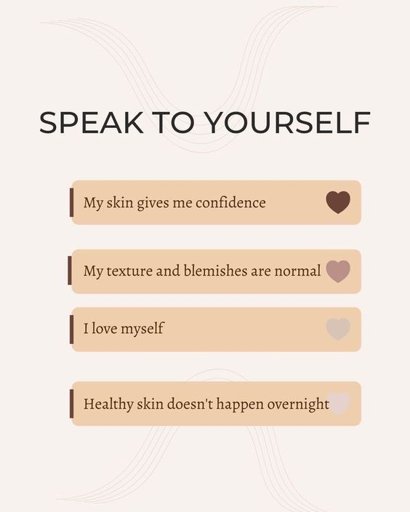
Data Preparation
Streamlining Data: Addressing missing information in skincare product entries and ensuring data completeness for robust analysis.
Changing the Indexes: Replaced numerical indexes with product names convenience to simplify data retrieval through product names.
Categories for Analysis: Separating and analyzing each category independently is essential to ensure focused analysis, tailored to our research scope

Slide 6
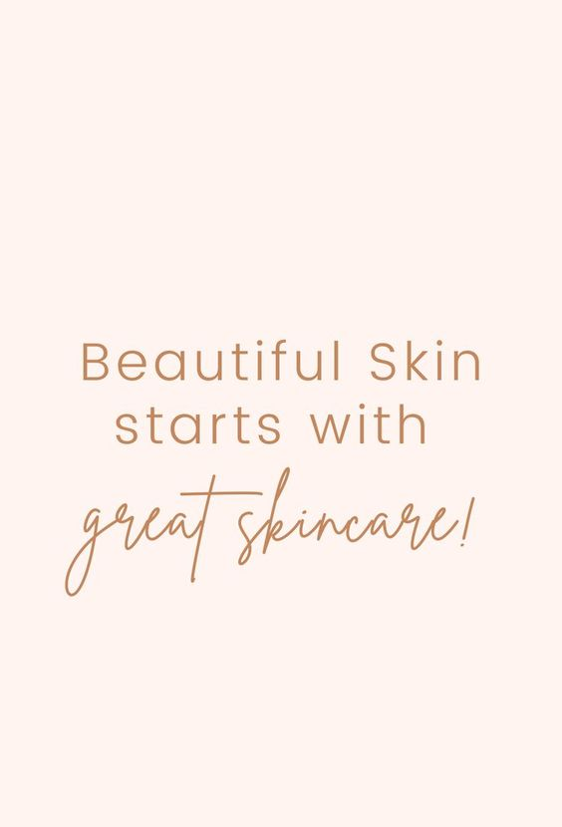
Dimensionality Reduction Techniques
Unsupervised Machine Learning: Input data of ingredients. No output variables to predict.
Methods include:
UMAP (Uniform Manifold Approximation and Projection)
PCA (Principal Component Analysis)
t-SNE (t-Distributed Stochastic Neighbor Embedding)

Slide 7

Dimensionality Reduction Techniques
UMAP:
Preservation of Global Structure: UMAP is known for its ability to preserve both local and global data structures. It can effectively capture the broader relationships and structures within the data.
Nonlinear Patterns: UMAP is particularly useful for revealing nonlinear patterns in the data. It can uncover complex relationships that linear techniques like PCA struggle with.

Slide 8
Dimensionality Reduction Techniques
t-SNE:
Emphasis on Local Structure: t-SNE focuses on preserving the pairwise similarities between data points in the lower-dimensional space. It excels at revealing fine-grained local structures and clusters.
Data Visualization: t-SNE is often used for data visualization in two or three dimensions, making it valuable for creating scatter plots or maps that display data points' relationships.

Slide 9
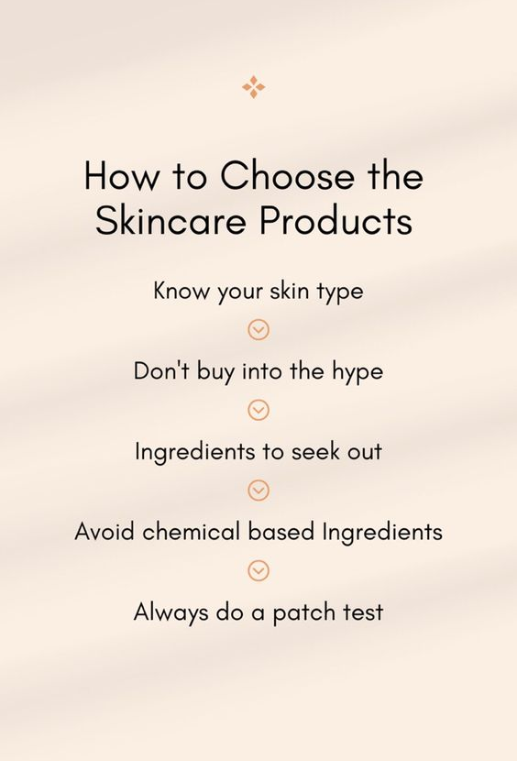
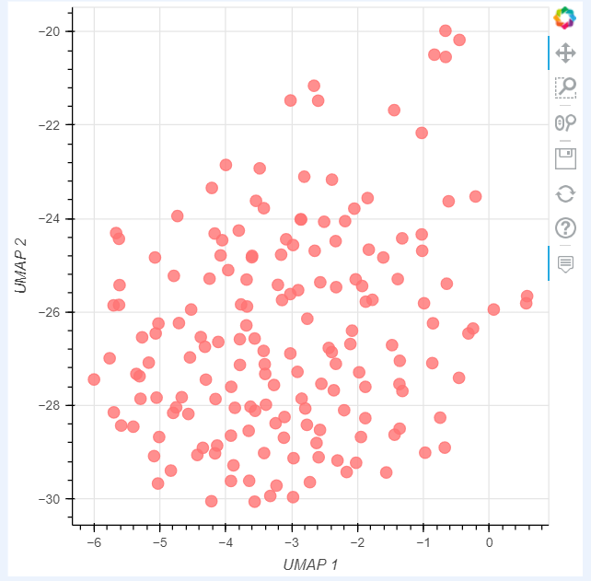
Visualization
Bokeh Diagram

Slide 10
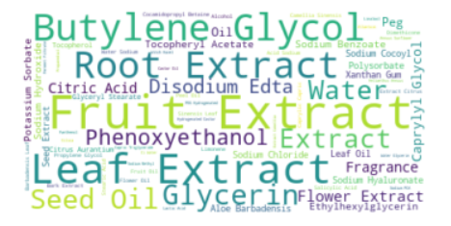
Visualization
Word Cloud for Cleanser

Slide 11
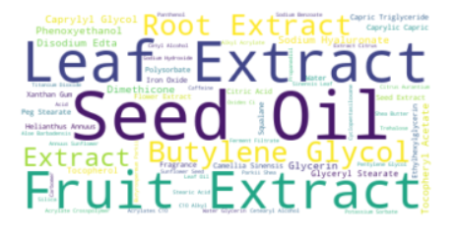
Visualization
Word Cloud for Moisturizer

Slide 12
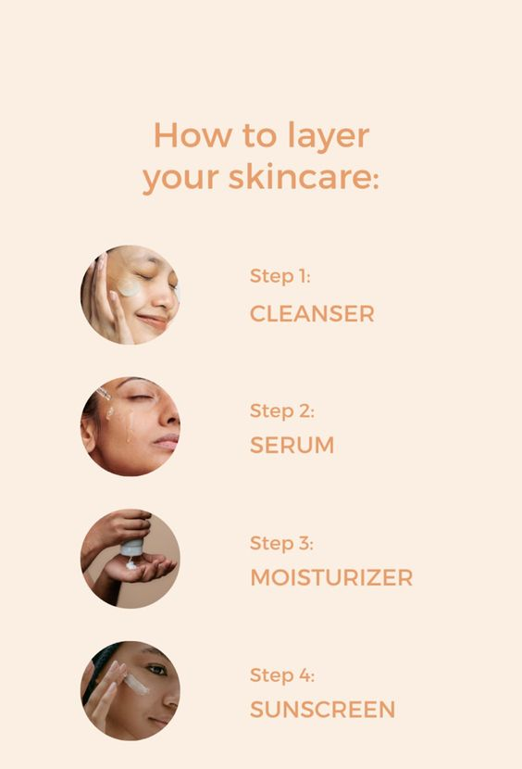
Conclusion
In our journey to transform skincare recommendations, we've created a powerful recommendation system. It effortlessly suggests products similar to your choices, driven by the ingredients that matter most.
We've made personalized skincare accessible, bridging the gap between aspirations and informed decisions. As the skincare world evolves, our system simplifies the path to radiant skin.

Slide 13
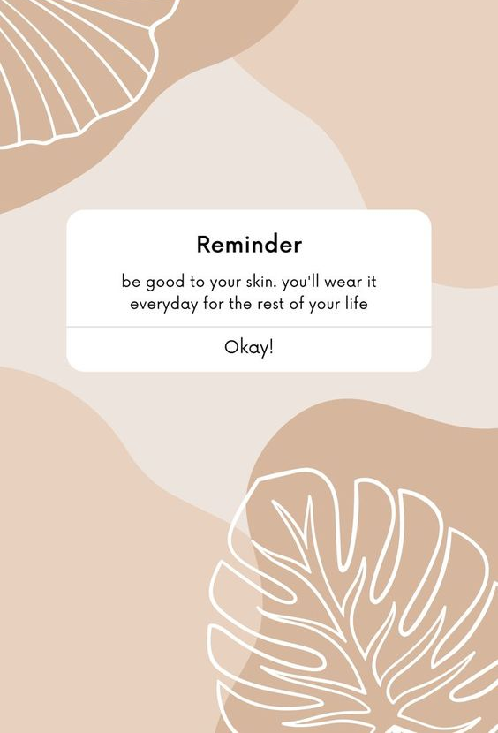
Thank you
The key takeaways reflect the rich learning journey in data analysis and dimensionality reduction, emphasizing the practical skills and insights gained throughout the project.

