Slide 1
Initial Engagement Analysis

Slide 2
My name is Manali Thakur, and I am excited to share with you my analysis and findings. Please note that this is very short initial analysis and ca be analyzed further based on the findings. I have tried to answer the following questions:
1. Which banners lead to the most conversions?
2. Which banners should be displayed to promote customer conversions?
3. What is the distribution of user engagement events (show, click, purchase) across different site versions (mobile vs. desktop)?
4. How does the overall click-through rate (CTR) vary across different banners and product categories?
5. Which user segments can be identified?

Slide 3
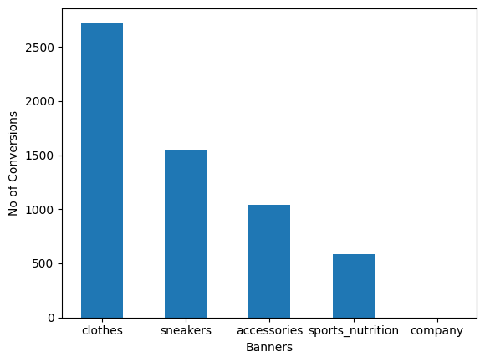
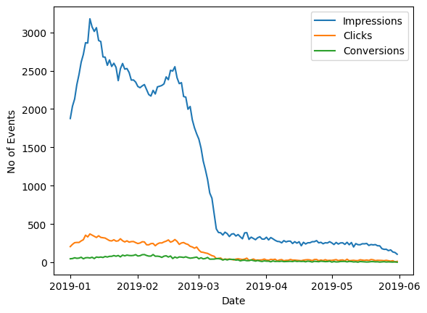
Which banners lead to the most conversions?
After 3 months, the impressions have reduced by 16%, indicating a decrease in the visibility or exposure of the products to the target audience.
No conversions for banner ‘company’, can be analyzed further for the reason behind this.

Slide 4
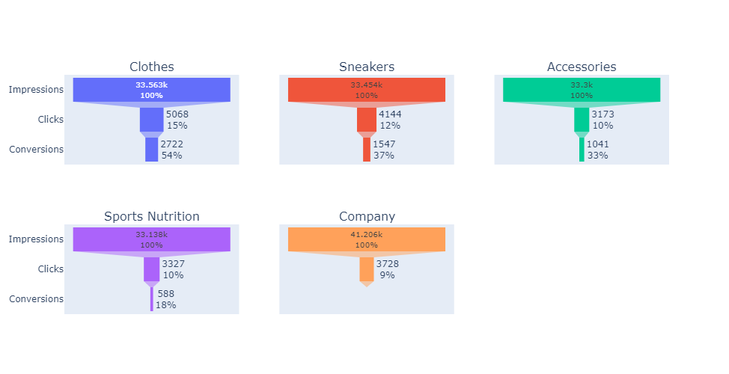
Which banners should be displayed to promote customer conversions?
Based on these conversion rates, the "Clothes" banner has the highest conversion rate of 53.7%, indicating that it is most effective in promoting customer conversions. The "Accessories" and "Sneakers" banners also have relatively high conversion rates of 32.8% and 37.3%, respectively. On the other hand, the "Company" and "Sports Nutrition" banners have lower conversion rates of 0.0% and 17.7%, respectively.
Therefore, if the goal is to promote customer conversions, it is recommended to prioritize displaying the "Clothes" banner followed by the "Accessories" and "Sneakers" banners. The "Company" and "Sports Nutrition" banners may not be as effective in generating conversions and could be further optimized or reconsidered.
NOTE: Conversion Rate = (Number of Purchases / Number of Clicks) * 100

Slide 5
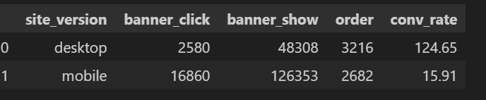
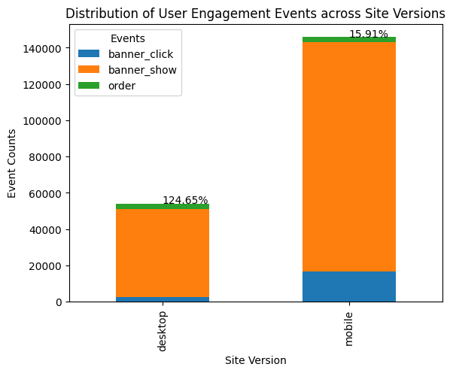
What is the distribution of user engagement events (show, click, purchase) across different site versions (mobile vs. desktop)?
It seems unusual that the number of orders from the desktop site is higher than the number of clicks. This could be due to various factors, such as differences in user behavior or the effectiveness of the banners on the desktop site and can be further analyzed. Due to this, even though the Desktop site has less events, the conversion rate is 124.65% (unreal).

Slide 6
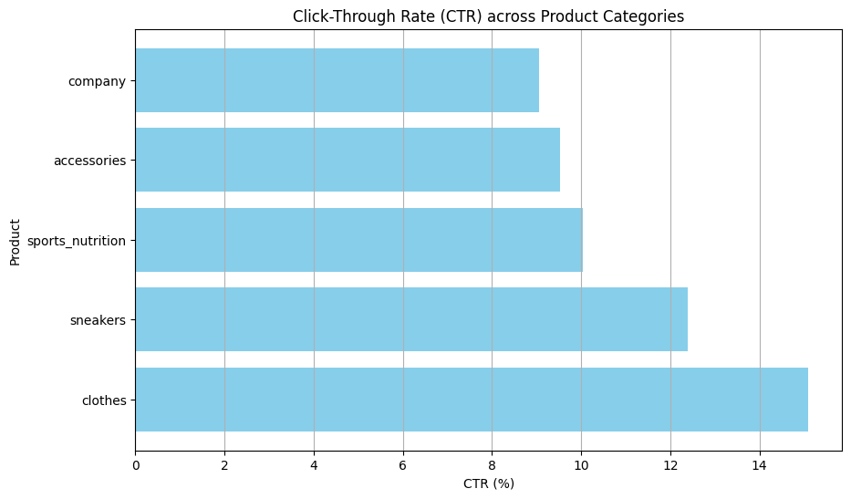
How does the overall click-through rate (CTR) vary across different banners and product categories?
The "clothes" category stands out as having both a higher CTR and conversion rate, suggesting that it may be an effective category for promoting customer conversions.
NOTE: Click-through Rate (CTR) = (Number of Clicks / Number of Impressions) * 100

Slide 7
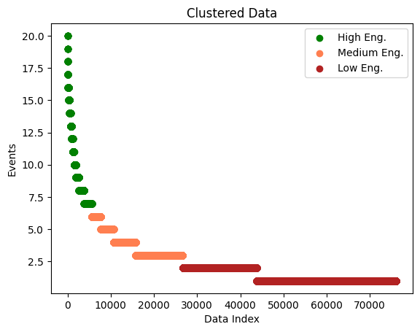
Segmentation criteria (User engagement)
Moderate Engagement Segment: Customers with 'events' values of 3, 4, 5, and 6
Low Engagement Segment: Customers with 'events' values of 1 and 2
High Engagement Segment: Customers with 'events' values ranging from 7 to 20

Slide 8
Segmentation criteria (User engagement)
Low Engagement Segment:
Total users in this segment: 66,596 (33% of the total)
Percentage of users who made an order: 1.3%
Site version distribution: There is a relatively equal distribution between mobile and desktop site versions in this segment.
Moderate Engagement Segment:
Total users in this segment: 80,432 (40% of the total)
Percentage of users who made an order: 3.9%
Site version distribution: The majority of users in this segment prefer the mobile site version.
High Engagement Segment:
Total users in this segment: 52,971 (26% of the total)
Percentage of users who made an order: 3.6%
Site version distribution: The majority of users in this segment prefer the mobile site version.

Slide 9
Conclusion
User Segmentation: The analysis revealed three distinct user segments based on their engagement levels - Low Engagement, Moderate Engagement, and High Engagement. Understanding these segments can help tailor marketing strategies and optimize promotional efforts to cater to each group's specific needs and behaviors.
Banner Performance: Based on the analysis, the "Clothes" banner had the highest conversion rate, followed by the "Accessories" and "Sneakers" banners. The "Company" and "Sports Nutrition" banners had lower conversion rates and may require optimization or reconsideration in the overall banner strategy.
Site Version Impact: The distribution of user engagement events across mobile and desktop site versions showed interesting insights. The desktop site had a higher number of orders compared to clicks, suggesting potential differences in user behavior or the effectiveness of banners on the desktop site. Further analysis is needed to understand the reasons behind this discrepancy.
Future Opportunities: The analysis of historical and future conversion rates provides valuable insights for decision-making and future planning. Identifying trends and patterns in user behavior can help anticipate changes, adapt strategies, and optimize promotional campaigns to maximize conversions.

Slide 10
Next Steps
Further Analysis: Conduct a deeper analysis of user behavior within each segment to identify specific patterns and trends that may influence conversion rates. Explore factors such as demographics, browsing behavior, and purchase history to gain a comprehensive understanding of user preferences and needs.
A/B Testing: Implement A/B testing to evaluate the performance of different banner variations and promotional strategies. Test different designs, messaging, and placement of banners to identify the most effective combinations that drive higher conversion rates. Continuously monitor and analyze the results to refine and optimize the promotional efforts.
Customer Feedback and Surveys: Gather feedback from customers to understand their perception of banners, website usability, and overall shopping experience. Conduct surveys or interviews to gain insights into customer preferences, pain points, and areas for improvement. Incorporate this feedback into future marketing strategies and website enhancements to enhance the overall customer experience.

