Slide 1

EXPLORATORY DATA ANALYSIS
(EDA)

Slide 2
Libraries used (python)
Pandas
Matplotlib
Seaborn

Slide 3
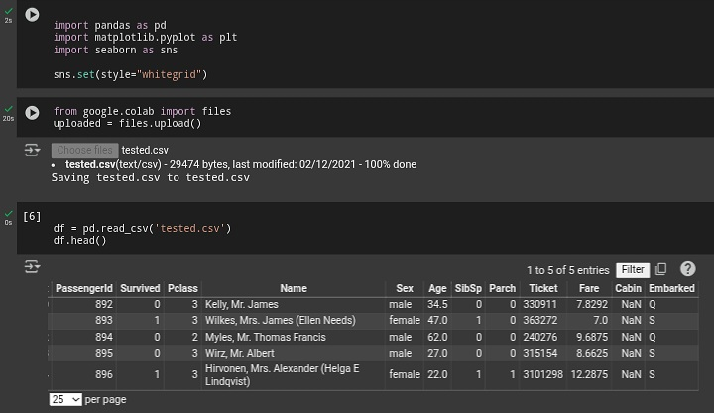

Slide 4
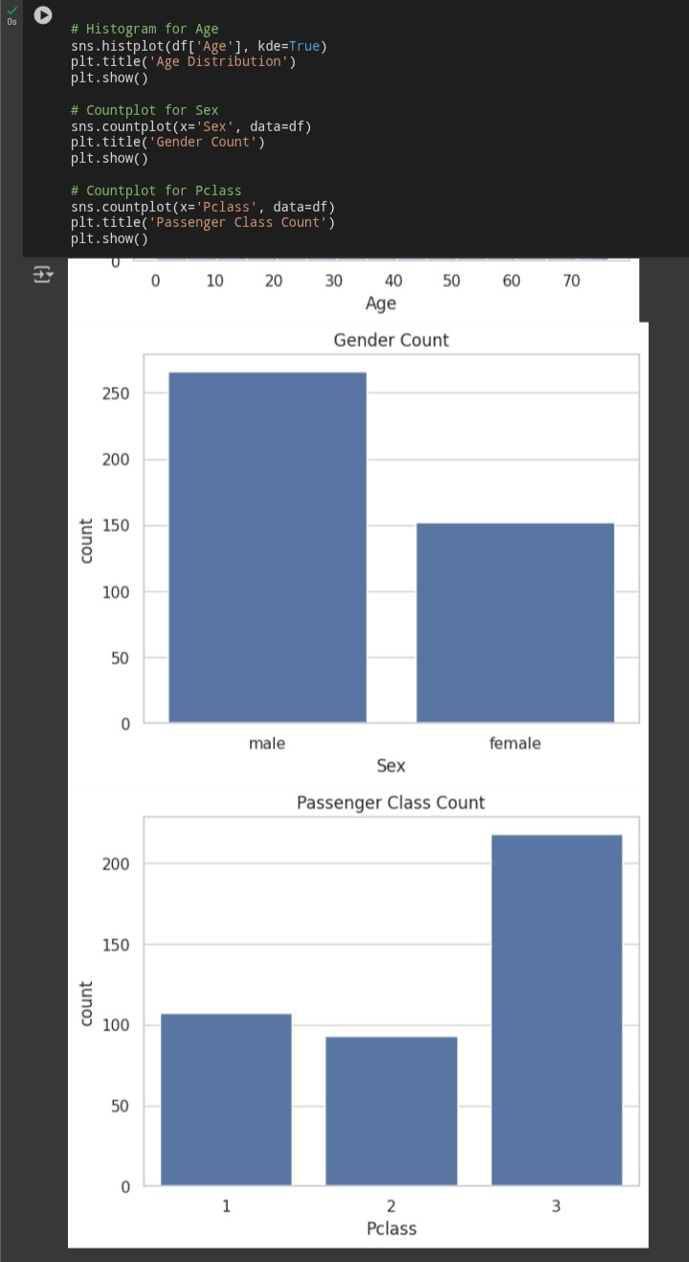
sns.histplot() – Histogram of Age
🔹 Code:
sns.histplot(df['Age'], kde=True) plt.title('Age Distribution’)
🧠 Observation:
Age distribution is unimodal and right-skewed.
Most passengers are between 20–40 years old.
There's a long tail toward elderly passengers, and some infants are also present.
sns.countplot(x='Sex') – Count of Genders
🔹 Code:
sns.countplot(x='Sex', data=df) plt.title('Gender Count’)
🧠 Observation:
More males than females on board.
Roughly 2:1 male-to-female ratio.

Slide 5
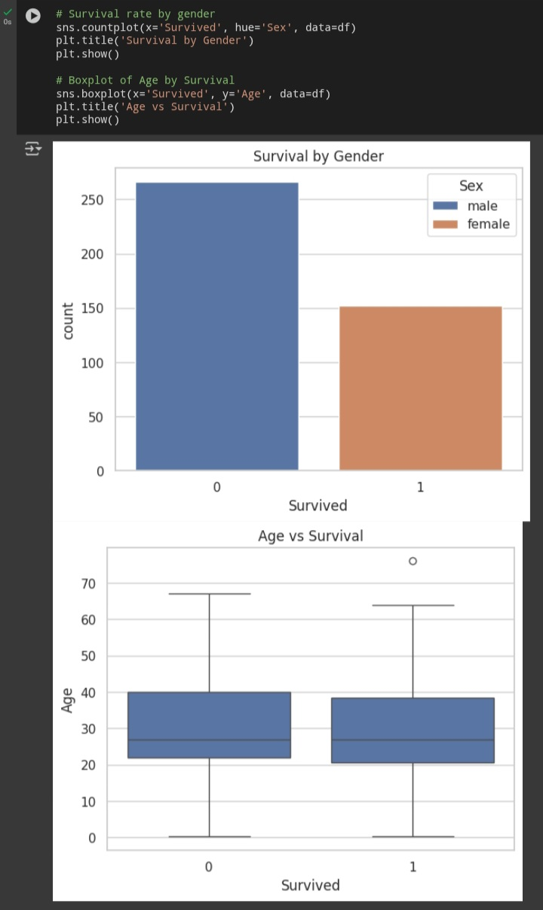
sns.countplot (x='Pclass’) – Passenger Class Count 🔹Code: sns.countplot(x='Pclass', data=df) plt.title('Passenger Class Count’) 🧠 Observation: Most passengers are from 3rd class. 1st class has the fewest passengers. 📌 sns.countplot(x='Survived', hue='Sex') – Survival by Gender 🔹 Code: sns.countplot(x='Survived', hue='Sex', data=df) plt.title('Survival by Gender’) 🧠 Observation: Females survived more often than males. Most of those who died were male. differences).

Slide 6
📌 sns.boxplot(x='Survived', y='Age') – Age vs Survival 🔹 Code: sns.boxplot(x='Survived', y='Age', data=df) plt.title('Age vs Survival’) 🧠 Observation: ●Survivors had a slightly lower median age. ●There are more young survivors, especially children.

Slide 7
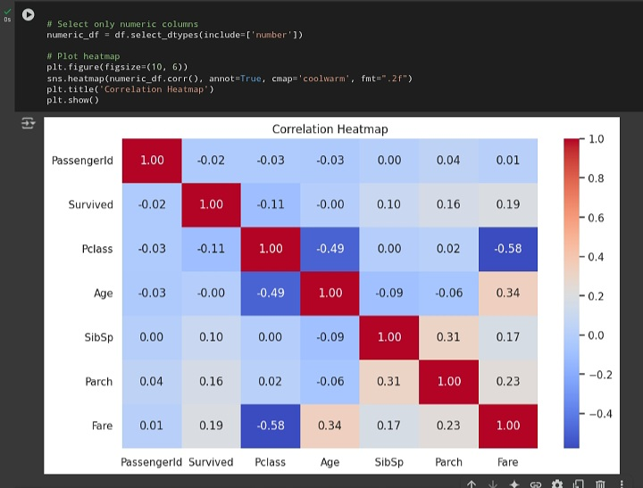
📌 sns.heatmap(df.corr()) – Correlation Heatmap 🔹 Code: sns.heatmap(df.select_dtypes(include='number').corr(), annot=True, cmap='coolwarm’) 🧠 Observation: ●Fare and Pclass have a negative correlation (as expected). ●Fare shows some positive correlation with Survived. ●Other correlations are weak, but SibSp and Parch are positively related.

Slide 8
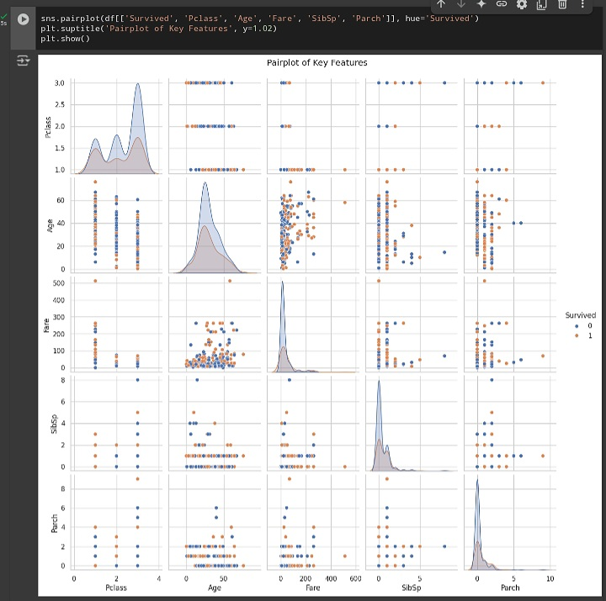
📌 sns.pairplot() – Multivariate Relationships 🔹 Code: sns.pairplot(df[['Survived', 'Pclass', 'Age', 'Fare', 'SibSp', 'Parch']], hue='Survived’) 🧠 Observation: ●1st class + high fare + younger age → more survival clusters. ●Some separability is visible for modeling. ●Fare vs Pclass shows distinct vertical stripes (due to class fare differences).

Slide 9
📌 Observations
• Most passengers are in Pclass 3 and male. • Survival rate is higher for females. • Younger passengers show slightly better survival chances. • Fare shows a positive correlation with survival (higher fare → better chance).

Slide 10
Summary
The EDA reveals that gender and passenger class significantly influence survival. Females and higher-class passengers had a better survival rate. Age and fare show moderate effects, and many features are skewed, suggesting possible Preprocessing for Modeling.

