Slide 1

Superstore Data

Slide 2
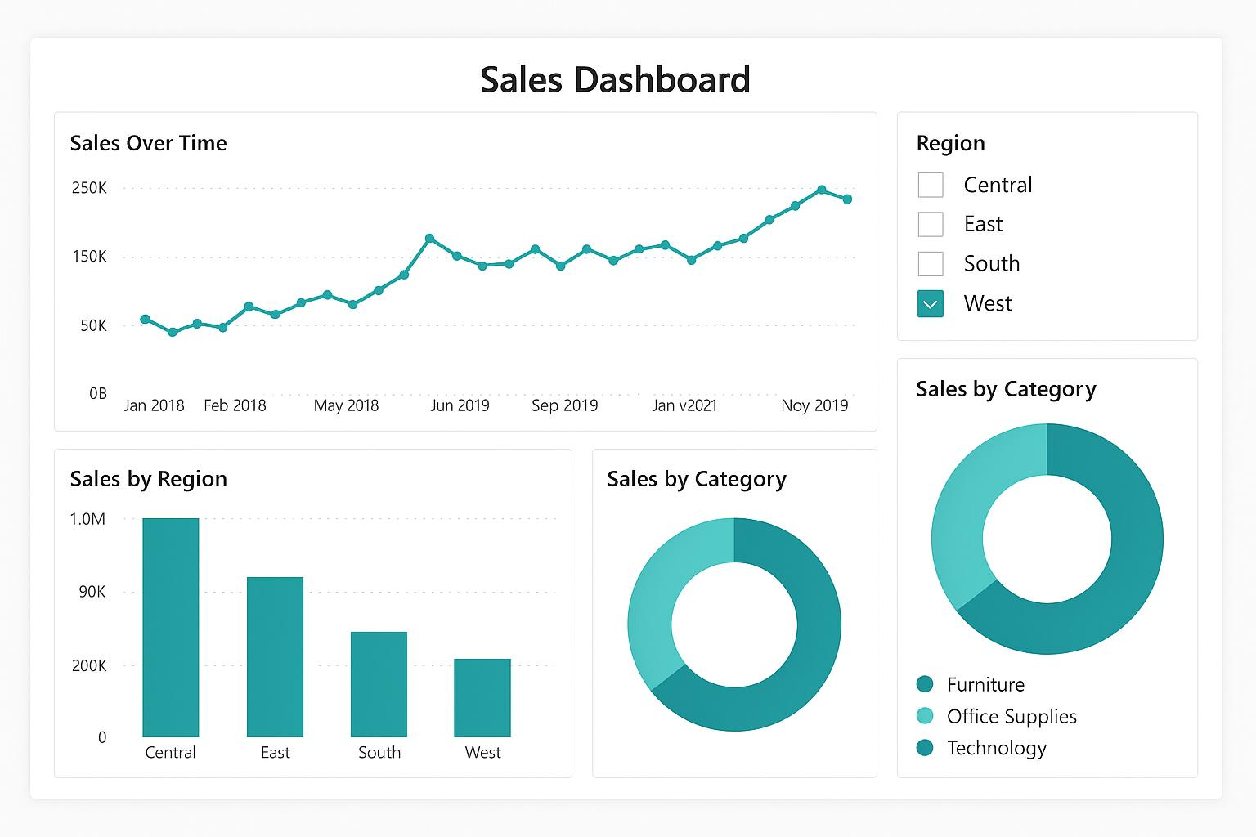

Slide 3
Sales Dashboard Insights
1.The Central region recorded the highest overall sales, followed by the East region.
2. The West region had the lowest total sales among all four regions.
3. The Technology category contributed the most to total sales across all categories.
4. There was a noticeable sales peak around mid to late 2019, possibly indicating seasonal demand or promotions.
These insights help focus attention on boosting sales in the West region and leveraging high-performing categories.

