Slide 1

EAS 509: Statistical Learning II (21047 Fall 23)
Manali Bansidhar Ramchandani
UBID: manaliba
UB Person Number: 50495140

Slide 2

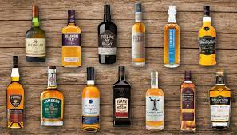
Leveraging Time Series Analysis for Liquor Sales Insights
A Time Series Approach to Uncover Market Dynamics

Slide 3

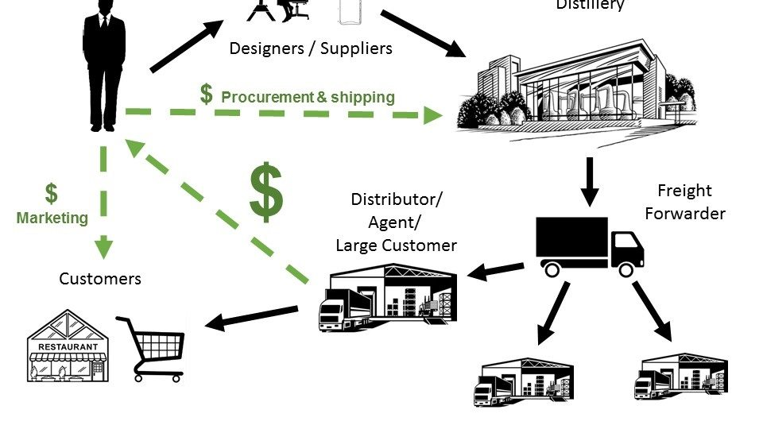
Introduction
"Welcome to our analytical journey into the Liquor Sales Industry, a sector rich with data and ripe for exploration."
"In this project, we harness the power of statistical learning to dissect and understand the patterns hidden within extensive liquor sales data. Our analysis spans from 2012 to 2020, covering diverse variables from 'Store Name' and 'Vendor Name' to 'Bottles Sold' and 'Sales in Dollars'."
"Our goal is twofold: First, to illuminate the trends and shifts in liquor sales over time, unraveling how external factors like store location, product category, and vendor influence these trends. Second, to build predictive models that accurately forecast future sales, providing a robust tool for strategic decision-making."
"This is not just a study of numbers and patterns; it is an endeavor to equip liquor retailers and distributors with insights that can drive their businesses forward in a competitive market."

Slide 4
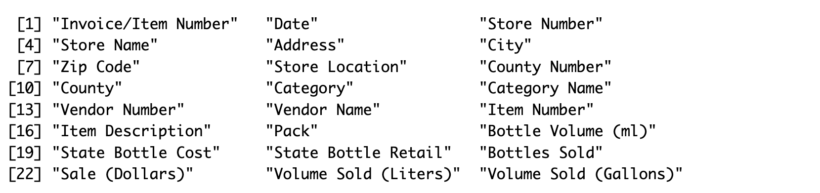
Dataset Overview: Sourced from Kaggle
"Utilizing a comprehensive liquor sales dataset from Kaggle, our analysis covers the period from January 2012 to September 2020."

Slide 5
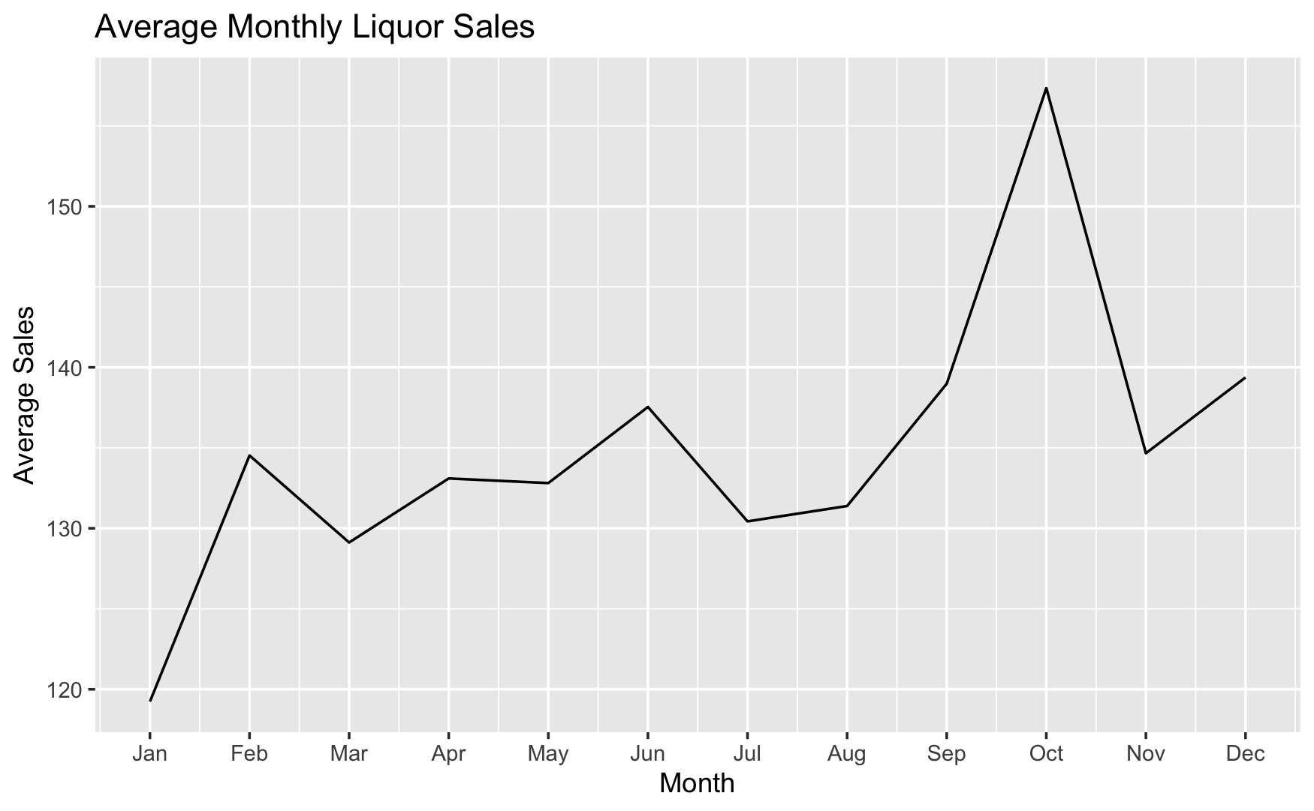
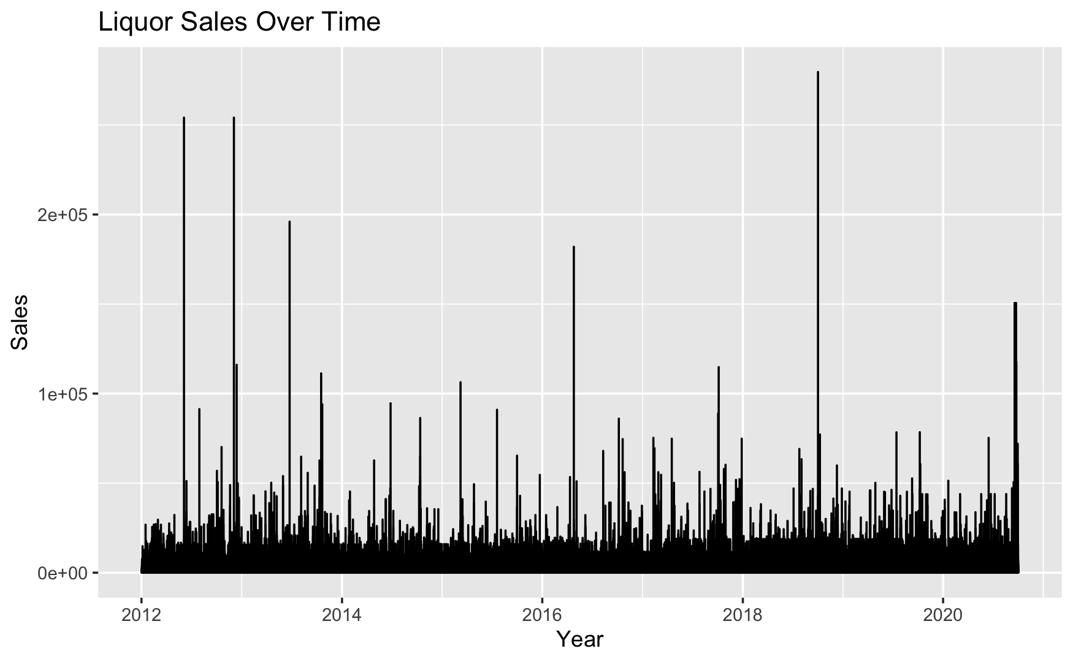
"Average Monthly Sales Trends” and "Yearly Sales Over Time"
Average Monthly Sales Trends:
The graph depicts a clear seasonal pattern in liquor sales, with peaks and troughs corresponding to various times of the year.
Sales typically increase during the months of [peak month(s)], which may correlate with holidays and special events, indicating a potential opportunity for targeted marketing strategies.
The lowest sales are observed in [trough month(s)], suggesting a period where consumer demand is at its lowest.
Yearly Sales Over Time:
The time series graph from 2012 to 2020 shows the overall trend in liquor sales, with notable spikes in certain years.
The increasing trend in sales over the years with some fluctuations suggests a growing market with potential yearly variances that could be linked to economic factors or changes in consumer behavior.

Slide 6
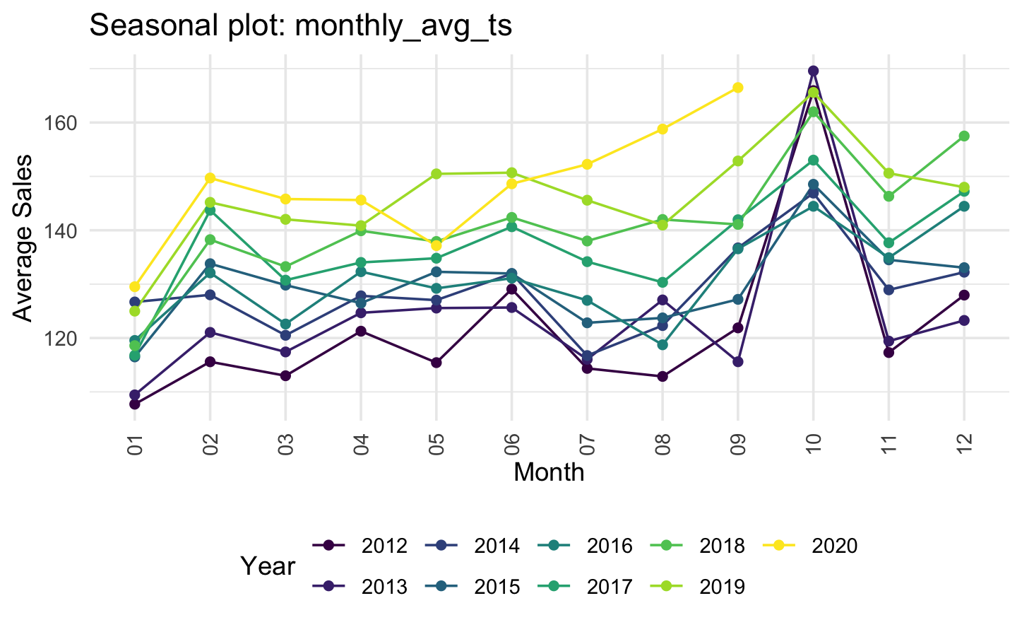
"Dissecting Seasonal Variations: A Multi-Series Analysis"
Comparative Seasonal Sales Trends Across Years
This graph represents the comparative seasonal trends in liquor sales across different years.
Each line corresponds to a different year, allowing us to observe how seasonal patterns vary annually.

Slide 7
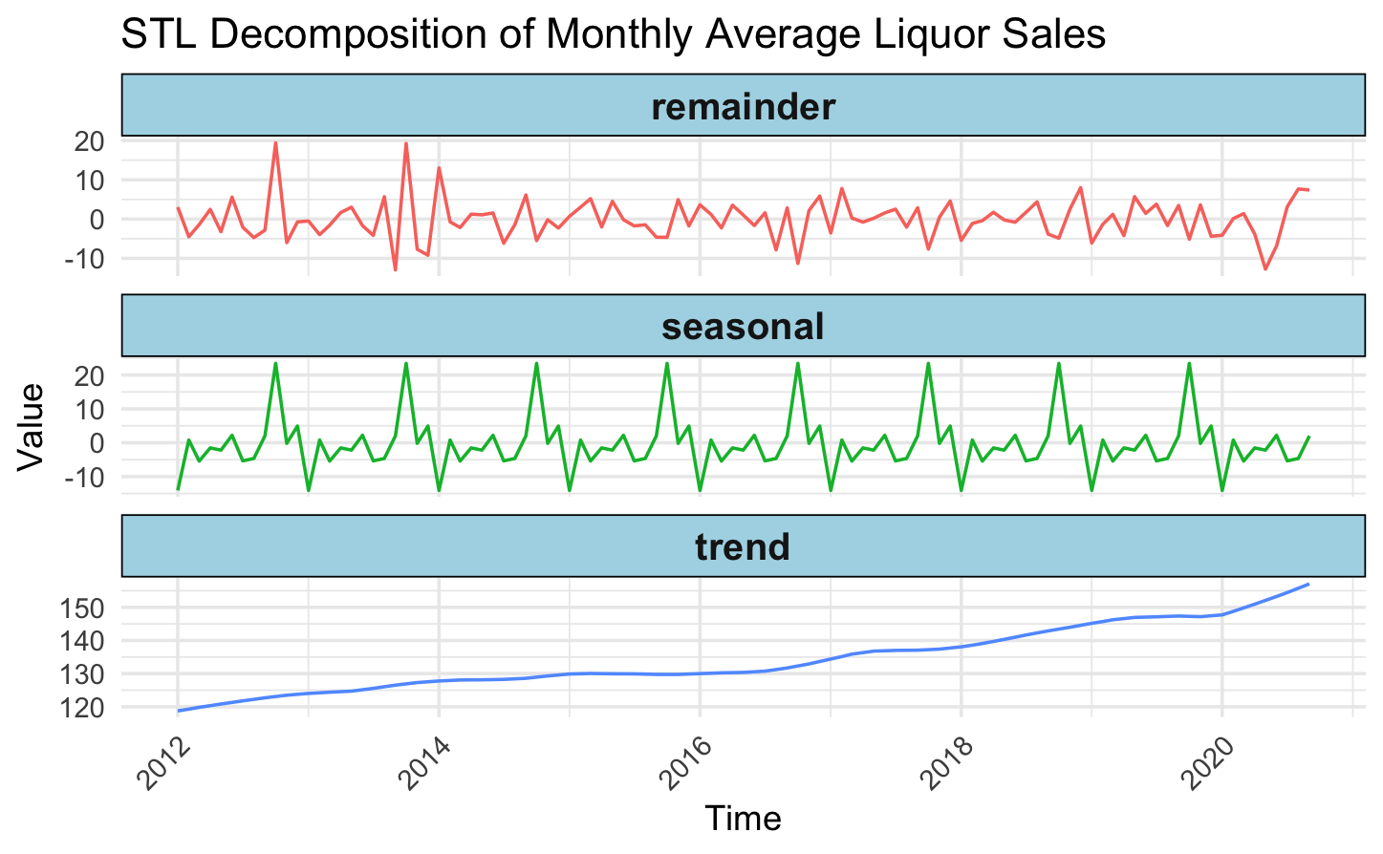
"Decomposing Liquor Sales Data: Trend, Seasonality, and Residuals"
Trend Component:
There is a noticeable upward trend indicating an overall increase in average monthly liquor sales over the period from 2012 to 2020.
The trend is relatively smooth, which suggests a steady growth in sales without abrupt changes, indicating a stable market expansion or increasing demand over time.
Seasonal Component:
The seasonal component displays a clear and consistent cyclical pattern, which repeats annually.
There are peaks and troughs that correspond to certain months each year, likely aligning with seasonal events or consumer habits.
The amplitude of the seasonal fluctuations appears relatively stable over the years, which suggests that the seasonal behavior of consumers has not undergone significant changes during this period.
Remainder Component:
The remainder, which is the residual after the trend and seasonal components have been removed, shows variability around the zero line.
Some spikes and dips go beyond the expected noise level, which could represent non-systematic factors affecting sales or potential outliers.
The remainder does not display any apparent pattern, which indicates that the trend and seasonal components have been effectively captured by the model, and what is left is likely random variation or irregular events.

Slide 8
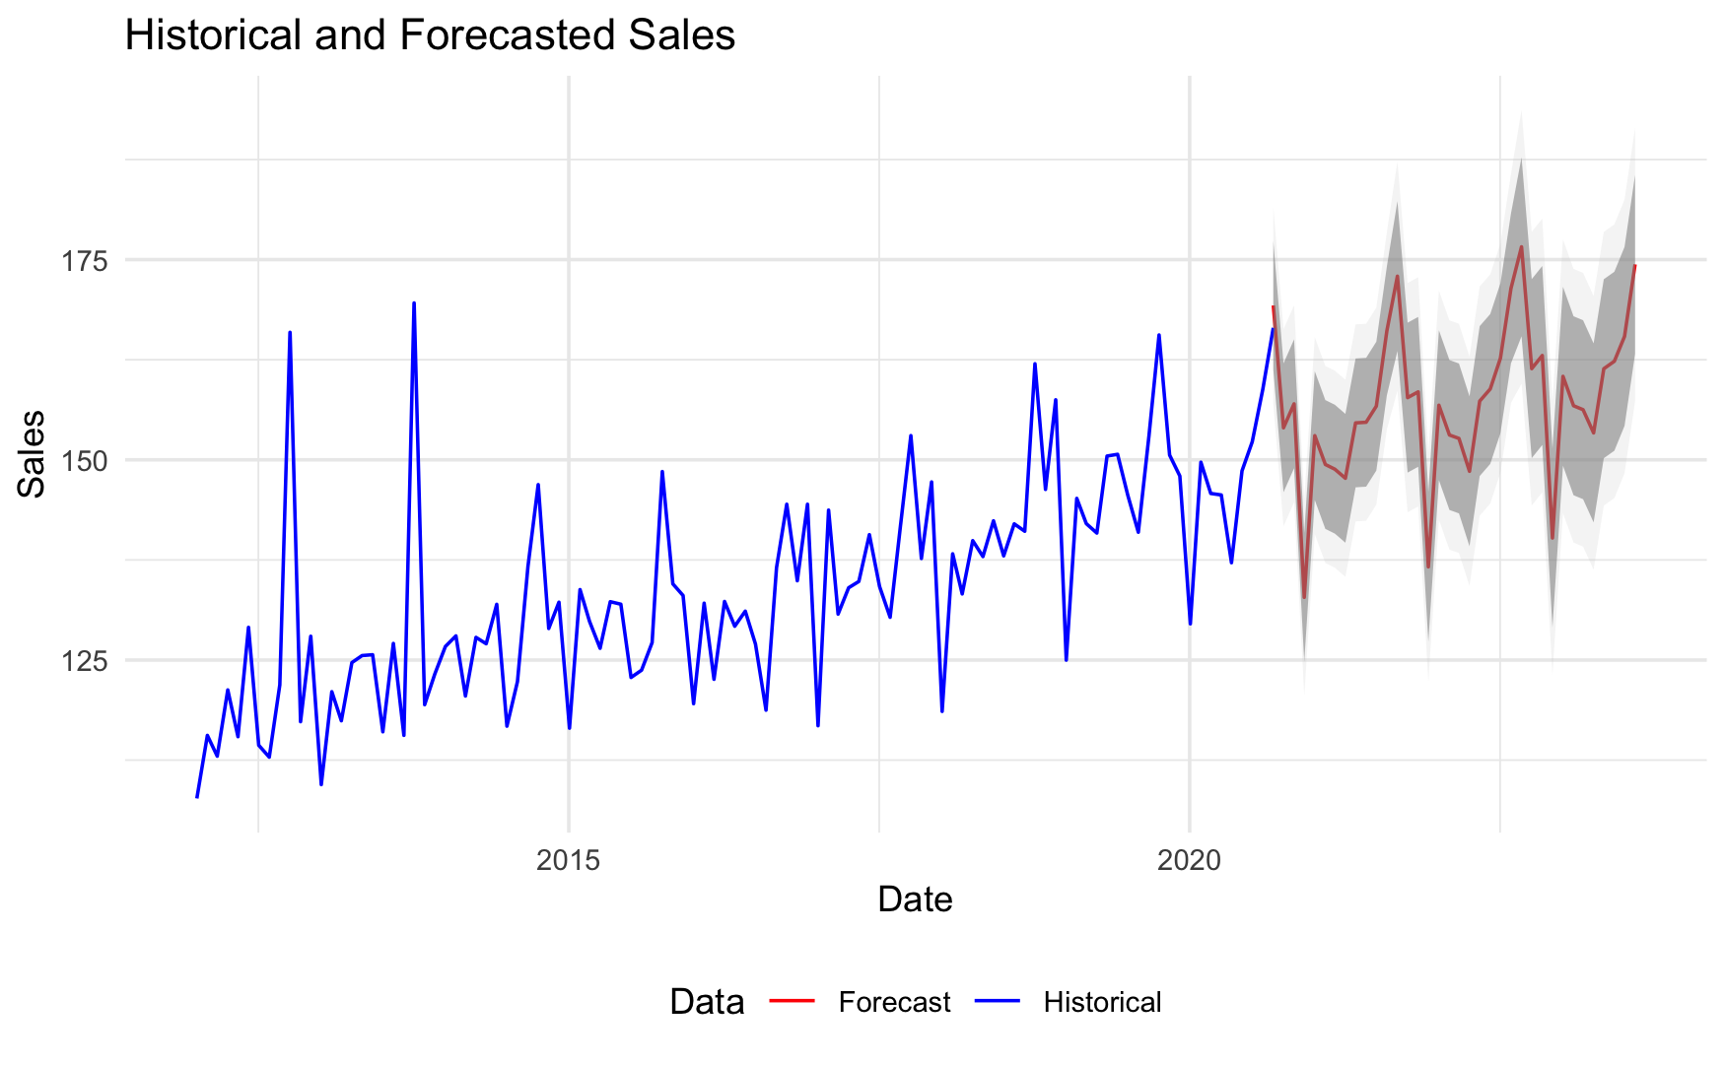
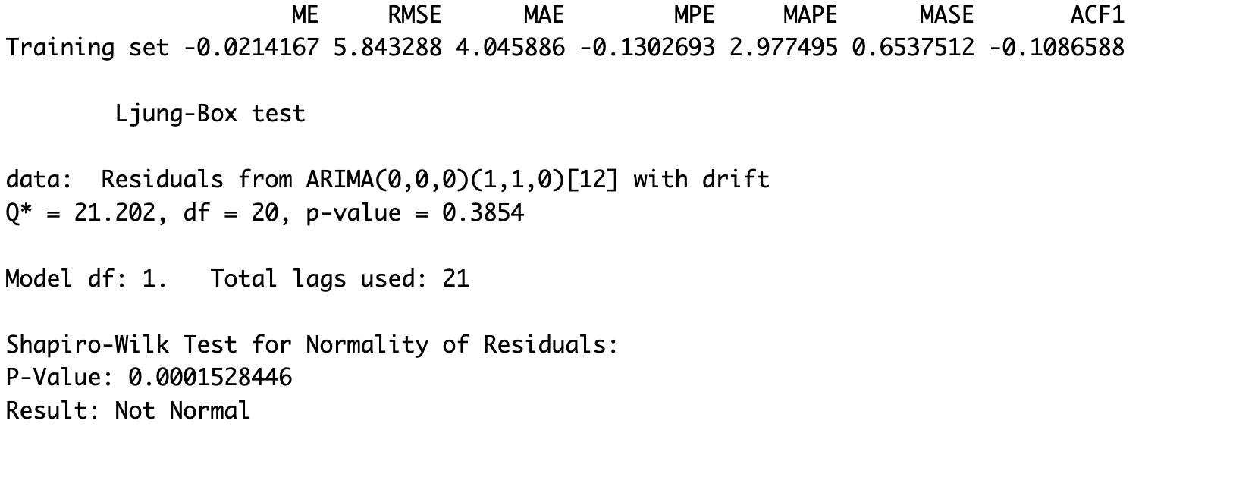
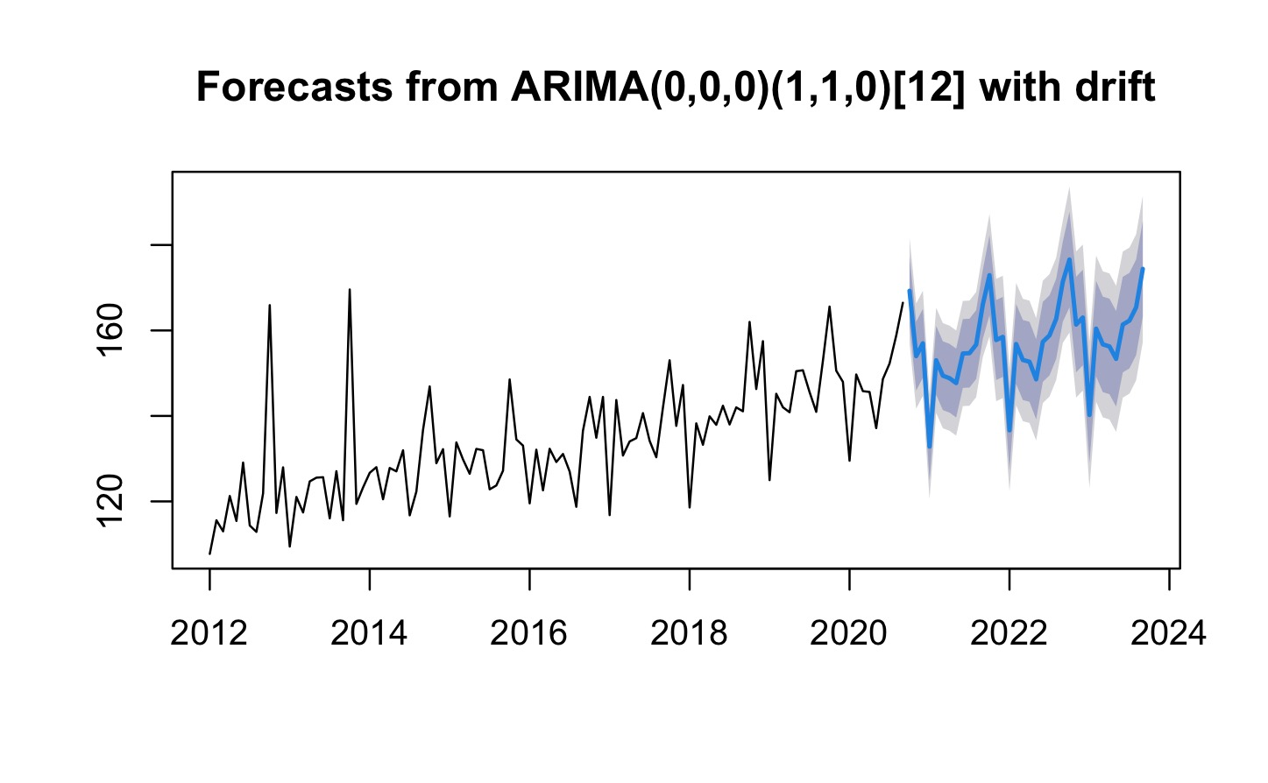
"Forecasting Future Sales: The ARIMA Approach"

Slide 9

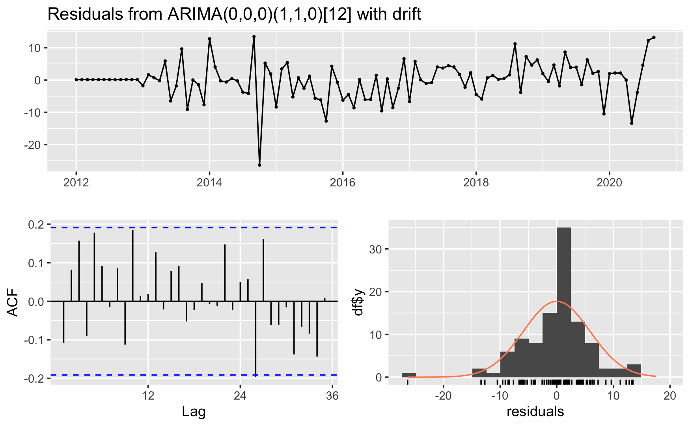
"Model Fit and Validity: Analyzing ARIMA Residuals"

Slide 10

"Beyond the Present: Future Endeavors in Sales Forecasting"
For enhanced predictive performance can investigate the potential of machine learning algorithms, like Random Forests or Neural Networks, which might reveal complex non-linear patterns not captured by ARIMA models.
We can incorporate exogenous variables & explore the impact of macroeconomic factors, such as unemployment rates or consumer confidence indices, on liquor sales to refine the forecasts.
We can also develop a framework for integrating forecasting models with real-time sales tracking to allow for dynamic adjustments to predictions based on the latest data.
We can consider contributing to or developing open-source forecasting tools that can be iteratively improved through community involvement.

Slide 11

Conclusion
Reflecting on Analytical Insights:
The ARIMA model has validated its strength in capturing and projecting the inherent seasonality and trends in liquor sales data.
Forecasting has shown both continuity with historical patterns and adaptability to evolving market conditions, as evidenced by confidence intervals.
Strategic Business Outcomes:
Time series analysis offers a strategic tool for optimizing inventory ahead of peak seasons, aligning with consumer purchase behaviors.
Accurate forecasts empower businesses to pre-emptively adjust their strategies, enhancing their competitive edge in the market.
Achievements and Future Aspirations:
The model's accuracy metrics and diagnostic checks underscore the reliability of our predictive approach while also pointing to opportunities for further refinement.
Looking ahead, incorporating additional variables and embracing machine learning could unlock new dimensions of analytical depth and precision.
Parting Thought:
"As we distill the essence of past sales data through analytical rigor, we not only predict the future but shape it, crafting tailored strategies that respond dynamically to the evolving palate of the market."

Slide 12


