Slide 1


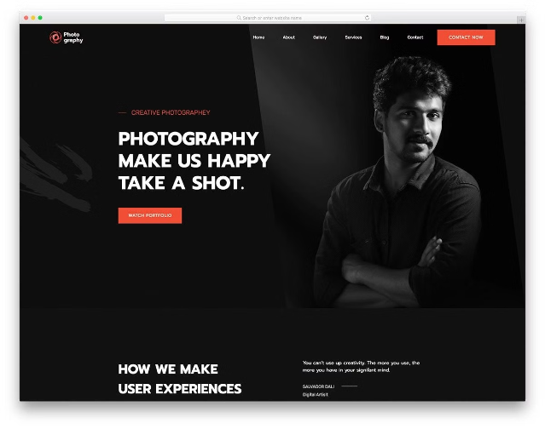
PortfolioForge
Group Members ( PANEL D) :
Manali Bhingare ( 1032222122) , Rollno:09
Priyanka Bista ( 1032222084), Rollno: 05
Paras Harwani ( 1032222180), Rollno: 20
Rajat Deshpande (1032222074), Rollno:02
PortfolioForge is a comprehensive portfolio making tool that simplifies the process of creating professional portfolios.

Slide 2

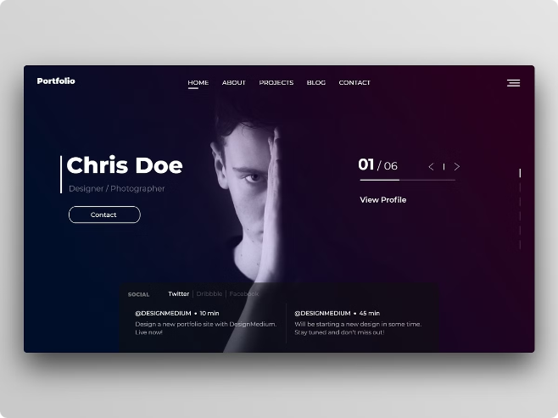
Abstract
1
Overview
PortfolioForge is an innovative tool that simplifies the process of creating professional portfolios. It provides users with customizable templates tailored to various industries, integrates seamlessly with popular platforms like LinkedIn and GitHub, and supports real-time collaboration.
2
Purpose
The primary aim of PortfolioForge is to address the challenges individuals face when creating portfolios, such as the lack of design skills, the time-consuming nature of updating content, and the difficulty of integrating data from multiple sources.
3
Keywords
Portfolio creation, automation, customization, integration, user-friendly design

Slide 3
Introduction
Problem Statement
Solution Overview
Traditional methods of portfolio creation are often manual, time-consuming, and require design expertise. Users struggle with updating portfolios regularly, integrating data from various sources, and presenting their work in a visually appealing manner.
PortfolioForge aims to streamline and automate the portfolio creation process by providing an easy-to-use platform that caters to professionals across various industries. It removes the barriers of design and technical know-how, allowing users to focus on content.

Slide 4

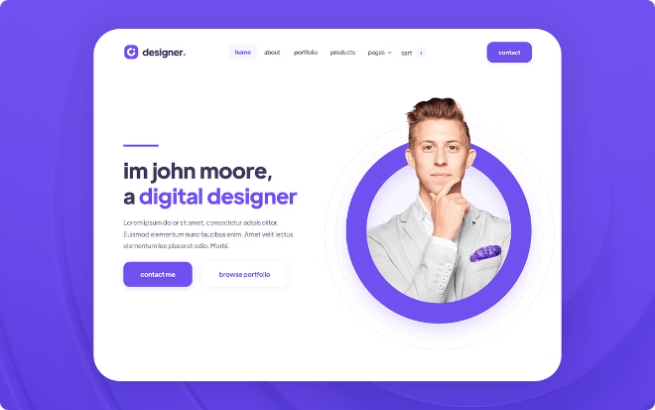
Objectives
Automation
Provide tools that automate the process of portfolio creation, reducing manual effort.
Customization
Offer industry-specific templates that can be easily customized to match the user's brand and style.
Integration
Seamlessly connect with platforms like LinkedIn, GitHub, and Google Drive to import and update portfolio content automatically.
Collaboration
Enable users to collaborate with colleagues, mentors, or clients in real-time during the portfolio creation process.

Slide 5

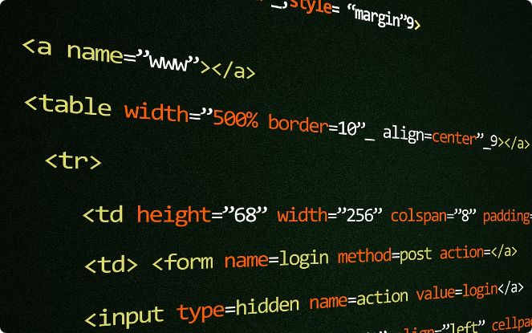
Software and Hardware Requirements
Software Requirements
Hardware Requirements
Operating System: Compatible with Windows 10, macOS 11.0, and Linux.
Processor: Intel i5 or equivalent for development environments; server deployment may require more powerful processors (Intel Xeon or AMD Ryzen).
Programming Languages: Primarily developed using Python for backend logic and JavaScript for frontend interactivity.
Memory (RAM): 8GB or more for smooth development; 16GB recommended for running multiple virtual environments.
Frameworks and Tools: Backend: Flask or Django for creating robust APIs and handling user authentication. Frontend: React.js for building responsive user interfaces.
Storage: SSD with at least 500GB for development; server environments should have scalable storage solutions depending on user base.
Database: MongoDB for storing portfolio data and user information, with optional MySQL for relational data storage.
Other Tools: Integration with Git for version control, Docker for containerization, and CI/CD pipelines for continuous deployment.

Slide 6
Workflow
1
User Registration and Login
Users sign up and log in using email, social media accounts, or single sign-on (SSO).
2
Portfolio Template Selection
Users choose a template based on their industry or personal preference.
3
Data Import
Users connect their LinkedIn, GitHub, and Google Drive accounts to import content automatically.
4
Customization
Users modify the template using the drag-and-drop editor, adding sections, adjusting layout, and inserting multimedia.
5
Collaboration
Users invite collaborators who can edit or review the portfolio in real-time.
6
Export and Publication
The final portfolio can be exported as a PDF, published online, or shared as a private link.

Slide 7

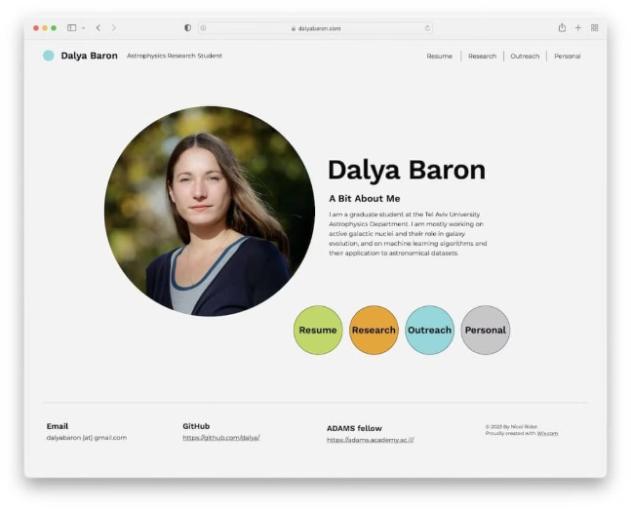
Use Cases
1
Academia
Professors and students can create portfolios to showcase research, publications, and academic achievements.
2
Creative Industries
Designers, artists, and photographers can present their work in visually appealing layouts that highlight their creativity.
3
Corporate
Business professionals can compile their work history, projects, and skills to support job applications or professional networking.

Slide 8
Challenges
Integration Challenges
User Adoption
Scalability
Resistance to Change: Users accustomed to traditional methods may be hesitant to switch to an automated tool.
Performance Issues: As the user base grows, the platform must handle increased traffic and larger datasets without compromising performance.
API Limitations: Some platforms may have restrictive APIs, limiting the amount of data that can be imported or updated automatically.

Slide 9


Future Enhancements
AI-Driven Features
Expanded Integrations
Content Suggestions: Implement AI to suggest content, such as skills or projects, based on the user’s industry and experience. Design Optimization: Use AI to recommend design improvements based on best practices and user preferences.
New Platforms: Add support for additional platforms like Behance, Dribbble, and Stack Overflow.
Advanced Customization
Mobile Support
Theme Builder: Allow users to create and share their own custom themes or templates.
Responsive Design: Ensure that portfolios can be easily viewed and edited on mobile devices.

Slide 10


Q&A
Open the floor for questions and invite the audience to discuss specific features or challenges they are interested in.

