Slide 1

AgriNation
Enabling Community-Supported Agriculture
Notes:
maintenance of farm equipment
farmers, non-tech
don’t have key details to solve the problem, lack experience
reduce effort, spend time with actual work
management of equipment
non-technical work
lack of expertise/information
access to information/technical stuff/guidance
monitoring and measurement of farming equipment
farmers, non-technical
complexity, manual processes, scale, cost
reduce time/cost of manual inspection, monitor multiple things in real-time, resilient systems
//// community gardens
/ schools (primary, highschool), universities, local councils, corporate parks
who: farmers
what: consolidated dashboard with IoT
wow: identify problems in near-real time vs 3 days…

Slide 2
The Market
local community
An opportunity for local residents to have a shared garden.
Traditionally managed by either residents themselves or hiring a farmer.
retirement villages
Keep them involved with less worrying about technical issues.
enterprises
Schedule and manage maintenance programs providing more interactive environment.
schools
Study and involve in farming with expert supervision
Farmer managed A farmer sets up and maintains a CSA, recruits subscribers, and controls management of the CSA.
Shareholder/subscriber Local residents set up a CSA and hire a farmer to grow crops, and shareholders/subscribers control most management.
Farmer cooperative Multiple farmers develop a CSA program.
Farmer-shareholder cooperative Farmers and local residents set up and cooperatively manage a CSA

Slide 3




Key Industry Issues
Irrigation
Understanding weather and seasonal conditions to water the right amount at the right time
pest management
Identifying pests and applying control schemes with minimal impact to neighbouring crops.
soil improvement
Analysing the soil to improve crop yield through plant supplements and checking for run-off into neighbouring crops.
crop management
Harvesting at the right time.

Slide 4
Unique Value Proposition
Provide quick and easy to access platform for local community to engage in collaborative farming with less attention to technical details
Farm Monitoring System
Irrigation
Realtime Monitoring
Alert System
Maintain
Pumps
Fault Detection
Scheduling
Solar Panels
Planning
Monitoring
Maintenance
Pest Management
Farmers Network
Social platform
Expert Support
Imminent threats
Cultivation Management
Soil
Fertilizer scheduling
Crops
Harvesting at right time
Notes:
maintenance of farm equipment
farmers, non-tech
don’t have key details to solve the problem, lack experience
reduce effort, spend time with actual work
management of equipment
non-technical work
lack of expertise/information
access to information/technical stuff/guidance
monitoring and measurement of farming equipment
farmers, non-technical
complexity, manual processes, scale, cost
reduce time/cost of manual inspection, monitor multiple things in real-time, resilient systems
who: farmers
what: consolidated dashboard with IoT
wow: identify problems in near-real time vs 3 days…

Slide 5


Personas
Jim is a 50 years old veteran farmer from Geelong and trying to help his local community by setting up a community farm so that everyone can come and contribute. The local community can share the produce from the garden. Since Jim is getting old, he can’t travel to the community farm everyday to take care of the plants. He can make use of technology to get real-time information about his produce.
Rob is a 25 years old IT graduate engineer from Melbourne who started to eat healthy and organic vegetables in the popular supermarkets are expensive. He recently joined his local community garden to grow his own organic vegetables. His job doesn’t allows him a lot of free time over the weekdays and makes it difficult for him to take care of his plants. If he can get alerts about the health of his plants, he can either ask himself or his friends to help him out.

Slide 6
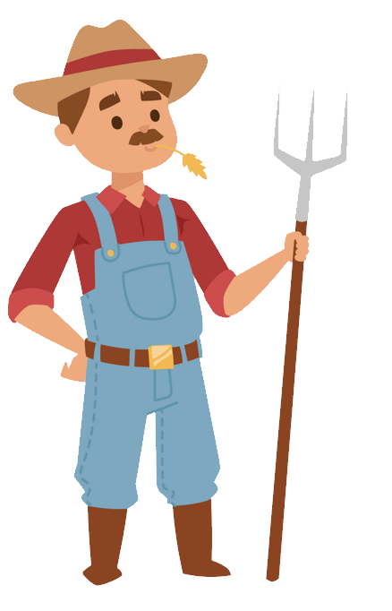

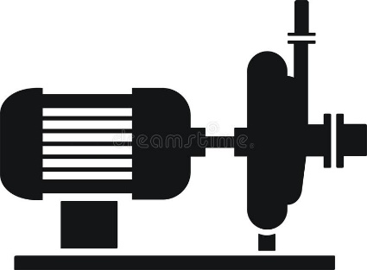

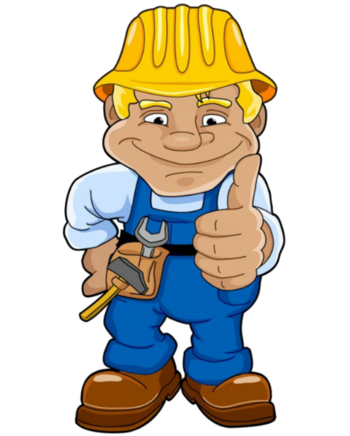

Establish a strong link
Notes:
maintenance of farm equipment
farmers, non-tech
don’t have key details to solve the problem, lack experience
reduce effort, spend time with actual work
management of equipment
non-technical work
lack of expertise/information
access to information/technical stuff/guidance
monitoring and measurement of farming equipment
farmers, non-technical
complexity, manual processes, scale, cost
reduce time/cost of manual inspection, monitor multiple things in real-time, resilient systems
who: farmers
what: consolidated dashboard with IoT
wow: identify problems in near-real time vs 3 days…

Slide 7


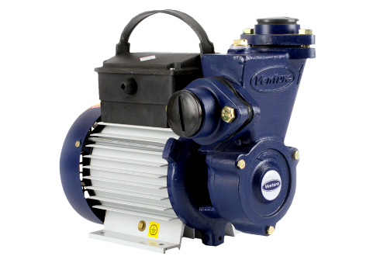
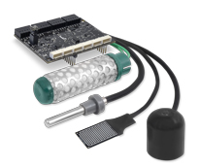

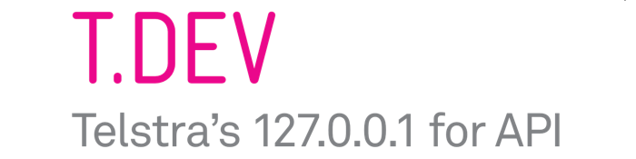
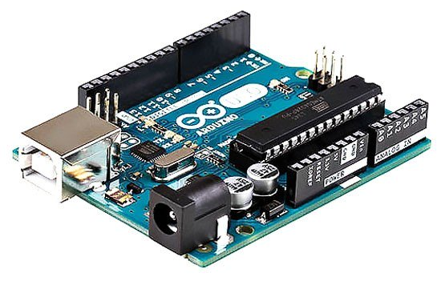
Tech Stack
UI
AgriNation
Equipments
Internet
IoT

Slide 8
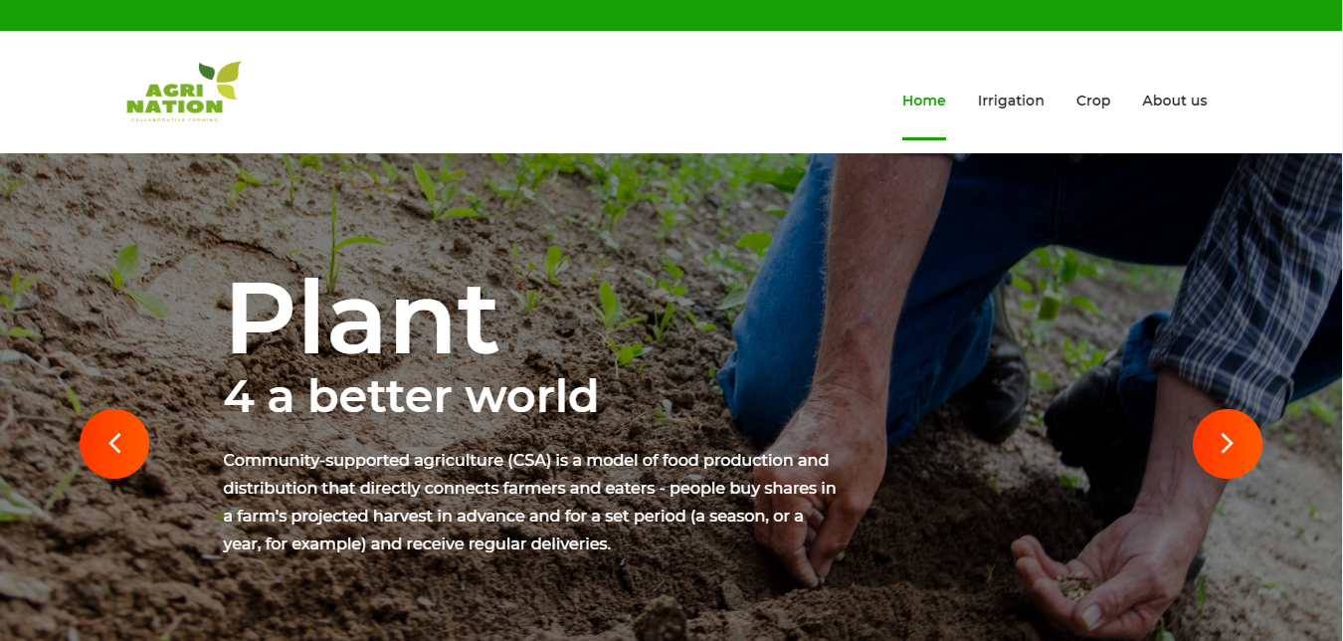
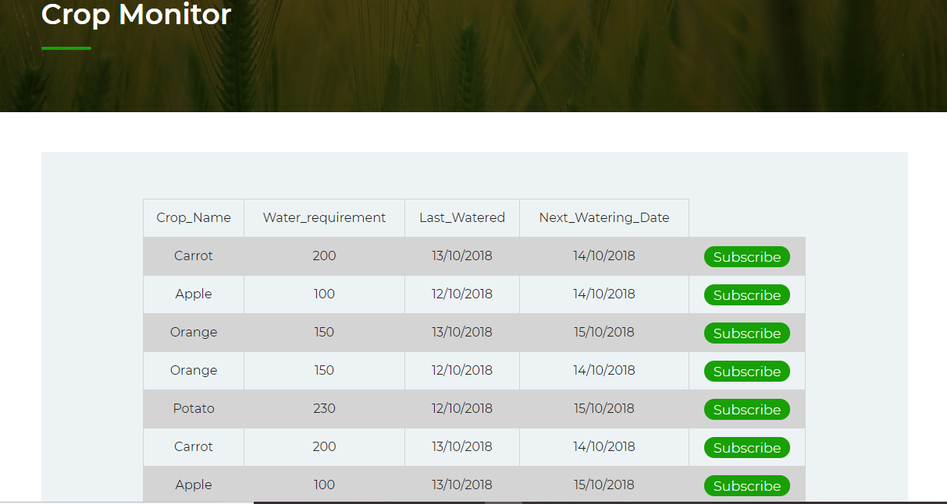
Solution
Notes:
maintenance of farm equipment
farmers, non-tech
don’t have key details to solve the problem, lack experience
reduce effort, spend time with actual work
management of equipment
non-technical work
lack of expertise/information
access to information/technical stuff/guidance
monitoring and measurement of farming equipment
farmers, non-technical
complexity, manual processes, scale, cost
reduce time/cost of manual inspection, monitor multiple things in real-time, resilient systems
who: farmers
what: consolidated dashboard with IoT
wow: identify problems in near-real time vs 3 days…

Slide 9
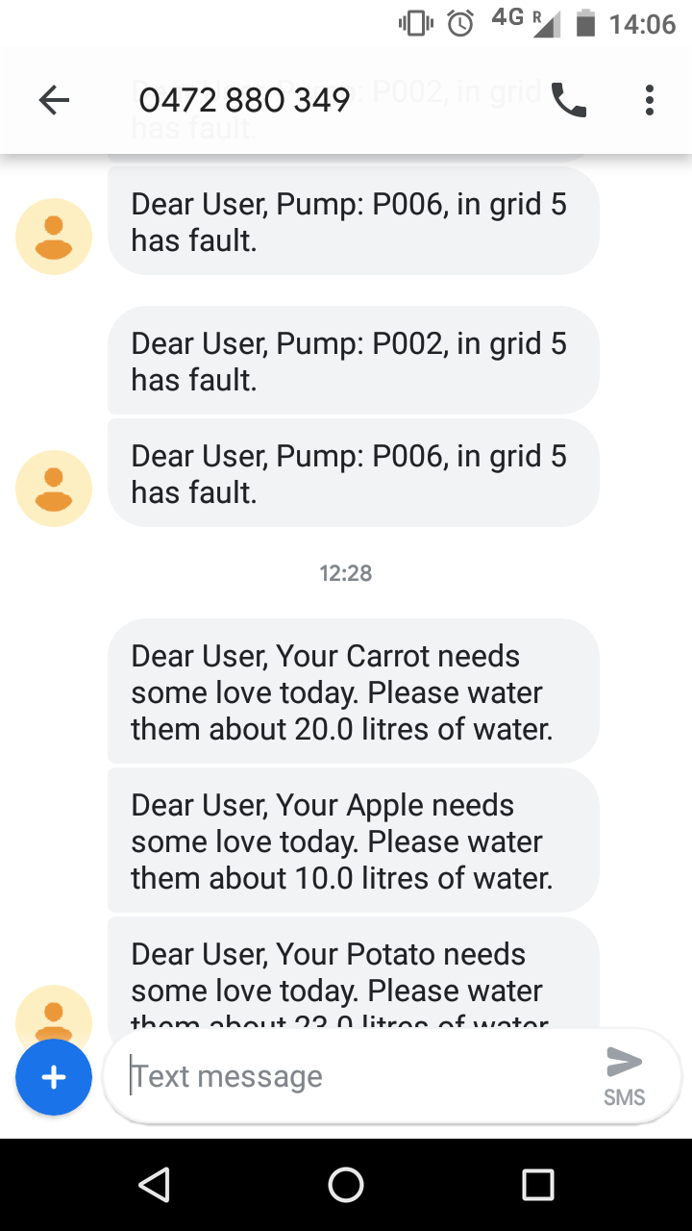
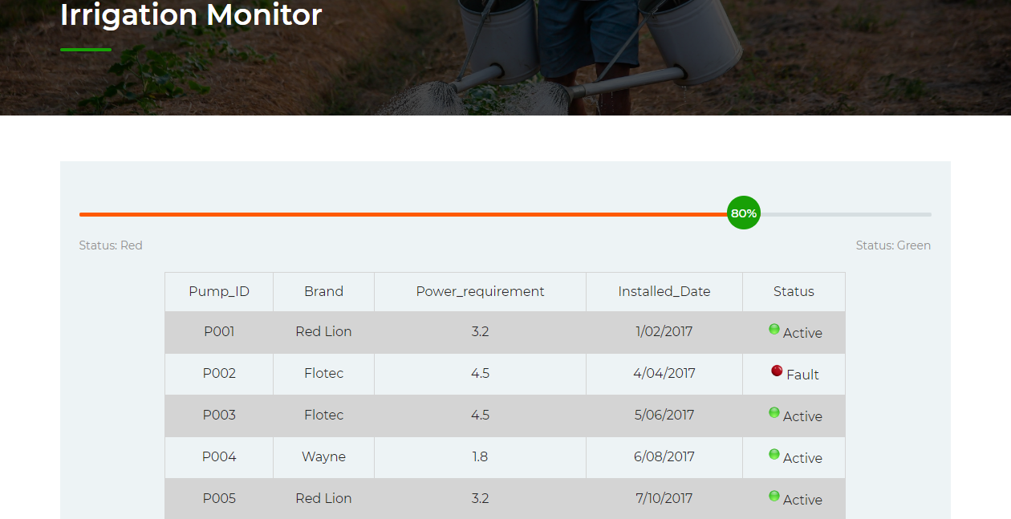
Solution
Notes:
maintenance of farm equipment
farmers, non-tech
don’t have key details to solve the problem, lack experience
reduce effort, spend time with actual work
management of equipment
non-technical work
lack of expertise/information
access to information/technical stuff/guidance
monitoring and measurement of farming equipment
farmers, non-technical
complexity, manual processes, scale, cost
reduce time/cost of manual inspection, monitor multiple things in real-time, resilient systems
who: farmers
what: consolidated dashboard with IoT
wow: identify problems in near-real time vs 3 days…

