Slide 1
Module 2 Verification & Validation
Notes:
1

Slide 2
Verification & Validation
Verification
Verification is the process of evaluating work-products of a development phase to determine whether they meet the specified requirements
Also called as Static Testing
Are we building the product right?
Verification ensures that the product is built according to the requirements and design specifications.
Notes:
2

Slide 3
Verification & Validation
Verification Cont...
Verification rely on manual examination (reviews) of Documents(Workproducts)
Defects found costs less to fix as compare to Dynamic Testing
Verification can happen on Any software work product, including requirements specifications, design specifications, code, test plans, test specifications, test cases, test scripts, user guides etc.
Benefits of verification include early defect detection.
And it avoids defect multiplication.
Notes:
3

Slide 4
Verification & Validation
Verification Cont...
Verification and Dynamic testing(Validation) have the same objective – identifying defects.
Compared to dynamic testing, Verification find causes of failures (defects) rather than the failures themselves
Done by QA(Quality Assurance) Team
Verification Techniques:
Informal Review
Walk-through
Technical Review
Inspection
Notes:
4

Slide 5
Verification & Validation
Informal Review
No formal process
May take form of Pair Programming or Technical Lead reviewing design and code.
Result May be Documented
Varies in usefulness depending on reviewers
Main purposes: Inexpensive way to get some benefits
Notes:
5

Slide 6
Verification & Validation
Review Process
Planning
Kick-off
Review Meeting
Rework
Follow up
Notes:
6

Slide 7
Verification & Validation
Walkthrough
Led by author
It is a step-by-step presentation by the author of a document in order to gather information and to establish a common understanding of its content
Done between colleagues.
It may be formal or informal process
Main purposes: learning, gaining understanding, finding defects
Notes:
7

Slide 8
Verification & Validation
Technical Review
A discussion meeting that focuses on achieving consensus about technical content of document
Experts are needed for Technical review i.e. Architects ,Chief Designers
It may be formal or informal process
Main purposes: discuss, make decisions, evaluate alternatives, find defects, solve technical problems and check conformance to specifications and standards
Notes:
8

Slide 9
Verification & Validation
Inspection
Led by trained moderator (not the author);
Done at Each phase to have opinion ,is phase is completed & can we move to next phase ?
It is formal process
Main purposes: Finding defects
5 Major Roles in Inspection Meeting
Moderator: Activity Leader
Author : who’s document under inspection
Reader : Reads documents for all
Recorder : Notes Minutes of meeting
Inspector : Domain Expert
Notes:
9

Slide 10
Verification & Validation
Validation Testing
Validation, which requires the execution of Software
Also Called as Dynamic Testing
It requires Execution of Software
Ensures Are we building the right product ?
Validation is the process of evaluating software during or at the end of the development process to determine whether it satisfies specified requirements
Notes:
10

Slide 11
Verification & Validation
Validation/Dynamic Testing
Defect found in Dynamic Testing Cost more as Compare to Verification
Dynamic Testing finds just failures not causes of failures
Checks the Product, not process.
Done by QC(Quality Control) team
Advantages of Validation if During verification some defects are missed then during validation process it can be caught as Defect
Notes:
11

Slide 12
Verification & Validation
Validation Technique/ Levels of Testing
Unit Testing
Integration Testing
Unit Integration Testing
System Integration Testing
System Testing
Acceptance Testing
Notes:
12

Slide 13
Verification & Validation
Component Testing
Component testing is also known as unit, module or program testing
Testing small piece of executable code.
The unit testing purpose is to ensure that the unit satisfies its functional specification
If Unit is working properly further testing(i.e. Integration Testing ) will be simplified.
Typically done by Programmer since it requires access to code
Defects found & fix during Unit testing typically not recorded( Reported).
Notes:
13

Slide 14
Verification & Validation
Integration Testing
The purpose of integration testing is to expose defects in the interfaces and in the interactions between integrated components or systems
There may be more than one level of integration testing as follows
Component integration testing tests the interactions between software components and is done after component testing
System integration testing tests the interactions between different systems or between hardware and software and may be done after system testing.
Notes:
14

Slide 15
Verification & Validation
Integration Testing cont ..
At each stage of integration, testers concentrate solely on the integration itself.
For example, if they are integrating module A with module B they are interested in testing the communication between the modules, not the functionality of the individual module as that was done during component testing. Both functional and structural approaches may be used.
Integration Testing Approaches
Top-Down
Bottom-Up
Notes:
15

Slide 16
Verification & Validation
Bottom Up Approach
Bottom up testing, as the name suggests starts from the lowest or the innermost unit of the application, and gradually moves up. The Integration testing starts from the lowest module and gradually progresses towards the upper modules of the application.
This integration continues till all the modules are integrated and the entire application is tested as a single unit.
we would need some program or a “stimulator”. These stimulator programs are called DRIVERS.
Notes:
16

Slide 17
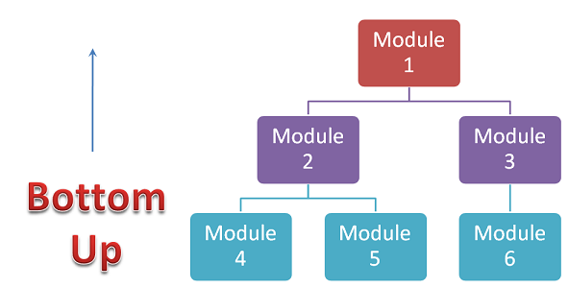
Verification & Validation
Bottom Up Approach
In simple words, DRIVERS are the dummy programs which are used to call the functions of the lowest module in case when the calling function does not exists.
Notes:
17

Slide 18
Verification & Validation
Top – Down Approach
This technique starts from the top most module and gradually progress towards the lower modules. Only the top module is unit tested in isolation.
After this, the lower modules are integrated one by one. The process is repeated until all the modules are integrated and tested
we would need some program or a “stimulator”. These stimulator programs are called STUBS.
Notes:
18

Slide 19
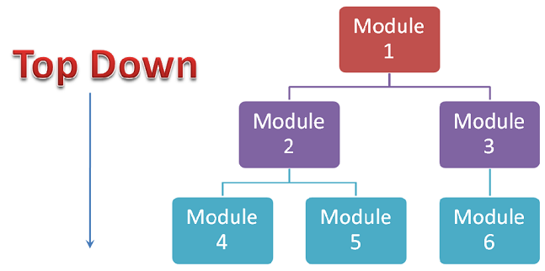
Verification & Validation
Top – Down Approach
“Stubs” can be referred to as code a snippet which accepts the inputs / requests from the top module and returns the results/ response
Notes:
19

Slide 20
Verification & Validation
System Testing
System testing is concerned with the behavior of a whole system/product as defined by the scope of a development project or product.
System testing is most often the final test to verify that the system to be delivered meets the customer need or requirement.
Its purpose is to find as many defects as possible
System testing should investigate both functional and non-functional requirements of the system
Notes:
20

Slide 21
Verification & Validation
System Testing cont..
In system testing, the test environment should correspond to the final target or production environment as much as possible in order to minimize the risk of environment-specific failures not being found in testing
Most often it is carried out by independent test team
In some organizations system testing is carried out by a third party team.
Notes:
21

Slide 22
Verification & Validation
User Acceptance Testing
Acceptance testing is most often the responsibility of the user or customer
User acceptance is a type of testing performed by the Client to certify the system with respect to the requirements that was agreed upon.
The acceptance test should answer questions such as: 'Can the system be released?'
The main purpose of this testing is to validate the end to end business flow & not to find defects.
Notes:
22

Slide 23
Verification & Validation
User Acceptance Testing Cont..
This testing happens in the final phase of testing before moving the software application to Market or Production environment.
Notes:
23

Slide 24
Verification & Validation
Alpha Testing
A type of UAT in which customer or client do testing in production environment.
Developers and Testers monitor Alpha Testing.
It is always performed within the organization not open for market or public.
Alpha Testing is done before the launch of software product into the market
Notes:
24

Slide 25
Verification & Validation
Beta Testing
A type of UAT in which customer or client do testing in live environment.
It is performed at the user’s premises in the absence of the development team
It is always performed open for market or public.
Beta Testing is always performed at the time when software product and project are marketed
Beta Testing is also known by the name Field Testing.
Notes:
25

Slide 26
Verification & Validation
Operational (Acceptance ) Testing
The acceptance of the system by the system administrators, including:
Testing of backup/restore;
Disaster recovery;
User management;
Maintenance tasks;
Data load and migration task;
periodic checks of security vulnerabilities
Notes:
26

Slide 27
Verification & Validation
Contract and Regulation Acceptance Testing
Contract acceptance testing is performed against contract’s acceptance criteria for producing custom-developed software. Acceptance criteria should be defined when the parties agree to the contract.
Regulation acceptance testing is performed against any regulations that must be adhered to, such as governmental, legal or safety regulations
Notes:
27

Slide 28
Verification & Validation
Testing within a Life Cycle Model
For every development activity there is a corresponding testing activity
The analysis and design of tests for a given test level should begin during the corresponding development activity
Advantage:
Avoid defect Multiplication
Notes:
28

Slide 29
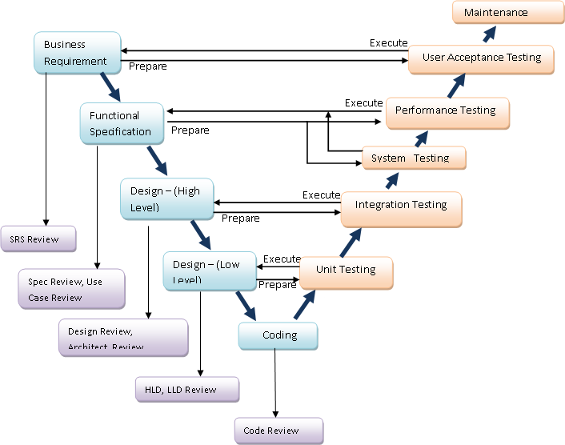
Verification & Validation
V model
Notes:
29

