Slide 1
Module 2
Types of Testing

Slide 2
Types of Testing
  A test type is focused on a particular test objective, which could be any of the following:
    Change related, i.e., confirming that defects have been fixed (Retesting /Confirmation testing) and looking for unintended changes (regression testing)
    A function to be performed by the software
    A non-functional quality characteristic, such as reliability or usability
    The structure or architecture of the software or system

Slide 3
Types of Testing
  Testing Related To Change:
    Retesting
      After a defect is detected and fixed, the software should be re-tested to confirm that the original defect has been successfully removed. This is called confirmation.
      Debugging (locating and fixing a defect) is a development activity, not a testing activity

Slide 4
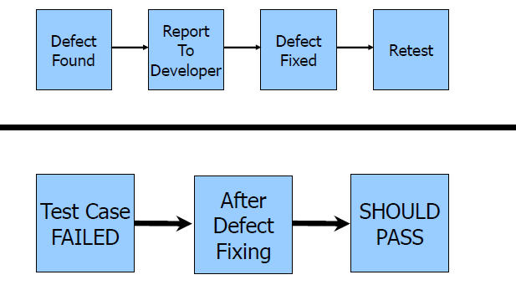
Types of Testing
  Testing Related To Change:
    Retesting

Slide 5
Types of Testing
  Testing Related To Change:
    Regression Testing
      Regression testing is the repeated testing of an already tested program, after modification, to discover any defects introduced or uncovered as a result of the change(s).
      It is performed after any kind of changes are made like when requirements change, environments changed or legislation changed
      Impact Analysis is done with the help of RTM (Requirement Traceability Matrix) to decide how much Regression should be done
      Automation Testing Tools should be used for Regression Testing since it is repetitive in nature.

Slide 6
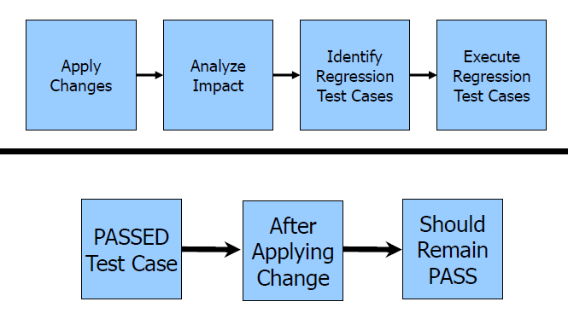
Types of Testing
  Testing Related To Change:
    Regression Testing

Slide 7
Types of Testing
  Testing of Function (Functional Testing)
    The functions that a system, subsystem or component are to perform may be described in work products such as BRS or SRS.
    The functions are “what” the system does.

Slide 8
Types of Testing
  Testing of Function (Functional Testing)
    Security testing:
    A type of functional testing, investigates the functions (e.g. a firewall) relating to detection of threats, such as viruses, from malicious outsiders. Some more points on Security test
      Authentication / Authorization
      Access Control
      Cookies
      Encryption
    Smoke Testing(BAT/BVT):
    Smoke testing is basic functionality test which is performed once the build is received from the development team it is also known as Build verification testing

Slide 9
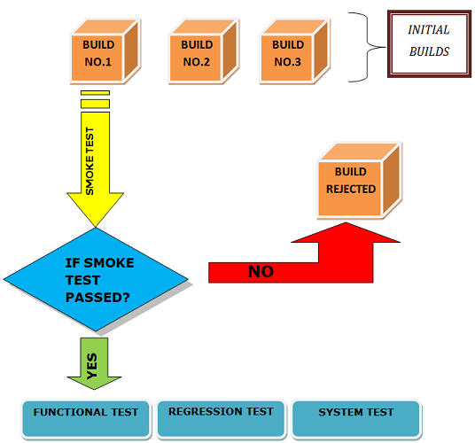
Types of Testing
  Testing of Function (Functional Testing)
    Smoke testing:

Slide 10
Types of Testing
  Testing of Function (Functional Testing)
    Sanity testing:
    Sanity testing is also the basic functionality test which is performed before we return the build back to the development team after all the type of testing is performed on system
    Some More Points on Functional Test
      Checking Links( to find dead links)
      Forms( i.e. Login, Registration, Payment etc. )

Slide 11
Types of Testing
  Testing of Software Characteristics
  (Non-Functional Testing)
    Non-functional testing includes, but is not limited to, performance testing, load testing, stress testing, usability testing, maintainability testing, reliability testing and portability testing. It is the testing of “how” the system works.
    Types of Non Functional Testing
      Performance Testing
      Compatibility Testing
      Configuration Testing
      Usability Testing
      User Interface Testing

Slide 12

Types of Testing
  Performance Testing
    The degree to which a system or component accomplishes its designated functions within given constraints regarding processing time and throughput rate.
    Types:
      Load Testing
      Stress Testing
      Spike Testing
      Endurance Testing

Slide 13
Types of Testing
  Load Testing
    Load testing is a kind of performance testing which determines a system's performance under real-life load conditions. This testing helps determine how the application behaves when multiple users access it simultaneously
    Why load testing:
    1.Load testing gives confidence in the system & its reliability and performance
    2.Load Testing helps identify the bottlenecks in the system under heavy user stress scenarios before they happen in a production environment

Slide 14
Types of Testing
  Stress Testing
    It validates an application’s behavior when it is pushed beyond normal or peak load conditions.
    The goal of stress testing is to reveal application bugs that surface only under high load conditions. These bugs can include such things as memory leaks.
    Why Stress Testing:
1.To check whether the system works under abnormal conditions.
2.Displaying appropriate error message when the system is under stress.
3.System failure under extreme conditions could result in enormous revenue loss.
4.To find the crash point.

Slide 15
Types of Testing
  Spike Testing
It is a subset of Stress testing, used to validate a system’s performance under sudden changes (Load increments and decrements)
  Endurance Testing
It is a subset of Load testing, used to validate a system’s performance under continues load

Slide 16
Types of Testing
  Performance Testing Tool
    Since Performance Testing requires lots of user’s
    Which is impossible to have physically .Hence tools are used in performance Testing.
    Performance Testing Tools:
      Jmeter
      LoadRunner
      RPT

Slide 17
Types of Testing
  Compatibility Testing
    Compatibility Testing is performed to check that the application functions properly across various hardware and Software environment.(customer expected platform)
    More Important in web applications since user can use any browser for accessing
  Configuration Testing
    Configuration Testing is also known as Hardware compatibility testing is performed to check that the application functions properly across various hardware

Slide 18
Types of Testing
  Usability Testing
    Usability means how easy the application is to use(Color, Font size etc.)
    Ease of use should be balance between fresh user and Experience User.
    It should be done by user of user.
  User interface Testing
    User interface means how user Friendly the application is for the customer.
    Deals with Graphical User Interface
      Spelling Check
      Grammatical Check
      Font and Size
      Color

