Slide 1
Module 5
Test Planning and Strategy

Slide 2
Test Plan and Strategy
    Test Plan is a document that includes details of scope, Objective and method of testing such as resources and schedule of intended test activities.
    The test plan serves as a blueprint to conduct software testing activities as a defined process which is minutely monitored and controlled by the test manager.
    Test Strategy is the document that tell us what type of technique to follow to test the different modules of software it is High level document prepared by the project manager.

Slide 3
Test Plan and Strategy
  Importance of Test Plan
    It helps to determine the needed efforts.
    It helps various stakeholders such as developers, business managers, customers to understand the details of testing.
    It is like a Protocol book, which needs to be followed and will guide us.
    Avoids Random Testing.

Slide 4
Test Plan and Strategy
  Guidelines for test plan
    Be specific. For example, when you specify an operating system as a property of a test environment, mention the OS Edition/Version as well, not just the OS Name
    Make use of lists and tables wherever possible. Avoid lengthy paragraphs
    Have the test plan reviewed a number of times prior to baseline it or sending it for approval.
    Update the plan as and when necessary.

Slide 5
Test Plan and Strategy
  Test Plan Attributes/Template IEEE 829
    Test plan ID(Name)
    Introduction
    References
    Test Items
    Features to be tested
    Features not to be tested
    Approach
    Entry & Exit Criteria
    Suspend resume criteria
    Test deliverables
    Test Environment

Slide 6
Test Plan and Strategy
  Test Plan Attributes/Template IEEE 829 Cont..
    Schedule
    Staffing and training needs
    Responsibilities
    Risk & Contingencies
    Software Risk issues
    Approvals

Slide 7
Test Plan and Strategy
  Test Plan Identifier:
    Unique name given to plan so that we can identify different project and plan
  Introduction
    Detail description about the plan if it’s a Master plan or Generic Plan
  References
    Different documents and version that we have referred to prepared the plan
  Test Items
    All the items that is the version of the software

Slide 8
Test Plan and Strategy
  Features to be tested :
    All the Functionalities that has to be tested
    This is a listing of what is to be tested from the Users viewpoint of what the system does. This is not a technical description of the software, but a Users view of the functions.
  Features not to be tested
    All the functionalities that may not be released in the current version. If there is less time then the low priority test cases may not be executed

Slide 9
Test Plan and Strategy
  Approach/Strategy
    This is your overall test strategy for this test plan; it should be appropriate to the level of the plan (master, acceptance, etc.) and should be in agreement with all higher and lower levels of plans. Overall rules and processes should be identified.

Slide 10
Test Plan and Strategy
  Entry & Exit Criteria :
    Entry Criteria describes when to start Testing
    Exit Criteria describes when to stop testing.
  Schedule
    Schedule for all Test activities in this Software Test Process.
  Staffing and Training
    Hiring new Employee as per Project Need.
    Training on the application/system (Domain Training)
    Training for any test tools to be used.

Slide 11
Test Plan and Strategy
  Suspend/Resume criteria (Pause Criteria):
    defines under what circumstance we may not be able to continue further testing
    Resume criteria defines under what circumstance we can continue the testing activates
  Test Deliverable
    All the documents that will be generated as a result of testing activities (Test plan, Test cases, Execution log )
  Test Environment/ Test Bed
    Describe the environment in which the application is going to be accessed
    It describes Require Hardware and software for setting-up Test Environment or Test Lab.

Slide 12
Test Plan and Strategy
  Roles & Responsibilities:
    Team Lead or Test Lead and Team members Roles and Responsibilities.
  Risk & Contingencies:
    Identify the high-risk assumptions of the test plan related to testing process
    Specify contingency plans for each
  Software Risk issues:
    Also called as Quality Risk and Product Risk.
    Delivery of incomplete / faulty product to customer.
    Software hard to use or slow to response.

Slide 13
Test Plan and Strategy
  Approvals:
    Specify the names and titles of all persons who must approve the plan
    Provide space for signatures and dates

Slide 14
Module 8
Incident Management

Slide 15
Incident Management
  What is Defect :
    Difference between the expected and actual behaviour of the software
  Types of Defects:
    Functional and Non functional Defects
  Synonyms of defects:
    Incident, Bug, Problem, Error, Failure

Slide 16
Incident Management
  What is Incident/Defect Management :
    Defect Reporting, Defect Tracking, and Status Tracking is called Defect Management.
    Some companies use Manual Process (Excel workbook), and some companies use Tool based process for Defect Management.
    Tools Examples:
      Bugzilla
      Mantis
      QC( ALM)

Slide 17
Incident Management
  Status of Defect:
    New:
    Open
    Duplicate
    Deferred
    Assign/ Re-assign
    Fixed/Resolved
    Close

Slide 18
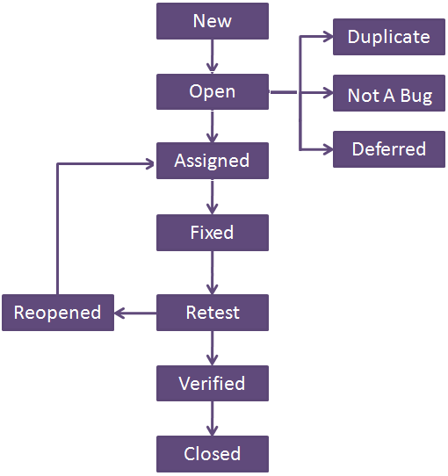
Incident Management
  Defect Life Cycle:

Slide 19
Incident Management
  Error, Defect , Failure:
  We have three phase in SDLC
    Development Phase, Testing Phase, Production Phase
  Development Phase
    In this phase If developers find any mismatch, they call it as Error or Mistake.
  Testing Phase
    In this phase If Testers find any mismatch, they call it as Defect or Bug or Fault.
  Production Phase
    In this phase If End users find any mismatch, they call it as Failure.

Slide 20
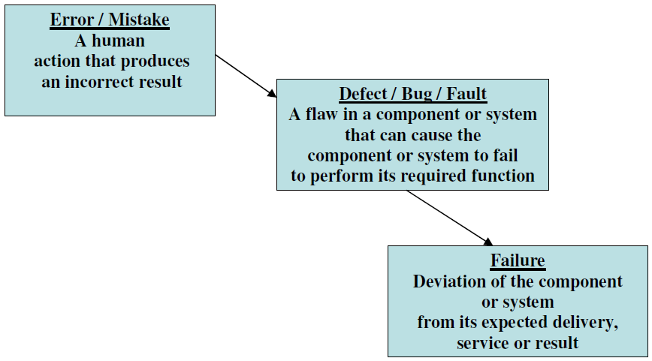
Incident Management
  Error, Defect , Failure:

Slide 21
Incident Management
  Defect Reporting Template/ Attributes:
  1) Defect Id 10) Priority
  2) Defect Reporting date 11) Status
  3) Project Name 12) Test Case ID
  4) Module/Sub Module Name 13) Reported By
  5) Type of Defect 14) Reported To
  6) Phase in which defect is identified
  7) Summary of defect
  8) Description of defect
  9) Severity

Slide 22
Incident Management
  Reasons for defect in software
    Incomplete and incorrect requirement
    Wrong Design
    Wrong Coding
    Wrong Testing
    Error at the time of Defect fixing
    Error because of Impact of Defect Fixing

Slide 23
Incident Management
  Severity
    Severity is assigned to the Defect by the tester on the basis of Impact of the defect on the functionality of the Software
    Decided By Tester
  Priority
    Priority is assigned by the developer to the defect on the basis of how urgent that bug is to be fixed
    Decided by Developer / BA / Client as Urgency is decided based of business

Slide 24
Incident Management
  Severity and Priority Examples
    High Severity and High Priority
    Low severity and High Priority
    High Severity and Low priority
    Low severity and Low priority

Slide 25
Module 9
Manual Testing
VS
Automation Testing

Slide 26
Manual VS Automation Testing
  Manual VS Automation Testing:
    Software testing is a huge domain, but it can be broadly categorized into two areas: manual testing and automated testing
    Both manual and automated testing offer benefits and disadvantages. It’s worth knowing the difference, and when to use one or the other for best results
    In manual testing (as the name suggests), test cases are executed manually (by a human, that is) without any support from tools or scripts. But with automated testing, test cases are executed with the assistance of tools, scripts, and software.

Slide 27
Manual VS Automation Testing
  Manual VS Automation Testing cont..:
    The type of testing (manual or automated) depends on various factors, including
      project requirements
      Budget
      Timeline
      Expertise
      suitability

Slide 28
Manual VS Automation Testing
  Manual Testing Advantage:
    Manual testing can be used in big as well as small projects
    Test cases can be updated easily
    Easy to learn for the new people who entered it to testing
    Manual testing allows for human observation, which may be more useful if the goal is user-friendliness or improved customer experience
    If you’re only testing a simple app once, and don’t expect lots of updates, manual testing doesn’t require you to invest in expensive tools or software
    Automation cannot replace human intuition and reasoning

Slide 29
Manual VS Automation Testing
  Manual Testing Disadvantage:
    Manual testing is not accurate at all times due to human error, hence it is less reliable.
    Manual testing is time-consuming, taking up human resources
    Repetition of the Task is not much
    Tiredness
    Simultaneous auctions are not possible (Parallel Testing)
    GUI Objects size difference & color combination etc is not easy to find out in manual testing
    Load testing & performance testing is not possible in manual testing

Slide 30
Manual VS Automation Testing
  When to use Manual Testing:
    As Soon as Possible Testing
    Exploratory Testing
    Usability Testing
    Ad-hoc Testing

Slide 31
Manual VS Automation Testing
  Automation Testing Advantage:
    Reliable: Tests perform precisely the same operations each time they are run, thereby eliminating human error
    Repeatable: You can test how the software reacts under repeated execution of the same operations
    Programmable: You can program sophisticated tests that bring out hidden information from the application
    Comprehensive: You can build a suite of tests that covers every feature in your application
    Reusable: You can reuse tests on different versions of an application, even if the user interface changes

Slide 32
Manual VS Automation Testing
  Automation Testing Advantage Cont..:
    Economical: As the number of resources for regression test are reduced
    Better Quality Software: Because you can run more tests in less time with fewer resources
    Fast: Automated Tools run tests significantly faster than human users
    Gives your team a break: There’s a better chance your development team will get fatigued and weary if they’re manually testing an app after coding it. Automating testing will give them a chance to focus more on the big picture.

Slide 33
Manual VS Automation Testing
  Automation Testing Disadvantage:
    Though the automation testing has many advantages, it has its own disadvantages too. Some of the disadvantages are
    Proficiency is required to write the automation test scripts
    Debugging the test script is major issue. If any error is present in the test script, sometimes it may lead to deadly consequences
    Test maintenance is costly in case of playback methods. Even though a minor change occurs in the GUI, the test script has to be re-recorded or replaced by a new test scripts.

Slide 34
Manual VS Automation Testing
  Automation Testing Disadvantage Cont..:
    Maintenance of test data files is difficult, if the test script tests more screens
    It is expensive
    We cannot automate all areas.

