Slide 1
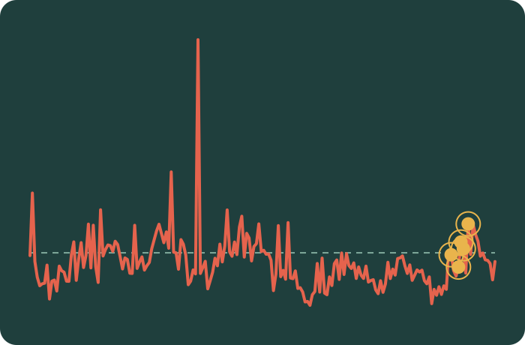
A digital twin that warns of glucose spikes early
Phase-1 proof of concept: clinic records plus wearable data, two hours of notice. Built for the Happiest Health Digital Twin Challenge.
One demo patient, 48 hours of glucose. Dashed line = 180 mg/dL. Yellow ring = model alert. Synthetic data.

Slide 2



Join who the patient is with what is happening now
+
=
Clinic record (EHR)
Wearable stream
Early warning
Who the patient is: age, BMI, HbA1c, kidney function, genetic risk markers
What is happening now: glucose, heart rate, heart-rate variability, sleep, steps
An alert about 2 hours before glucose goes above 180 or climbs fast
The twin is a model of one patient that updates with every new reading and forecasts what comes next.

Slide 3
How the project works, from raw data to dashboard
1
2
3
4
5
Generate data
Build features
Train and test
Export results
Console
Synthetic clinic records and wearable streams for 500 patients
Trailing windows only, so nothing from the future leaks in. Label: spike in next 2 h
Gradient-boosted model, scored with patient-grouped cross-validation
Risk scores, alerts and explanations for six demo patients
Offline web dashboard that shows roster, streams and alerts
data/
feature_engineering
train_model
export_dashboard_data
dashboard/
Every number in the repo's reports is generated from one metrics file, never typed by hand.

Slide 4
What the model sees, and what counts as a spike
500
21 days
A spike means, within the next 2 hours:
virtual patients
of readings each, every 15 minutes
30-minute smoothed glucose passes 180 mg/dL
or it rises by 30 mg/dL or more
Smoothing matters: an earlier version fired on sensor noise
Inputs: 12 clinic fields and 5 wearable signals
1.0 M
1.8%
patient-moments (rows) to learn from
of moments are followed by a spike

Slide 5


One model, tested the hard way
The model
The testing rules
Gradient-boosted decision trees
Learns from the clinic record and the live signals together
Same settings reused for a second, week-ahead heart-strain target
A patient's rows are never in both train and test
Five repeated splits, 25% of patients held out each time
Significance judged across patients, not across folds
Every claim paired with a control that could disprove it

Slide 6
Headline: a useful signal, and an honest number
0.843
~1 a day
4 in 10
ROC-AUC, averaged over five independent data draws (plus or minus 0.021)
alerts per patient when the alert budget is set to 1% of moments
of those alerts are real spikes (precision 0.41), about 14x better than chance
This is the average, not the best run. The shipped model scored 0.876, which was the luckiest of the five draws, and we say so.

Slide 7
Wearable signals are what lift the score
Shortcut control = clock + current glucose + trend + baseline labs
Full model beats it by +0.022 (p < 0.001)
Heart-rate variability, sleep and activity give +0.017 of that
The gain holds in all 5 data draws
Chart shows the shipped data draw

Slide 8
What the model leans on most
About two-thirds of the weight sits on live wearable signals
Heart-rate variability (HRV) is the single top signal
Time of day is down from 29% in v2 to 15%, no longer the main shortcut
Clinic fields like age and HbA1c still add a steady base

Slide 9



We tried to break our own result
0.495
0.802
0.82 to 0.88
Shuffled labels
Same patient, shuffled timing
Five data draws
Scrambling who spiked drops the score to a coin flip, so the pipeline is not leaking answers.
Knowing who the patient is gives most of the score. Their current state adds about +0.06 on top.
The score moves with the draw, so we quote the average rather than the best run.
A score is only believable once the shortcuts have been tested and the numbers still stand.

Slide 10
Does combining both streams pay off? Mixed
+0.053
vs clinic record alone
Our read
Clear win (p < 0.001)
Both streams carry signal, and the model uses it. But fusing everything is not proven better than the best single-stream mix. We report it as a negative finding.
+0.022
vs shortcut control
Clear win (p < 0.001)
+0.005
vs best non-fusion mix
Not significant (p = 0.18) and negative in 4 of 5 data draws
The 'best non-fusion mix' was assembled after seeing the results, so even +0.005 flatters fusion.

Slide 11
Real data: the code works, the gain shrinks
Run: UCI Diabetes
Pending: BIG IDEAs Lab
70 real patients with type 1 diabetes, 50 scored
Same code ran unchanged on real data
Gain over naive baseline: +0.006 (p < 0.001), about 4x smaller than synthetic
AUC of 0.98 is not comparable: 54% of moments are spikes and the naive baseline already scores 0.977
16 prediabetic adults with glucose, wearable and clinic table for the same people
The one cohort that can test fusion properly
Downloader, converter and checks are built, but only 6 of 16 are downloaded
The paired test has not been run, so no number is quoted

Slide 12
The clinician console
Six virtual patients, picked by a clinical rule set in advance
Roster with live risk levels
Glucose, heart-rate and HRV streams with real spikes marked
Alert feed and a per-feature explanation of each score
Runs offline, with a clear synthetic-data, not-for-clinical-use banner
A conceptual front end over precomputed output. Not a live system.

Slide 13
Scores fell as our checks got stricter
v1
v2
v3
0.986
0.953
0.843
One clinic field (diabetes diagnosis) did the work: 82% of the weight
The answer was hidden in the meal clock: time of day alone gave 29%
Labels fixed, controls added, five-draw average, tests and CI in place
Caught by the same-patient label shuffle
Caught by the shortcut baseline
The number we stand behind
A high AUC is not evidence of a good model until a shortcut baseline has been run against it.

Slide 14


What the project delivers
End-to-end pipeline
Working predictor
Wearables proven useful
Data, features, model, reports and console all run from five commands
0.843 ROC-AUC with a 2-hour warning, calibrated risk scores
+0.022 over a clock-and-glucose shortcut, in 5 of 5 data draws
Honest evaluation kit
Real-data protocol
Reproducible and open
Leakage tests, seed sweep, patient-level significance, alert budgets
Ran unchanged on 70 real patients; second cohort wired up
Tests, CI and MIT licence; no raw real data committed

Slide 15
What is not proven yet, and what comes next
Not proven yet
Next steps
Synthetic data is not real physiology
Fusion benefit is untested on real paired data
Much of the score comes from who the patient is, not their current state
Week-ahead heart-strain target is weak (AUC 0.64)
Console is a static demo: no login, audit trail or drift checks
1
Run the BIG IDEAs paired fusion test
2
Find CGM-grade real data with a matching clinic record
3
Tune alert thresholds per patient
4
Add login, audit logging, alert-fatigue and drift monitoring

