Slide 1

CAREERNEST
MANALI SANJAY RAUT-raut.ma@northeastern.edu
POOJA KULKARNI – kulkarni.pooja@northeastern.edu
SHREYA SANJAY RAUT-raut.shr@northeastern.edu
SAI GEETA ACHARYA- acharya.sa@northeastern.edu

Slide 2
OVERVIEW
CareerNest, the platform that redefines the job search and hiring experience.
CareerNest stands as a dynamic ecosystem connecting candidates with their dream job opportunities and providing recruiters with robust tools for efficient talent acquisition.
User-Friendly Interface for Easy Navigation
Core values:
User Experience: Putting Candidates and Recruiters First
Transparency: Clear and Honest Communication
Empowerment:: Providing the Tools for Success

Slide 3
FEATURES
Profile Management
User Authentication
Job Search
Job Management
Application Process
Application Status
Interview Scheduling
Skill Matching
Data Visualization

Slide 4
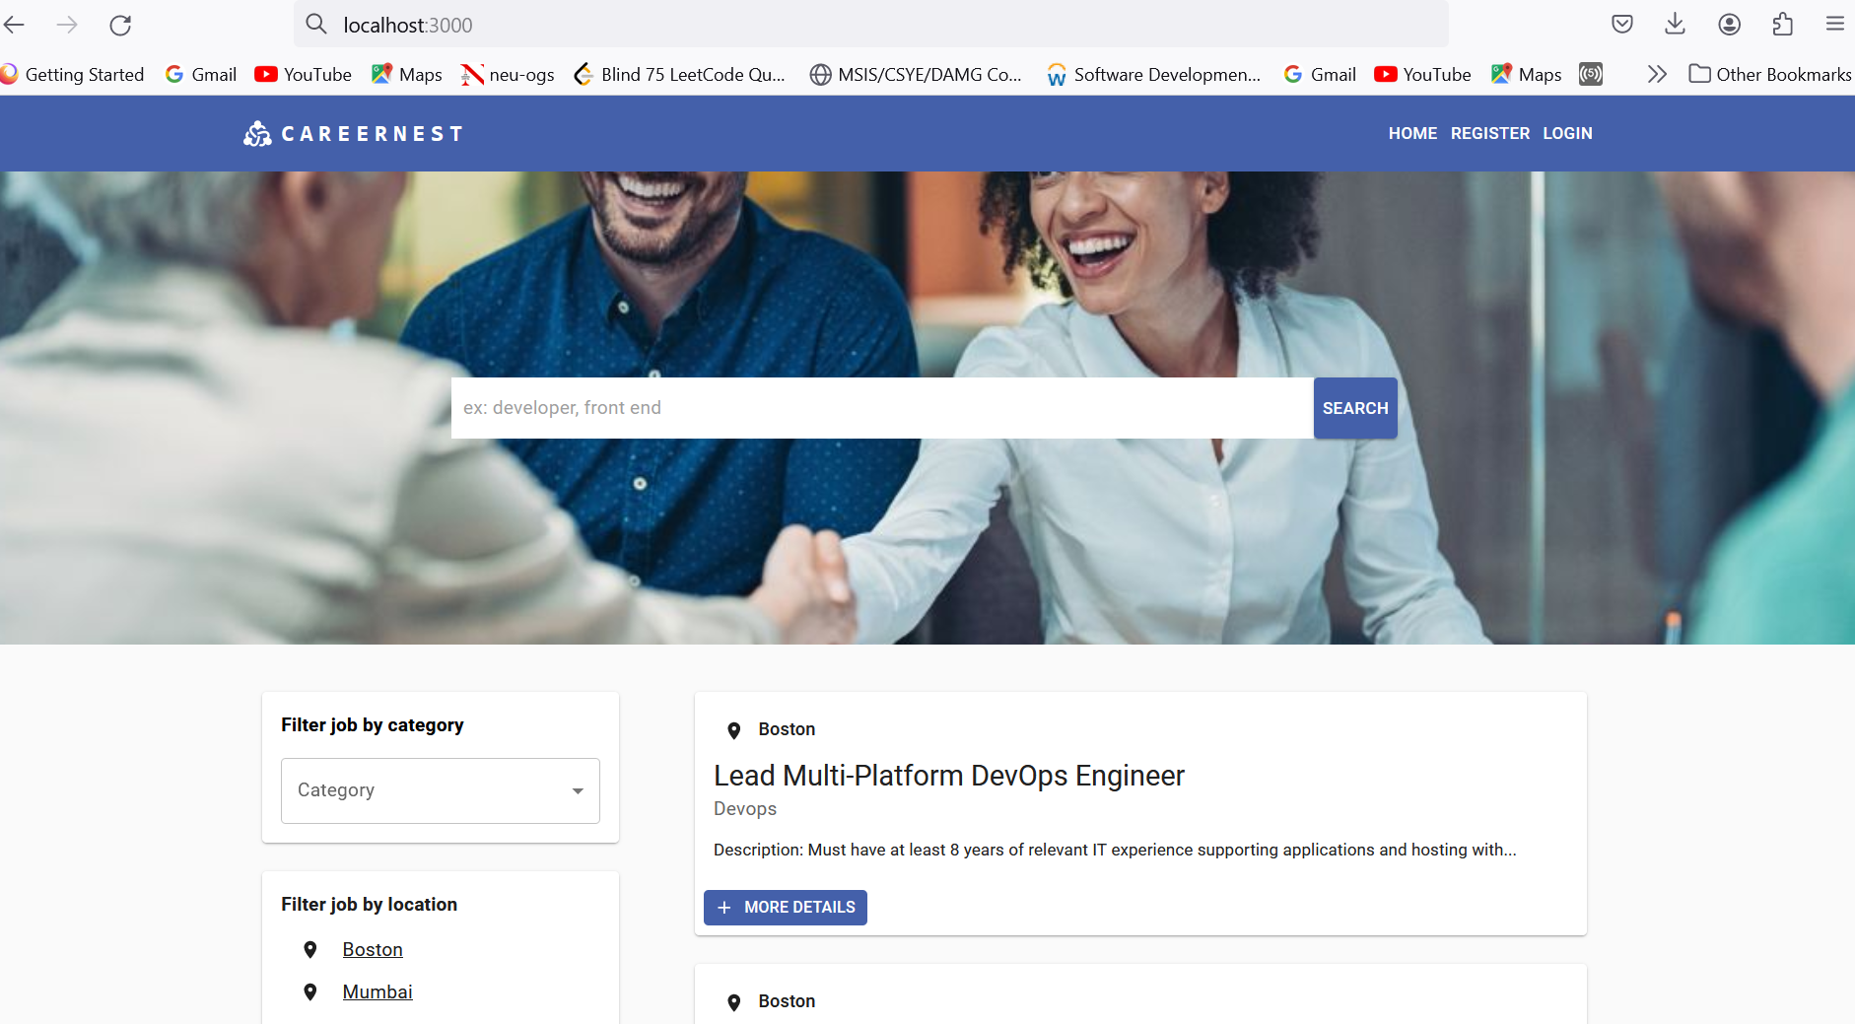
Explore Limitless Opportunities: A Snapshot of Our Job Portal's Diverse Listings

Slide 5
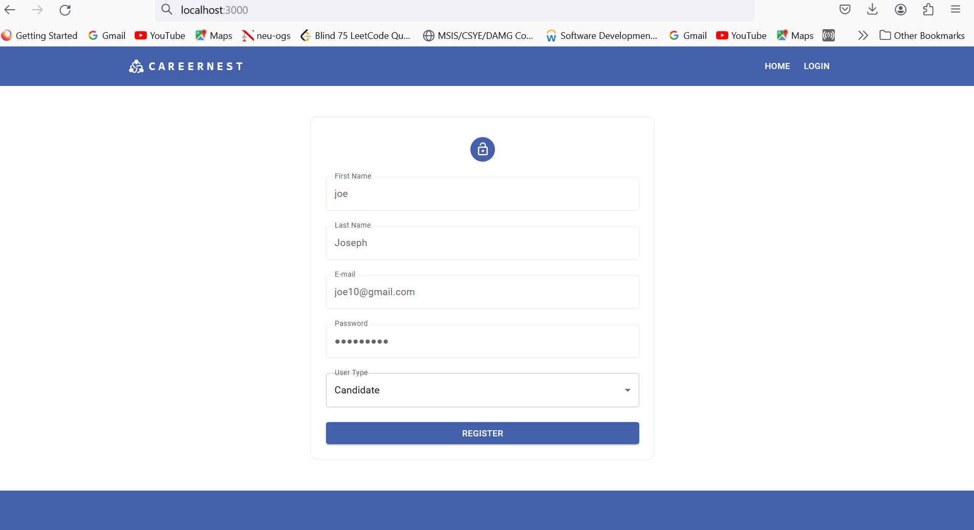
Seamless Entry to Your Career Journey: Join Our Community with a Simple Sign-Up

Slide 6
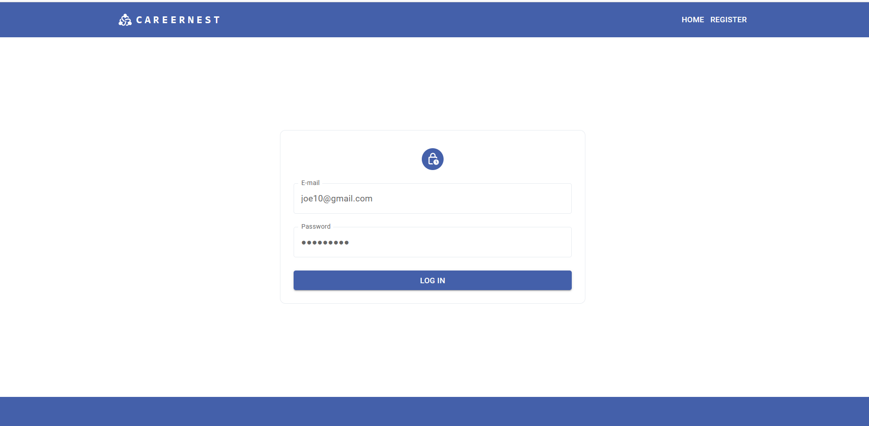
Secure Access to Your Career Hub: Effortless Login to Your CareerNest Account

Slide 7
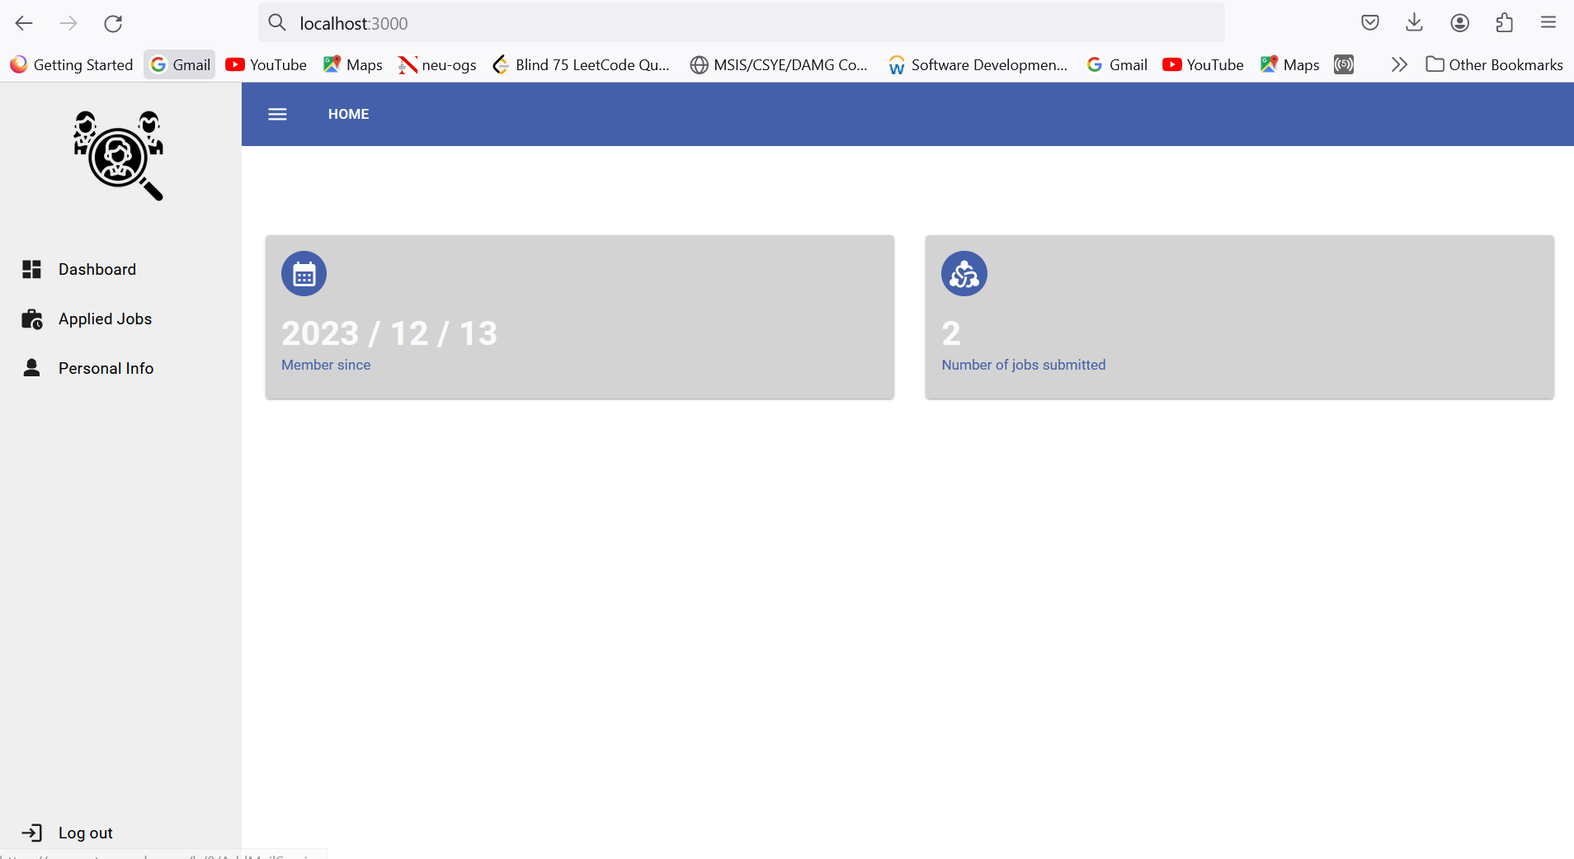
Your Career Command Center: A Glimpse into the Candidate Dashboard

Slide 8
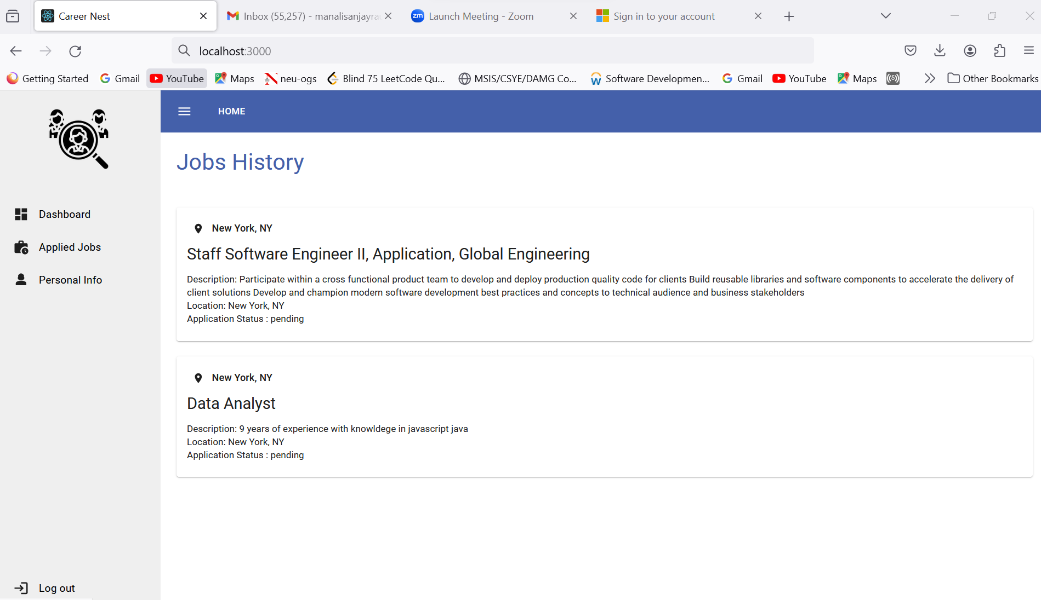
Track Your Career Journey: Job History - A Chronicle of Your Applied Opportunities

Slide 9
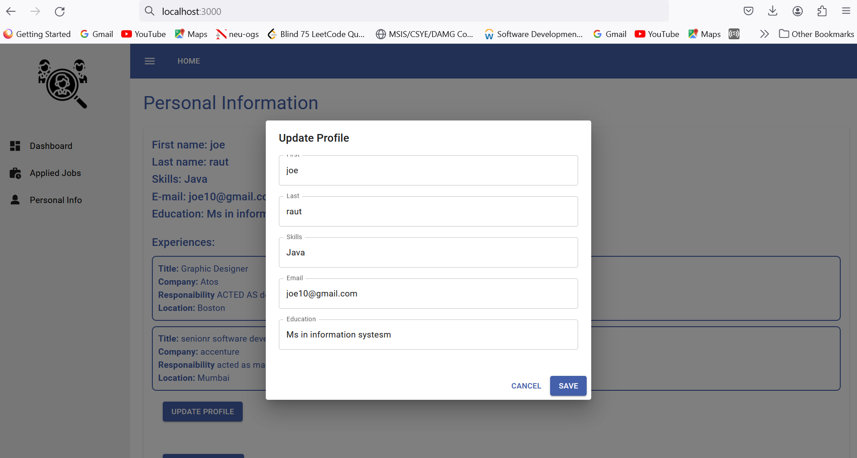
Crafting Your Professional Identity: Elevate Your Job Profile with Updated Personal Info, Skills, and Experience

Slide 10
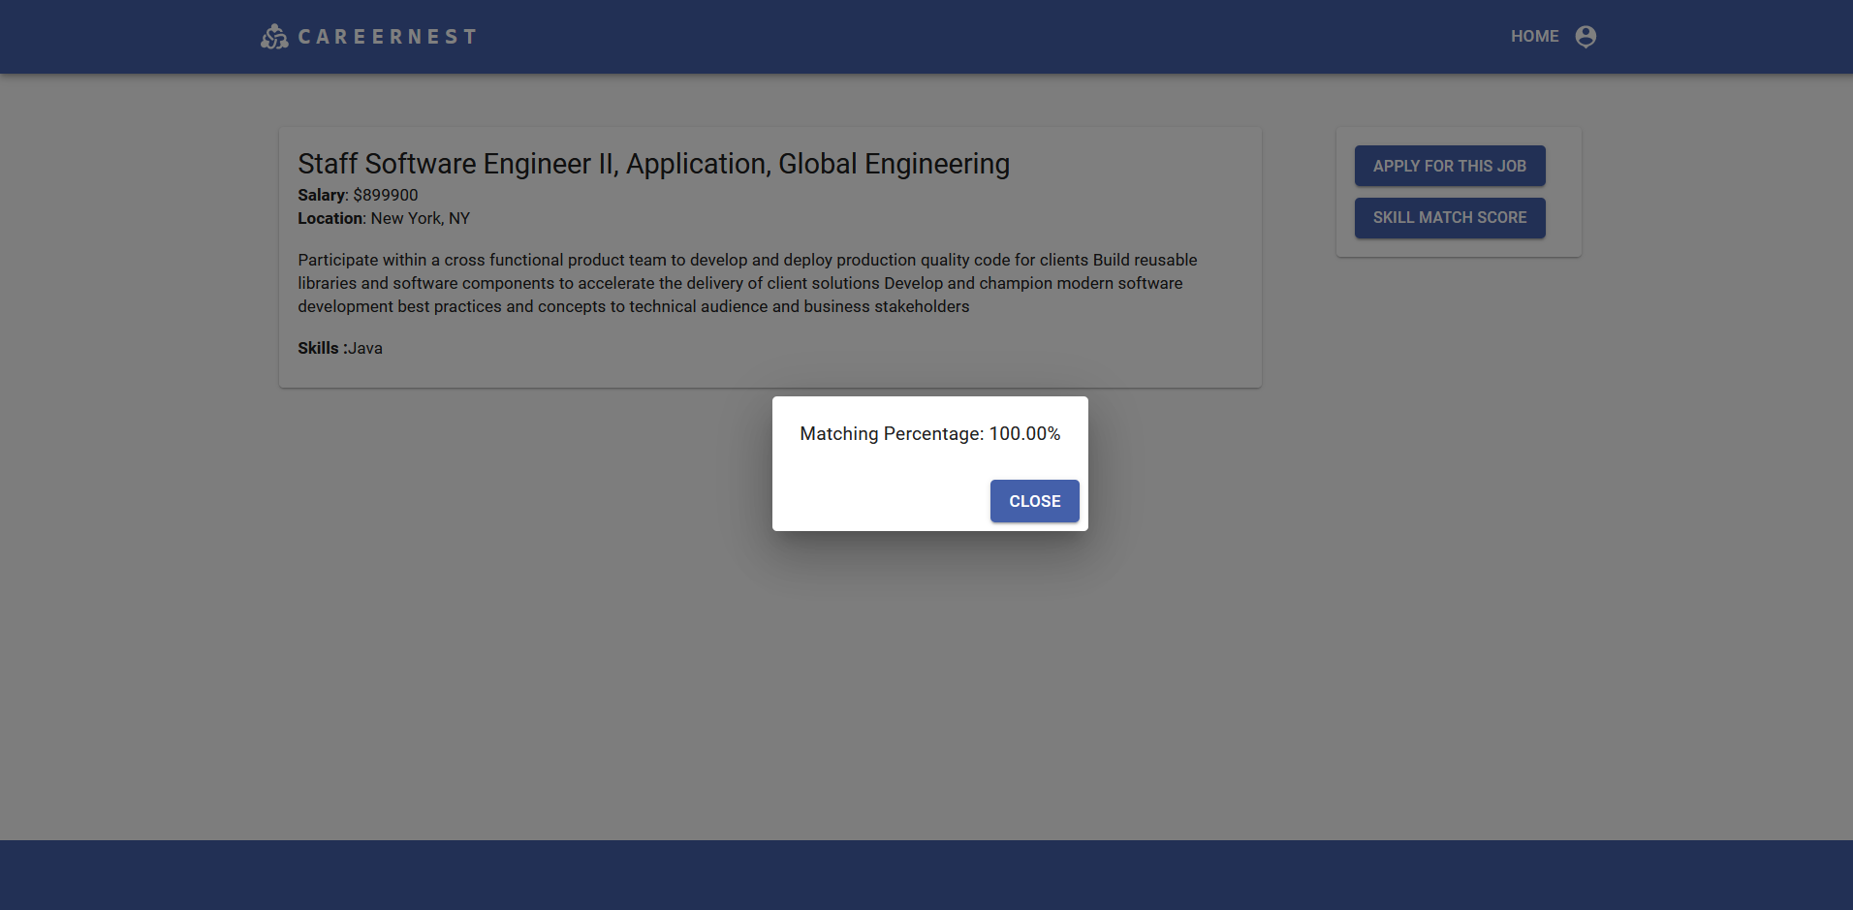
Perfect Match: Assess Your Skills Against Job Requirements for Optimal Career Compatibility

Slide 11
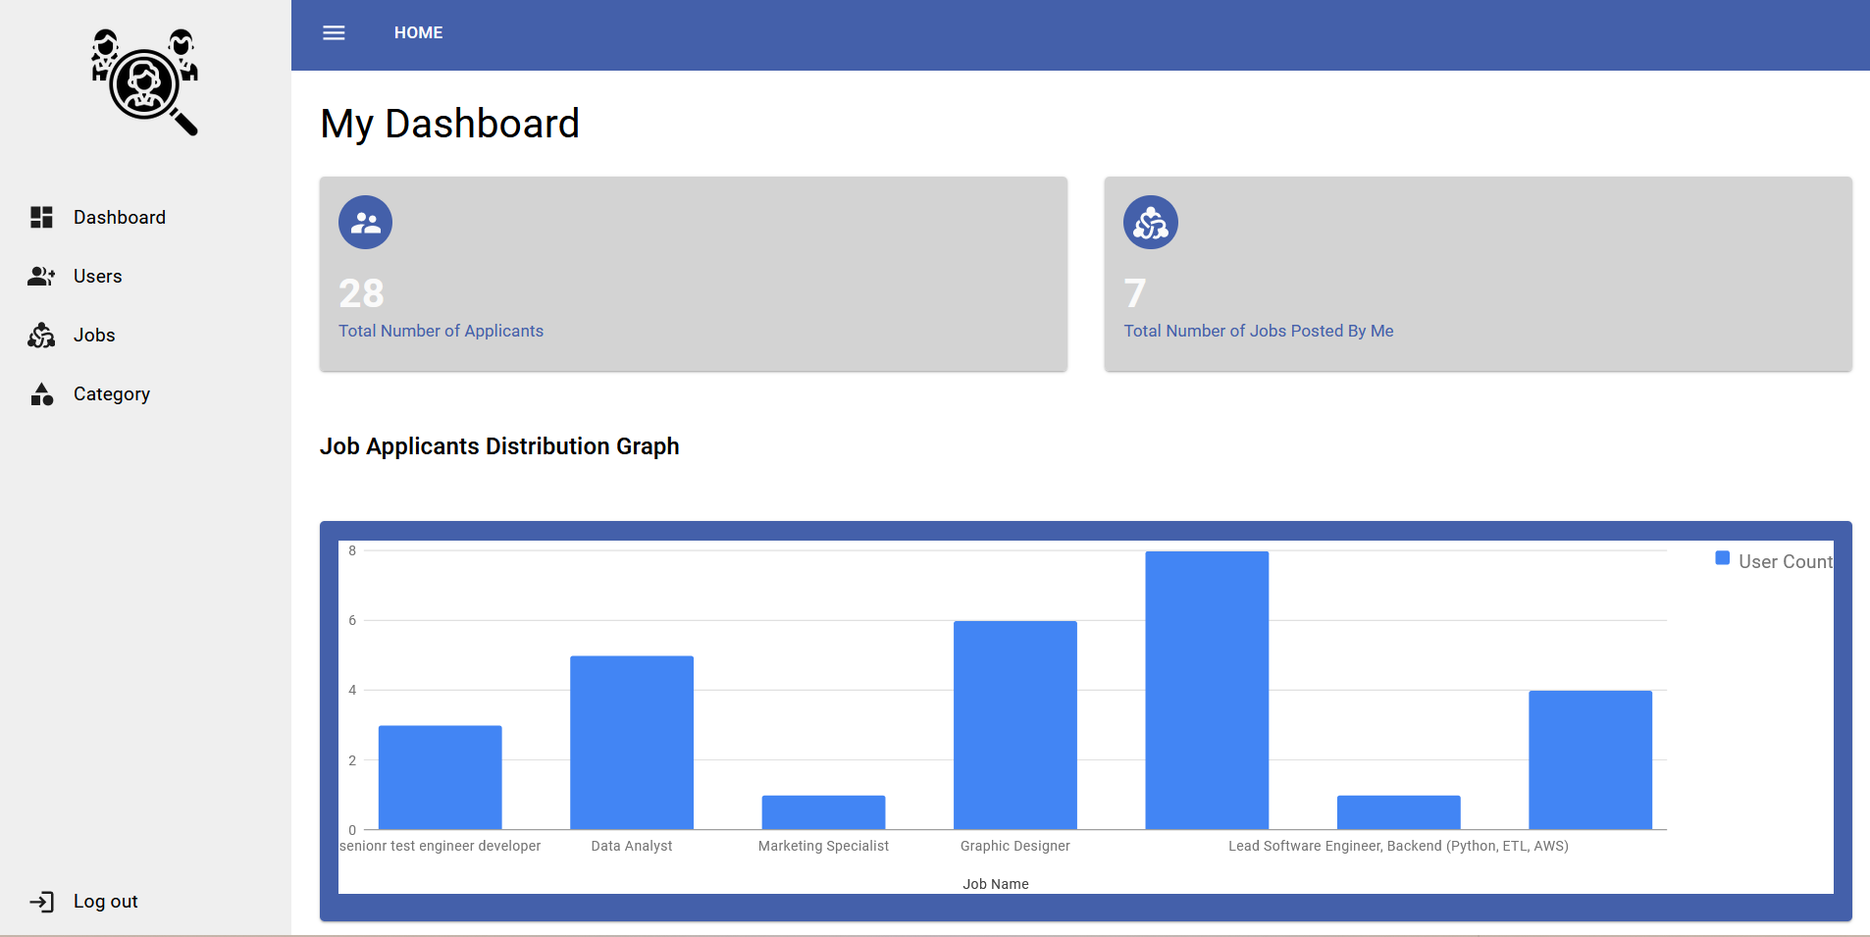
Strategic Talent Insights: HR Dashboard Visualizing Applicant Volume for Listed Job Positions

Slide 12
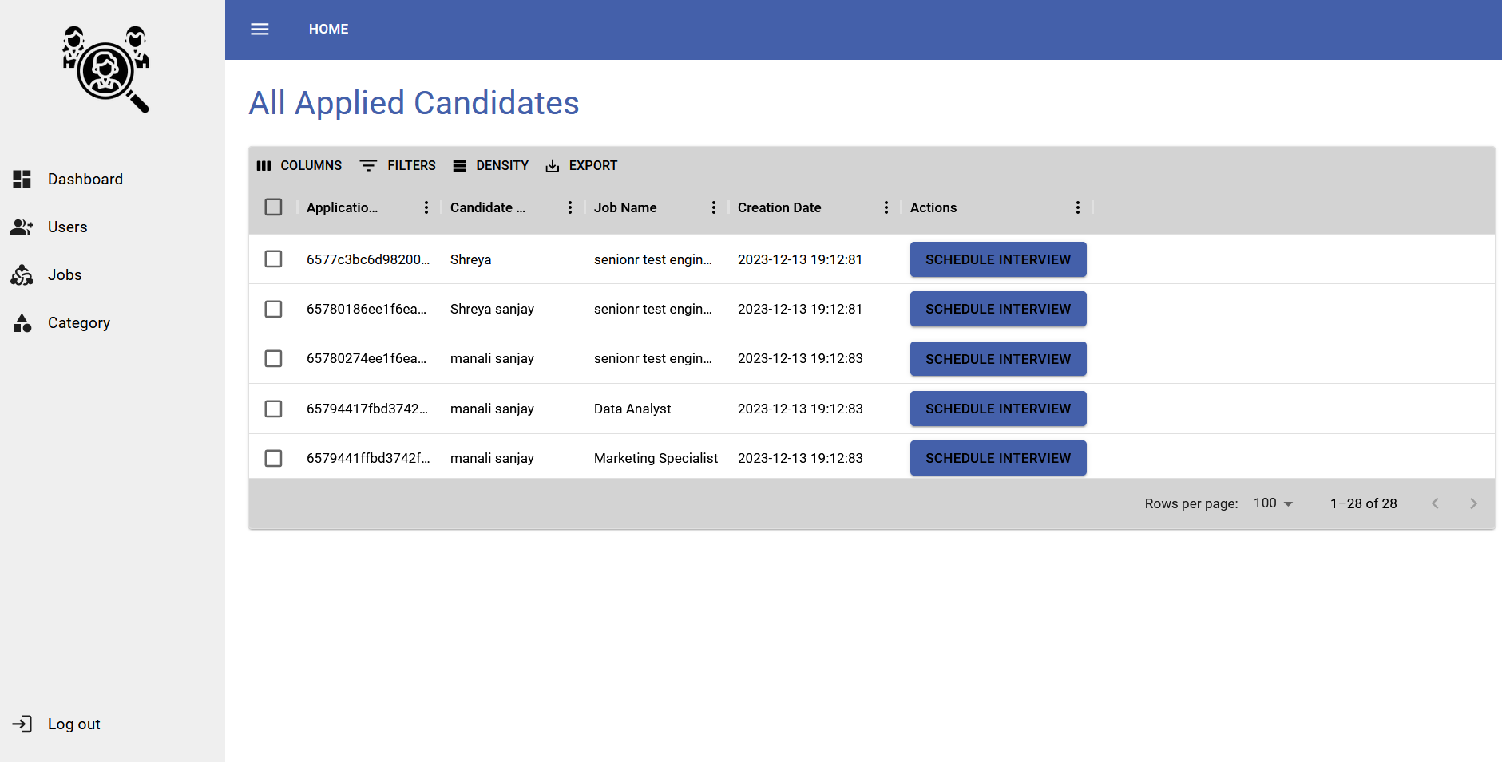
Curated Talent Pool: Explore All Applicants for Your Job Listing in One Comprehensive View

Slide 13
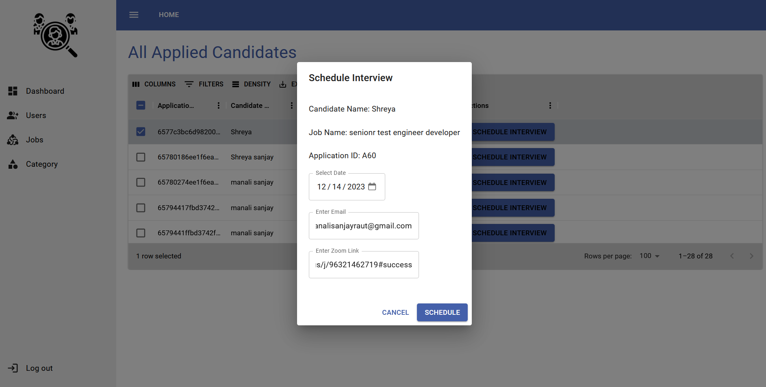
Seamless Interview Coordination: Date, Time, and Zoom Link Sent for Your Convenience

Slide 14
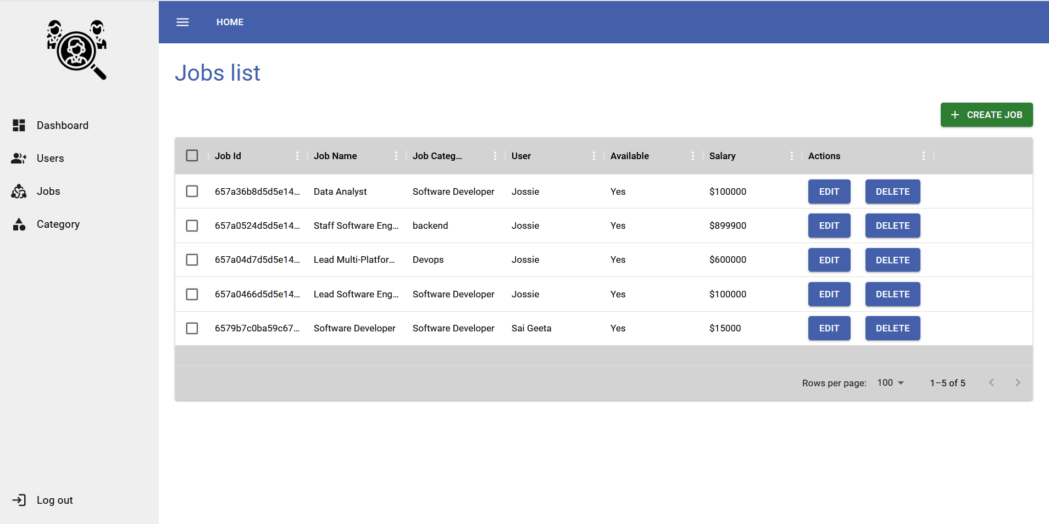
Effortless Job Management: Create, Edit, and Delete Job Requirements with Ease"

Slide 15
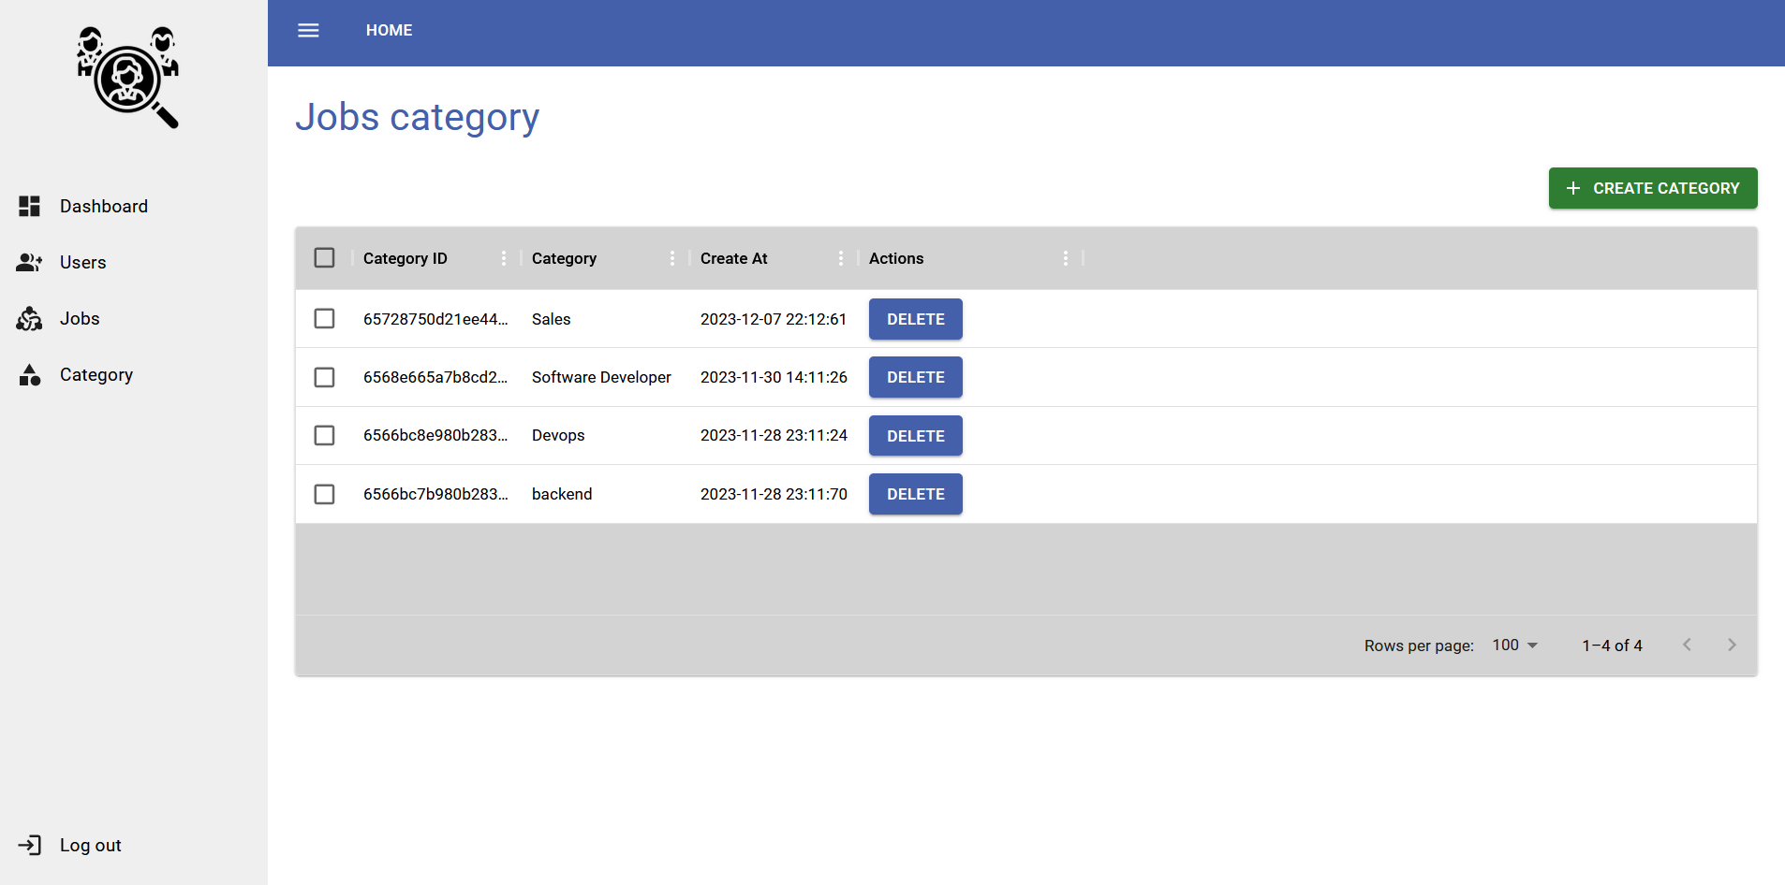
Organize with Ease: Create and Delete Job Categories for Seamless Job Management

Slide 16

THANK YOU

