Slide 1


Slide 2
Oracle Data Guard 11g Release 2:
High Availability to Protect Your Business
Joseph Meeks
Director,
Product Management
Oracle USA
Aris Prassinos
Distinguished Member
of Technical Staff
MorphoTrak, SAFRAN Group
Michael T. Smith
Principal Member of Technical Staff
Oracle USA

Slide 3


Program
<Insert Picture Here>
Traditional approach to HA
The ultimate HA solution
Active Data Guard 11.2
Implementation
Resources

Slide 4
Buy Components That Never Fail
Notes:
HA is simple, right.
Just purchase high end servers and storage arrays with redundant internal components.
But its very expensive, and its still not a guarantee.
For example, its not unusual to be approached by customers who have experienced SAN failures that have caused extended outages and data loss for their mission critical databases.

Slide 5
Deploy HA Clusters That Never Fail
(to compensate for components that fail)
Notes:
So what next – deploy HA clusters that never fail. That will do it. Well …..
How many folks in here are running HA clusters of one kind or another – either Oracle RAC or third party cold failover clusters.
Keep your hands up. Now, if that cluster has NEVER failed, bring your hand down.
One of the HA challenges with a cluster for Oracle is that at its foundation, an HA cluster runs on a single Oracle Database. Failures that can impact the database can impact the entire cluster. Data corruptions caused by faulty system components for example. Or more frequently, the challenge posed by this next approach to achieving high availability ….

Slide 6
Hire People That Never Make Mistakes
(to manage HA clusters that never fail)
Notes:
You have invested in redundant components, and in HA clusters, that never fail of course, and now you simply make sure you hire people that never make mistakes. This reminds me of one of our customers who operated a large Oracle RAC cluster and was very happy with their high availability until a storage admin deleted the files containing the online logs for one of the RAC instances. On a Unix/Linux platform, LGWR continues writing to the deleted log file because it maintains an open file descriptor which keeps a reference count in the node. When LGWR tried to switch to the next log group, it crashed the instance and eventually all RAC instances died attempting instance recovery.
The customer thought they were ok, after all they had a DR site maintained by array based remote-mirroring. But the mirroring software had deleted the same file at the remote mirror, replicating the human error to the remote site.
The poor customer had an extended outage and data loss while they rebuilt their database from an earlier backup.
Oh, and then there was the case where admin tripped over the power cords for the array – and brought their cluster down.

Slide 7

Notes:
When it comes to achieving high availability for your most critical systems please do me a favor, never say never again. You can’t achieve high availability by assuming you can buy components and train people such that a failure will never happen. In spite of best efforts, failures are guaranteed, its only a mater of time.

Slide 8
Three Production Examples
(that never said never)
Notes:
Lets look at 3 production examples that never say never.

Slide 9
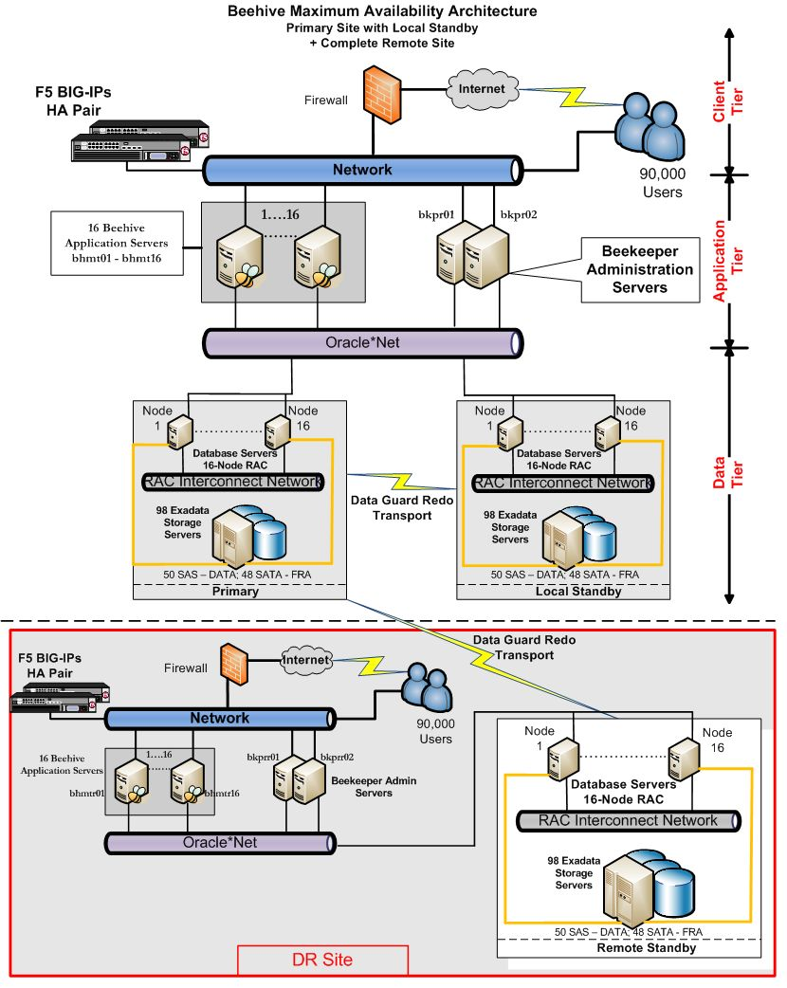
Oracle - 90,000 Users
Beehive Office Applications
Beehive – Oracle’s unified collaboration solution
  Email, instant messaging, conferencing, collaboration, calendar…
  Oracle Database 11.1.0.7
  16 node RAC clusters
  98 Exadata storage cells / site
  Data Guard
    Local standby for HA
      Offload read-only workload
      Offload backups
    Remote standby for DR
      Dual purpose as test system

Slide 10


Major Credit Card Issuer
Website Authentication and Authorization
Local standby
database for HA
Data Guard
SYNC
SAN mirroring - ASYNC
Remote Mirror
Disaster Recovery
Primary Database
Oracle 10g - RAC
Single-Sign-On Application
  Internal and external website authentication and authorization, including web access to personal accounts
Notes:
Ravi Sharma wrote:
Hi Joe, It was American Express and the application was their in-house developed Single-Sign-On application that serves their internal and external website authentication and authorization, including the My Card Account application that we are all familiar with. Was about 5 to 6 years ago.
I forgot to mention that a few years ago, I had a similar situation at a customer and the stated needs were active-active real-time replication across 2000 miles for an important/mission critical system. After some analysis we found that what they were looking for was really high availability with ability to transparently / quickly failover in case of a problem. When the requirements were "dissected" the customer realized that Oracle RAC with local (using Data Guard) and remote replication (using EMC SRDF - customer used this as a standard otherwise they could have used Data Guard for this as well) was an ideal solution for them than replicating massive amounts of data across two geographically different sites. This addressed all the scenarios that they were looking to protect against.

Slide 11

MorphoTrak
Aris Prassinos - Distinguished Member of Technical Staff
US subsidiary of Sagem Sécurité, SAFRAN Group
Innovators in multi-modal Biometric Identification and Verification
  Fingerprint, palmprint, iris, facial
  Printrak Biometrics Identification Solution
Government and Commercial customers
  Law enforcement, border management, civil identification
  Secure travel documents, e-passports, drivers’ licenses, smart cards
  Facility / IT access control
Recently chosen by the FBI as Biometric Provider for their
Next Generation Identification Program
http://www.sagem-securite.com/eng/site.php?spage=04010847

Slide 12

MorphoTrak
Printrak Biometrics Identification Solution
Goal – high availability and disaster recovery at minimal cost
Read-write transactions
Read-only transactions
Data Guard Maximum Availability - SYNC
Active Data Guard
continuous redo shipping, validation and apply
(up to 10ms network latency - approx 60 miles)
Oracle 11.1.0.7
Oracle RAC, XML DB, SecureFiles, ASM
15TB, 2MB/sec redo rate
Mixed OLTP – read intensive
Automatic database failover (Fast-Start Failover)
  Complements RAC HA
  Remote location provides DR
Off-load read-only transactions to active standby
  Full utilization reduces acquisition cost
  Simpler deployment reduces admin cost
At 10ms network latency, SYNC has 5% - 10% impact on primary throughput
MorphTrak - Open World 2009 Session 307560

Slide 13
Program
<Insert Picture Here>
Traditional approach to HA
The ultimate HA solution
Active Data Guard 11.2
Implementation
Resources
Notes:
Each of the previous examples share the same HA attributes – lets identify them and then drill down into the Oracle has a solution that can get you there.

Slide 14
High Availability Attributes
Attribute | Why Important
1. Redundancy with isolation | No single point of failure, failures stay put
2. Zero data loss | Complete protection, no recovery concerns
3. Extreme performance | Deploy for any application
4. Automatic failover | Fast, predictable
5. Full systems utilization | Fast recovery, high return on investment
6. Management simplicity | Reliable, reduced administrative costs

Slide 15


Cluster
Production
Database
Redundancy with isolation | Automatic failover
Zero data loss | Full systems utilization
Extreme performance | Management simplicity

Slide 16
Cluster with Remote DR Site
Primary Site
Remote Site
Disaster Recovery
SAN
Mirroring
ASYNC
?
Primary
Database
Redundancy with isolation | Automatic failover
Zero data loss | Full systems utilization
Extreme performance | Management simplicity

Slide 17
Cluster with Remote DR Site
Primary Site
Remote Site
Disaster Recovery
Data Guard
ASYNC
Primary
Database
Remote Standby
Database
Redundancy with isolation | Automatic failover
Zero data loss | Full systems utilization
Extreme performance | Management simplicity

Slide 18
Cluster with Data Guard Local and Remote Standby
Primary Site
Remote Site
Disaster Recovery
Data Guard
ASYNC
SYNC
Primary
Database
Remote Standby
Database
Local
Standby
Database
Redundancy with isolation | Automatic failover
Zero data loss | Full systems utilization
Extreme performance | Management simplicity

Slide 19
Cluster with Data Guard Local and Remote Standby
Primary Site
Remote Site
Disaster Recovery
Data Guard
ASYNC
Remote Standby
Database
Primary
Database
Redundancy with isolation | Automatic failover
Zero data loss | Full systems utilization
Extreme performance | Management simplicity
Notes:
No restart of mid tier

Slide 20
Program
<Insert Picture Here>
Traditional approach to HA
The ultimate HA solution
Active Data Guard 11.2
Implementation
Resources

Slide 21

What is Active Data Guard?
Primary Site
Active Standby Site
Data Guard
Physical Standby
Database
Open Read-Only
Primary
Database
Data availability and data protection for the Oracle Database
Up to thirty standby databases in a single configuration
Physical standby used for queries, reports, test, or backups
Notes:
Data Guard and Real Application Clusters are complementary and are ideally used together - Maximum Availability Architecture
Real Application Clusters provides high availability
Rapid and automatic recovery from node failures or an instance crash
Low cost, application transparent scale-out using commodity hardware
Data Guard provides data availability, data protection and disaster protection, preventing downtime and data loss
Maintains synchronized copies of primary database
Protects against disasters, data corruption and user errors
Does not require expensive HW/SW mirroring

Slide 22
High Availability Attributes
How Does Active Data Guard Stack Up?
Attribute | Why Important
1. Redundancy with isolation | No single point of failure, failures stay put
2. Zero data loss | Complete protection, no recovery concerns
3. Extreme performance | Deploy for any application
4. Automatic failover | Fast, predictable
5. Full systems utilization | Fast recovery, high return on investment
6. Management simplicity | Reliable, reduced administrative costs

Slide 23
HA Attribute: Redundancy with Isolation
Data Guard Transport and Apply
Primary Database
Standby Database
1
SYNC or ASYNC
Oracle Instance
Oracle Instance
3
2
Oracle Data files
Oracle Data files
Recovery data
Automatic outage resolution
Recovery data
4

Slide 24
HA Attribute: Redundancy with Isolation
Data Integrity
Primary changes transmitted directly from SGA
  Isolates standby from I/O corruptions
Software code path on standby different than primary
  Isolates standby from firmware and software errors
Multiple Oracle corruption detection checks
  Data applied to the standby is logically and physically consistent
Standby detects silent corruptions that occur at primary
  Hardware errors and data transfer faults that occur after Oracle receives acknowledgment of write-complete
Known-state of standby database
  Oracle is open, ready for failover if needed
Notes:
Active Data Guard is a loosely coupled architecture where standby databases are isolated from failures that can occur at the primary database. Primary database changes are transmitted directly from memory, isolating the standby from I/O corruptions that occur at the primary. The software code-path executed on an active standby is different from that of the primary – isolating it from firmware and software errors that impact the primary. Oracle corruption-detection checks insure that data is logically and physically consistent before it is applied to a standby database. An active standby also acts as a “canary in a coal mine” by detecting silent corruptions that can occur at the primary due to hardware errors (memory, cpu, disk, NIC) and data transfer faults, preventing them from impacting the standby database.

Slide 25

HA Attribute: Zero Data Loss
Synchronous redo transport
User Transactions
Queries, Updates, DDL
Commit
Commit ACK
Active
Standby
Database
Primary Online
Redo Logs
SGA
Redo Buffer
LGWR
Standby
Redo
Logs
NSA
RFS
MRP
Oracle Net
Primary
Database
Queries, Reports
Testing & Backups
Maximum Availability Protection Mode
- Controlled by NET_TIMEOUT parameter of LOG_ARCHIVE_DEST_n
- Default value 30 seconds in Data Guard 11g
Notes:
7
LNS
Network round trip
Commit acknowledgement
Net_timeout

Slide 26






HA Attribute: Automatic Failover
Database
Data Guard Fast-Start Failover
Automatic failover
  Database down
  Designated health-check conditions
  Or at request of an application
Failed primary automatically reinstated as standby database
All other standby’s automatically synchronize with the new primary
Observer
Primary
Database
Standby Database
Primary
Database
Primary Database
Standby Database

Slide 27

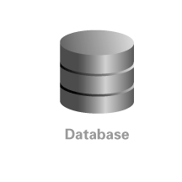
HA Attribute: Automatic Failover
Applications
Primary Database
Standby Database
3
FAN breaks clients out
of TCP timeout.
TAF/FCF automatically
reconnects applications
to new primary
Application Tier - Oracle Application Server Clusters
2
Role
specific
database
services start
automatically
Database Tier- Oracle
Real Application Clusters
Data Guard
Automatic
Failover
Database
Services
Primary
Database
1
Data Guard
Redo Transport
Standby
becomes
primary database
Standby
Database

Slide 28
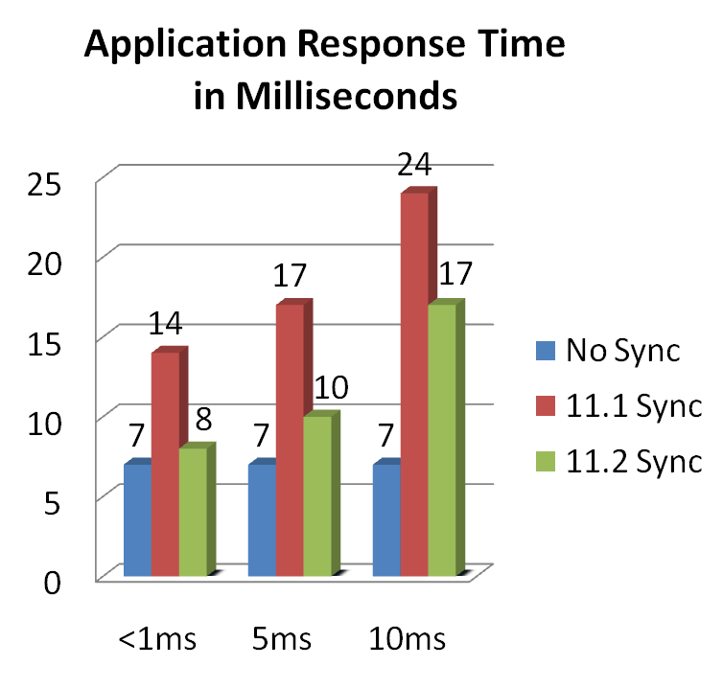
HA Attribute: Extreme Performance
Primary Database
Data Guard 11.2 SYNC
  Redo shipped in parallel with LGWR write to local online log file
Little to no impact on response time when using SYNC in low latency network
  40% improvement over 11.1 on low latency LAN
network latency

Slide 29
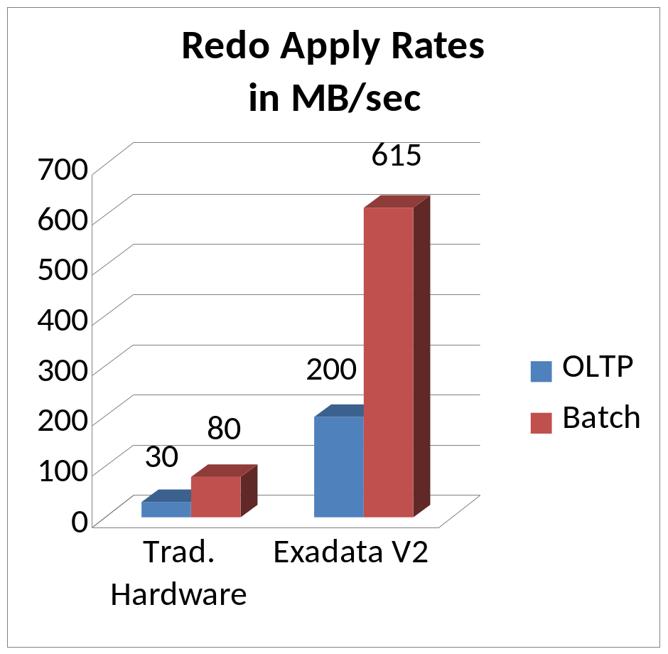
HA Attribute: Extreme Performance
Standby Database
Data Guard 11.2 Redo Apply
  Across the board increase in apply rates
  High query load on active standby does not impact apply
  Redo Apply is optimized to utilize Exadata I/O bandwidth
  Improved “Apply Lag” stat allows for finer grained monitoring of standby progress
Notes:
High query load on active standby does not impact apply – 11.2. Bug 7212222 fixed in 11.2.

Slide 30




HA Attribute: Full Systems Utilization
Active Data Guard
Read-write
Workload
Real-time Reporting
Real-time Reporting
Real-time
Queries
Fast Incremental Backups
Fast Incremental Backups
Continuous redo
shipping, validation & apply
Production
Database
Active Standby
Database
Offload read-only queries to an up-to-date physical standby
Use fast incremental backups on a physical standby – up to 20x faster

Slide 31
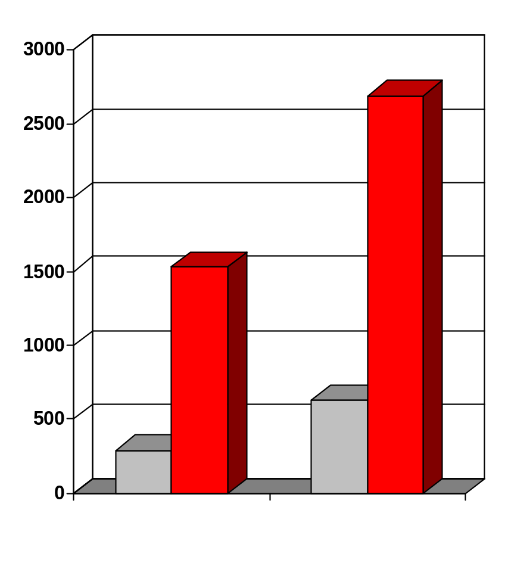
Standby is used as Production System
2,610
More scalable
Better performance
  Eliminate contention between read-wite and read-only workload
  Simplify performance tuning
Transactions / sec
1,530
630
+ 117%
Read-write service
290
+ 70%
Read-only service
All services
run on primary
database
Read-only
offloaded to
standby

Slide 32
Standby is used to Reduce Planned Downtime
Database rolling upgrades
  Transient Logical Standby
Migrations to ASM and/or RAC
Technology refresh – servers and storage
Windows/Linux migrations *
32bit/64bit migrations*
Implement major database changes in rolling fashion
  e.g. ASSM, initrans, blocksize
Implement new database features in rolling fashion
  e.g. Advanced Compression, SecureFiles, Exadata Storage
* see Metalink Note 413484.1

Slide 33
Standby is used to Eliminate Risk
Data Guard Snapshot Standby – Ideal for Testing
Updates
Queries
Queries
Updates
redo
data
Replay
workload
using
Real
Application
Testing
Primary
Database
Active Standby
Database
Active Standby
Database
Snapshot Standby
Database
DGMGRL> convert database <name> to snapshot standby;
DGMGRL> convert database <name> to physical standby;
Notes:
Open read-write while maintaining data protection
Ideal QA system
Ideal for use with Real Application Testing
Refer audience to Larry’s talk for more details

Slide 34
HA Attribute: Simple to Manage
Active Data Guard
All data types
All storage attributes
All DDL
Fewest moving parts
Based on media recovery – mature technology
Highest performance
Guaranteed EXACT replica of production

Slide 35
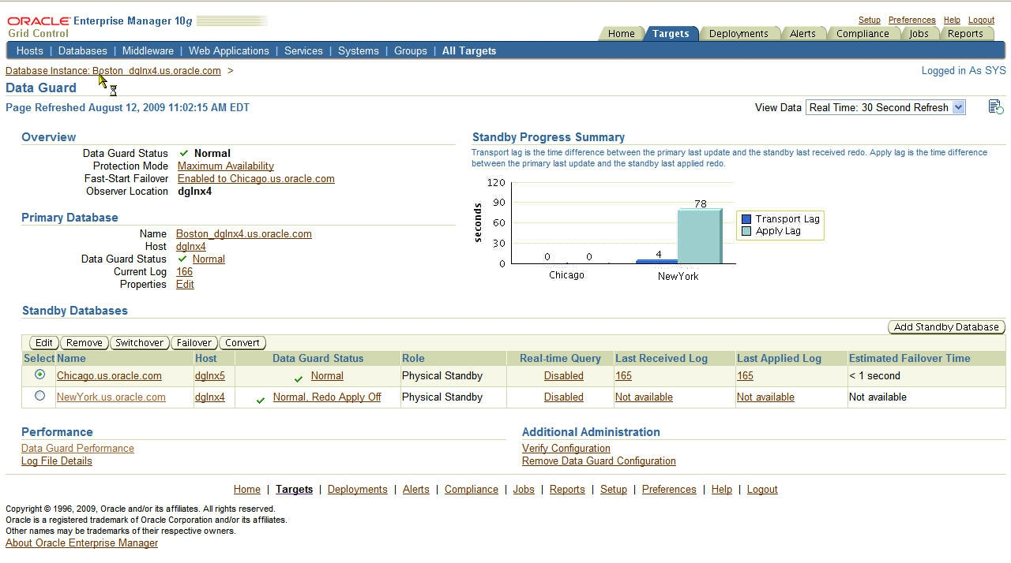
HA Attribute: Simple to Manage

Slide 36
Program
<Insert Picture Here>
Traditional approach to HA
The ultimate HA solution
Active Data Guard 11.2
Implementation
Resources

Slide 37
Adding a Local Data Guard Standby Database
Primary Site
Remote Site
Disaster Recovery
Data Guard
ASYNC
SYNC
Primary
Database
Remote Standby
Database
Local
Standby
Database

Slide 38
Key Components
Local physical standby – Maximum Availability
Active Data Guard
Data Guard Broker
Data Guard Observer and Fast-Start Failover
Flashback Database
Fast Application Failover

Slide 39
Implementation Considerations
Data Guard Transport Tuning and Configuration
Local Standby
  Low latency network (ideally less than 5ms)
  Maximum Availability Mode with SYNC transport
  Set NET_TIMEOUT to 10 seconds from default of 30
  Standby redo logs on fast storage
Remote Standby
  High network latency
  ASYNC transport
  Potentially increase log_buffer to ensure LNS reads from memory instead of disk (MetaLink Note 951152.1)
  Tune TCP socket buffer sizes and device queues
    Value is a function of bandwidth and latency
    See HA Best Practices

Slide 40
Implementation Considerations
Basic Configuration
Flashback Database
  Configure on all databases in the configuration
  Appropriately size Flash Recovery Area
  FLASHBACK_RETENTION_PERIOD minimum of 60 minutes
  See MetaLink Note 565535.1 for performance best practices
Data Guard Broker
  Required for Fast-Start Failover
  Required for auto-restart of role specific database services (11.2)
  Required for Fast Application Notification
  Close integration with RAC (ie apply instance failover)
  Simplified role transitions when using multiple standbys
  Check MetaLink for Data Guard Broker bundled patch
    E.g. 10.2.0.4 bundle has backports of several Broker 11.1 features

Slide 41
Implementation Considerations
Fast-Start Failover
Data Guard Observer
  Local standby is the Fast-Start Failover Target
  Deploy Observer on 3rd host, independent of primary/standby
  Set FastStartFailoverThreshold
    10 seconds for single instance databases
    20 seconds plus time for node eviction for Oracle RAC
  Use Oracle Enterprise Manager for Observer HA
    Auto restart of Observer on new host

Slide 42
Implementation Considerations
Configuring Client Failover
Role based services (11.2)
  Application service only runs on primary database
All primary and standby hostnames in ADDRESS_LIST / URL
Outbound connect timeout
  Limits amount of time spent waiting for connection to failed resources
Application notification
  Break clients out of TCP with Fast Application Notification events
Pre Data Guard 11.2 please refer to Client Failover Best Practices
http://www.oracle.com/technology/deploy/availability/pdf/MAA_WP_10gR2_ClientFailoverBestPractices.pdf

Slide 43
The Result
An HA architecture built on the assumption that
eventually something will fail

Slide 44
Ultimate High Availability
Primary Site
Remote Site
Disaster Recovery
Data Guard
ASYNC
SYNC
Primary
Database
Remote Standby
Database
Local
Standby
Database

Slide 45
Ultimate High Availability
Primary Site
Remote Site
Disaster Recovery
Data Guard
ASYNC
Remote Standby
Database
Primary
Database
Redundancy with isolation | Automatic failover
Zero data loss | Full systems utilization
Extreme performance | Management simplicity

Slide 46
Start Here
Primary Site
Remote Site
Disaster Recovery
Data Guard
ASYNC
SYNC
Primary
Database
Remote Standby
Database
Standby
Database
Redundancy with isolation | Automatic failover
Zero data loss | Full systems utilization
Extreme performance | Management simplicity

Slide 47
Key Best Practices Documentation
HA Best Practices
http://www.oracle.com/pls/db111/portal.portal_db?selected=14&frame=
Active Data Guard and Redo Apply
http://www.oracle.com/technology/deploy/availability/pdf/maa_wp_11gr1_activedataguard.pdf
Data Guard Redo Transport
http://www.oracle.com/technology/deploy/availability/pdf/MAA_WP_10gR2_DataGuardNetworkBestPractices.pdf
Data Guard Fast-Start Failover
http://www.oracle.com/technology/deploy/availability/pdf/MAA_WP_10gR2_FastStartFailoverBestPractices.pdf
Automating Client Failover (Data Guard 10g and 11gR1)
http://www.oracle.com/technology/deploy/availability/pdf/MAA_WP_10gR2_ClientFailoverBestPractices.pdf
Managing Data Guard Configurations with Multiple Standby Databases
http://www.oracle.com/technology/deploy/availability/pdf/maa10gr2multiplestandbybp.pdf
Using your Data Guard Standby for Real Application Testing
http://www.oracle.com/technology/deploy/availability/pdf/oracle-openworld-2008/298770.pdf
S307560 Active / Active Configurations with Oracle Active Data Guard
http://www.oracle.com/technology/deploy/availability/pdf/oracle-openworld-2009/307560.pdf

Slide 48
HA Sessions, Labs, & Demos by Oracle Development
Sunday, 11 October – Hilton Hotel Imperial Ballroom B
3:45p Online Application Upgrade
Monday, 12 October – Marriott Hotel Golden Gate B1
11:30a Introducing Oracle GoldenGate Products
Monday, 12 October – Moscone South
1:00p Oracle’s HA Vision: What’s New in 11.2, Room 103
4:00p Database 11g: Performance Innovations, Room 103
2:30p Oracle Streams: What's New in 11.2, Room 301
5:30p Comparing Data Protection Solutions, Room 102
Tuesday, 13 October – Moscone South
11:30a Oracle Streams: Replication Made Easy, Room 308
11:30a Backup & Recovery on the Database Machine, Room 307
11:30a Next-Generation Database Grid Overview, Room 103
1:00p Oracle Data Guard: What’s New in 11.2, Room 104
2:30p GoldenGate and Streams - The Future, Room 270
2:30p Backup & Recovery Best Practices, Room 104
2:30p Single-Instance RAC, Room 300
4:00p Enterprise Manager HA Best Practices, Room 303
Tuesday, 13 October – Marriott Hotel Golden Gate B1
11:30a GoldenGate Zero-Downtime Application Upgrades
1:00p GoldenGate Deep Dive: Architecture for Real-Time
Wednesday, 14 October – Moscone South
10:15a Announcing OSB 10.3, Room 300
11:45a Active Data Guard, Room 103
5:00p Exadata Storage & Database Machine, Room 104
Thursday, 15 October – Moscone South
9:00a Empowering Availability for Apps, Room 300
12:00p Exadata Technical Deep Dive, Room 307
1:30p Zero-Risk DB Maintenance, Room 103
Demos Moscone West DEMOGrounds
Mon & Tue 10:30a - 6:30p; Wed 9:15a - 5:15p
Maximum Availability Architecture (MAA), W-045
Oracle Streams: Replication & Advanced Queuing, W-043
Oracle Active Data Guard, W-048
Oracle Secure Backup, W-044
Oracle Recovery Manager & Flashback, W-046
Oracle GoldenGate, 3709
Hands-on Labs Marriott Hotel Golden Gate B2
Monday 11:30a-2:00p Oracle Active Data Guard, Parts I & II
Thursday 9:00a-11:30a Oracle Active Data Guard, Parts I & II

Slide 49
For More Information
search.oracle.com
data guard
or
oracle.com/ha
Notes:
[wh] To learn more about Active Data Guard with Oracle Database 11g and how it fits into Oracle’s Maximum Availability Architecture framework go to oracle.com/ha, or simple type ‘active data guard’ into search.oracle.com
Thank you.

Slide 51


