Slide 1
Real randomized trials in diabetes
Bochra Jamal Zareini, MD, PhD, Post. doc fellow

Slide 2
Outline
Diabetes
Historic perspective
Important features of the GLP1-RA, SGLT2i and DPP4i trials
Bridging the gap from RCT to trial emulation – methodological considerations

Slide 3




GENETICS
INSULIN SECRETION
INSULIN SENSITIVITY
HYPERGLYCEMIA
KIDNEY GLUCOSE REABSORPTION

Slide 4
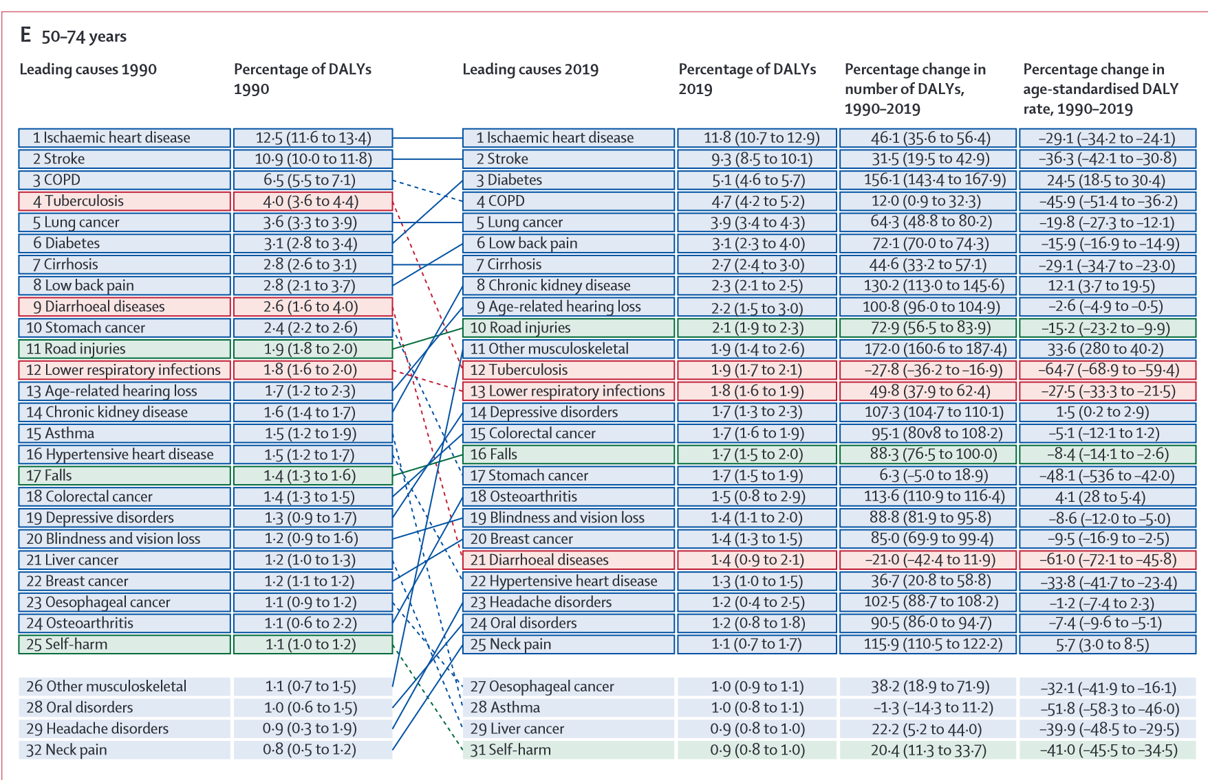

Slide 5

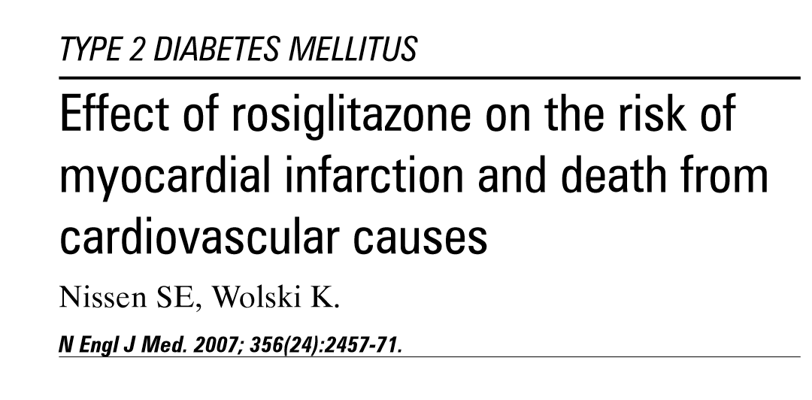

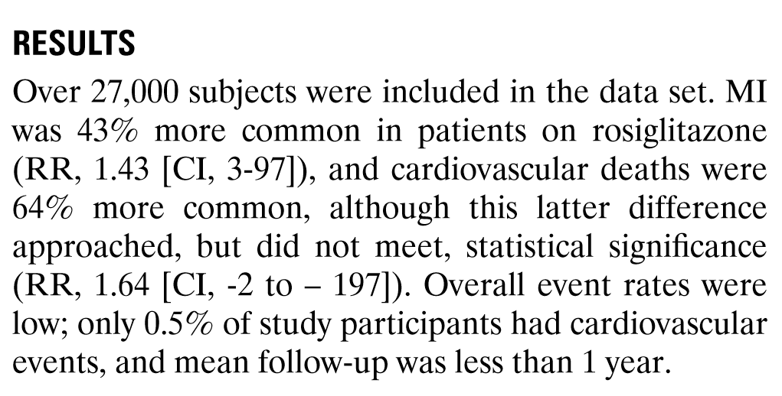
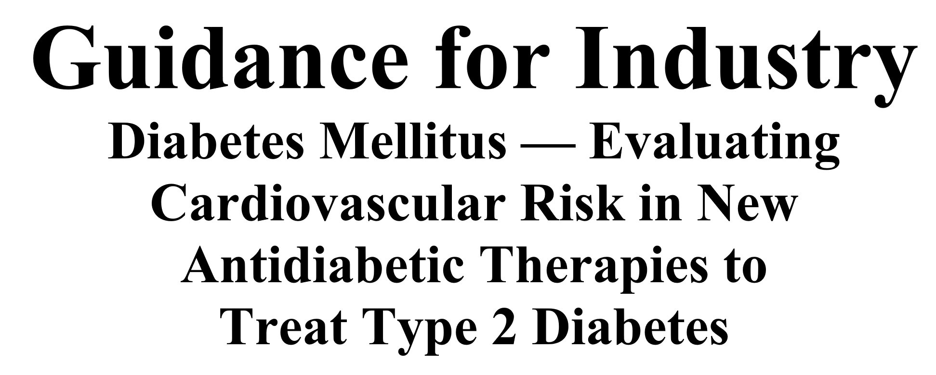
CVOT ERA
2007
2008
2023
Notes:
2008 is an important landmark year.

Slide 6
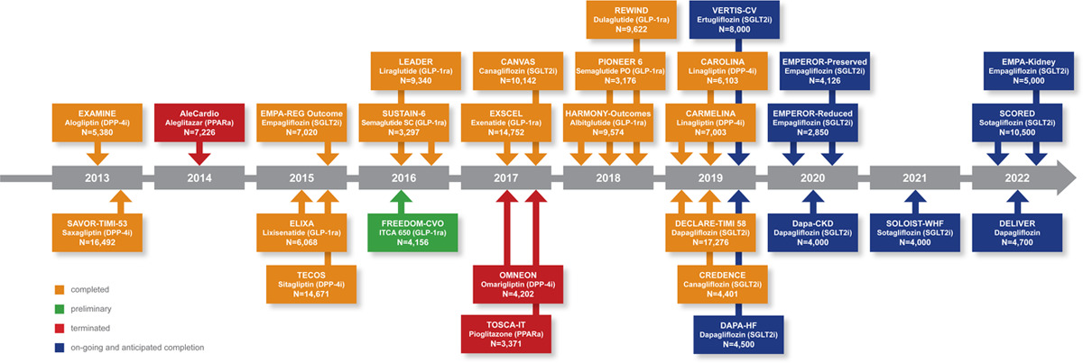

Slide 8
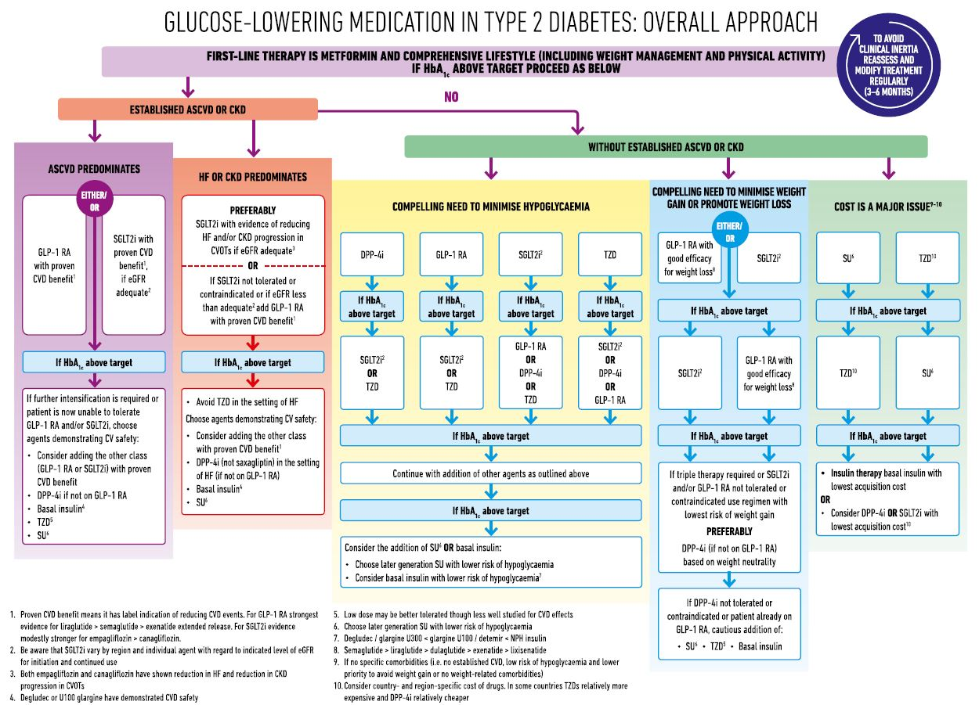

Slide 12
Notes:
Skriv hvad registrene hedder

Slide 13

Bridging the gap from RCT to trial emulation – methodological considerations

Slide 14
Bridging the gap
Inclusion criteria – who should we include?
How do we define treatment?
What control group?
The year of introduction to the market (DDP4 in 2007, GLP1 in 2011, SGLT2 2012)
Intention to treat or on-treatment analyses?
What outcomes to include?

