Slide 1
Introduction to computing
Stephanie Spielman
Ecological Functional Genomics Workshop
Lacawac Sanctuary, May 24-26th 2017

Slide 2
computers are stupid
No, really.

Slide 3
Unix and the shell
UNIX is a computer operating system
Mac and Linux are built on UNIX, but PCs are not ☹ (but Windows 10 now has Linux inside!)

Slide 4
Unix and the shell
UNIX is a computer operating system
Mac and Linux are built on UNIX, but PCs are not ☹ (but Windows 10 now has Linux inside!)
We interact with this system using a shell.
We’ll use Bash (bourne-again shell)

Slide 5
navigating Unix systems
Files and directories in UNIX systems are organized hierarchically

Slide 6
navigating Unix systems
Every file/directory has a specific address, or path, in the hierarchy

Slide 7
navigating Unix systems
Every file/directory has a specific address, or path, in the hierarchy
Levels are separated by slashes: /

Slide 8
navigating Unix systems
Every file/directory has a specific address, or path, in the hierarchy
A
Levels are separated by slashes: /
B
C
The path from A to C is B/C

Slide 9
navigating Unix systems
Every file/directory has a specific address, or path, in the hierarchy
A
Move up the hierarchy with ..
Levels are separated by slashes: /
B
C

Slide 10
navigating Unix systems
Every file/directory has a specific address, or path, in the hierarchy
A
Move up the hierarchy with ..
Levels are separated by slashes: /
B
C
The path from C to A is ../..

Slide 11
navigating Unix systems
The top-level directory is called root, and is denoted with single slash
/
Notes:
Generally, this is where secret important things happen. If you don’t understand computers well, don’t mess around in here!

Slide 12
navigating Unix systems
Your home directory is where you live
~
Desktop
Documents
Downloads

Slide 13
navigating Unix systems
Your home directory is where you live
~
Desktop
Documents
Downloads
The full path to my home directory is /Users/sjspielman/

Slide 14
navigating Unix systems
We move around in our file system with the command cd (change directory)
Absolute, or full, path is the path from the root
Relative path is the path from the working directory (i.e., where you are)
Notes:
DEMONSTRATE CD HERE!!!
INCLUDE ~, .., . cd on its own. relative path vs absolute path demo.

Slide 15
basic unix commands
All UNIX commands are actually little computer programs
Their behavior can be modified or specified with flags and arguments

Slide 16
DEMO and exercise BREAK

Slide 17
basic unix commands
UNIX Command | What it does
cd | Change Directory
pwd | Print Working Directory (gives the full path)
ls | List (contents of a directory
mv | Move a file or directory (original not retained!)
cp | Copy a file or directory (original is retained)
rm | Remove a file or directory *forever* (NOT A TRASHCAN)
mkdir | Make a new directory
echo | Prints to screen
touch | Create a new (empty) file
man | Manual (shows documentation for a given command)
…And UNIX symbols/shortcuts!
Typing tab “auto-completes”
The greater-than sign, >, will re-direct printing to a file (overwrites the file!)
Two greater-than signs, >>, will also re-direct, but will append to the file
Notes:
NOW SHOW THESE COMMANDS IN ACTION, AND THEN BREAK FOR THEM TO DO THE WORKSHEET.

Slide 18
Regular expressions
Pattern-based search and replace
Extremely powerful beyond all reason
Excellent for text (file) manipulation!

Slide 19
critical psa: text editors
Microsoft Word is not a text editor!!!!!!! I’m so serious!!!
GUI
TextEdit and Notepad
Textwrangler/BBEdit for Macs
Sublime 3 for everyone else
Newer, awesome one called Atom (but still buggy)
CLI
Vim/vi, emacs, nano, pico (b/c puns)
https://en.wikipedia.org/wiki/Editor_war

Slide 20
Regular expressions
String: Mus musculus
Regex: Mus
Match: Mus musculus

Slide 21
Regular expressions
String: Mus musculus
Regex: Mus musculus
Match: Mus musculus

Slide 22
Regular expressions
String: Mus musculus
Regex: [mM]us
Match: Mus musculus

Slide 23
Regular expressions
String: Mus musculus
Regex: [A-Za-z]us
Match: Mus musculus

Slide 24
Regular expressions
String: Mus musculus
Regex: \wus
Match: Mus musculus

Slide 25
Regular expressions
String: Mus musculus
Regex: \w+
Match: Mus musculus

Slide 26
Regular expressions
String: Mus musculus
Regex: [A-Z]\w+ \w+
Match: Mus musculus

Slide 27
Regular expressions
String: Mus musculus
Regex: ([A-Z])\w+ (\w+)
Replace: \1. \2
New string: M. musculus

Slide 28
Regular expressions
String: 85.34 cm
Regex: \d+
Match: 85.34 cm

Slide 29
Regular expressions
String: 85.34 cm
Regex: \d+\.\d+
Match: 85.34 cm

Slide 30
Regular expressions
String: 85.34 cm
Regex: \d+\.\d+ \w+
Match: 85.34 cm

Slide 31
Regular expressions
String: 85 cm
Regex: \d+\.\d+ \w+
Match: 85 cm

Slide 32
Regular expressions
String: 85 cm
Regex: \d+\.*\d* \w+
Match: 85 cm

Slide 33
Regular expressions
String: 85 cm
Regex: ^\d
Match: 85 cm

Slide 34
Regular expressions
String: 85 cm
Regex: \w$
Match: 85 cm

Slide 35
Regular expressions
String: 85.341234 cm
Regex: (\d+\.\d{3})\d+ cm
Replace: \1
New string: 85.341

Slide 36
Regular expressions
String: 85.34 cm
Regex: (\d+\.\d{3})\d+ cm
Replace: \1
New string: ?????

Slide 37
Exercise
Come up with a regular expression to convert the following text:
85.34 cm 85.3 cm
85.678 cm 85.6 cm
923.1115 cm 923.1 cm
1.95 cm 1.9 cm
6 cm 6 cm

Slide 38
exercise break

Slide 39
Installing software
You may (will) one day have to install new software via the command line
Remember your PATH? It’s an environment variable in UNIX systems.

Slide 40
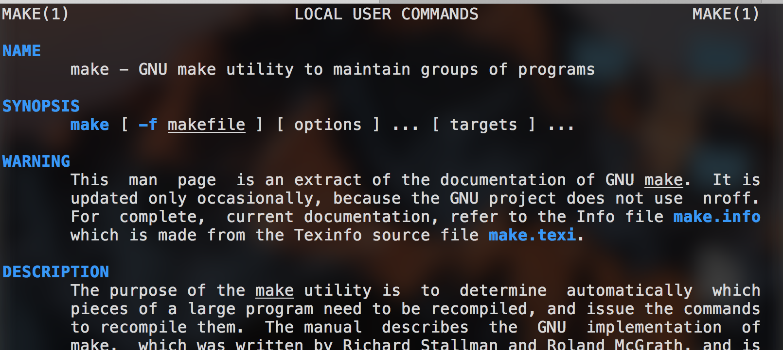
Example: Installing mafft
MAFFT is a multiple-sequence alignment software
It uses the standard make utility

Slide 41
The Make approach
Download and unzip/untar the source code
Navigate into the source code directory with cd
Read the README (check also for INSTALL)
Run:
make # compiles the executable
make install # moves exec to path

Slide 42
The Make approach
Download and unzip/untar the source code
Navigate into the source code directory with cd
Read the README (check also for INSTALL)
Run:
make # compiles the executable
make install
sudo make install # moves exec to path

Slide 43
The Make approach
Download and unzip/untar the source code
Navigate into the source code directory with cd
Read the README (check also for INSTALL)
Run:
./configure # only sometimes, see README!
make # compiles the executable
make install
sudo make install. # moves exec to path

Slide 44
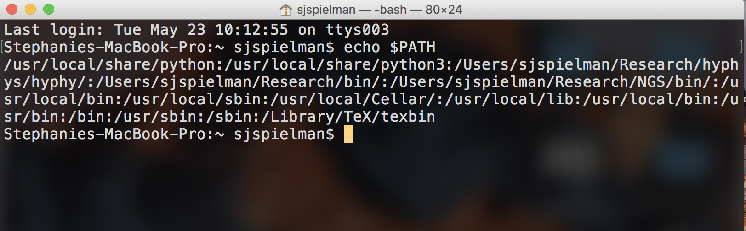
The path environment variable
# Define a variable
VAR=6
# Print variable
echo $VAR

Slide 45
Adding to the path variable
Generally, this variable lives in ~/.bash_profile or ~/.profile
Hidden file in home directory
Modify: export PATH=/new/path/to/add:$PATH
Save with command: source ~/.bash_profile

