Slide 1
Procalcitonin-Guided Antibiotic Stewardship in Hospitalized Patients with Community-Acquired Pneumonia:
Manal Almutairi, RN, BSN
AGACNP Student, University of Pennsylvania School of Nursing

Slide 2
Background
Community Acquired Pneumonia (CAP) is a leading cause of hospitalization and in-hospital mortality worldwide
~1.5 million adults hospitalized annually in the U.S. due to CAP; morbidity and mortality disproportionately higher in older adults and those with comorbidities (File & Ramirez, 2023)
CAP is a leading reason for antibiotic use and antibiotic overuse contributes to antimicrobial resistance
Optimal antibiotic duration in CAP remains poorly defined across clinical guidelines
Procalcitonin (PCT) is a biomarker that rises with bacterial infection and falls as infection resolves
PCT-guided algorithms have been proposed to safely shorten antibiotic duration
The aim of this literature review is to analyze and synthesize the evidence regarding the use of PCT to guide antibiotic treatment in hospitalized patients with CAP.
References: Duijkers et al. (2024); Voiriot et al. (2025); Bouadma et al. (2010)

Slide 3
Methods
Design: Systematic literature review following PRISMA guidelines
Databases: CINAHL (n=113), Scopus (n=54), PubMed (n=4) Total = 171
Keywords: Procalcitonin, CAP, antibiotic stewardship, hospitalized adults
Inclusion criteria: Hospitalized adults with CAP, PCT intervention, antibiotic outcome
Exclusion: Non-adult populations, HAP/VAP, reviews, editorials, case reports; limited to RCTs and controlled study designs
Screening: 166 screened after deduplication; 17 sought for retrieval; 3 final studies included
Synthesis tool: Table of Evidence (TOE) used to organize, compare, and contrast variables and findings
Quality appraisal: All 3 studies rated Level I, Quality A (JHEBP framework)
References: Duijkers et al. (2024); Voiriot et al. (2025); Bouadma et al. (2010)

Slide 4
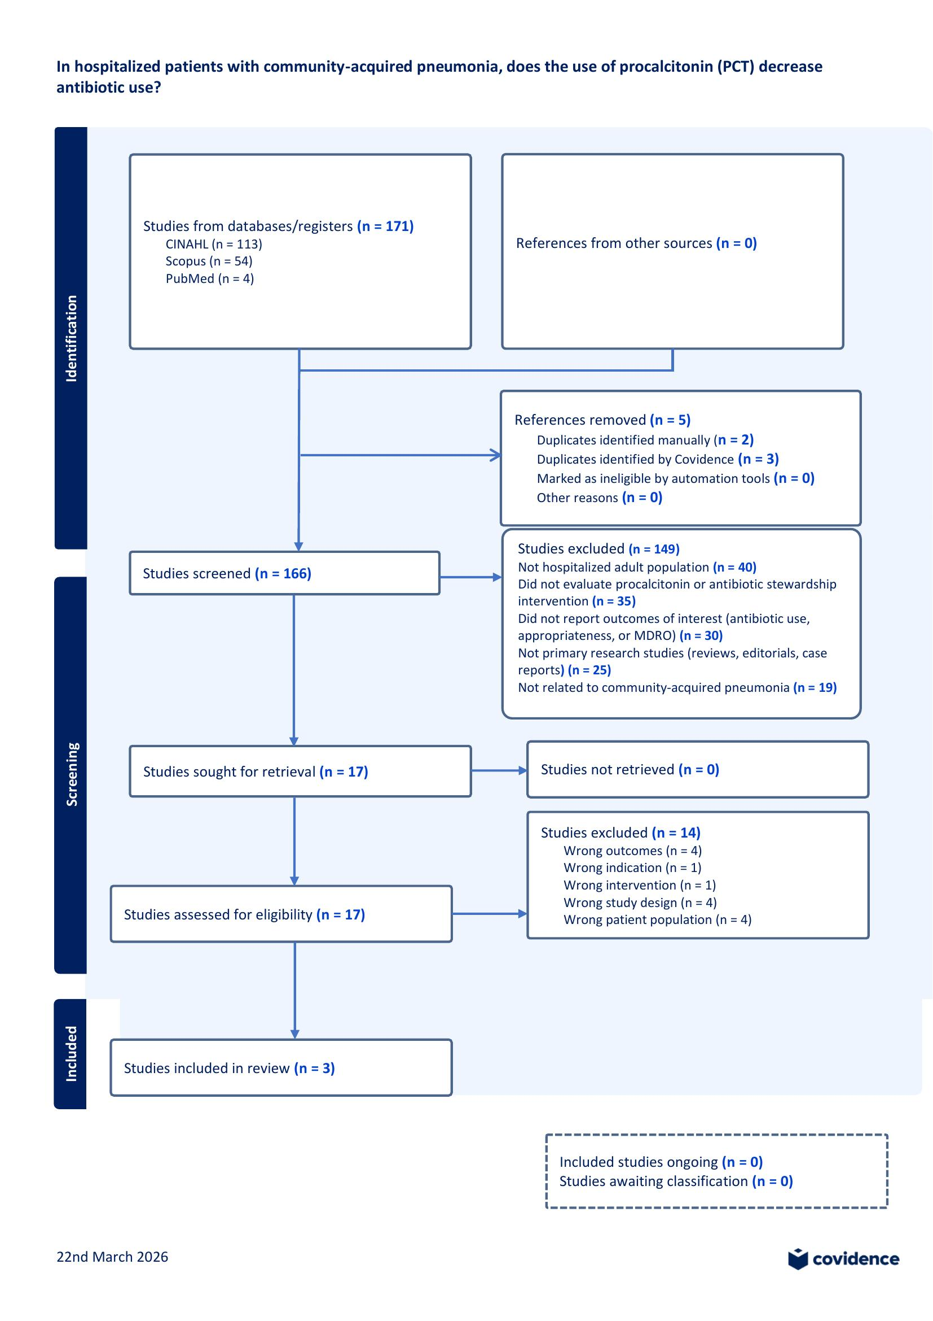
PRISMA Flow Diagram

Slide 5
Results: Antibiotic Duration & Safety
Study | Setting / N | Intervention | Key Finding | Safety Outcome
Duijkers et al. (2024) | Non-ICU RCT n=468 | PCT- & CRP-guided algorithms to stop antibiotics vs standard care | PCT: 5.5 vs 7d (−22%); CRP: 4 vs 7d (−30%); p<0.001 — NOT clinically significant for PCT arm (1.5-day difference only) | No difference in mortality, LOS, or clinical stability
Voiriot et al. (2025) | ICU RCT n=385 | mPCR + PCT-guided decisions vs standard PCT-guided care | Antibiotic duration reduced by 3 days (95% CI −5.1 to −0.9); p<0.001 | No difference in mortality or adverse events
Bouadma et al. (2010) | ICU RCT n=621 (France) | PCT-guided algorithm to start & stop antibiotics vs standard guideline-based care | +2.7 antibiotic-free days (14.3 vs 11.6d, p<0.001); 23% reduction in ABX exposure | Non-inferior mortality Day 28 & 60; no relapse or superinfection difference

Slide 6

Discussion, Limitations & Recommendations
Discussion: 3 RCTs demonstrated PCT-guided protocols reduced antibiotic use across non-ICU wards and ICUs without increasing adverse outcomes or mortality
Benefits on antimicrobial resistance were limited in low-resistance regions; larger reductions seen in non-ICU settings
Limitations: Only 3 studies met inclusion criteria; all conducted in Europe (low MRSA- may affect generalizability); open-label designs; not powered for safety
Selection bias in non-ICU trial (randomized after 2-3 days on antibiotics, milder cases); 53% non-adherence to PCT algorithm in PRORATA; PCT guidance used in both arms in MULTICAP trial
Lack of standardized intervention each study used different PCT thresholds, measurement frequencies, and decision algorithms, limiting direct comparison across studies
Practice Recommendation: PCT-guided stewardship is a low-risk intervention benefits of reduced antibiotic exposure outweigh minimal risk in stable, immunocompetent CAP patients; supports cautious integration into clinical stewardship programs
Future Research: (1) Standardize PCT algorithms with universal thresholds and measurement frequency across institutions; (2) Larger trials in high-resistance/diverse settings; (3) Non-inferiority trials in sicker/ICU populations
Conclusion: PCT-guided stewardship safely reduces antibiotic exposure in hospitalized CAP patients; evidence supports but does not yet mandate universal adoption
References: Duijkers et al. (2024) PLoS ONE; Voiriot et al. (2025) Intensive Care Med; Bouadma et al. (2010) Lancet

Slide 7
Questions and Answers
For more information, please contact:
Manal Almutairi, RN, BSN | AGACNP Student, University of Pennsylvania School of Nursing
manala@upenn.edu
Almutairimanal92@gmail.com

Slide 8
In hospitalized patients with community-acquired pneumonia, does the use of procalcitonin (PCT) decrease antibiotic use?
Studies from databases/registers (n = 171)
CINAHL (n = 113)
Scopus (n = 54)
PubMed (n = 4)
References from other sources (n = 0)
Identification
References removed (n = 5)
Duplicates identified manually (n = 2)
Duplicates identified by Covidence (n = 3)
Marked as ineligible by automation tools (n = 0)
Other reasons (n = )
Studies excluded (n = 149)
Not hospitalized adult population (n = 40)
Did not evaluate procalcitonin or antibiotic
stewardship intervention (n = 35)
Did not report outcomes of interest (antibiotic use,
appropriateness, or MDRO) (n = 30)
Not primary research studies (reviews, editorials,
case reports) (n = 25)
Not related to community-acquired pneumonia (n = 19)
Studies screened (n = 166)
Screening
Studies sought for retrieval (n = 17)
Studies not retrieved (n = 0)
Studies excluded (n = 14)
Wrong outcomes (n = 4)
Wrong indication (n = 1)
Wrong intervention (n = 1)
Wrong study design (n = 4)
Wrong patient population (n = 4)
Studies assessed for eligibility (n = 17)
Included
Studies included in review (n = 3)
Included studies ongoing (n = 0)
Studies awaiting classification (n = 0)
22nd March 2026

