Slide 1

Exploratory Data Analysis
Project:G2M Insight For Cab Investment Firm
Data Science Virtual Internship
Manal Shahab
20 July 2022

Slide 2
Agenda
Problem Statement
Datasets Information
Exploratory Data Analysis
Multiple Hypothesis
Conclution

Slide 3
Problem Statement
XYZ is a private equity firm in the US. Due to remarkable growth in the Cab Industry in the last few years and multiple key players in the market, it is planning for an investment in the Cab industry.
Objective: Provide actionable insights to help XYZ firm in identifying the right company for making an investment.
The analysis has been divided into four parts:
Data Understanding and Visualization
Finding the most users Cab company
Finding the cheapest Cab company for users
Finding the most profitable Cab company
Multiple Hypothesis and Investigate

Slide 4
Data Information
Cab_Data.csv – this file includes details of transaction for 2 cab companies
Customer_ID.csv – this is a mapping table that contains a unique identifier that links
Transaction_ID.csv – this is a mapping table that contains transaction to customer
City.csv – this file contains a list of US cities, their population, and the number of cab users

Slide 5
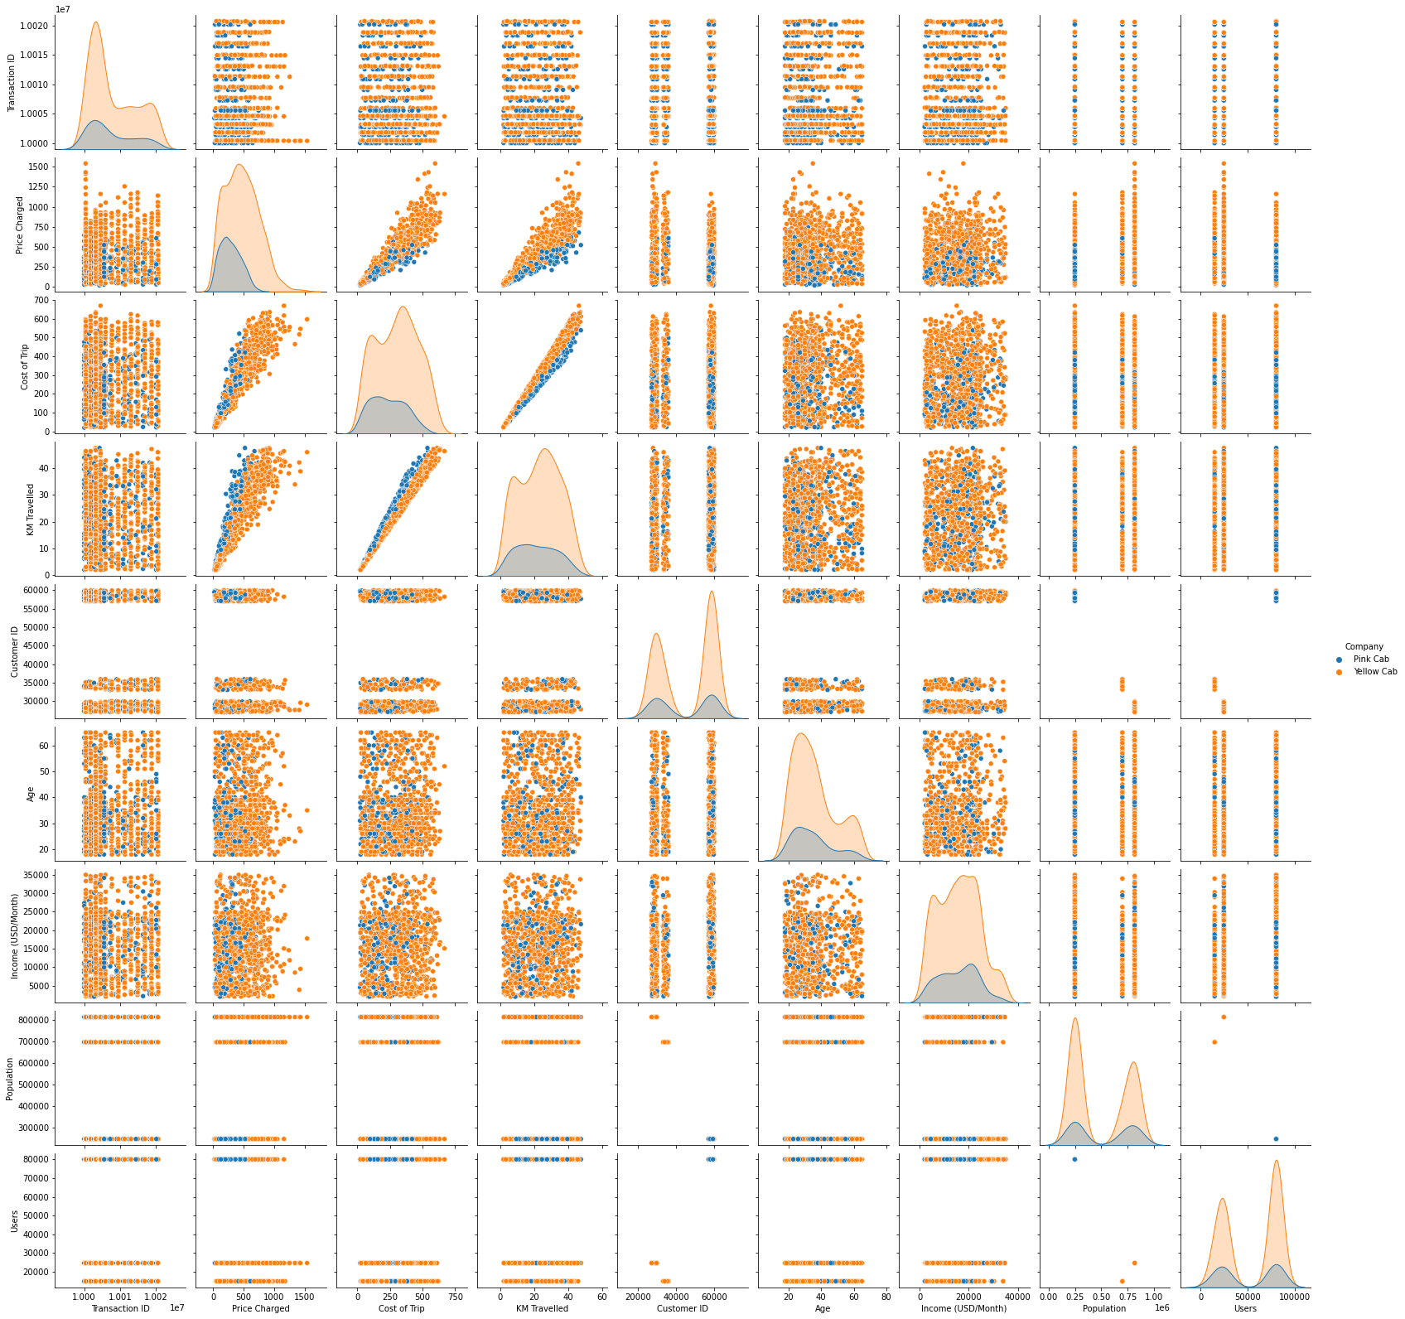
Relationships between Variables

Slide 6
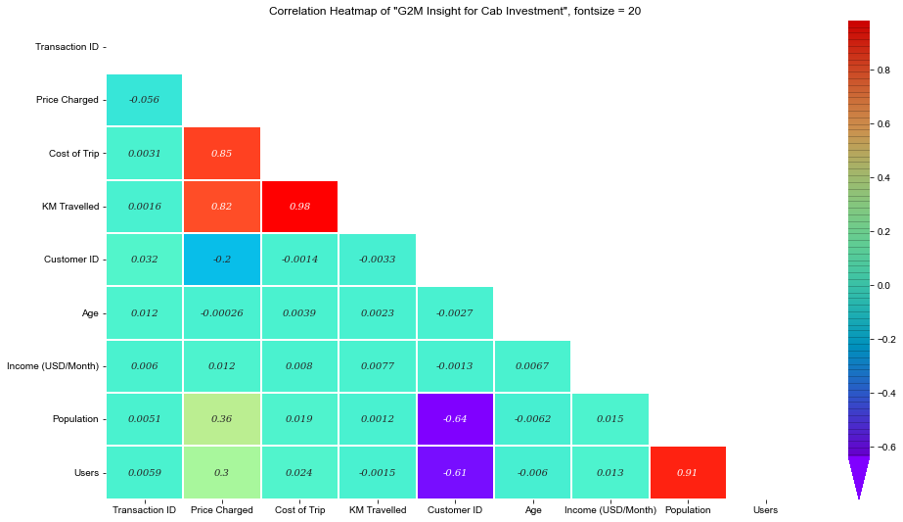
Correlation Between Variables
As we can see there is a strong correlation between
Population vs users
Price charged vs cost of trip vs KM travelled

Slide 7
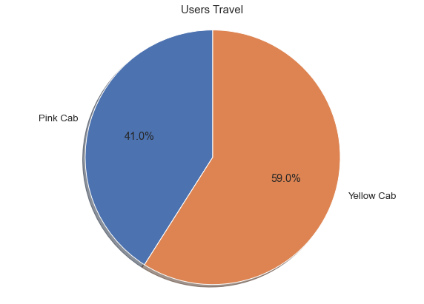
Which Company has more Users?

Slide 8
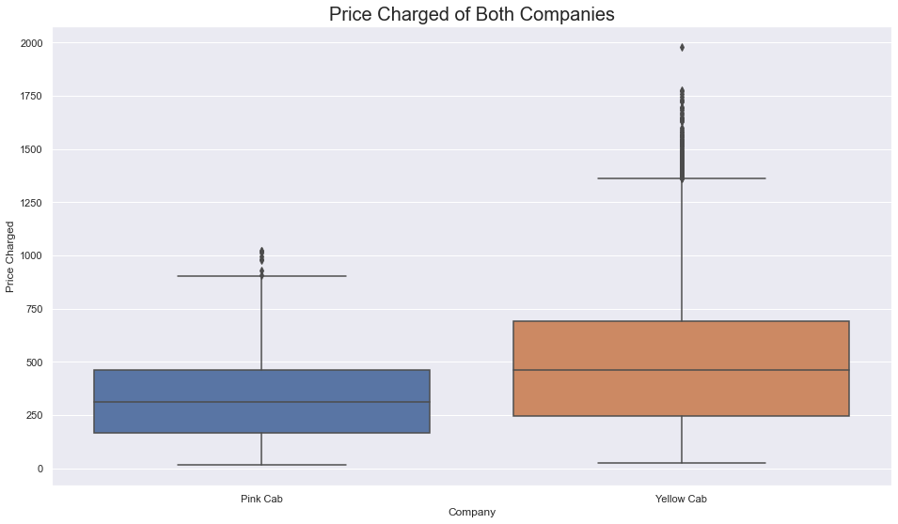
Which company has a high price charged
As we can see price charged for
Yellow Cab is highest as
compared to Pink Cab

Slide 9
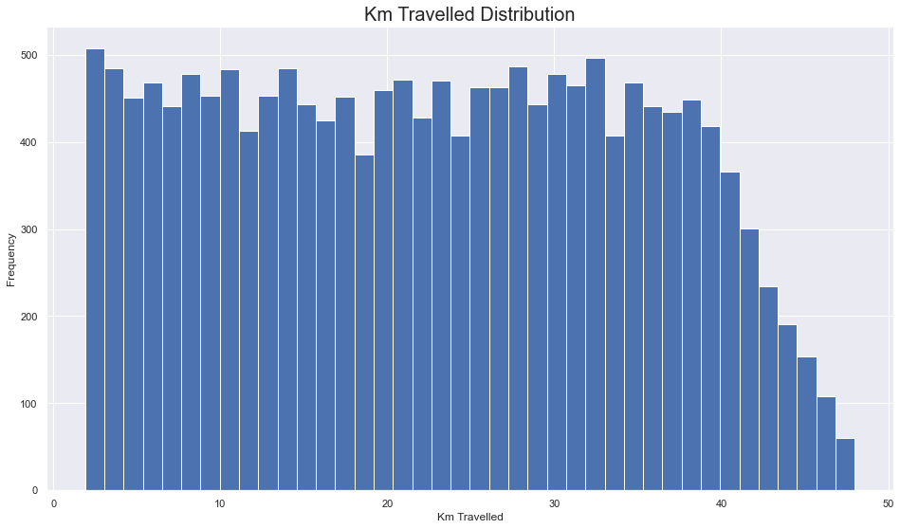
KM Travelled Distribution
Most of the rides varies from 2 to 48 KM

Slide 10
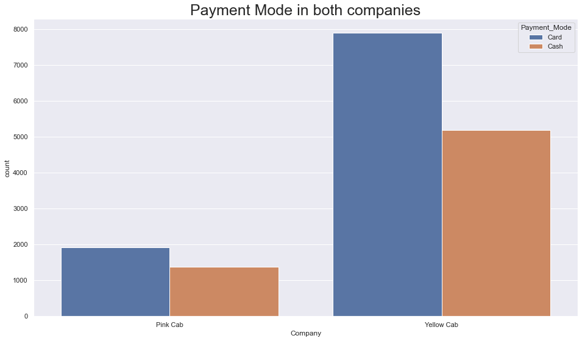
Payment Mode
As we can see that users prefer to pay with
A card more compared to cash

Slide 11
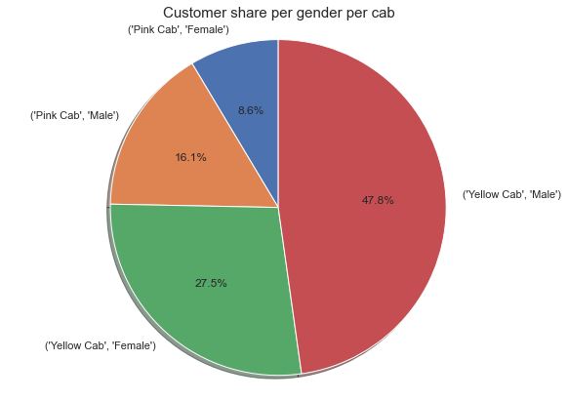
Users w.r.t Gender
Male users prefer more to travel in cab
Also users prefer to travel in Yellow cab

Slide 12
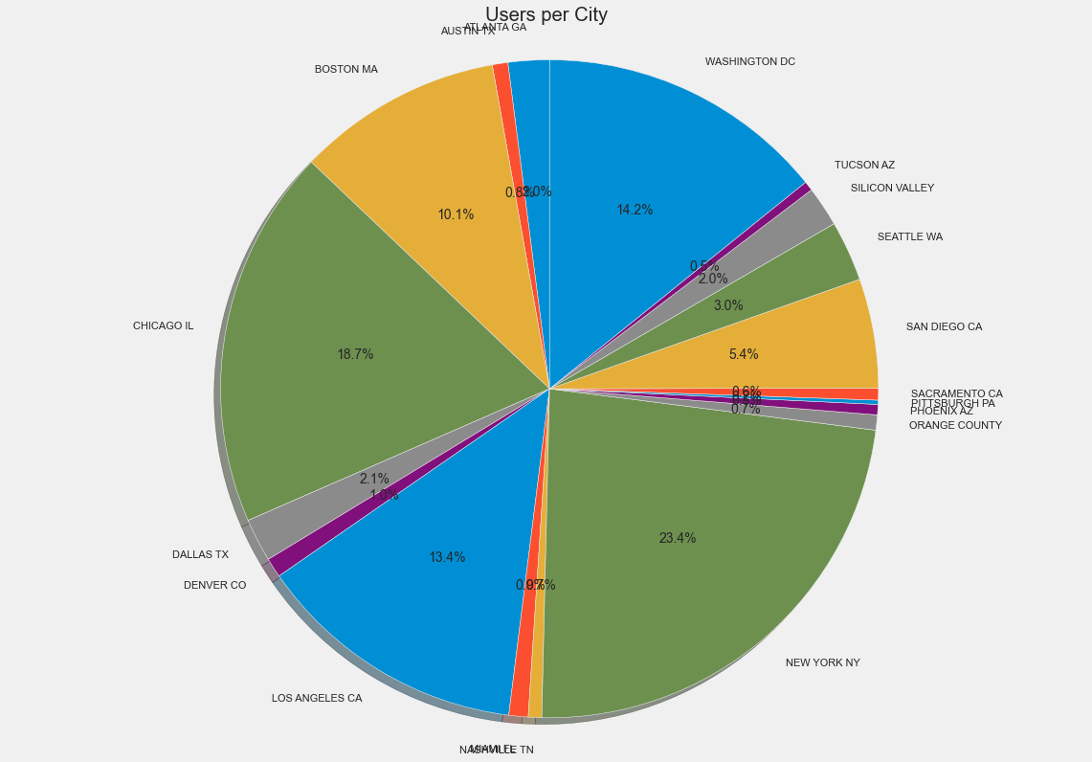
Users w.r.t Cities
New York City has the highest cab users with
23.4% followed by Chicago with 18.7% and
Washington DC with 14.2

Slide 13
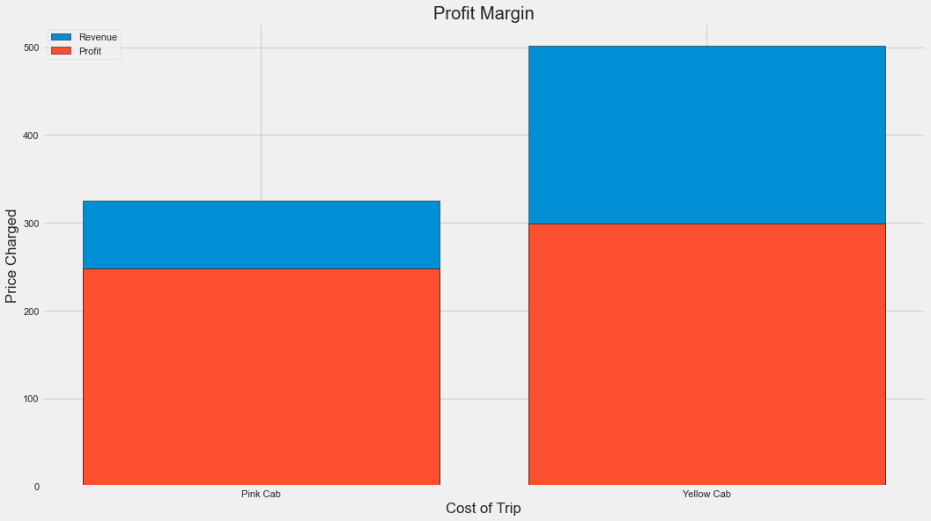
Profit Margin
The Yellow cab has a higher Profit Margin
(Price charged-cost of trip) compared to
Pink cab

Slide 14
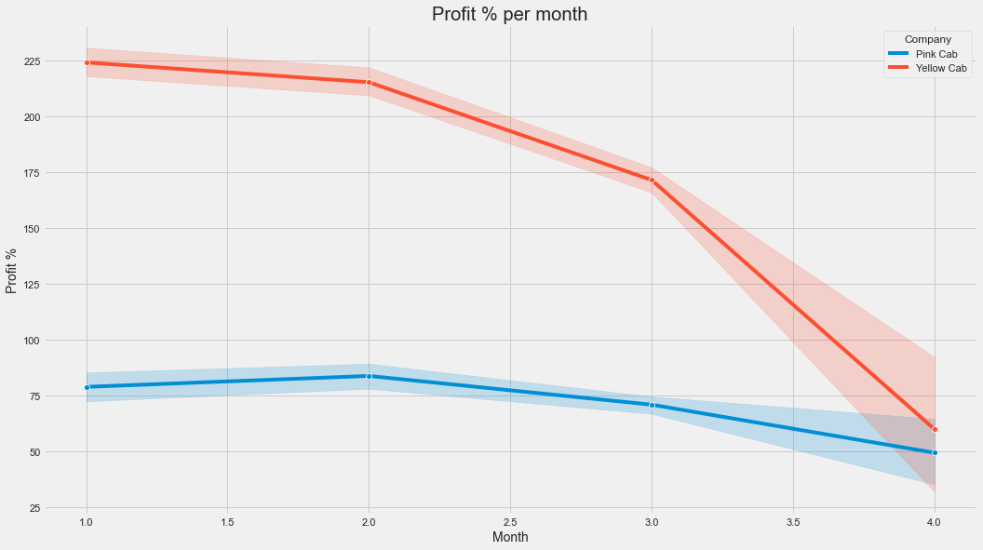
Profit Margin w.r.t Month
The profit margin decreased w.r.t year
The profit margin varies w.r.t month

Slide 15
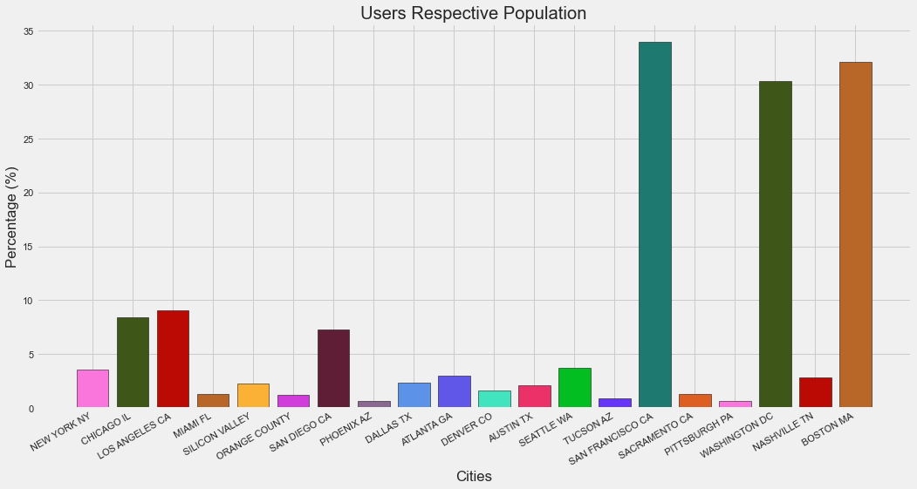
Users w.r.t Population
As we can see in the cities of San Francisco, Boston, Washington DC more than 30% of the population use cab services

Slide 16
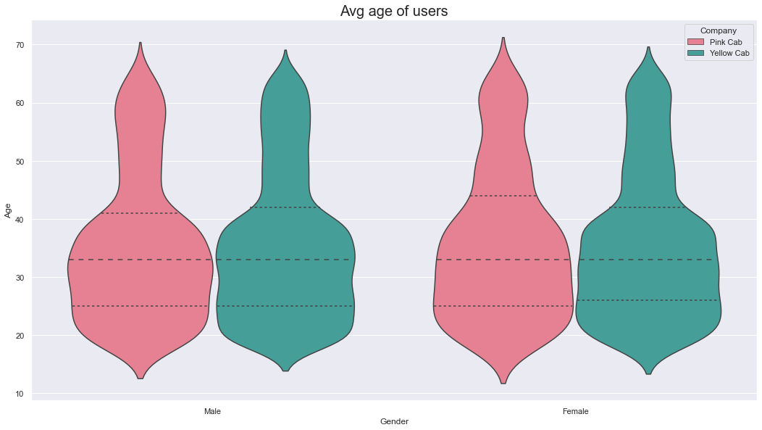
Average Age of Users
As we can see 35 Avg age of females
And male who use Cab servies

Slide 17
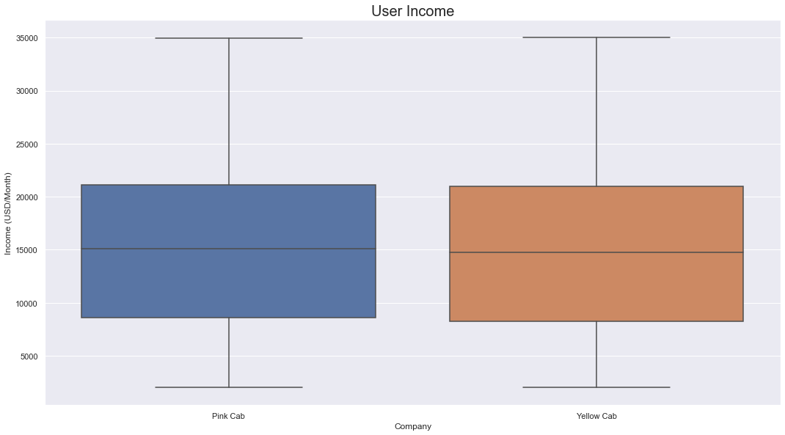
Average Income of Users
As we can see Avg income in around $15k
who use service

Slide 18
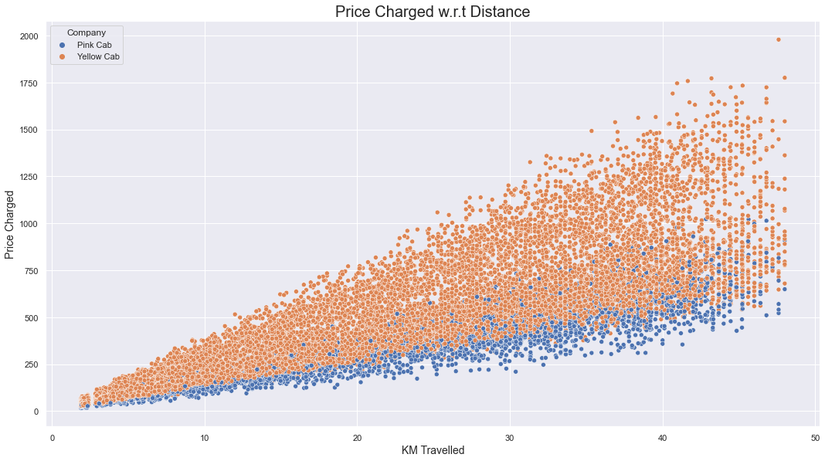
Price Charged w.r.t Distance
As we can see there is a linear relationship
Between KM travelled and price charged as
We expected. However, Yellow Cab has high
Charges compared to Pink

Slide 19
Hypothesis 1: is there any difference in profit regarding Gender
H0: There is no difference regarding gender in both
cab companies
H1:There is a difference regarding gender in both
Cab companies

Slide 20
Hypothesis 2: is there any difference in profit regarding Age
H0: There is no difference regarding age in both
cab companies
H1:There is a difference regarding age in both
Cab companies

Slide 21
Hypothesis 1: is there any difference in profit regarding Payment mode
H0: There is no difference regarding age in both
cab companies
H1:There is a difference regarding age in both
Cab companies

Slide 22
Conclution
Yellow Cab company is better than Pink Cab company
Because:
Profit Margin
More Users
More Transaction per Year

Slide 23
Thank You

