Slide 1
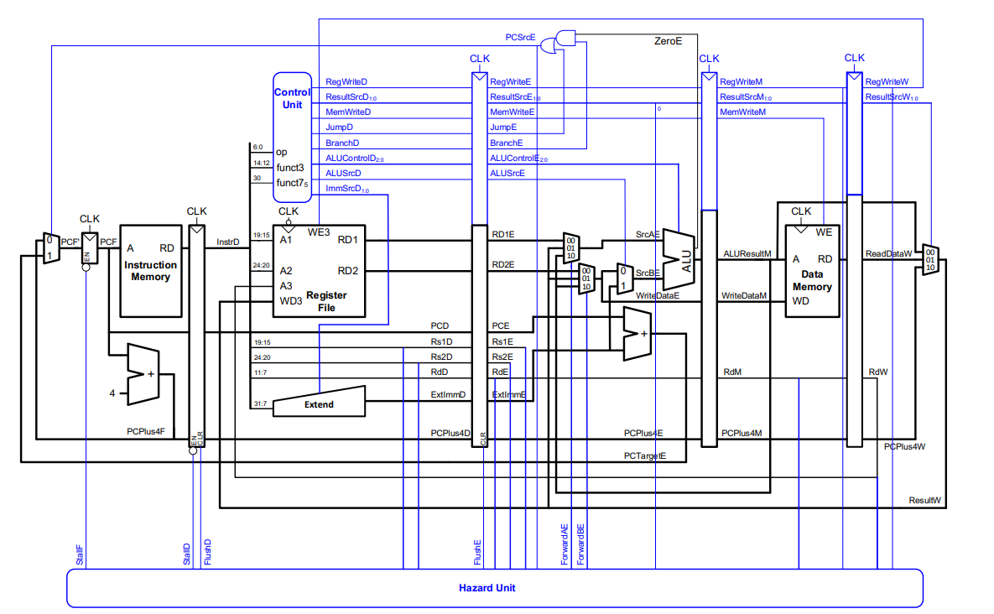












Slide 2

 |  | RegWrite | ResultSrc | MemWrite | jump | branch | jalr | ALUControl | ALUSrc | ImmSrc
R-Type | add | 1 | 00 | 0 | 0 | 0 | 0 | 000 | 0 | XXX
 | sub | 1 | 00 | 0 | 0 | 0 | 0 | 001 | 0 | XXX
 | and | 1 | 00 | 0 | 0 | 0 | 0 | 010 | 0 | XXX
 | or | 1 | 00 | 0 | 0 | 0 | 0 | 011 | 0 | XXX
 | slt | 1 | 00 | 0 | 0 | 0 | 0 | 101 | 0 | XXX
I-Type | lw | 1 | 01 | 0 | 0 | 0 | 0 | 000 | 1 | 000
 | addi | 1 | 00 | 0 | 0 | 0 | 0 | 000 | 1 | 000
 | xori | 1 | 00 | 0 | 0 | 0 | 0 | 100 | 1 | 000
 | ori | 1 | 00 | 0 | 0 | 0 | 0 | 011 | 1 | 000
 | slti | 1 | 00 | 0 | 0 | 0 | 0 | 101 | 1 | 000
 | jalr | 1 | 10 | 0 | 0 | 0 | 1 | 000 | 1 | 000
S-Type | sw | 0 | XX | 1 | 0 | 0 | 0 | 000 | 1 | 001
J-Type | jal | 1 | 10 | 0 | 1 | 0 | 0 | XXX | X | 010
B-Type | beq | 0 | XX | 0 | 0 | 1 | 0 | 001 | 0 | 011
 | bne | 0 | XX | 0 | 0 | 1 | 0 | 001 | 0 | 011
 | blt | 0 | XX | 0 | 0 | 1 | 0 | 101 | 0 | 011
 | bge | 0 | XX | 0 | 0 | 1 | 0 | 101 | 0 | 011
U-Type | lui | 1 | 11 | 0 | 0 | 0 | 0 | XXX | X | 100

