Slide 1

MUTUAL FUND ANALYSIS
Mutula Fund investments are subject to market risk,
Read all scheme related documents carefully.

Slide 2
What is an Asset Management Company
An Asset Management Company is a financial institution that specializes in managing various types of assets on behalf of clients. These assets can include stocks, bonds, mutual funds, real estate, and other investments.
The primary objective of an asset management company is to maximize the value of these assets while minimizing risk.
Asset management companies typically offer a range of services, including, Portfolio Management, Investment Advisory, Risk Management, Performance Measurement and Tax Planning.

Slide 3
What is Mutual Fund ?
A mutual fund is a pool of money managed by a professional Fund Manager. It is a trust that collects money from a number of investors who share a common investment objective and invests the same in equities, bonds, money market instruments and other securities.

Slide 4
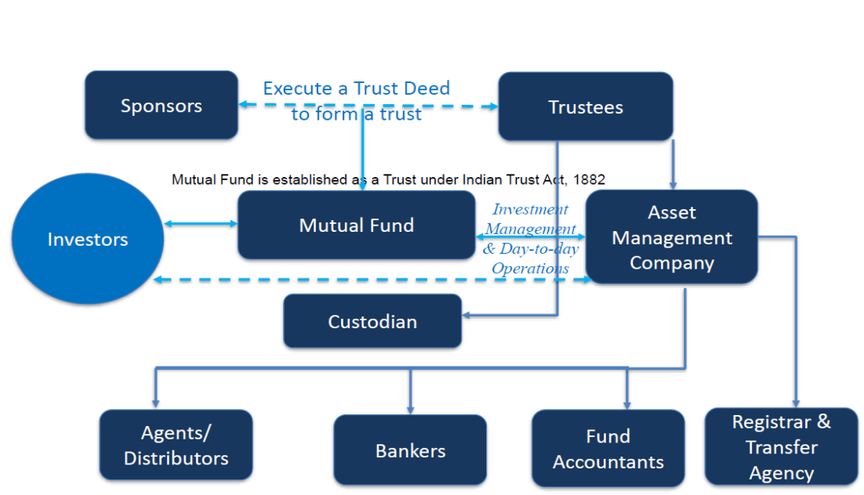
Structure of Mutual Fund

Slide 5
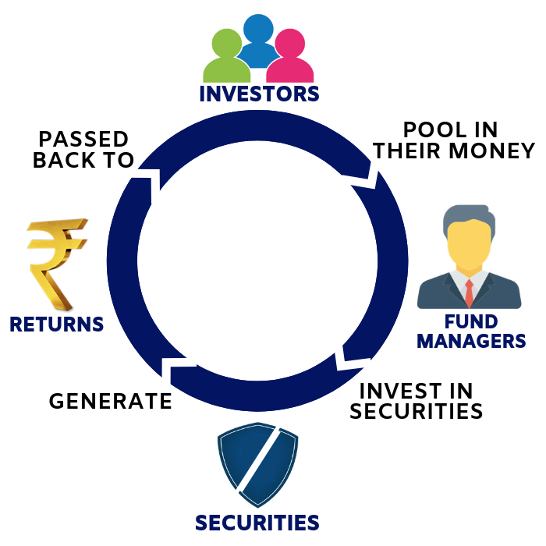
How does Mutual Fund works

Slide 6
Classification of Mutul Fund
Types Of Fund
Based on Structure
Based on Investment Objective
Based on Investment Style
Open ended Fund
Debt Fund
Passive Fund
Closed ended Fund
Equity Fund
Active Fund
Interval Fund
Hybrid Fund

Slide 7
Classification - Based on Structure
Open ended Fund
It’s have no Fixed Maturity Date.
Accept continues sales and re-purchase requests.
Transaction is based on NAV Value.
Unit capital is not fixes.
Closed ended Fund
It’ doing for a specific period.
Offered in an NFO but are closed for further purchases NFO.
Unit capital is kept constant.
Interval Fund
Variant of closed ended funds.
Becomes open-ended at specific intervals.
Have to be mandatorily listed.

Slide 8
Classification - Based on Investment Objective
Debt Fund
Invest in short and long term debt instruments.
Aim to provide regular income.
Equity Fund
Invest in equity securities.
Aim to provide growth and capital appreciation over long term.
Hybrid Fund
Invest in a combination of equity and debt securities.
Proportion of equity debt may vary.
Aim to provide for both income and capital appreciation.

Slide 9
Classification - Based Investment Style
Passive Fund
Replicate a mark index.
Invest in same securities and in same proportion as that of index.
No active selection of any stock.
Expense are vary lower.
Portfolio is modified every time index composition changes.
Active Fund
Invests in securities and sectors that may offer a better return than the index.
Actively manage the allocation to market securities and cash.
May perform better or worse than the market index.
Incur a higher cost than passive fundas.

Slide 10
Types of Investors :
Based on investing different types of categories
Low risk & within 1 Year → DEBT Ultra Short term funds
Low risk & 1-5 Year → Hybrid Equity savings fund & Conservative Hybrid Fund
Low risk & >5 Year → Equity Large-Cap funds
Moderate risk & within 1 year → DEBT Low Duration funds
Moderate risk & 1-5year → Hybrid Balanced Advantage Fund
→ Hybrid Dynamic Asset Allocation fund
→ Equity large & Mid-Cap funds
→ Multi-Cap Funds
→ ELSS funds & Focused funds

Slide 11
Types of Investors :
Moderate risk & > 5 year → Large & Mid-Cap funds
→ Multi-Cap funds
→ ELSS funds
→ Contra funds
→ Value funds
→ Focused funds
High risk & within 1 year → DEBT Banking & PSO funds
→ Floating Interest funds
→ Short Duration funds

Slide 12
Types of Investors :
High risk & 1-5 years → Aggressive Hybrid Funds
→ Multi Asset Allocation Funds
High risk & > 5 years → Equity Mid-Cap Funds
→ Contra Funds
→ Value Funds
→ Focused Funds
High risk & >= 10 years → Equity Small-Cap Funds

Slide 13
Client's Requirements
Client was investing 10,000 per month for 10 years long time period with high amount of risk and high returns.
Based on Client’s requirements, the investment falls under category of Equity Mutual Funds, where the company is willing to take on higher risks in pursuit of maximizing profits as its primary objective.
As per client requirement we taken top 4 AMC’s.
1. HDFC Asset Management Company
2. SBI Asset Management Company
3. Nippon India Asset Management Company
4. Quant Asset Management Company

Slide 14
Data Explanation
Collecting or extracting data from various mutual fund scheme-related websites.
Divide all data into two parts: one for training, which is 80% of the data, and the other for testing, which is 20%.

Slide 15
HDFC Asset Management Company
Top 5 Mutual Funds
HDFC Mid-Cap Opportunities Fund-Dir Growth
HDFC Small-Cap Fund-Dir Growth
HDFC Large & Mid-Cap Fund-Dir Growth
HDFC Flexi-Cap Fund-Dir Growth
HDFC Hybrid Equity Fund-Dir Growth

Slide 16
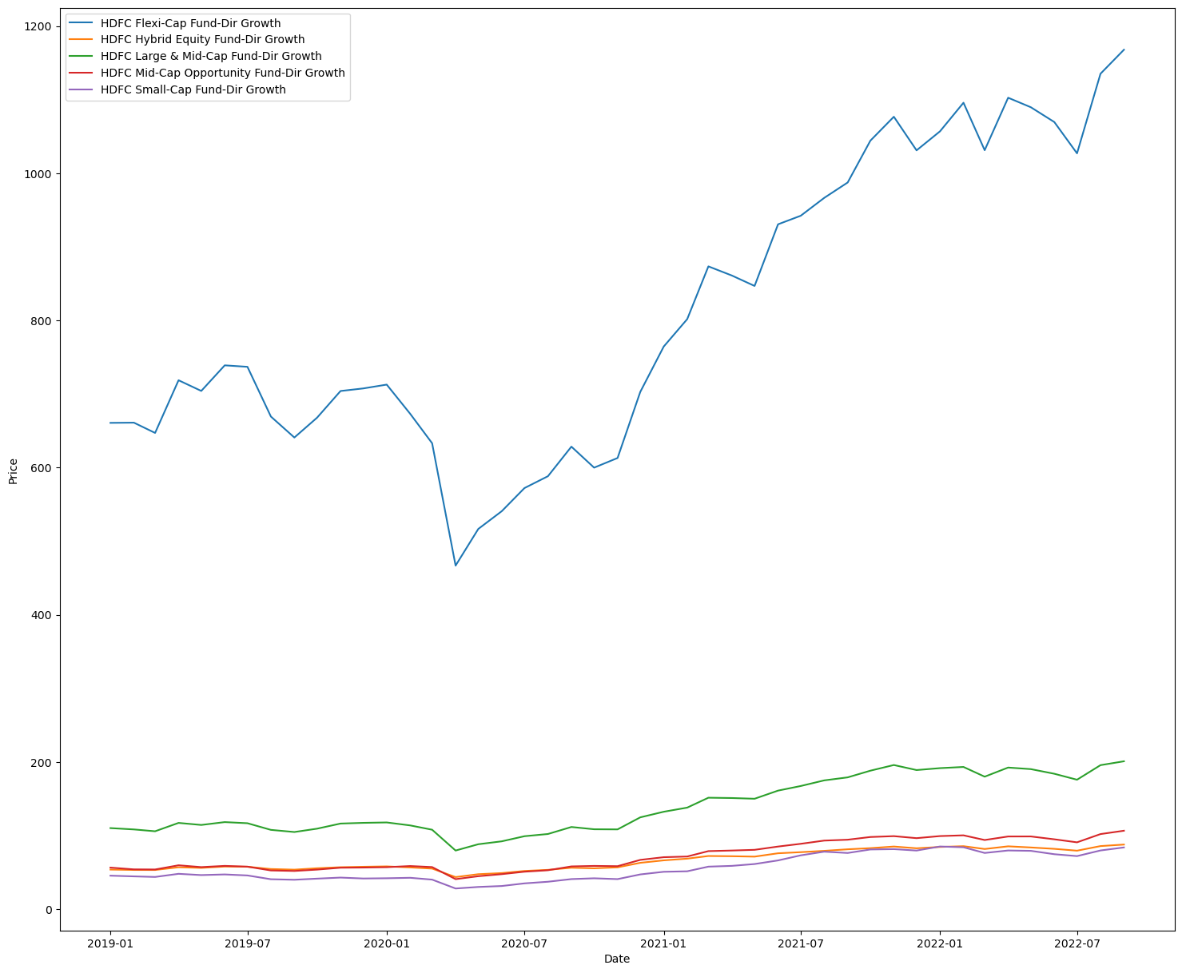
HDFC Train Data

Slide 17
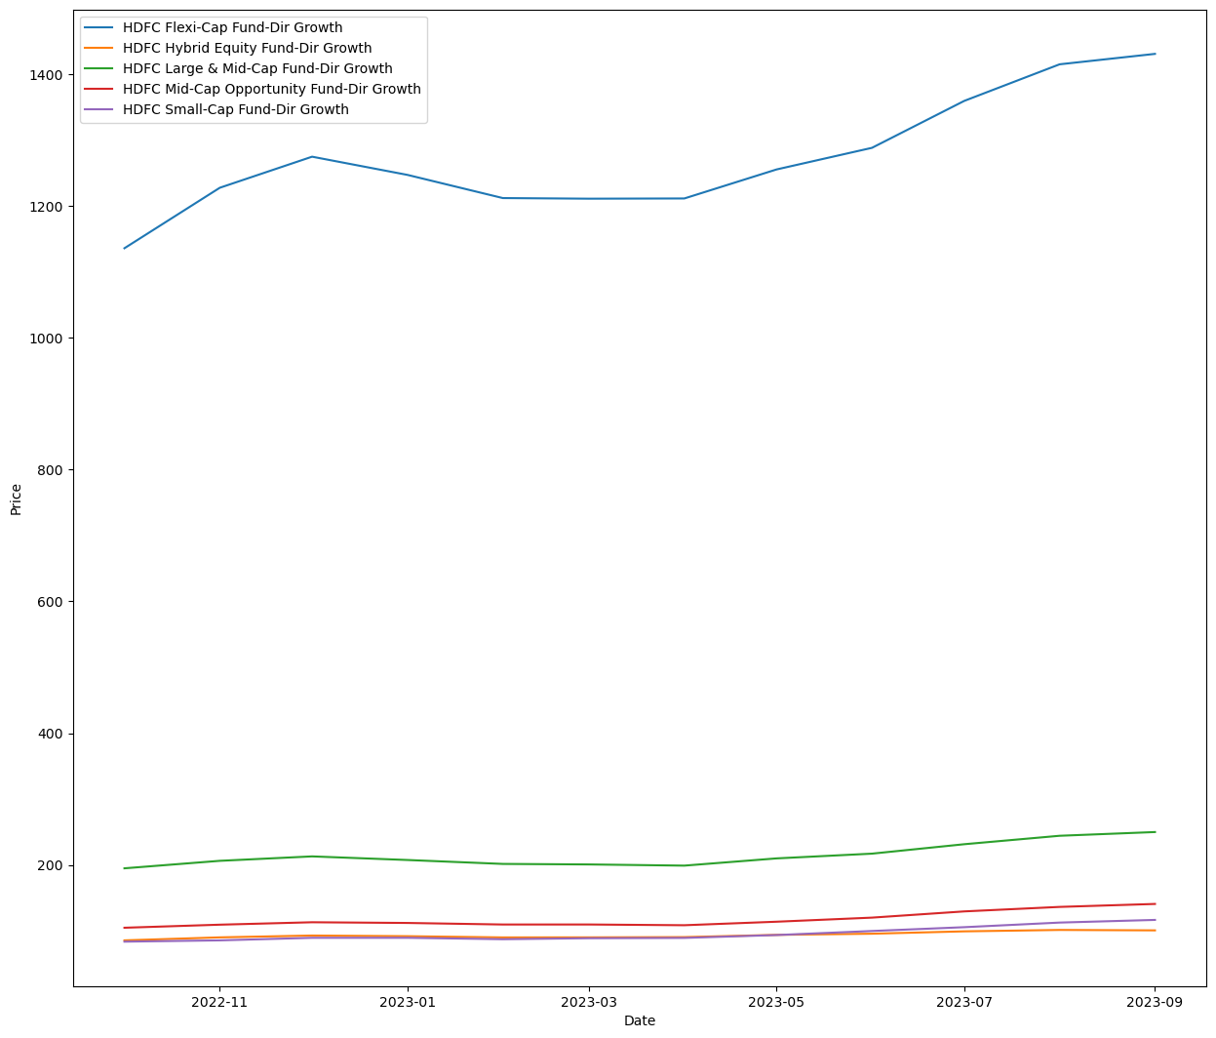
HDFC Test Data

Slide 18
HDFC :
In HDFC Mutual Funds, HDFC Mid-Cap Opportunities Fund-Direct and HDFC Small-Cap Fund have demonstrated good performance over the last 5 years compared to other funds, and delivering high returns.
Both funds have performed with only a small amount of difference.
In 2018, when all funds were experiencing negative returns.
Both funds have nearly identical 5-year average returns, and they share the same fund manager.

Slide 19
HDFC :
When comparing risk parameters such as Alpha, Beta, Standard Deviation, R-squared, Sharpe Ratio, and Treynor Ratio, HDFC Mid-Cap Opportunities Fund performs well across these metrics, while some of the parameters are also satisfied with HDFC Small-Cap Fund.
Finally, if you are willing to take on high risk for the potential of high returns, you can opt for HDFC Mid-Cap Opportunities Fund. Otherwise, consider diversifying your investment by allocating 50% to HDFC Mid-Cap Opportunities Fund and 50% to HDFC Small-Cap Fund.

Slide 20
SBI Asset Management Company
Top 5 Mutual Funds
SBI Infrastructure Fund-Dir Growth
SBI Magnum Mid-Cap Fund-Dir Growth
SBI Small-Cap Fund-Dir Growth
SBI Contra Fund-Dir Growth
SBI Long Term Equity Fund-Dir Growth

Slide 21
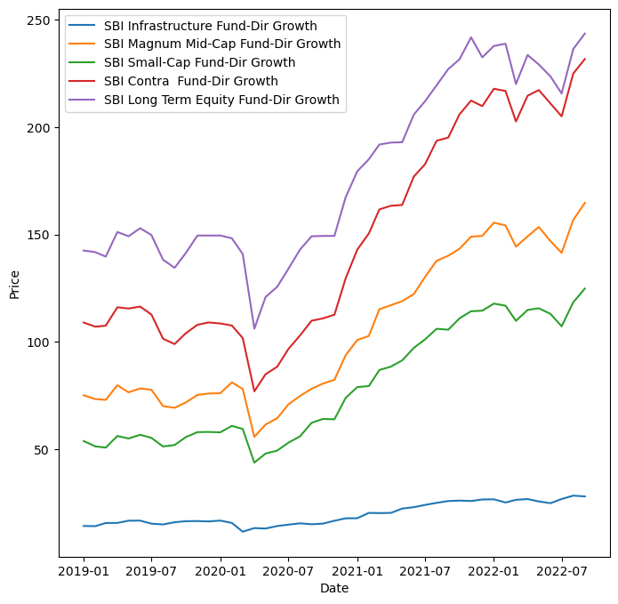
SBI Train Data

Slide 22
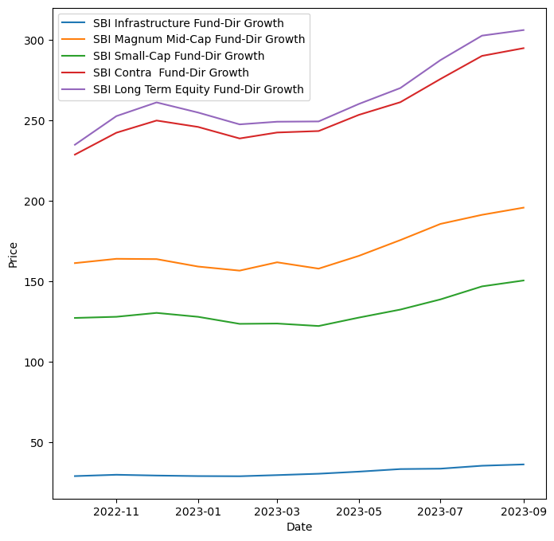
SBI Test Data

Slide 23
SBI :
In SBI Mutual Funds, there are three funds namely SBI Small-Cap Fund Direct, SBI Magnum Mid-Cap Fund Direct, and SBI Contra Fund Direct, have been performing well compared to other SBI funds, delivering high returns over the past 5 years.
In 2018, all funds experienced negative returns. SBI Contra Fund performed less effectively in 2018 compared to SBI Small-Cap Fund and SBI Magnum Mid-Cap Fund.
SBI Contra Fund has been providing higher returns compared to SBI Small-Cap Fund and SBI Magnum Mid-Cap Fund over the past year.

Slide 24
SBI :
When comparing risk parameters, SBI Contra Fund and SBI Small-Cap Fund both exhibit strong performance. Some parameters are satisfied with SBI Contra Fund, while others are met by SBI Small-Cap Fund.
In conclusion, it is advisable to consider investing in SBI Contra Fund due to its favorable returns, the track record of the fund manager, and risk analysis.
However, it's important to note that investing in a single fund entails very high risk at this time. Diversifying your investment across different funds can help mitigate risk and provide a more balanced approach to your investment strategy.

Slide 25
Nippon India Asset Management Company
Top 5 Mutual Funds
Nippon India Small-Cap Fund-Dir Growth
Nippon India Growth Fund-Dir Growth
Nippon India Power & Infra Find-Dir Growth
Nippon India Multi-Cap Fund-Dir Growth
Nippon India Value Fund-Dir Growth

Slide 26
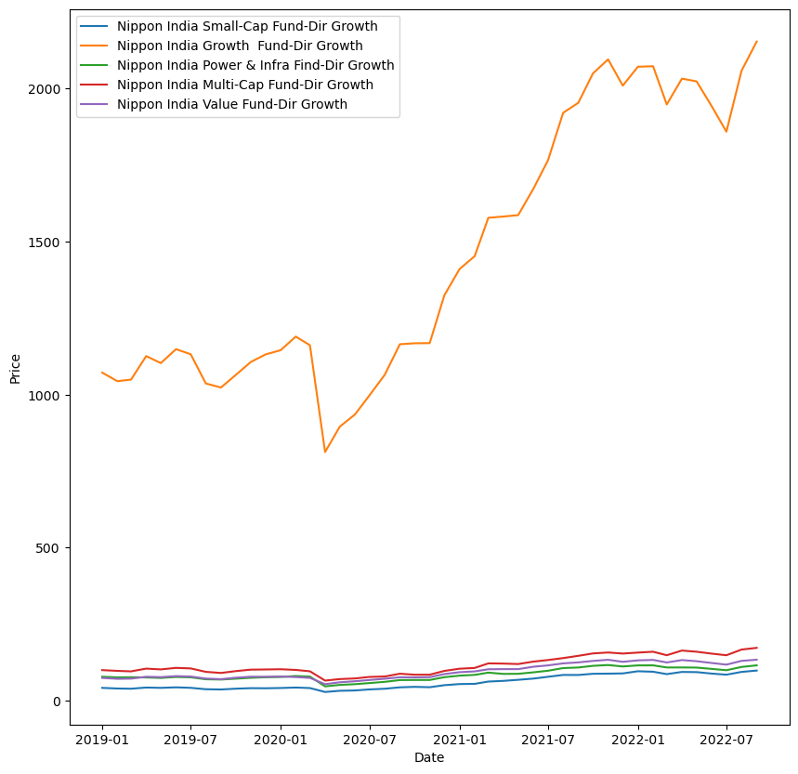
Nippon India Train Data

Slide 27
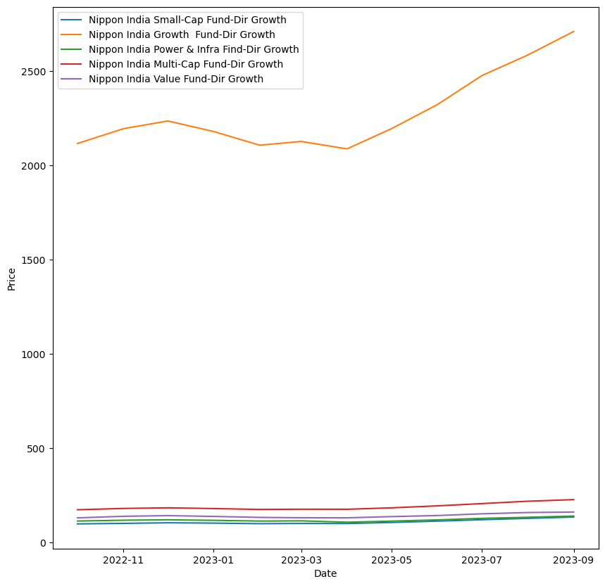
Nippon India Test Data

Slide 28
Nippon India :
Among the top 5 Nippon India Mutual Funds mentioned above, Nippon India Small Cap Fund - Direct Plan is performing exceptionally well and delivering high returns when compared to the other four funds.
Nippon India Growth Fund - Direct Plan also exhibits strong performance, but when compared to Nippon India Small Cap Fund - Direct Plan, it has lower returns. The remaining three funds exhibit average performance.
Over the past 5 years, Nippon India Small Cap Fund - Direct Plan has consistently gives positive and high returns compared to Nippon India Growth Fund - Direct Plan.

Slide 29
Nippon India :
However in 2018, Nippon India Growth Fund - Direct Plan exhibited lower effectiveness compared to Nippon India Small Cap Fund.
The manager of Nippon India Small Cap Fund has more experience and is considered to be better than the manager of Nippon India Growth Fund.
Nippon India Small Cap Fund also boasts a high 5-year average return. Moreover, when evaluating risk parameters such as Alpha, Beta, Standard Deviation, R-squared, Sharpe Ratio, and Treynor Ratio, Nippon India Small Cap Fund performs admirably.

Slide 30
Nippon India :
In conclusion, you may consider investing in Nippon India Small Cap Fund – Direct for potentially higher returns but with a very high level of risk. If you prefer to mitigate that level of risk, diversifying your investment by also considering Nippon India Growth Fund could be a prudent choice.

Slide 31
Quant Asset Management Company
Top 5 Mutual Funds
Quant Small-Cap Fund-Dir Growth
Quant Tax Plan Fund-Dir Growth
Quant Infrastructure Fund-Dir Growth
Quant Mid-Cap Fund-Dir Growth
Quant Flexi-Cap Fund-Dir Growth

Slide 32
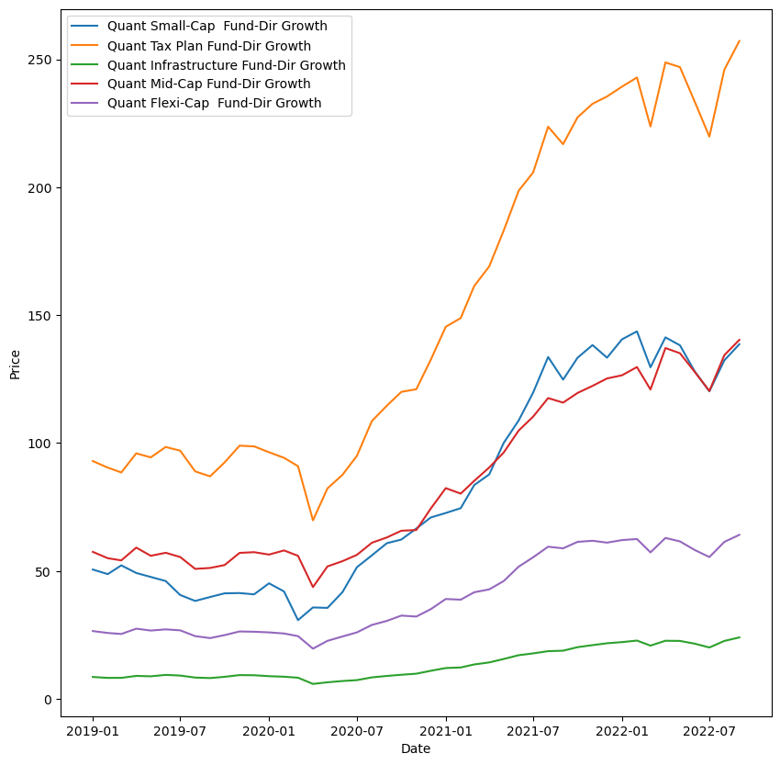
Quant Train Data

Slide 33
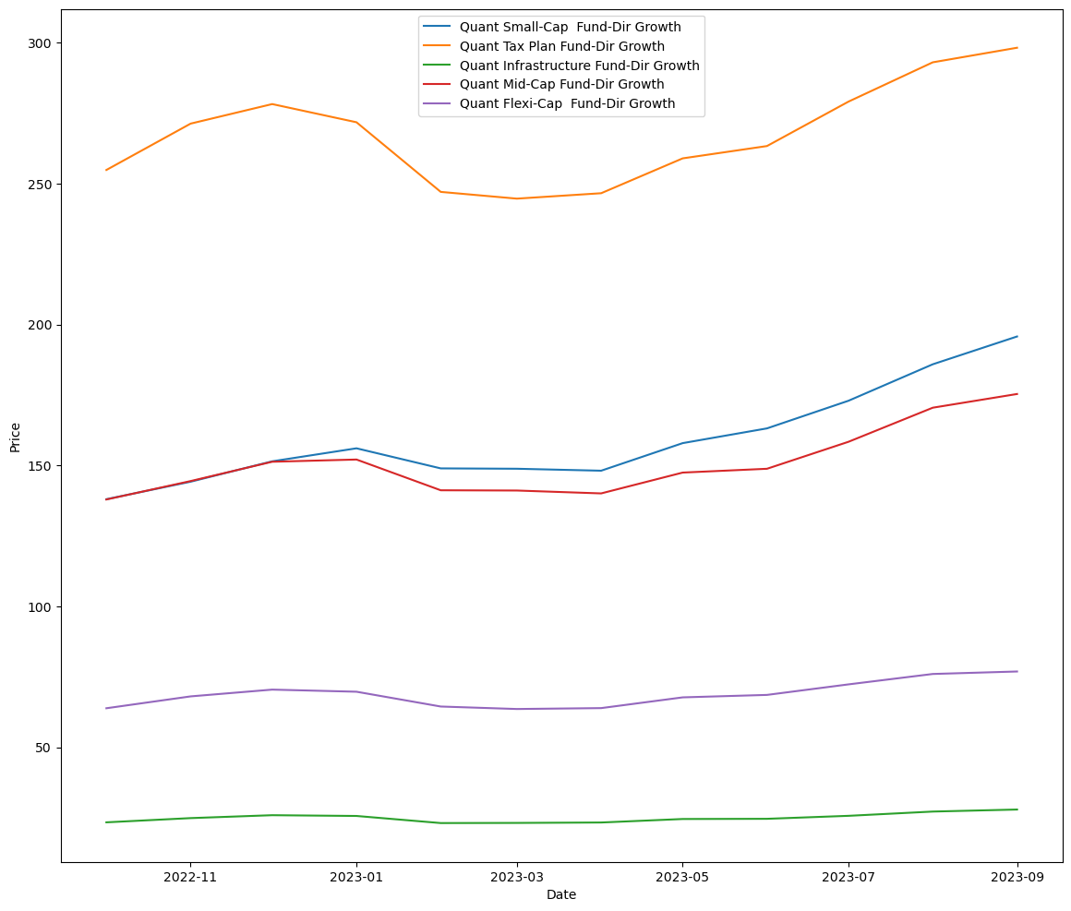
Quant Test Data

Slide 34
Quant :
In Quant Mutual Fund Infrastructure, Small cap, and Tax plan funds are performed very well.
In the three funds, the Quant small-cap fund has shown good returns compared to the other funds. Over the past five years, its average return has also been significantly higher than that of the other two funds.
Moreover, the risk parameters for Quantum Small Cap Funds have all been satisfied. It's worth noting that the same fund manager oversees all three mutual funds.

Slide 35
Quant :
In 2018,all funds are giving negative returns, but Quant Small-Cap fund still it’s giving positive returns.
In conclusion, all three funds have performed very well, with no significant differences in their performance. However, when we consider all parameters, including risk analysis, the small-cap fund has a relatively lower impact.

Slide 36
53.16

Slide 39
Conclusion
In our assessment of various AMCs offering different mutual funds, as per client requirement based on my research, we have to suggested Quant Small-Cap Fund Direct Growth is the best option.
These funds have not only delivered high returns but have also demonstrated resilience in adverse market conditions, while consistently meeting all parameters.

