Slide 1

DoorDash Food Delivery Service
CS-6360:001: Database Design
Team Number: 31
Team Members:
1.Manan Dalal (MUD200000)
2.Vishesh Mehta (VJM190001)
3.Fenil Godhani (FKG210000)

Slide 2
Data/Functional Requirements
For Customers:
Create/Update Login and Contact Information
They can search for restaurants based on name, cuisine, menu items etc...
They can add items to their cart, place orders, specific requests within the order, updates and track the status of their order.
Payment, their order histories.
Can provide feedback/reviews for the order, restaurant or/and the dasher.
Can become a member and enjoy other benefits by buying DashPass.

Slide 3
Cont...
For Restaurants:
Create a profile and can add new items/edit existing items to the menu.
They can receive orders, update status of the order and get information of the dasher.
Receive payments from the customer via DoorDash.
Can view insightful data such as most/least items ordered, best/least rated items, user feedbacks etc.…
Can add bank information to receive payments.
For Dashers:
Choose from available orders to pick up around their area/current location.
Know when the order is available for pickup.
De-Register incase they want to discontinue.
Can receive payments/fees from DoorDash and tips from customers.
Can add bank/wallet information to receive payments.

Slide 4
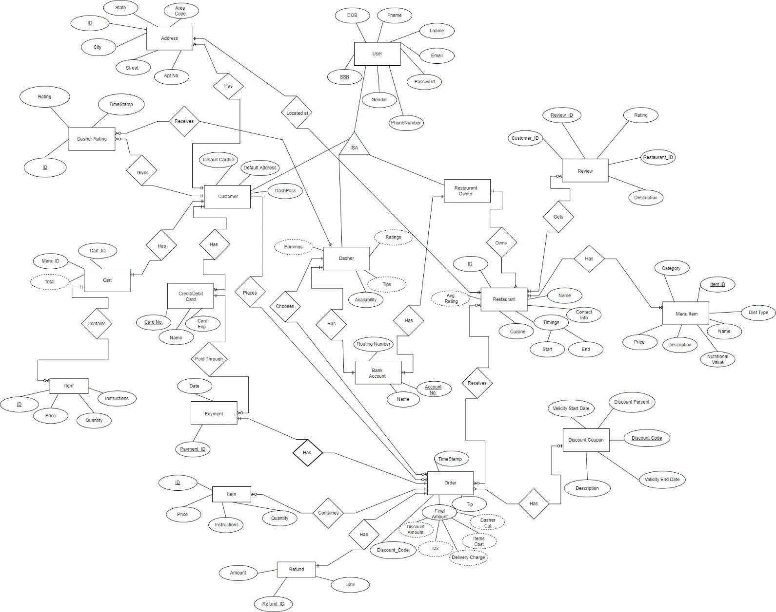
ER/EER Diagram

Slide 5
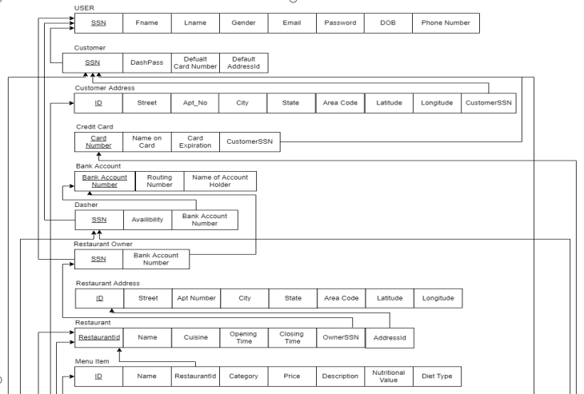
Final Relational Model After applying normalization, the below diagram is the normalized relational schema of our system.

Slide 6
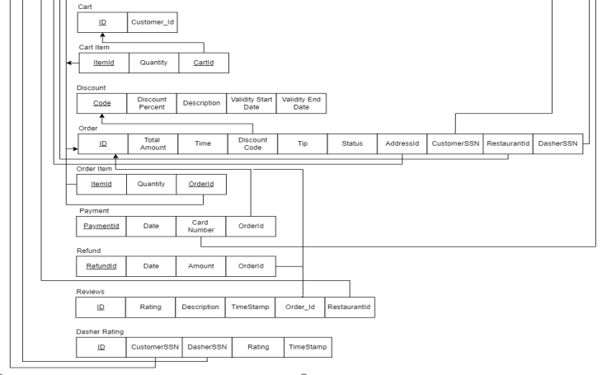

Slide 7
PL/SQL Statements

Slide 8
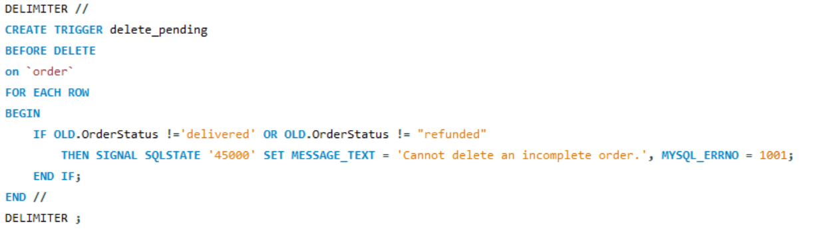
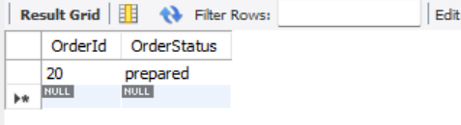
Triggers 1.Creating a trigger that can satisfy the condition that “An order cannot be deleted if it has not been delivered or refunded”

Slide 9
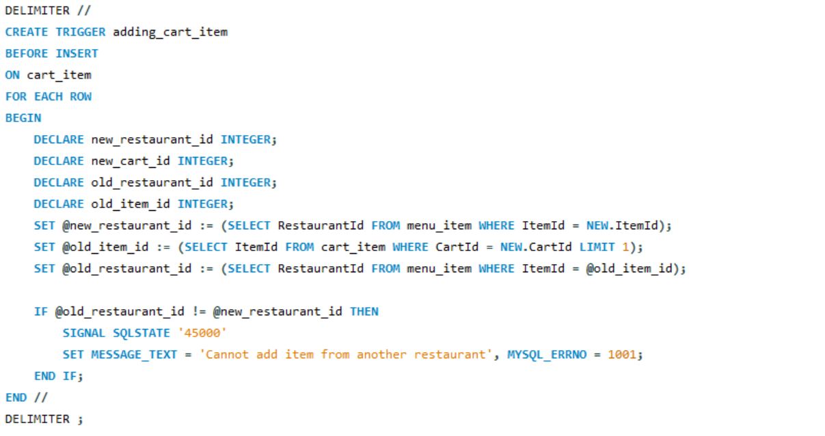
2.Creating a trigger that can satisfy the condition that “A customer can only have items from a single restaurant in his cart at a single time. If he adds an item from another restaurant, then the cart should be emptied first.”

Slide 10
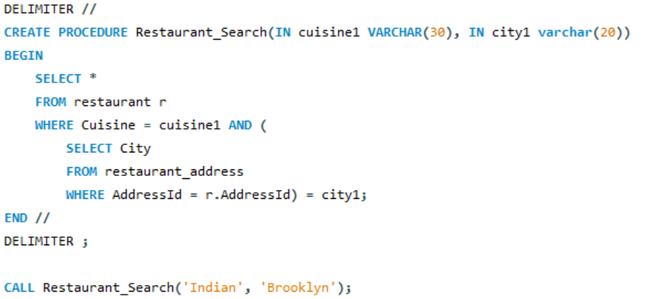
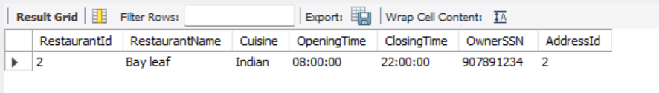
Stored Procedures
1. A Customer can search for restaurants using filters like cuisine, city etc..

Slide 11
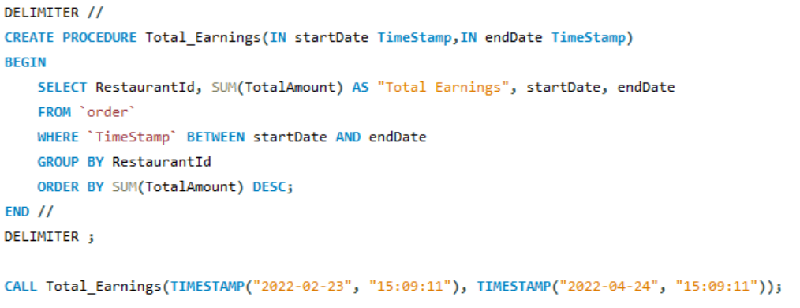
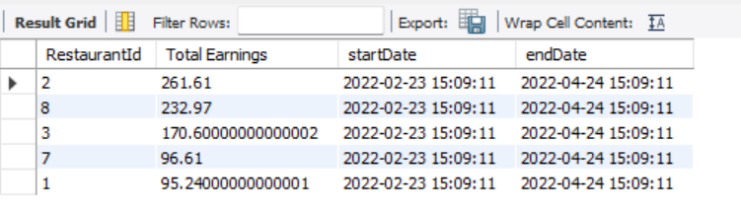
2. DoorDash can find out the earnings of each restaurant between a particular period.

Slide 12
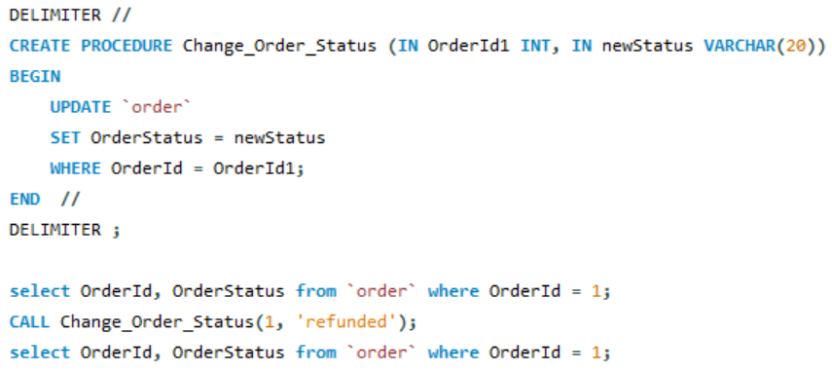
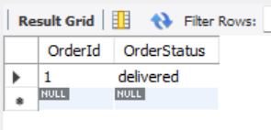
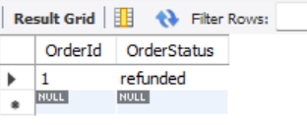
3. A Restaurant can change the status of an order as it gets processed and completed.

Slide 13
Thank You…..

