Slide 1
SCHOOL OF ENGINEERING AND TECHNOLOGY
DEPARTMENT OF COMPUTER SCIENCE AND ENGINEERING
GIET UNIVERSITY, GUNUPUR, ODISHA
MINOR / LEARNING PROJECT PRESENTATION ON
ZYNTRA: A MODERN REAL-TIME CONTEXTUAL CHAT & WORKPLACE APPLICATION
Full-Stack Realtime Architecture with WebSockets, Turso LibSQL, and Multi-Tenant Workspaces
Presented By:
Soumya Mohanty & Team
Regd No: [Student Registration Number]
B.Tech, Computer Science & Engineering
Under the Guidance of:
[Supervisor Name]
[Designation, Dept. of CSE]
GIET University, Gunupur

Slide 2
TABLE OF CONTENTS
Presentation Outlines
1. System Design & Architecture
High-level client-server micro-architecture, WebSocket pipeline, and edge storage tier
2. Database / Data Design
Turso LibSQL relational models: users, multi-tenant workspaces, channels, messages, and contacts
3. Coding & Technical Implementation
Controller-service pattern, REST APIs, Socket.io duplex event handling, and Zustand state store
4. Module Development & Integration
Authentication, workspace code system, login workspace popup, live calling suite, and mobile UI
5. Work Progress & Weekly Report
Milestone timeline, automated browser test suite (26/26 passed), and Render cloud deployment

Slide 3
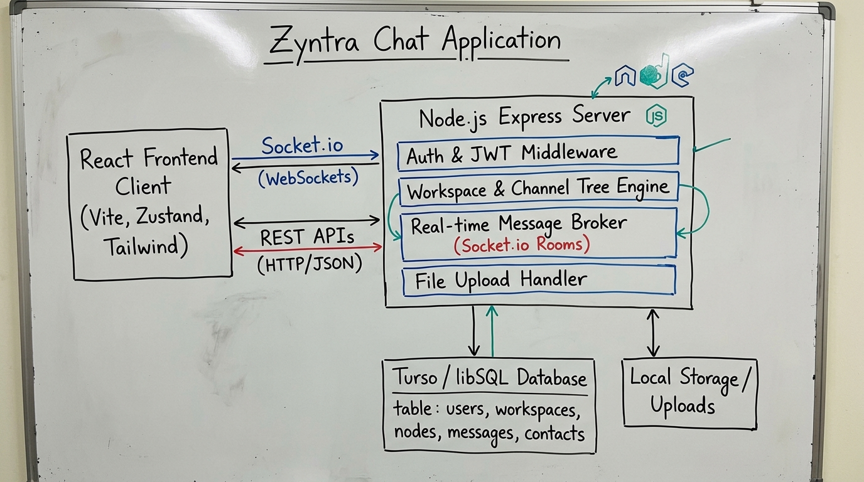
1. SYSTEM DESIGN & ARCHITECTURE
System Design & Overall Architecture
• Client Tier (Single-Page App):
Built with React 19, Vite 8, and Tailwind CSS 4. Uses Zustand for lightweight global reactive state and Framer Motion for responsive fluid transitions.
• Gateway & Realtime Tier:
Node.js with Express 4 for RESTful endpoints. Socket.io 4 manages persistent full-duplex WebSocket connections with automatic fallback to HTTP long-polling.
• Edge Storage Tier (Turso / LibSQL):
Cloud-native, SQLite-compatible edge database managed via @libsql/client. Provides distributed sub-millisecond query execution, zero cold starts, and resilience.
• Security & Transport Layer:
Stateless JSON Web Tokens (JWT) with Bearer headers, bcryptjs password hashing (salt rounds), and strict CORS authorization policies.

Slide 4
1. SYSTEM DESIGN & ARCHITECTURE
Real-Time WebSocket Event Pipeline
⚡ Connection & Handshake
Client connects with JWT auth token. Server verifies token, maps socket.id to user._id, and marks user status 'online'.
⚡ Room Subscriptions ('join_room')
Users automatically join workspace channel rooms (ws-channel-id) and private 1-on-1 DM rooms upon selection.
⚡ Instant Message Broadcast ('send_message')
Message is written to Turso DB and broadcasted simultaneously via io.to(roomId).emit('receive_message') in <50ms.
⚡ Typing Indicators ('user_typing')
Debounced typing state broadcasts to room participants without persisting to DB, keeping latency negligible.
⚡ Live Reactions ('send_reaction')
Real-time emoji reaction updates dispatched instantly to all active listeners in the conversation room.

Slide 5
2. DATABASE / DATA DESIGN
Turso Edge Database Schema Design
TABLE: users
• _id (PK, TEXT)
• name, email (UNIQUE)
• primaryUsername (UNIQUE)
• password (bcrypt hash)
• avatar, bio, status ('online')
• contexts (JSON array)
TABLE: workspaces
• id (PK, TEXT)
• name (TEXT)
• joinCode (UNIQUE, 'WS-XXXXX')
• description (TEXT)
• settings (JSON object)
• created_at (DATETIME)
TABLE: workspace_nodes (channels)
• id (PK, TEXT)
• workspace_id (FK -> workspaces)
• name (TEXT, e.g. 'general')
• folder (TEXT, e.g. 'ENGINEERING')
• isAnnouncement (BOOLEAN)
• membersCount (INTEGER)
TABLE: messages
• id (PK, TEXT)
• senderId (FK -> users)
• roomId (TEXT: channel/chat ID)
• content (TEXT)
• attachment (JSON metadata)
• reactions (JSON array)
• created_at (TIMESTAMP)
TABLE: contacts & groups
• contacts: (id, user_id, contact_id, type)
• groups: (id, name, description, avatar)
• group_members: (group_id, user_id, role)

Slide 6
3. CODING & TECHNICAL IMPLEMENTATION
Modular Coding Architecture & Implementation
⚙️ Backend MVC & Storage Layer
• Controllers (auth, workspace, message, contact) manage HTTP request lifecycle.
• storageService.js: Unified query engine using Turso libSQL client.
• Centralized error handling middleware with JWT token verification guards.
⚙️ Frontend State Management (Zustand)
• useAuthStore: Manages session credentials, JWT tokens, and login workspace prompts.
• useChatStore: Manages active channels, live messages, reactions, and workspace lists.
• Zero prop-drilling; components subscribe selectively to slice changes.
⚙️ Realtime Socket Bridge
• socketService.js: Resilient connection manager with reconnection backoff.
• Client listens to 'receive_message', 'update_reaction', and 'user_typing' events.
• Optimistic UI updates ensure instantaneous user experience before DB acknowledgment.
⚙️ Vite Proxy & Build Pipeline
• Vite dev proxy forwards /api and /socket.io directly to Node.js backend on port 5000.
• Tailwind CSS v4 compile pipeline with zero runtime CSS overhead.
• Production bundle minified to <500ms build execution.

Slide 7
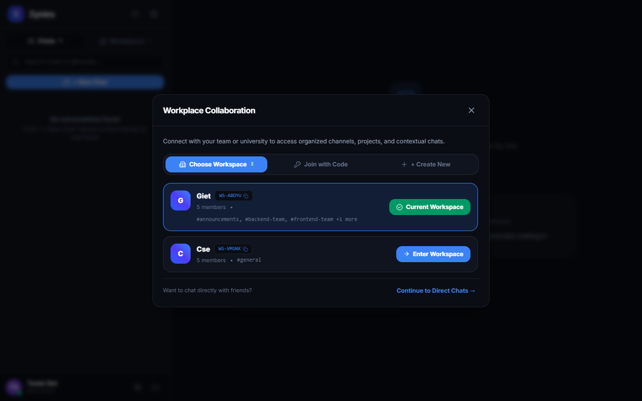
4. MODULE DEVELOPMENT & INTEGRATION
Workspace Collaboration & Login Selection Modal
📌 Multi-Tenant Workspaces:
Enables university departments (e.g. 'GIET', 'CSE') and team organizations to maintain isolated discussion channels with customized member roles.
📌 Unique 6-Character Join Codes:
Generates alphanumeric invite codes (e.g. 'WS-ABDYU') with one-click clipboard copying for frictionless team onboarding.
📌 Post-Login Workspace Selection Popup:
Automatically presents an interactive modal immediately after login prompting users to select a workspace, enter an invite code, or create a new organization.
📌 Hierarchical Channel Categorization:
Supports channel trees grouped by department folders (e.g. 'ENGINEERING' folder containing '#frontend-team' and '#backend-team').

Slide 8
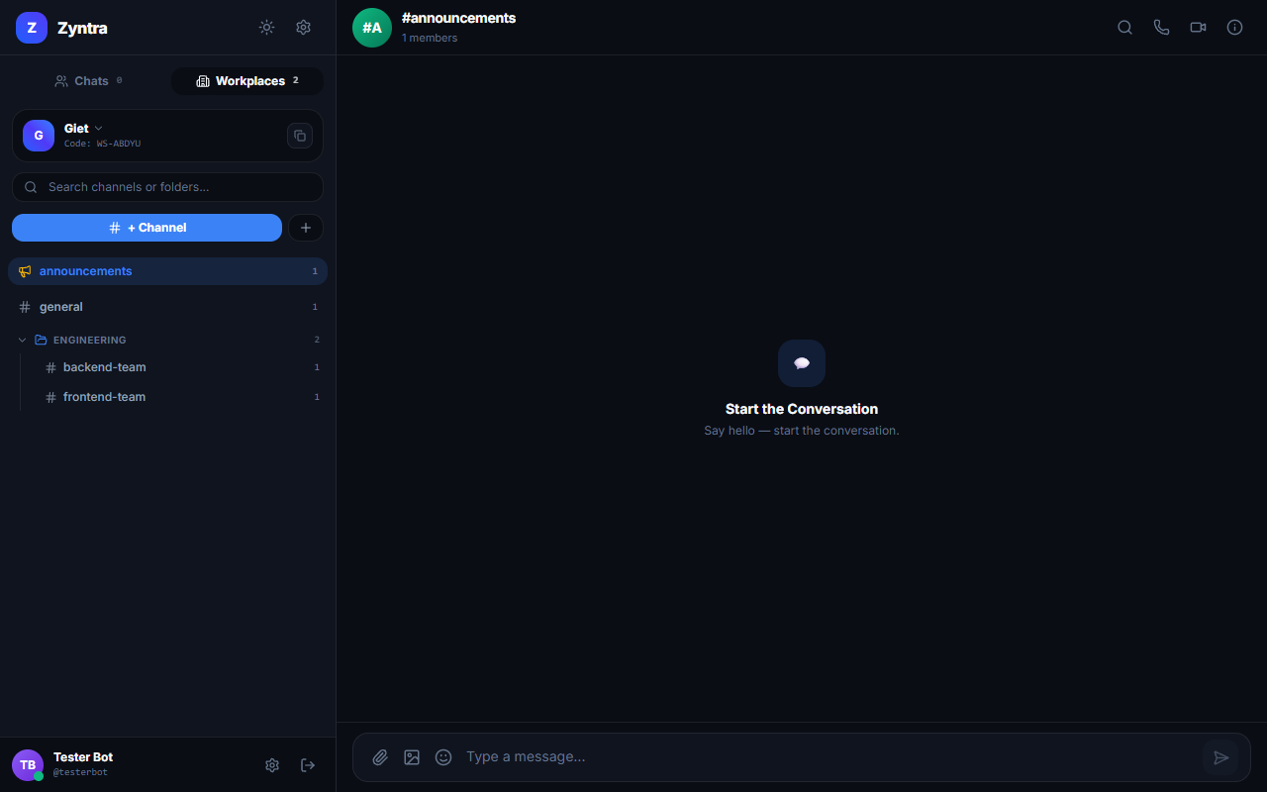
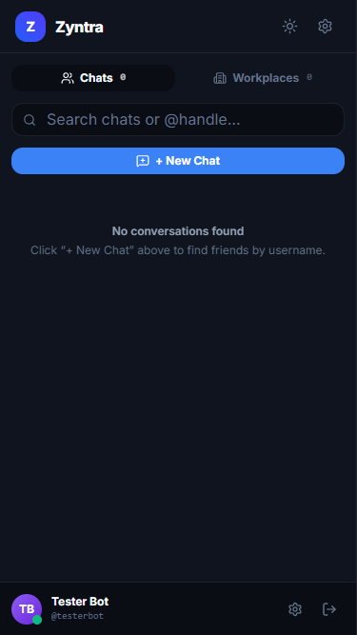
4. MODULE DEVELOPMENT & INTEGRATION
Real-Time Chat Area & Mobile Drawer Optimization
✨ Rich Message Composer:
Auto-expanding textarea, emoji picker popup, attachment preview, and instantaneous dispatch.
✨ Calling & Media Suite:
Interactive Voice Call (Opus audio) and Video Call modals with screen share, mute, and camera toggles.
✨ Channel Info Drawer:
Slide-over right panel detailing channel members, shared media tallies (photos & docs), and leave/mute controls.
✨ Responsive Mobile Architecture (<768px):
Single-column responsive view with full-width conversation list, slide-in chat area, and dynamic 'Back to conversations' navigation.

Slide 9
5. WORK PROGRESS & WEEKLY REPORT
Project Timeline & Weekly Progress Report
🗓️ Weeks 1 - 2: Architecture & Schema
Requirements analysis, architecture design, tech stack selection (React + Node.js + Turso), and initial DB schema.
🗓️ Weeks 3 - 4: Core Backend & Real-Time Engine
REST API development (Auth, Users, Contacts), Socket.io server integration, and Turso libSQL setup.
🗓️ Weeks 5 - 6: Frontend UI & State Architecture
React 19 SPA design, Zustand stores (authStore, chatStore), message composer, and emoji picker.
🗓️ Weeks 7 - 8: Workspace System & Calling Suite
Multi-tenant workspace engine, 6-char invite codes, login workspace popup, voice & video modals.
🗓️ Weeks 9 - 10: Testing, Mobile Tuning & Cloud Deploy
Puppeteer browser automated testing (26/26 passed), mobile responsiveness, and Render deployment.

Slide 10
Q & A
Thank you all for your attention!
Any questions?
🌐 Live Application: https://zyntra-oau1.onrender.com/
💻 GitHub Repository: https://github.com/manan933/Zyntra_Chat_Application

