Slide 1
Big Mountain Ski Resort Manan Amin May, 2022

Slide 2
Market overview
The Ski and Snowboard Resorts industry is expected to continue growing at a higher rate over the five years to 2020.
IBISWorld anticipates industry revenue to increase at an annualized rate of 3.6% to $3.4 billion over the five years to 2020.

Slide 3
Business objective
Big Mountain suspects it may not be maximizing its returns, relative to its position in the market.
It also does not have a strong sense of what facilities matter most to visitors, particularly which ones they're most likely to pay more for.

Slide 4
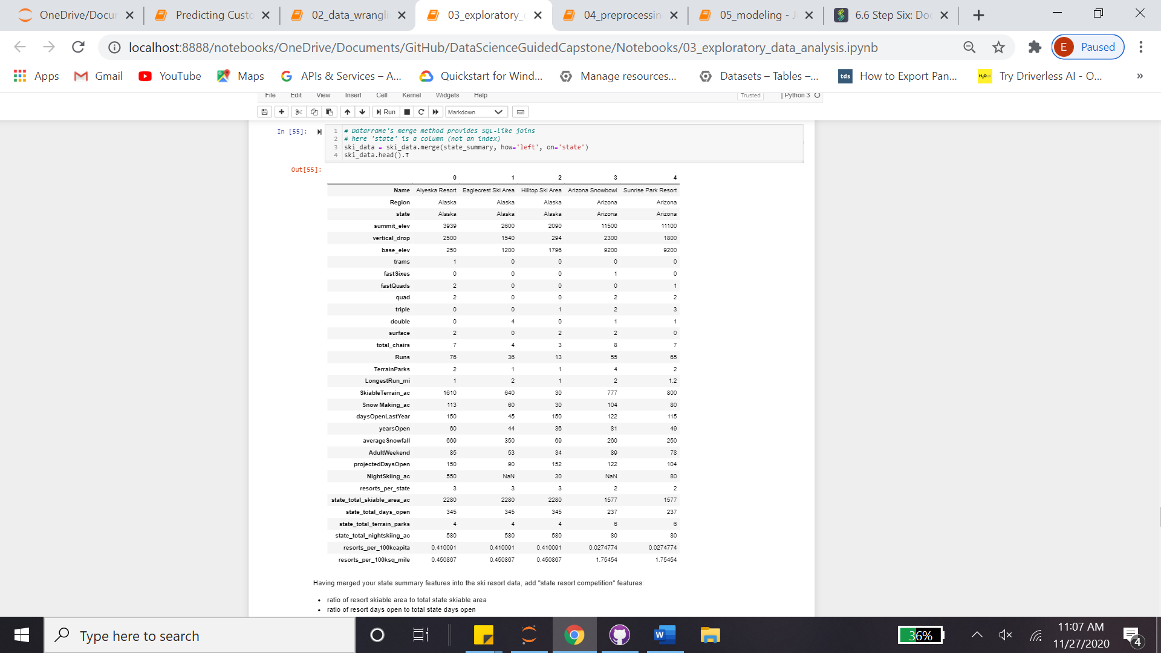
Feature engineering
Target column was identified as 'AdultWeekday’.

Slide 5
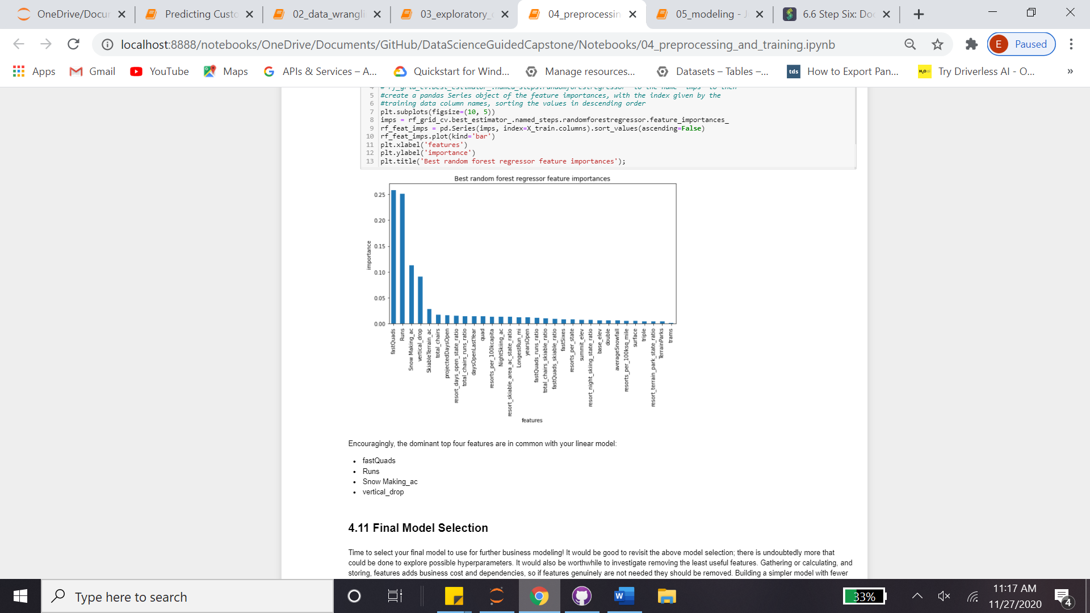
Fitting & Predicting
Pipes were created for both linear regression and random regressor, where the latter is performed better
CV was significantly varying, best_params was applied and gave only 8 features

Slide 6
Pricing
There are two gaining possibilities, either predicting a price increase/decrease or cost saving by feature reducing
The best model was applied, and it observed that Big Mountain Resort modelled price is 95.87 USD, where actual price is 81.00 USD.
Even with the expected mean absolute error of 10.39 USD, this suggests there is room for an increase.
5 USD increase may sum a total of 7.5M USD (350K guests per 5 days stay in average) per year.

Slide 7
Cost Cutting
Per cost saving, several change proposals were noted.
Adding a run, increasing the vertical drop by 150 feet, and installing an additional chair lift; 1.99 USD increase that may sum 3.5M USD per year. (Adding 2 acres of snow making on top of this does not look like having incremental effect.)
Close up to 10 of the least used runs -> Very slight price decrease with up to 6 (excluding) close ups, which makes it applicable.

Slide 8
Future directions
For instance, closing runs may have other benefits like decreasing the costs, other than our primary target which is Ticket Price.
Second, when we increase the lenght of the run, we're having some gain with the pricing, however this is not a net value, since we don't know the size of the investement we need for the extra chairs.

