Slide 1
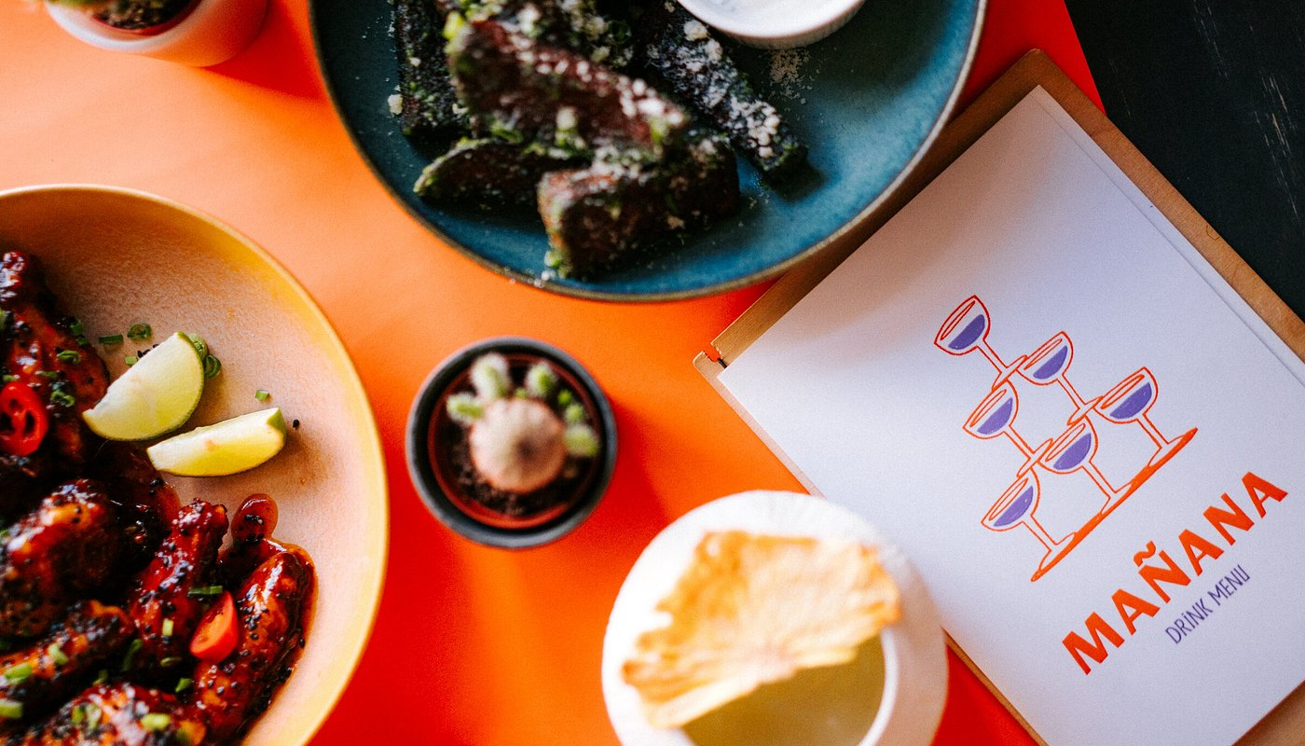
Inventory Management system
Presented by:
1.Osura Wijeweera 221ADB215
2. Lahiru Atigala 221ADB184
3. Avishka Sandun 221ADB142
4.Janith Kandambige 221ADB178
5.Isuri Nilupuli 221ADB141
6.Keyan Gisadh 221ADB140
7.Ravika mahapatabnedhige 213AEB041
Github:-https://github.com/DIP392-futureframe/DIP392-FutureFrame.git

Slide 2
Project Overview
Problem: Manual inventory tracking leads to wastage, overstocking, and human errors.
Users: Restaurant manager and kitchen staff (chefs).
Relevance: Helps automate low stock alerts, user-role management, and food item tracking for improved kitchen efficiency.

Slide 3
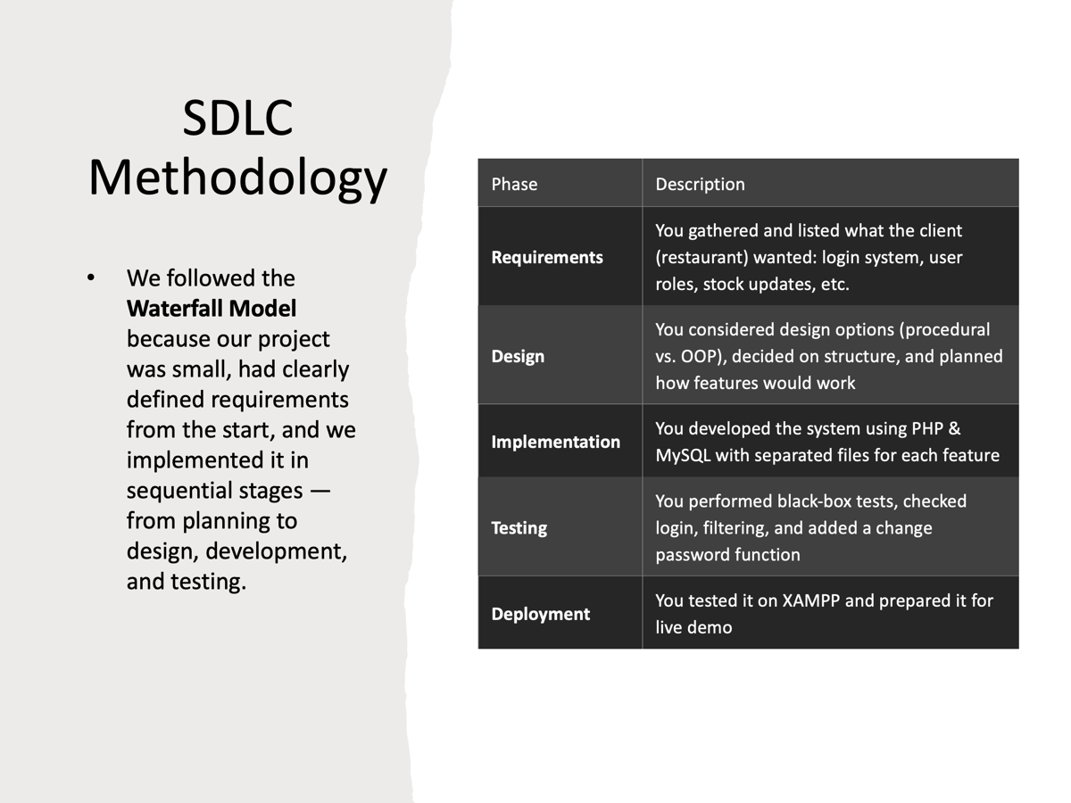
Chosen SDLC Methodology
We followed the Waterfall Model because our project was small, had clearly defined requirements from the start, and we implemented it in sequential stages — from planning to design, development, and testing.
Phase | What you did
Requirements | You gathered and listed what the client (restaurant) wanted: login system, user roles, stock updates, etc.
Design | You considered design options (procedural vs. OOP), decided on structure, and planned how features would work
Implementation | You developed the system using PHP & MySQL with separated files for each feature
Testing | You performed black-box tests, checked login, filtering, and added a change password function
Deployment | You tested it on XAMPP and prepared it for live demo
Maintenance (optional/future) | You discussed adding supplier tracking and moving to OOP later

Slide 4

Requirements Gathering & Analysis
Methods: Interviews with restaurant staff and Manager.
Questions Asked:
How often do you track stock?
What items run out most often?
Assumptions:
Only two user roles: Manager and Chef.
The users will regularly update the system

Slide 5
Software Requirements Specification
Functional Requirements:
User login/logout
Add/update/delete inventory items
Search/filter items
Role-based access
Non-Functional Requirements:
Secure authentication
Mobile responsiveness
Alerts within 1 second of threshold breach

Slide 6
Design Options
We used a procedural design with modular PHP files
Each feature (login, inventory, users) is handled in a separate file
Role-based logic was applied: Managers vs. Chefs
Used MySQL for storing users, products, and stock logs
Chosen for its simplicity, clarity, and faster development
Easy to test, expand, and maintain in future updates

Slide 7
Implementation Phase
Technologies Used:
Frontend: HTML, CSS, JavaScript
Backend: PHP
Database: MySQL
Hosting: XAMPP (local), deployment planned
Code Organization:
public/, views/, models/, controllers/
Team Approach: GitHub with branches, weekly merges

Slide 8
Testing Strategy
Used Black-box testing approach
Tested modules:
Login (valid/invalid credentials)
Inventory entry (zero, negative, large values)
User creation (duplicate email, role enforcement)
Food-ingredient linking
Designed tests based on inputs/outputs, not internal logic

Slide 9
Test Results and Validation
Test Case | Result
Valid login | ✅ Pass
Add item with 0 quantity | ✅ Alert shown
Add duplicate user | ✅ Error displayed
Chef tries to delete user | ✅ Access denied
Ingredient linking | ✅ Correct association retrieved

Slide 10

Process Reflection and Lessons Learned
PHP form handling and sessions
MySQL CRUD operations
Real-world software analysis and design
Collaborative planning and modular coding
File path issues with localhost
Session bugs and fixing SQL permissions
Learned importance of modular code and test-first thinking

Slide 11
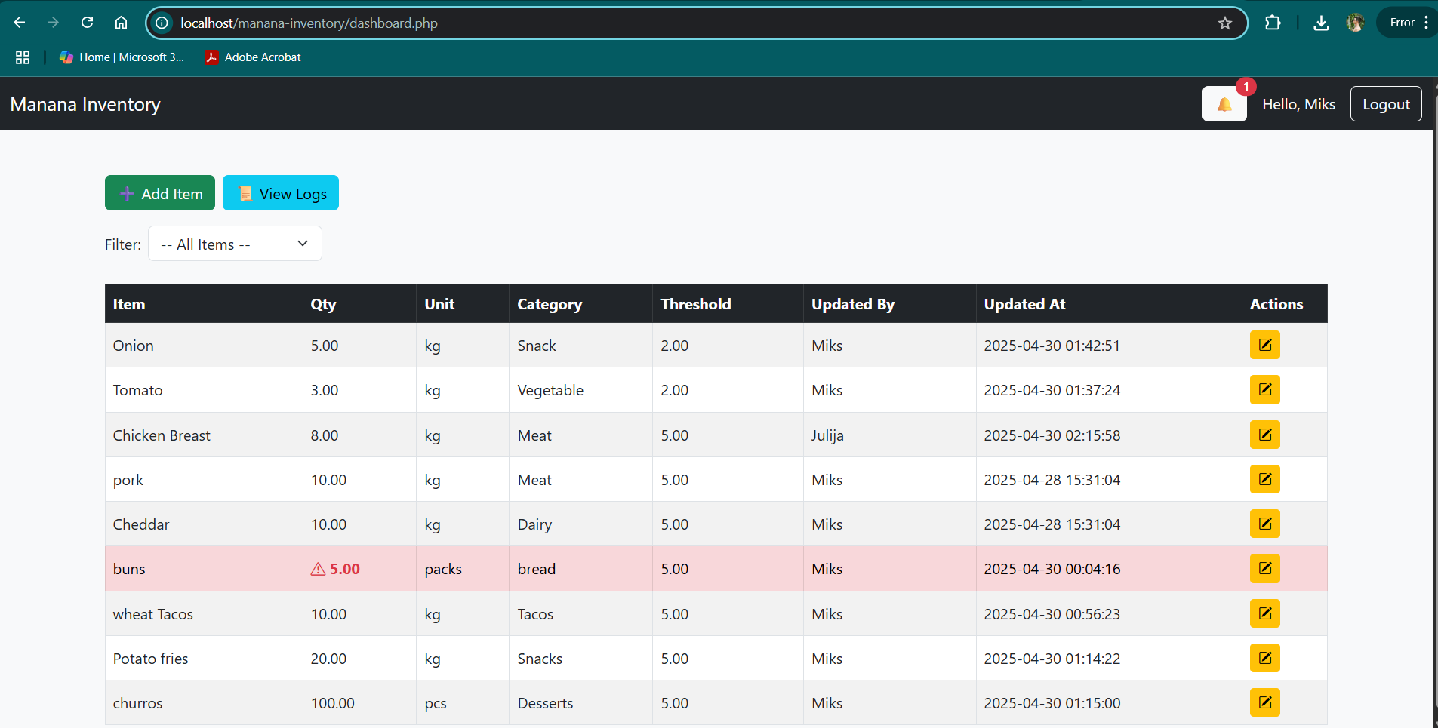
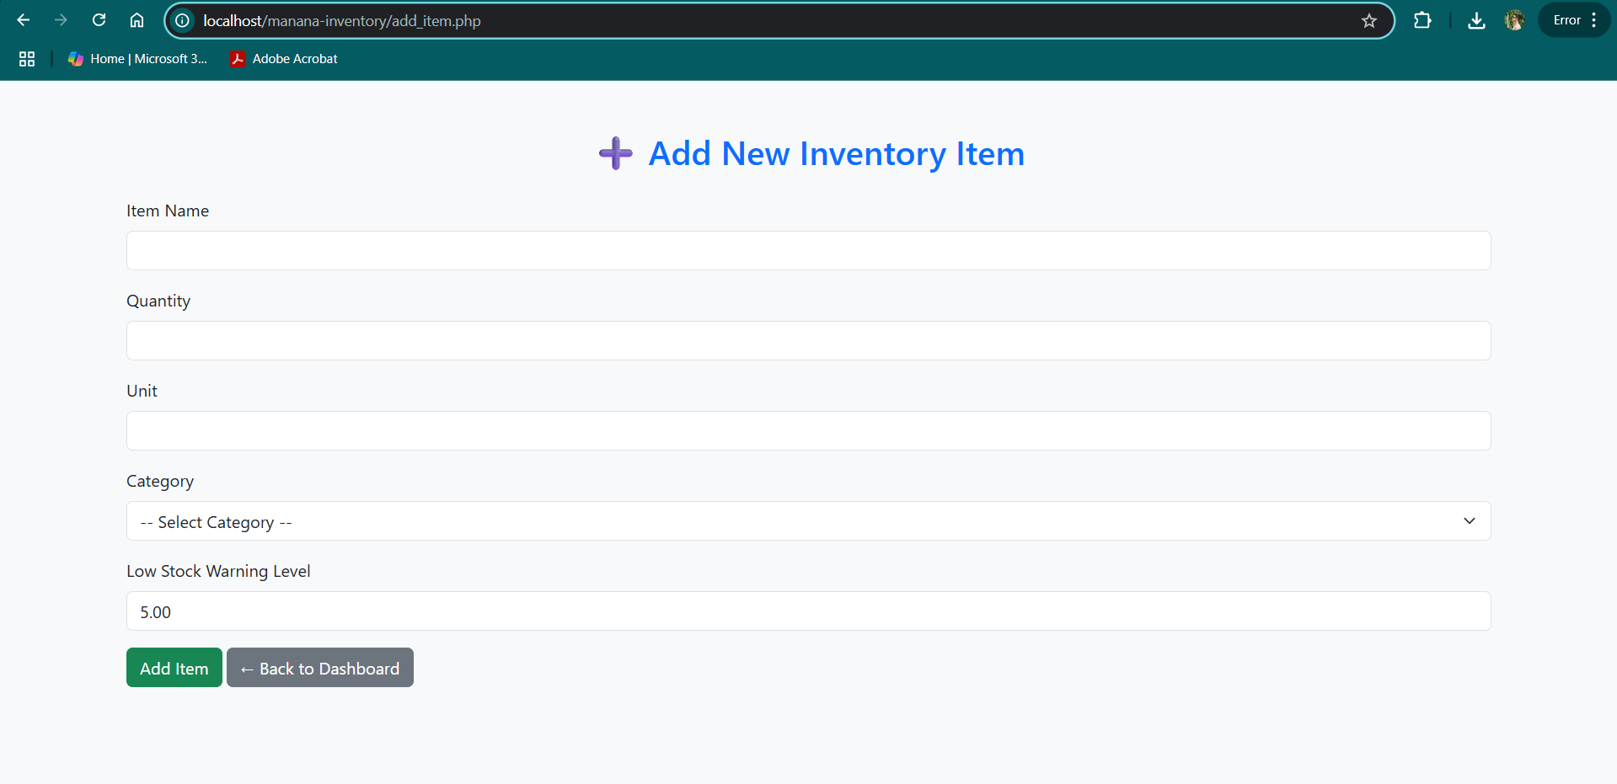
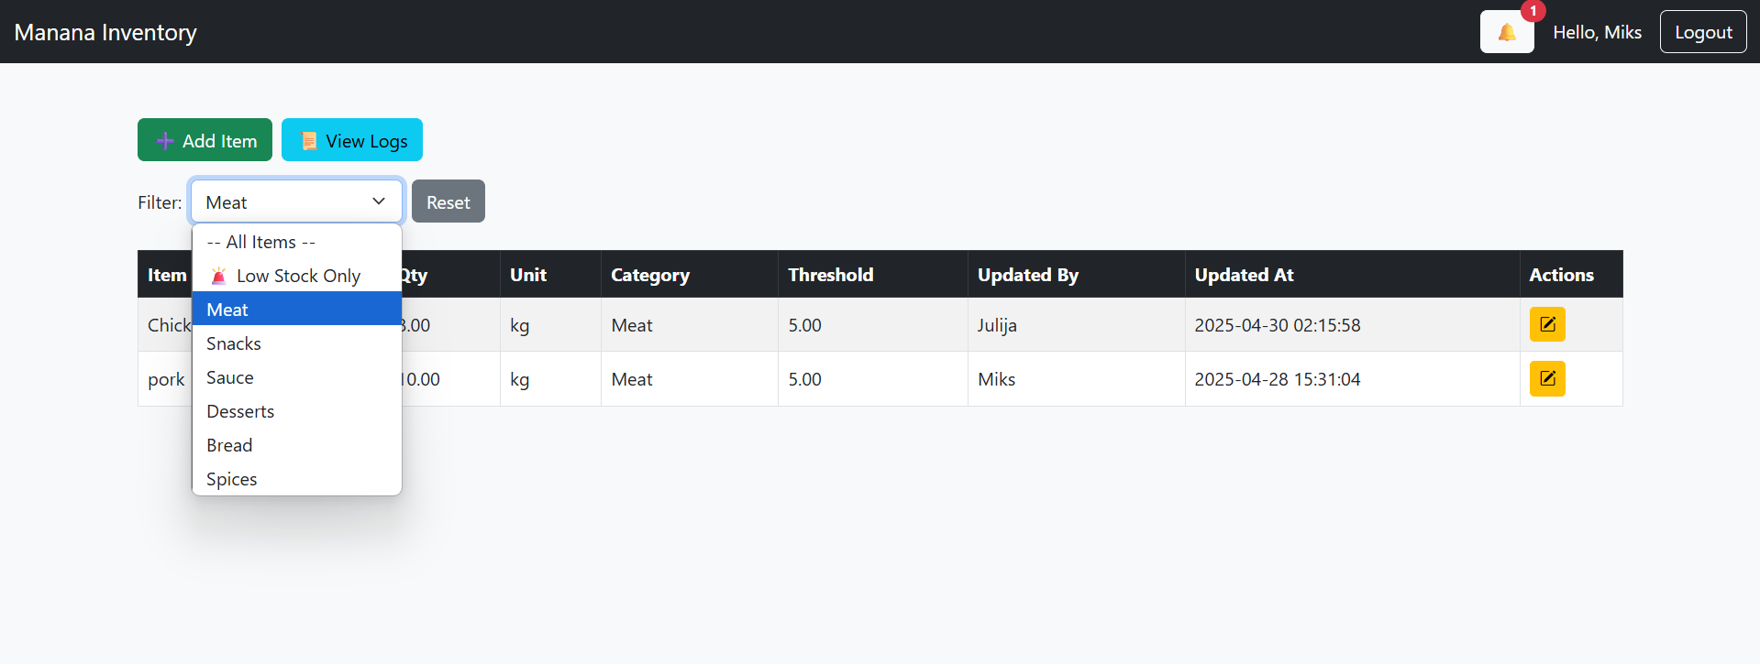
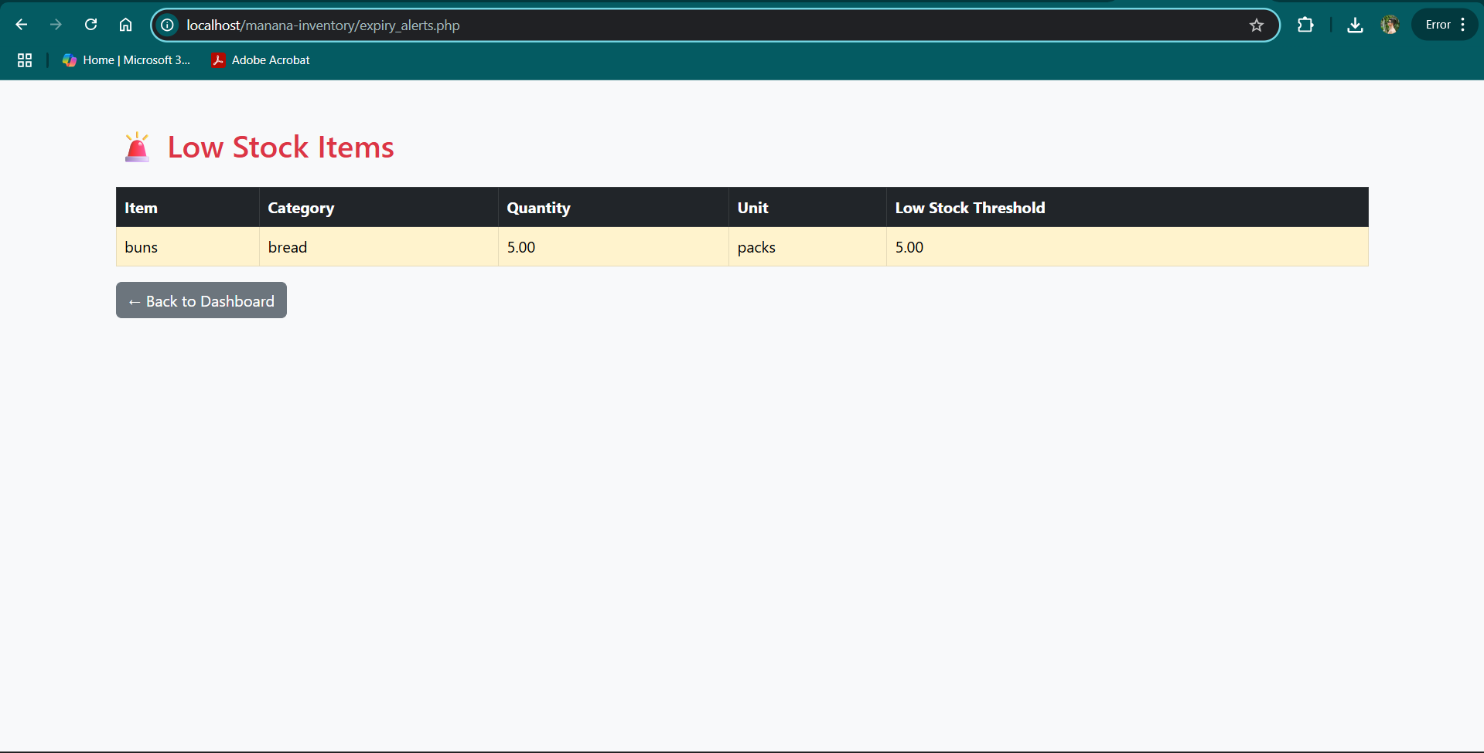
Demo Plan
Login as Manager and Chef
Add/update product
Filter inventory
Trigger low-stock alert
View logs
Remove user

Slide 12
Conclusion and Future Work
Summary:
Successfully implemented a working inventory system
Delivered all core features with testing
Future Improvements:
Add expiry tracking
Send Telegram alerts for out-of-stock items
Include analytics dashboard for usage trends

