Slide 1
Simulation and Automation in Cloud Computing
Using CloudSim and CI/CD Pipeline
Manan Bhimjiyani | 22070122107 | April 2025
CloudSim Plus Advanced Simulation

Slide 2
Abstract
This project explores cloud resource management simulation using CloudSim Plus and automates the process with a CI/CD pipeline.
Key features include VM scheduling, load balancing, fault tolerance, and energy consumption tracking.
Automation is achieved using GitHub Actions with OpenJDK 21.
CloudSim Plus Advanced Simulation

Slide 3
Problem Definition
Challenges in cloud data centers:
- Overloaded resources leading to bottlenecks.
- Energy inefficiency due to suboptimal utilization.
- System failures causing service disruptions.
- Manual workflows hindering reproducibility.
- Limited observability and environment standardization.
CloudSim Plus Advanced Simulation

Slide 4
Objectives
Simulate advanced cloud resource management using CloudSim Plus.
Optimize cloudlet scheduling using round-robin load balancing.
Improve fault tolerance by simulating host failures and VM migration.
Monitor and measure energy efficiency through integrated power models.
Implement DevOps practices including CI/CD, automated testing, and observability.
CloudSim Plus Advanced Simulation

Slide 5
Implementation
The simulation is implemented in Java using CloudSim Plus 8.0.0 and OpenJDK 21.
Key components:
- Datacenter: 5 hosts, each with 8 PEs (3000 MIPS), 64 GB RAM, and a power model (250W max, 50W idle).
- VMs: 10 VMs, each with 4 PEs (2000 MIPS), 16 GB RAM.
- Cloudlets: 20 tasks with lengths 10k–29k MI.
- Load balancing: Round-robin assignment of cloudlets to VMs.
- Fault tolerance: Host 0 fails at 5 seconds, triggering VM migration.
- Energy tracking: Power consumption calculated every second.
CloudSim Plus Advanced Simulation

Slide 6
Results and Analysis
Power consumption dropped to 600.00 W at 5 seconds due to Host 0 failure.
All 20 cloudlets completed successfully despite the failure.
Total energy consumption: 0.17 Wh.
Total simulation time: 14.71 seconds.
CloudSim Plus Advanced Simulation

Slide 7
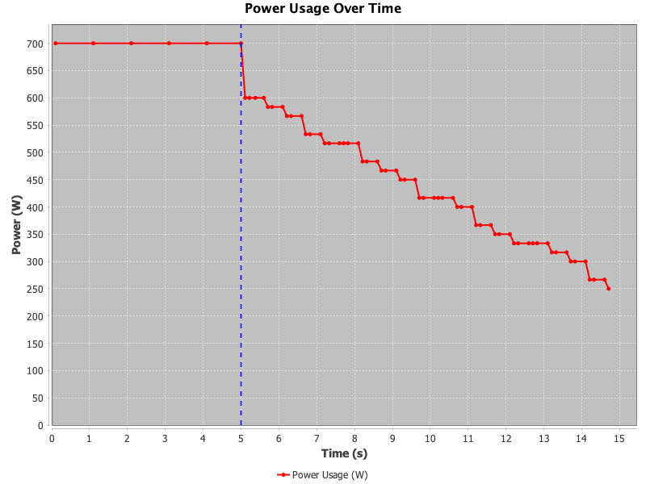
Power Usage Over Time
CloudSim Plus Advanced Simulation

Slide 8
Conclusion
Successfully simulated and automated cloud resource management using CloudSim Plus.
Achievements include optimized load balancing, enhanced fault tolerance, and improved energy efficiency.
Integrated CI/CD pipeline streamlined development and testing.
Future enhancements may include advanced algorithms and multi-datacenter simulations.
CloudSim Plus Advanced Simulation

