Slide 1

CF-STRESS
SNT PROJECT
PROGRAMMING CLUB, IIT KANPUR

Slide 2


TABLE OF CONTENTS
01
02
03
About CF-Stress
Timeline
04
05
06
Technical Aspects
CF-Stress Demo
Future Plans
Our Team

Slide 3
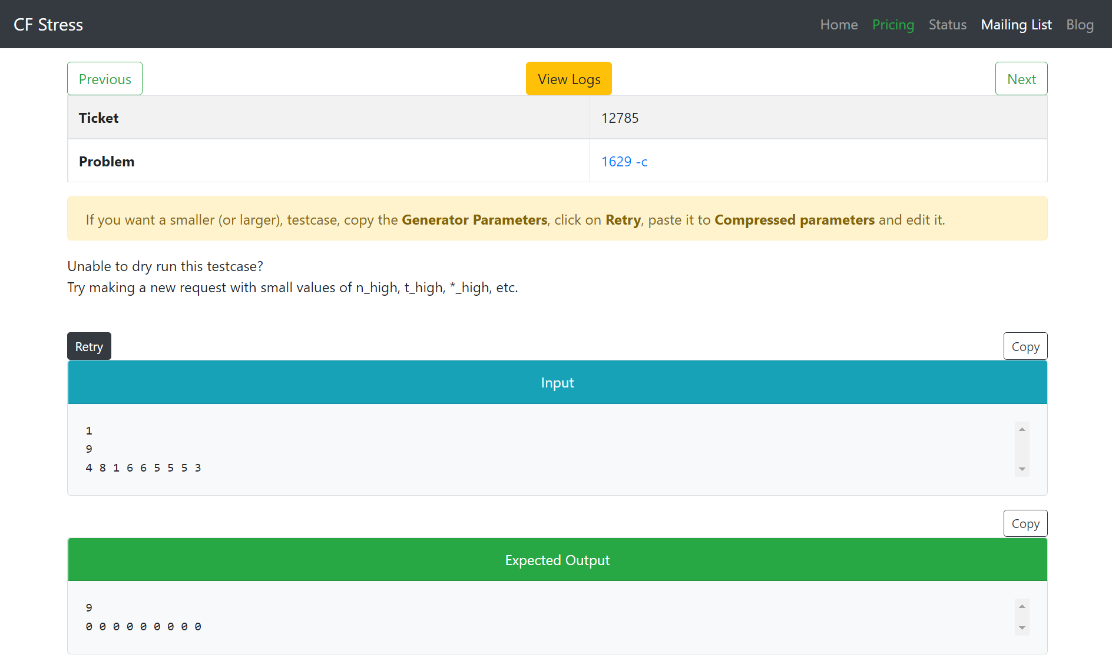
About CF-Stress
This project aims to build the Cf-Stress website from scratch.
Cf-Stress is a community driven and highly customizable no-code tool which stress tests Codeforces problems and generate smallest possible counter-example for failing submissions.

Slide 4
Project Timeline
Week 1-4
Week 5-6
Week 7
Making the Layout
We deep-dived into several documentation of Go packages to understand what we need to implement and how.
Development
Started structuring our code using routers, handlers,
Dummy html, etc.
Also completed our autograder Assignment.
Deploying our site
Used different database service management applications to implement our code.

Slide 5
Technical Aspects

Slide 6
Dependency Injection
Stress testing
Zap Library
Dynamic Routes

Slide 7
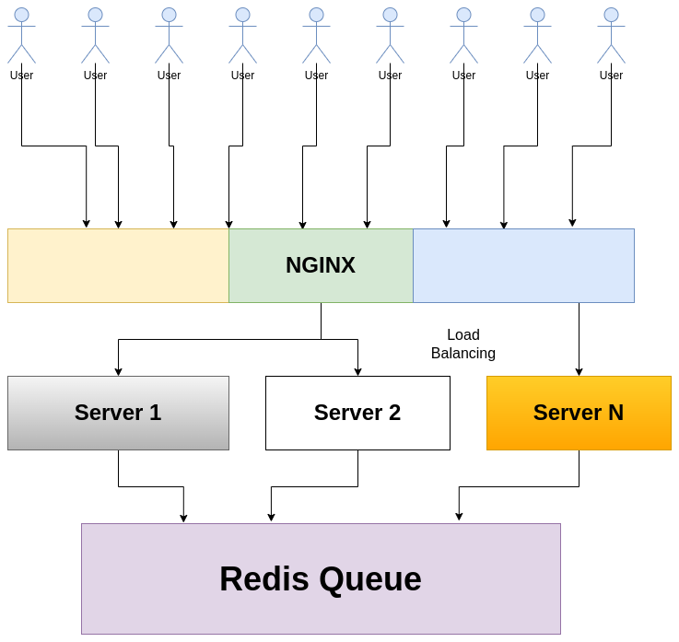
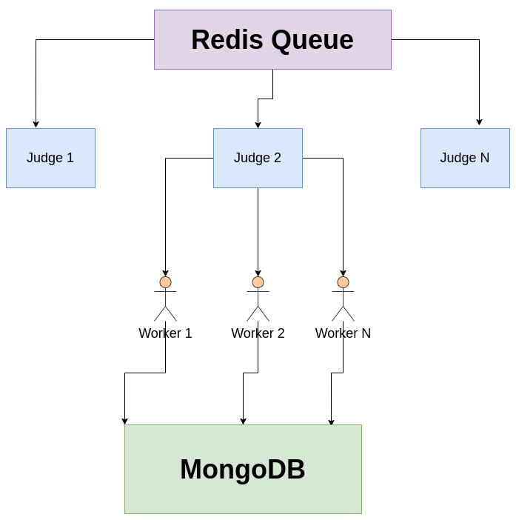
Microservice Architecture

Slide 8
Docker
MongoDB
Redis
NGINX
Kubernetes
Prometheus
Sandboxing and containerization tool
A document oriented database
in-memory key–value database
A load balancer, web server and a reverse proxy
orchestration system
Application used for time monitoring

Slide 9
Cf-Stress Demo

Slide 10
Future Plans
Building the Frontend
Script Customization
Deployment in Kubernetes cluster
Currently we use "Postman" to simulate the UI.
The current script does not allow users to limit the constraints
This project is supposed to work on multiple machines as a distributed system. This features was tested locally using scale in docker-compose.

Slide 11

OUR TEAM
Mentors: Masood Alam, Lavish Gupta, Vaibhav Goyal, Soham Ghoshal
Mentees: Covered in document.

Slide 12
THANKS!
We are open to any questions and feedbacks.

