Slide 1

INDIAN INSTITUTE OF TECHNOLOGY KANPUR
SURGE-2022
Evaluation of the accuracy of DestVI, CARD and AutoGeneS on cell-type Deconvolution
Mentor:
Dr. Hamim Zafar
Department of Computer Science and Engineering
IIT Kanpur (U.P.)
Submitted by:
MILAN ANAND RAJ
Department of Biological Sciences and Bioengineering
IIT Kanpur (U.P.)

Slide 2
OBJECTIVE
To evaluate the accuracy of DestVI, CARD and AutoGeneS on various real and simulated datasets.
To visualize the prediction clusters on the spatial map.
To implement pipelines for the three methods to predict the accuracy.
To compare the F1 score, precision, recall, divergence and Pearson correlation of the three methods.

Slide 3
KEY POINTS
In the preprocessing step, the top 2000 highly variable genes were selected and then the data was normalized.
Single-cell latent variable model help to dissect observed heterogeneity into different sources, thereby allowing for the correction of confounding sources of variation.
It was assumed that genes count in each spot of spatial data follow negative binomial distribution.
The single-cell data is first mapped to low dimensional latent vector accounting for the variability in the data with the help of a trained neural framework.
Fig 1: Single Agent with Dubin’s Model
Fig 1: Multi Agent RRT star

Slide 4
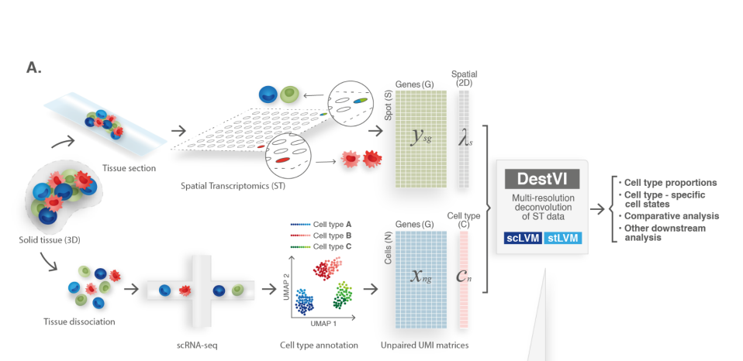
KEY POINTS
The analysis pipeline for cell type deconvolution is generalized in the figure attached:
For collecting single-cell data, solid tissue is dissociated.
For collecting spatial-data, solid tissue is dissected to generate a plain tissue section.
UMAP is applied to achieve non-linear dimension reduction of sc-data.
stLVM then takes the trained scLVM model and generate the final spot-wise proportion output matrix.
Fig 3: UI of GCS
Fig 1: Analysis Workflow

Slide 5
RESULTS AND FUTURE WORK
To evaluate the performance of the 3 integration methods, we collected 17 paired spatial transcriptomics and scRNA-seq datasets either simulated or published.
For the real mouse brain datasets, distinct cell type clusters were visualized on the spatial map.
We are planning to generate more simulated datasets with CSGAN generative model and robustly benchmark the three methods on that.

Slide 6
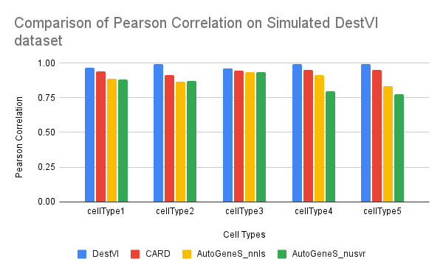

Slide 7
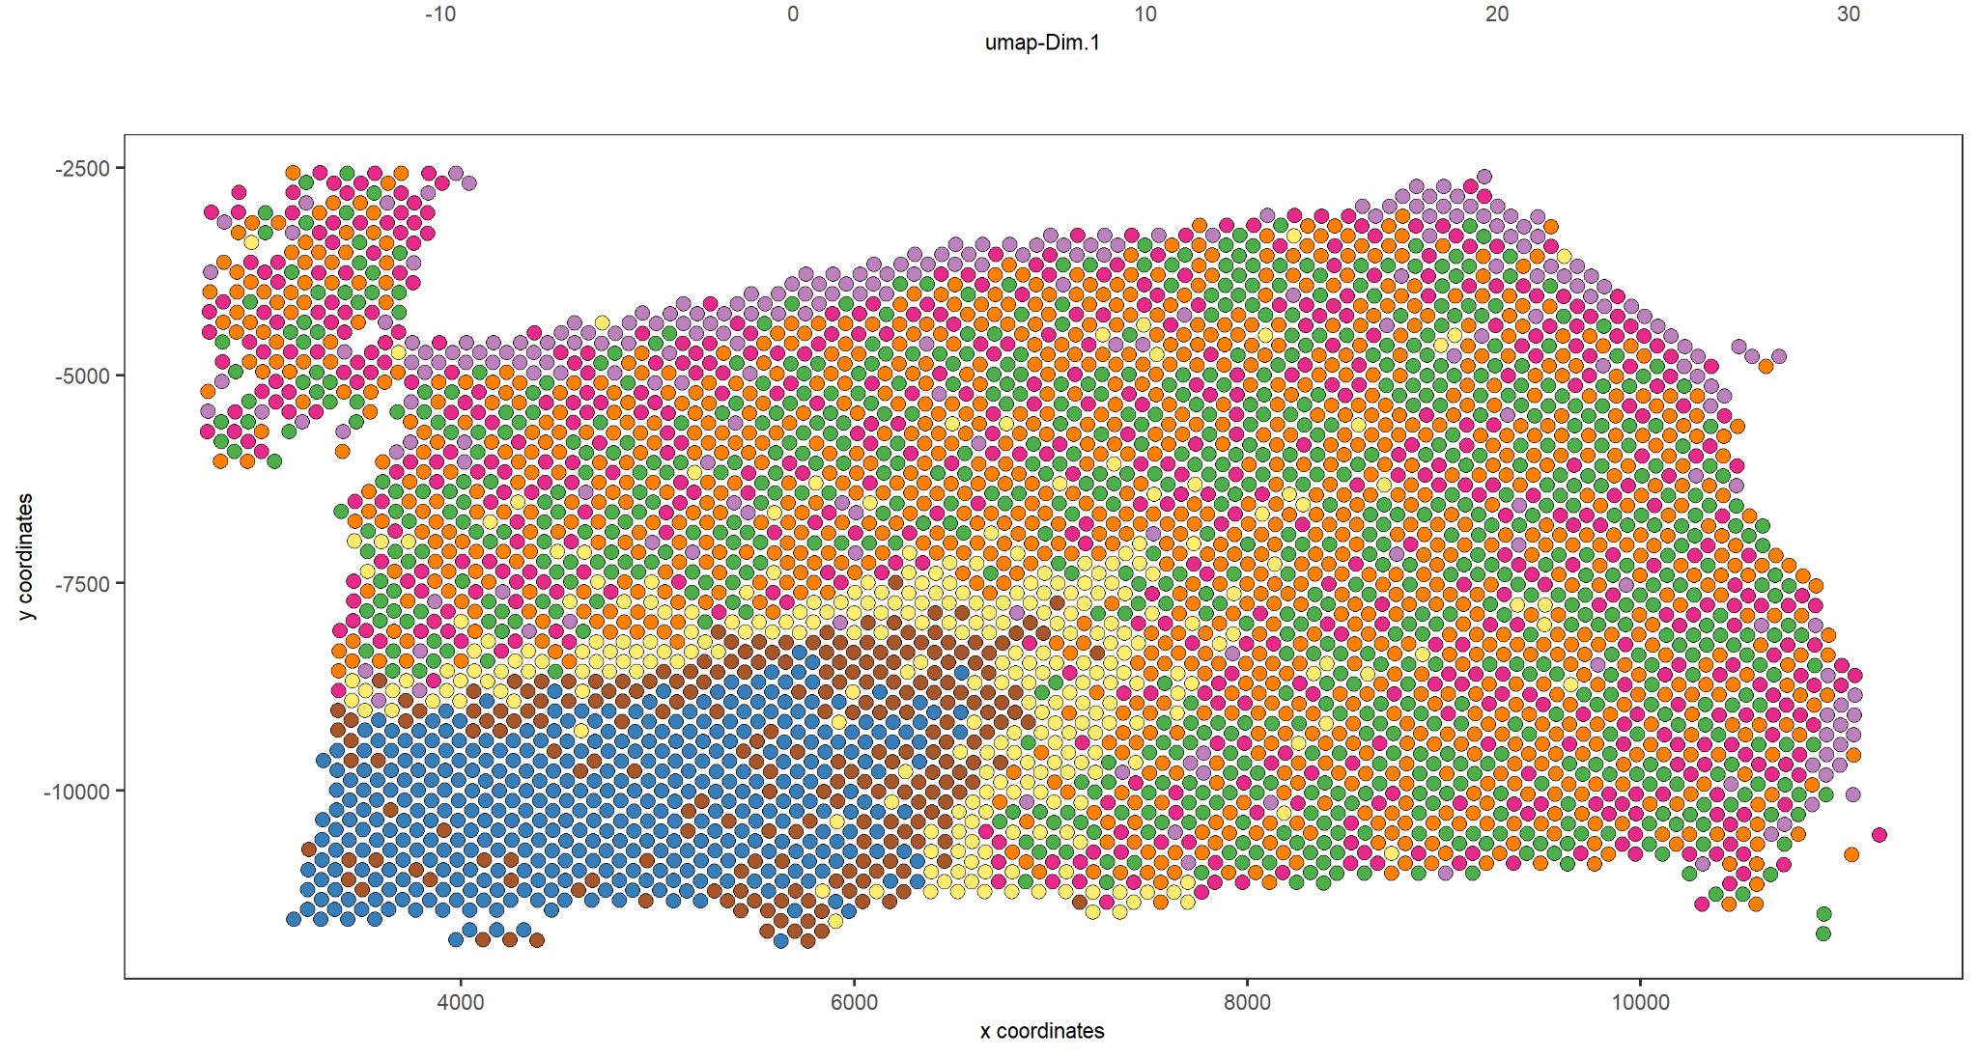
CLUSTERS OF CELLS ON THE SPATIAL MAP
(output of CARD method on 151675 10X Visium Brain Data)

Slide 8
Thank You
Surge-2022
MILAN ANAND RAJ

