Slide 1
Python code presentation
Manan 3035450307 and Ivan 3035647871

Slide 2
Outline:
- Packages utilized
- Web scrapping
- Loop to convert strings to float
- Bar plot
- Regression analysis and plotting

Slide 3
Packages
﻿import numpy as np
import pandas as pd
import matplotlib.pyplot as plt
from selenium.webdriver import Chrome
from selenium.webdriver.support.ui import WebDriverWait*
from selenium.webdriver.support import expected_conditions as EC*
from selenium.webdriver.common.by import By*
from sklearn.linear_model import LinearRegression*
from time import sleep*
The packages marked with * have been utilized in new ways then the lecture slides
Introduce shortly the Web scraping

Slide 4
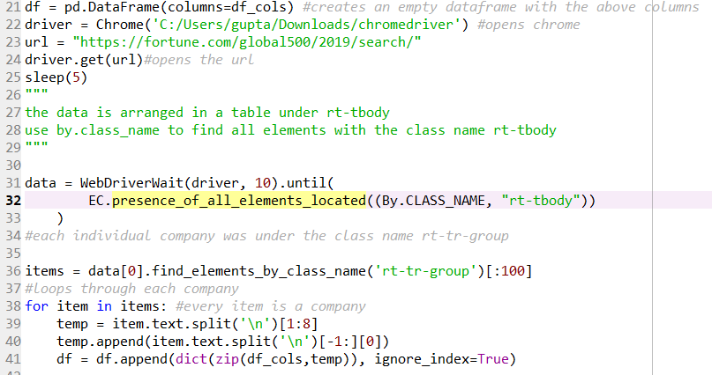
Web scraping
Website: Global 500
https://fortune.com/global500/2019/search/
Dynamically generated – need to use selenium
Appended each company’s data to the dataframe

Slide 5
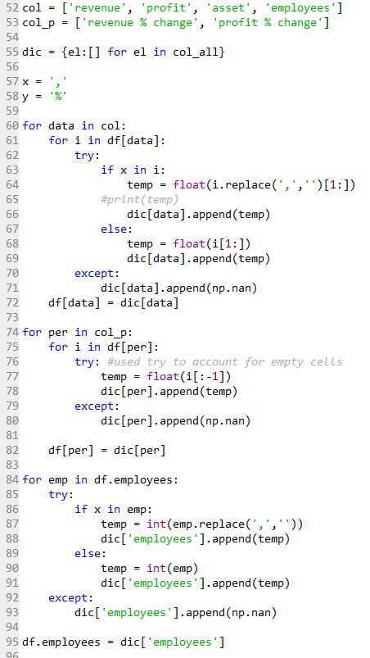
Loop to convert strings to float
Need to convert data from strings to float to enable data visualization
Used for loops to achieve this

Slide 6
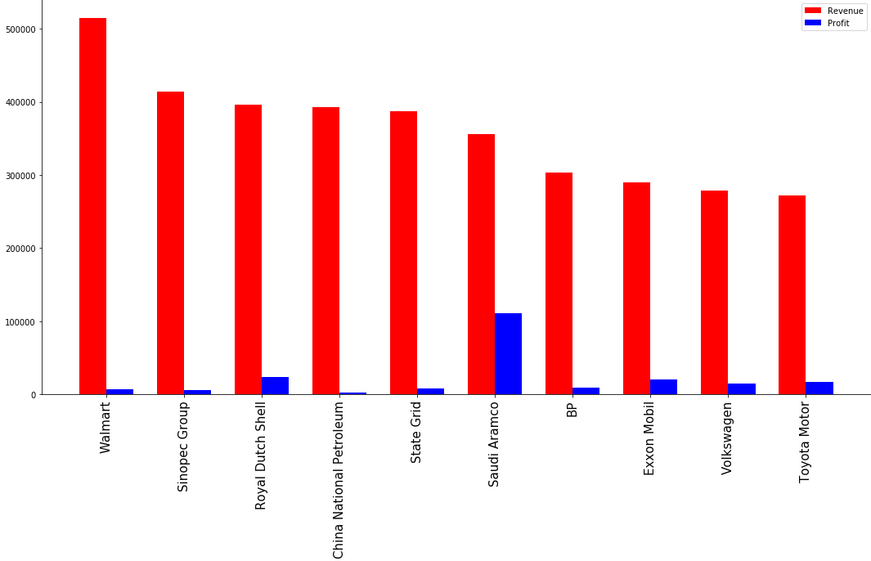
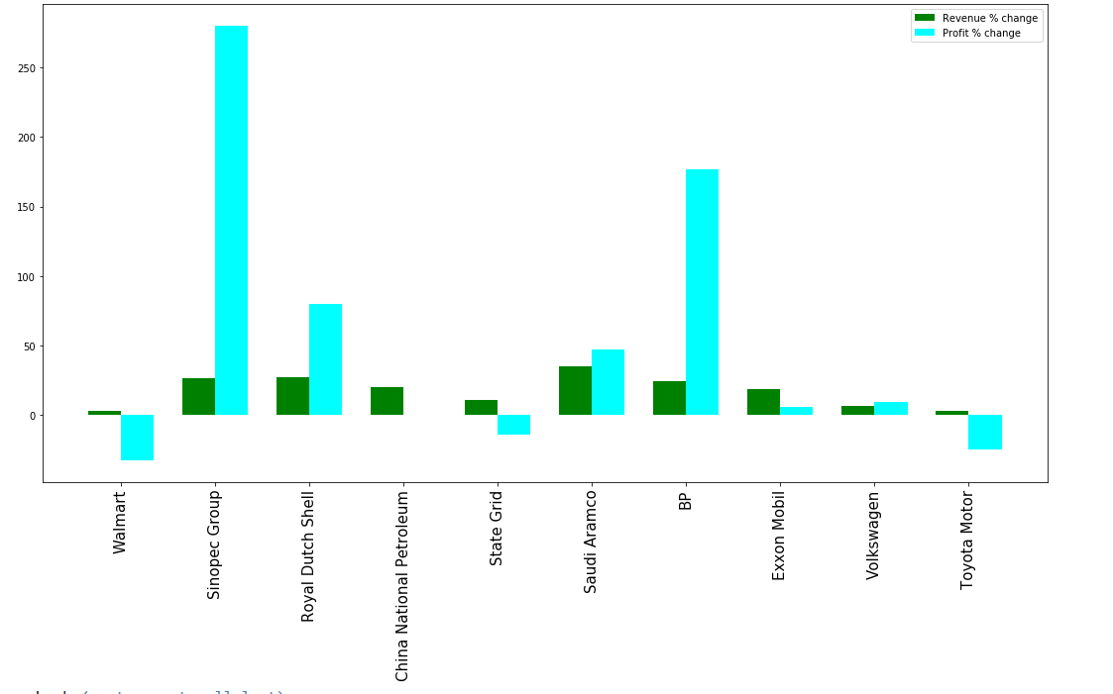
Data visualization with bar plot
Used matplotlib.bar
Ax1.bar
Ax1.set_xticklabels

Slide 7
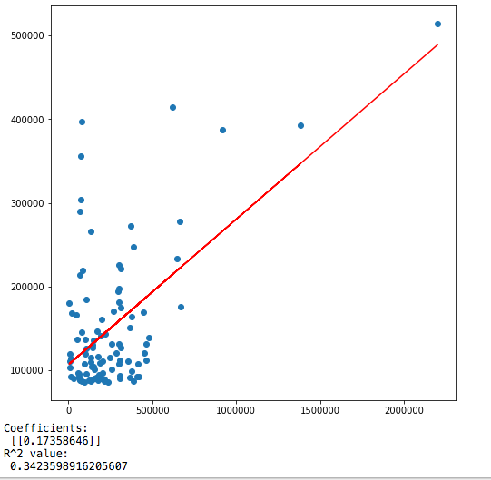
Regression analysis and visualization
Employees - x
Revenue - Y
﻿linear_regressor:
﻿np.reshape:

Slide 8
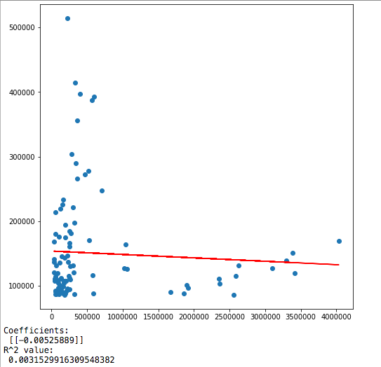
Regression analysis and visualization
Assets - x
Revenue - Y
Low explanatory power
Outliers of big Chinese banks.

