Slide 1
CORONAVIRUS Visualization & Prediction
TEAM MEMBERS: SARTHAK JAIN(RA2011026010112)
Manan Kadel (RA2011026010085)

Slide 2
Problem Statement
The coronavirus pandemic has affected the world in unprecedented ways, with millions of people infected and thousands losing their lives.
With such a vast amount of data available, it can be challenging to understand the scale and impact of the pandemic.
In this project, we aim to use data visualization techniques to present COVID-19 data in an easily understandable and informative way.
Our goal is to help individuals, organizations, and policymakers comprehend the spread and impact of the virus, identify trends and patterns, and make informed decisions based on the data.
By providing clear and visually compelling insights, we hope to contribute to the fight against COVID-19 and help mitigate its effects.

Slide 3
Why is it Important
Coronavirus data visualization is important for several reasons:
Understand the scale and impact of the pandemic: By visualizing data, it is easier to understand the magnitude of the pandemic and its impact on different regions, demographics, and industries.
Identify trends and patterns: Data visualization allows us to see patterns and trends in the data that may not be immediately apparent from looking at raw numbers. This can help researchers and policymakers identify areas that require attention or intervention.
Communicate complex information: Data visualization can simplify complex information and make it more accessible to a wider audience. It can help people understand the data quickly and easily, even if they don't have a technical background.
Make informed decisions: By analyzing the data, policymakers can make informed decisions about how to allocate resources, implement interventions, and manage the pandemic effectively.
Track progress: Data visualization allows us to track the progress of the pandemic over time, and monitor the impact of interventions and policies. This can help us adjust our strategies as needed and make data-driven decisions about how to respond to the pandemic.

Slide 4
How to visualize the Data
Visualizing data for coronavirus involves displaying the data in a way that is easy to understand and highlights important trends and patterns. Here are some suggestions for visualizing coronavirus data:
Use graphs and charts: Graphs and charts are effective for displaying numerical data, such as the number of cases or deaths over time, or the distribution of cases by age or region.
Use maps: Maps can help show the geographic spread of the pandemic and the areas that are most affected. Heat maps, choropleth maps, and bubble maps are some of the types of maps that can be used to display coronavirus data.
Use infographics: Infographics are visual representations of information that can help simplify complex data and make it more accessible to a wider audience.
Use animations: Animations can be used to show changes in data over time or to highlight specific trends or patterns.
Use interactive tools: Interactive tools, such as dashboards or data visualization software, can allow users to explore the data in more detail and customize the visualizations to their needs.

Slide 5
Data Source
Data was downloaded from Kaggle.
Coronavirus Case Data is provided by Johns Hopkins University
We are using 3 datasets in this Project
Confirmed Cases
Deaths
Latest Data

Slide 6
About our Dataset
The headers we are using are:
Country
Latitude
Longitude
Deaths
Confirmed
Dates

Slide 7
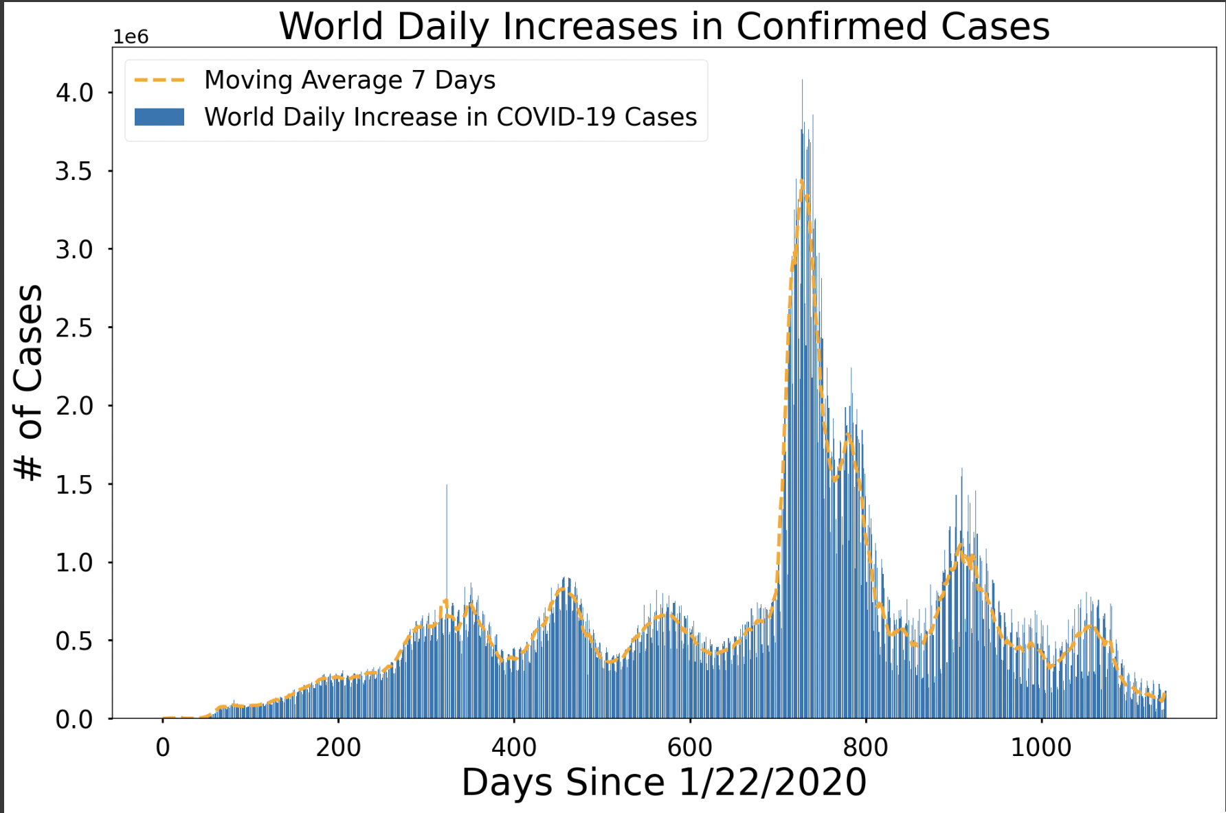

Slide 8
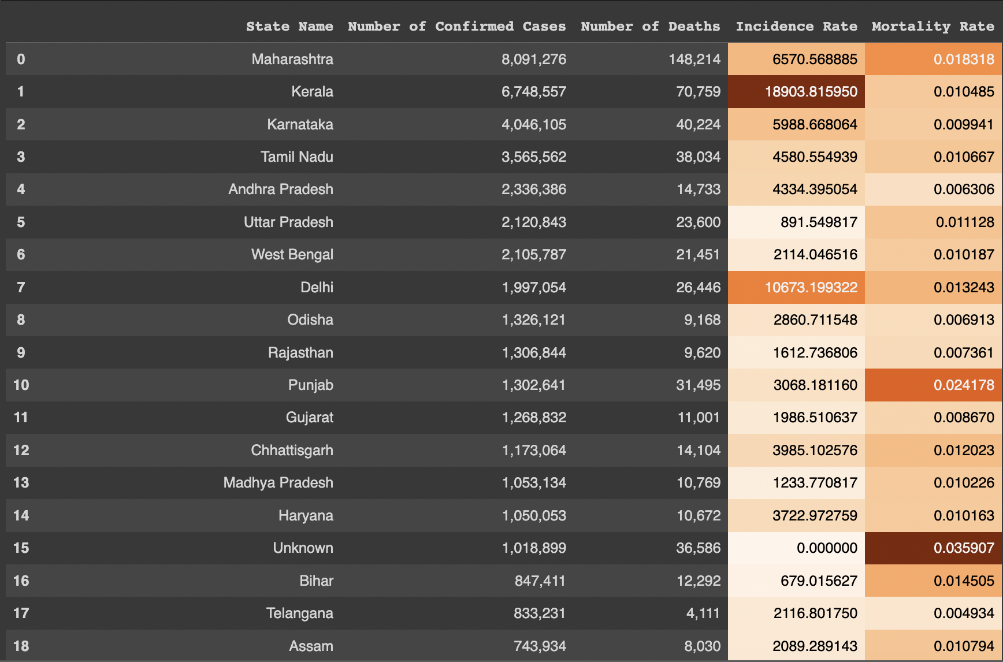
Country Specific Table

Slide 9
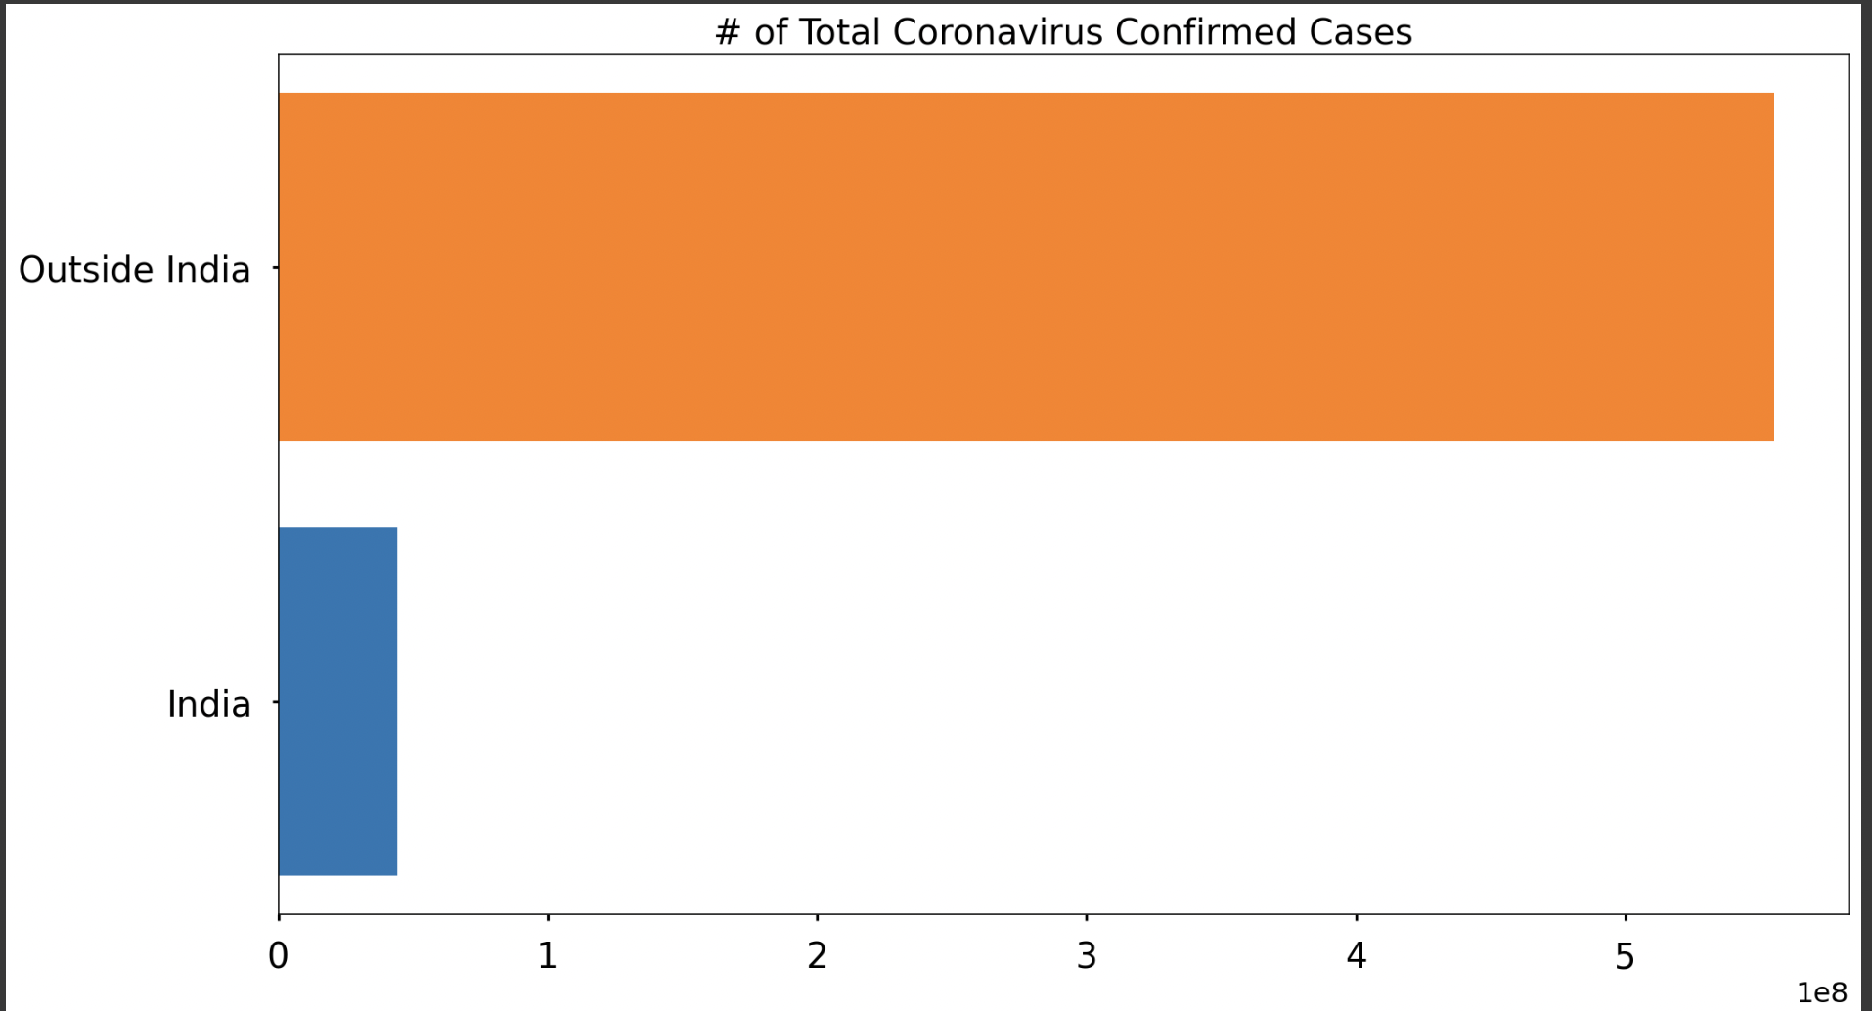
Comparison of Total Cases of India with Other Countries

Slide 10
Conclusion
Based on the analysis and visualization of coronavirus data, it can be concluded that the pandemic has had a significant impact on the world. The virus has spread rapidly across the globe, resulting in numerous cases, hospitalizations, and deaths. The data also shows that various countries have taken different approaches to controlling the spread of the virus, with varying degrees of success.
The pandemic has also had a significant impact on various sectors, including healthcare, the economy, and education. The healthcare sector has been stretched thin by the pandemic, with healthcare workers risking their lives to care for patients. The economy has also suffered, with businesses shutting down and people losing their jobs. The education sector has been forced to adapt to remote learning, which has been a significant challenge for students, teachers, and parents.

Slide 11
THANK YOU

