Slide 1
Lists and the Collection Interface
Chapter 4

Slide 2
Chapter Objectives
To become familiar with the List interface
To understand how to write an array-based implementation of the List interface
To study the difference between single-, double-, and circular linked list data structures
To learn how to implement the List interface using a linked-list
To understand the Iterator interface

Slide 3
Chapter Objective (continued)
To learn how to implement the iterator for a linked list
To become familiar with the Java Collection framework

Slide 4
The List Interface and ArrayList Class
An array is an indexed structure: can select its elements in arbitrary order using a subscript value
Elements may be accessed in sequence using a loop that increments the subscript
You cannot
  Increase or decrease the length
  Add an element at a specified position without shifting the other elements to make room
  Remove an element at a specified position without shifting other elements to fill in the resulting gap

Slide 5
The List Interface and ArrayList Class (continued)
Allowed operations on the List interface include:
  Finding a specified target
  Adding an element to either end
  Removing an item from either end
  Traversing the list structure without a subscript
Not all classes perform the allowed operations with the same degree of efficiency
An array provides the ability to store primitive-type data whereas the List classes all store references to Objects. Autoboxing facilitates this.

Slide 6

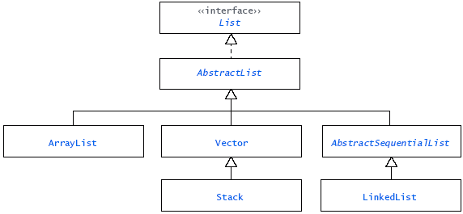
The List Interface and ArrayList Class (continued)

Slide 7
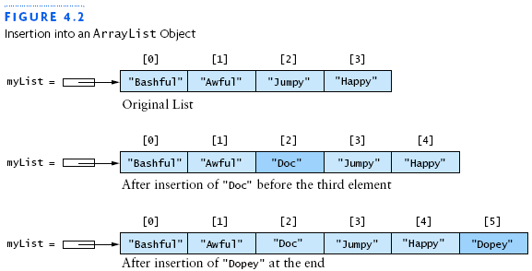
The ArrayList Class
Simplest class that implements the List interface
Improvement over an array object
Used when a programmer wants to add new elements to the end of a list but still needs the capability to access the elements stored in the list in arbitrary order

Slide 8


The ArrayList Class (continued)

Slide 9
Generic Collections
Language feature introduced in Java 5.0 called generic collections (or generics)
Generics allow you to define a collection that contains references to objects of a specific type
List<String> myList = new ArrayList<String>();
specifies that myList is a List of String where String is a type parameter
Only references to objects of type String can be stored in myList, and all items retrieved would be of type String.
A type parameter is analogous to a method parameter.

Slide 10
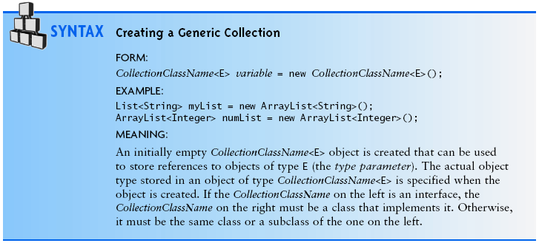
Creating a Generic Collection

Slide 11
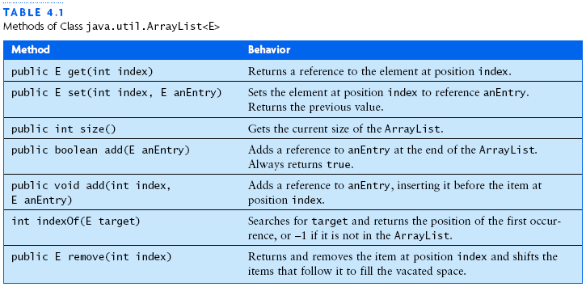
Specification of the ArrayList Class

Slide 12
Application of ArrayList
The ArrayList gives you additional capability beyond what an array provides
Combining Autoboxing with Generic Collections you can store and retrieve primitive data types when working with an ArrayList

Slide 13
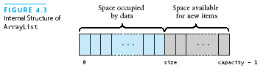
Implementation of an ArrayList Class
KWArrayList: simple implementation of a ArrayList class
  Physical size of array indicated by data field capacity
  Number of data items indicated by the data field size

Slide 14
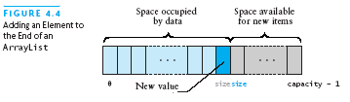
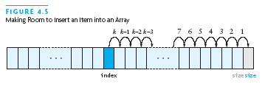
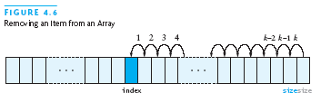
Implementation of an ArrayList Class (continued)

Slide 15
Performance of KWArrayList and the Vector Class
Set and get methods execute in constant time
Inserting or removing elements is linear time
Initial release of Java API contained the Vector class which has similar functionality to the ArrayList
  Both contain the same methods
New applications should use ArrayList rather than Vector
Stack is a subclass of Vector

Slide 16
Single-Linked Lists and Double-Linked Lists
The ArrayList: add and remove methods operate in linear time because they require a loop to shift elements in the underlying array
  Linked list overcomes this by providing ability to add or remove items anywhere in the list in constant time
Each element (node) in a linked list stores information and a link to the next, and optionally previous, node

Slide 17
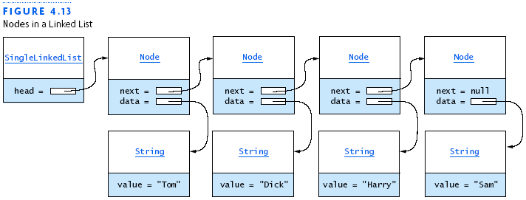
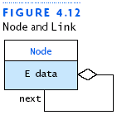
A List Node
A node contains a data item and one or more links
A link is a reference to a node
A node is generally defined inside of another class, making it an inner class
The details of a node should be kept private

Slide 18
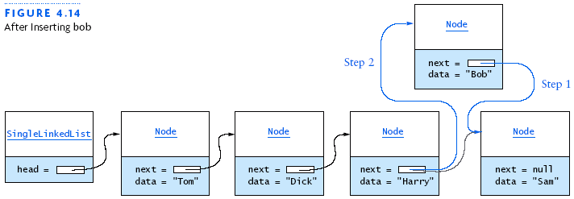
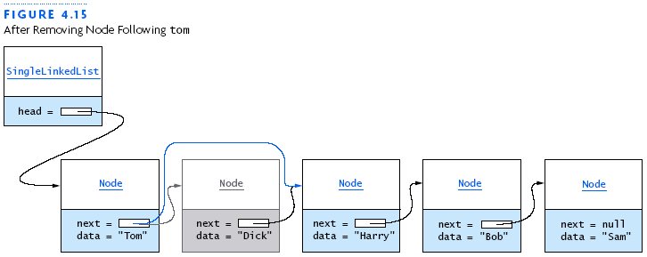
Single-Linked Lists

Slide 19
Double-Linked Lists
Limitations of a single-linked list include:
  Insertion at the front of the list is O(1).
  Insertion at other positions is O(n) where n is the size of the list.
  Can insert a node only after a referenced node
  Can remove a node only if we have a reference to its predecessor node
  Can traverse the list only in the forward direction
Above limitations removed by adding a reference in each node to the previous node (double-linked list)

Slide 20
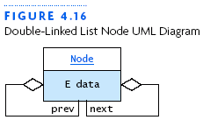
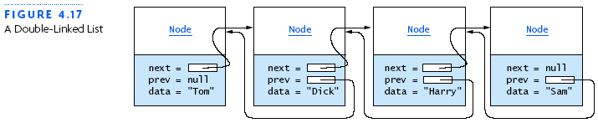
Double-Linked Lists (continued)

Slide 21
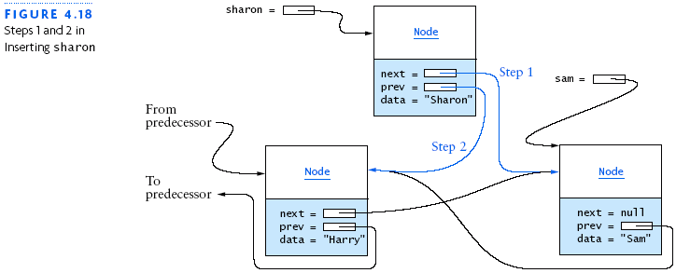
Inserting into a Double-Linked List

Slide 22
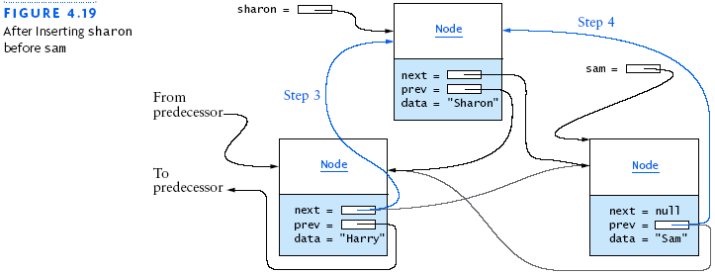
Inserting into a Double-Linked List (continued)

Slide 23
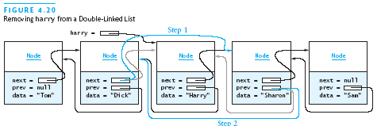
Removing from a Double-Linked List

Slide 24
Circular Lists
Circular-linked list: link the last node of a double-linked list to the first node and the first to the last
Advantage: can traverse in forward or reverse direction even after you have passed the last or first node
  Can visit all the list elements from any starting point
Can never fall off the end of a list
Disadvantage: infinite loop!

Slide 25
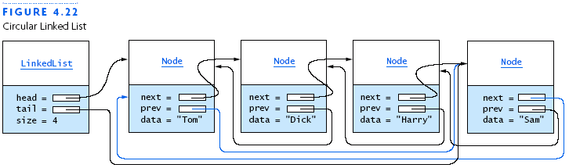
Circular Lists Continued

Slide 26
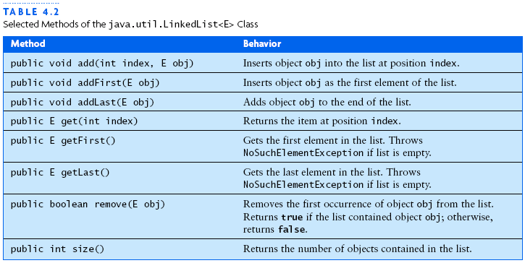
The LinkedList<E> Class
Part of the Java API
Implements the List<E> interface using a double-linked list

Slide 27
The Iterator<E> Interface
The interface Iterator is defined as part of API package java.util
The List interface declares the method iterator, which returns an Iterator object that will iterate over the elements of that list
An Iterator does not refer to or point to a particular node at any given time but points between nodes

Slide 28
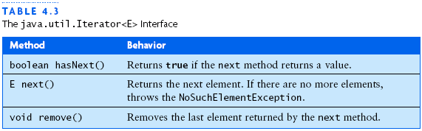

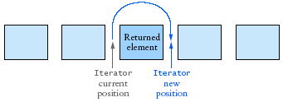
The Iterator<E> Interface (continued)

Slide 29
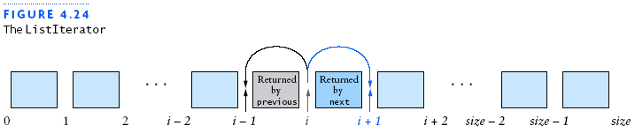
The ListIterator<E> Interface
Iterator limitations
    Can only traverse the List in the forward direction
    Provides only a remove method
    Must advance an iterator using your own loop if starting position is not at the beginning of the list
ListIterator<E> is an extension of the Iterator<E> interface for overcoming the above limitations
Iterator should be thought of as being positioned between elements of the linked list

Slide 30
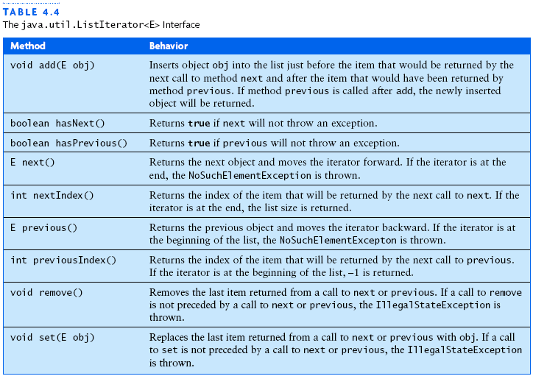
The ListIterator<E> Interface (continued)

Slide 31
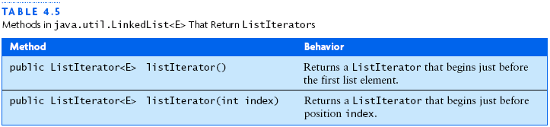
The ListIterator<E> Interface (continued)

Slide 32
Comparison of Iterator and ListIterator
ListIterator is a subinterface of Iterator; classes that implement ListIterator provide all the capabilities of both
Iterator interface requires fewer methods and can be used to iterate over more general data structures but only in one direction
Iterator is required by the Collection interface, whereas the ListIterator is required only by the List interface

Slide 33
Conversion between a ListIterator and an Index
ListIterator has the methods nextIndex and previousIndex, which return the index values associated with the items that would be returned by a call to the next or previous methods
The LinkedList class has the method listIterator(int index)
  Returns a ListIterator whose next call to next will return the item at position index

Slide 34
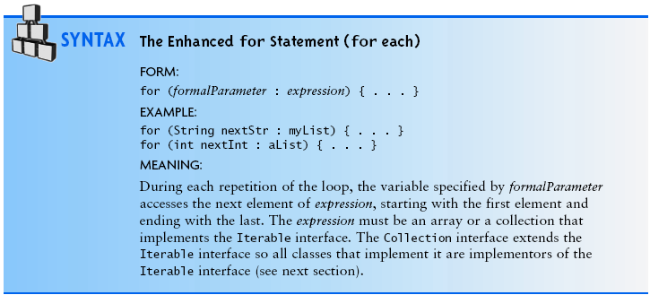
The Enhanced for Statement

Slide 35

The Iterable Interface
This interface requires only that a class that implements it provide an iterator method
The Collection interface extends the Iterable interface, so all classes that implement the List interface (a subinterface of Collection) must provide an iterator method

Slide 36
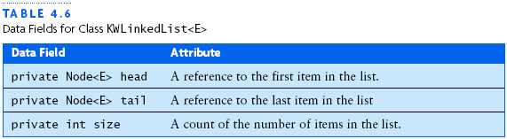
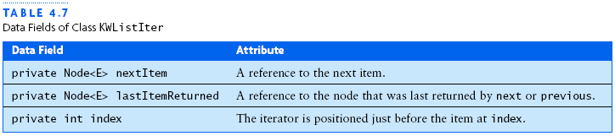
Implementation of a Double-Linked List

Slide 37
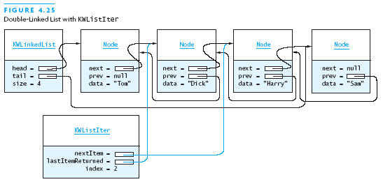
Implementation of a Double-Linked List (continued)

Slide 38
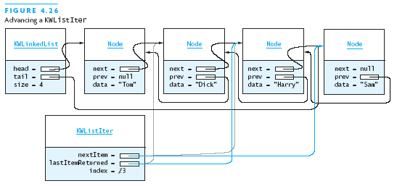
Implementation of a Double-Linked List (continued)

Slide 39
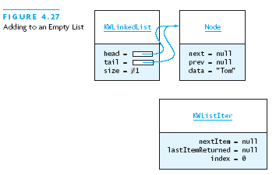
Implementation of a Double-Linked List (continued)

Slide 40
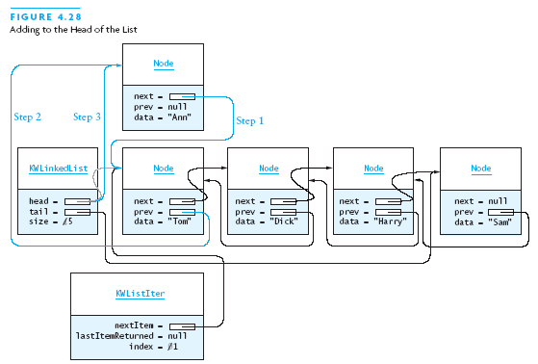
Implementation of a Double-Linked List (continued)

Slide 41
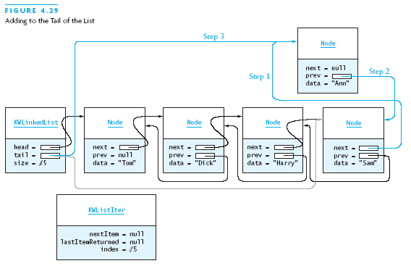
Implementation of a Double-Linked List (continued)

Slide 42
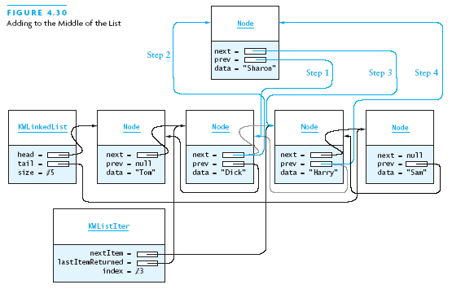
Implementation of a Double-Linked List (continued)

Slide 43
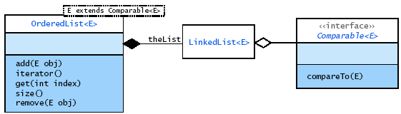
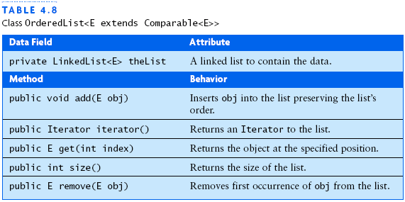
Application of the LinkedList Class
Case study that uses the Java LinkedList class to solve a common problem: maintaining an ordered list

Slide 44
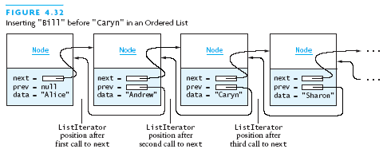
Application of the LinkedList Class (continued)

Slide 45
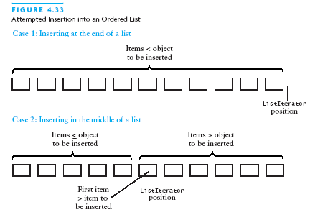
Application of the LinkedList Class (continued)

Slide 46
The Collection Hierarchy
Both the ArrayList and LinkedList represent a collection of objects that can be referenced by means of an index
The Collection interface specifies a subset of the methods specified in the List interface

Slide 47
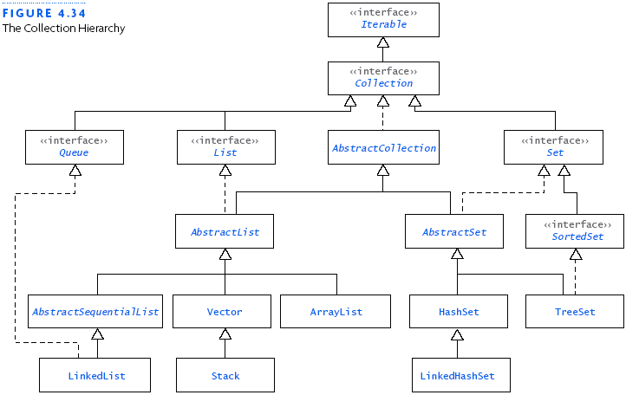
The Collection Hierarchy (continued)

Slide 48
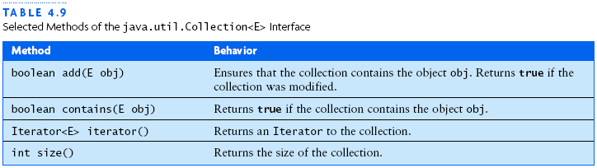
Common Features of Collections
Collection interface specifies a set of common methods
Fundamental features include:
  Collections grow as needed
  Collections hold references to objects
  Collections have at least two constructors

Slide 49
Chapter Review
The List is a generalization of the array
The Java API provides the ArrayList class, which uses an array as the underlying structure to implement the List
A linked list consists of a set of nodes, each of which contains its data and a reference to the next node
To find an item at a position indicated by an index in a linked list requires traversing the list from the beginning until the item at the specified index is found
An iterator gives with the ability to access the items in a List sequentially

Slide 50
Chapter Review (continued)
The ListIterator interface is an extension of the Iterator interface
The Java API provides the LinkedList class, which uses a double-linked list to implement the List interface
The Iterable interface is the root of the Collection hierarchy
The Collection interface and the List interface define a large number of methods that make these abstractions useful for many applications

